Slide 1
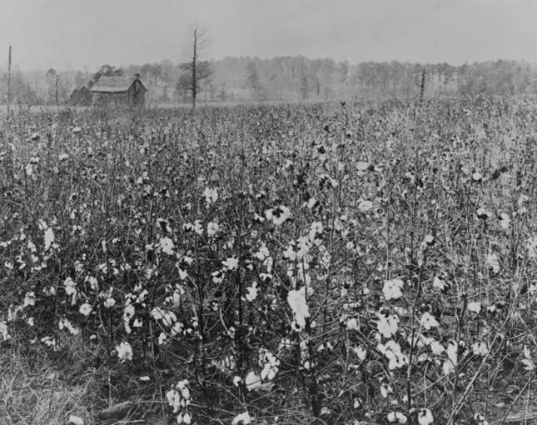
Unit 6:
The Republic of Texas
Lesson 4:
What’s the Story?
Notes:
Cotton Field With Building in Background. ca. 1922. Photograph. Library of Congress Prints and Photographs Division. https://www.loc.gov/item/2001695615/

Slide 2

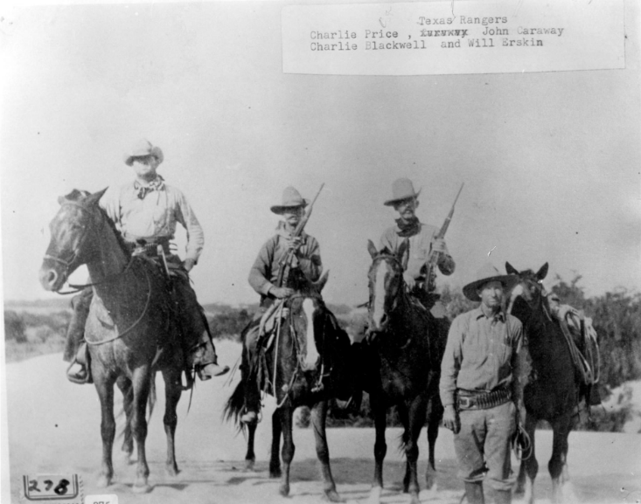
Warm-up:
Follow the directions to complete your warm-up
Respond to the prompt based on the information and image on your warm-up.
Notes:
Texas Rangers, photograph, Date Unknown; (https://texashistory.unt.edu/ark:/67531/metapth43196/: accessed April 25, 2025), University of North Texas Libraries, The Portal to Texas History, https://texashistory.unt.edu; crediting Cattle Raisers Museum.

Slide 3


Share with the class
I think the Texas Rangers may have played a role in addressing the challenges facing the Republic of Texas by ________

Slide 4

Essential Question
What are the defining characteristics and most significant events of the Republic of Texas era?

Slide 5
In today’s lesson…
We will examine a chronology of the significant events that took place during the Republic of Texas and identify their significance to Texas history.
I will read short passages about each event, identify key information, explain cause and effect relationships, and determine how the event is significant to Texas history.

Slide 6
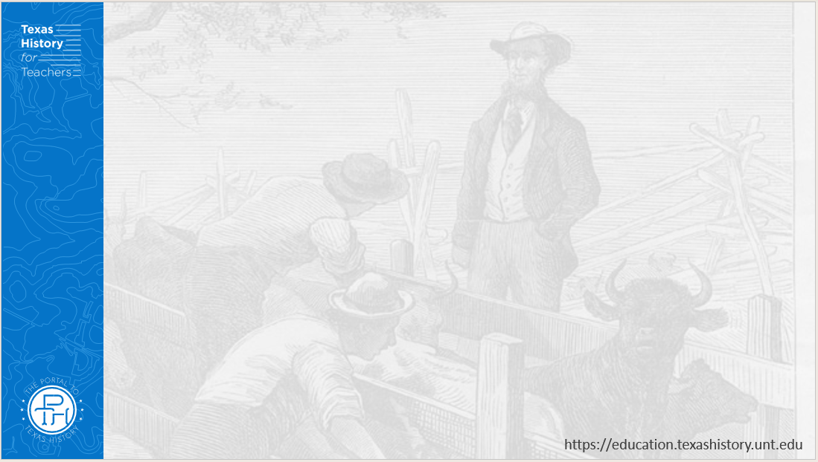
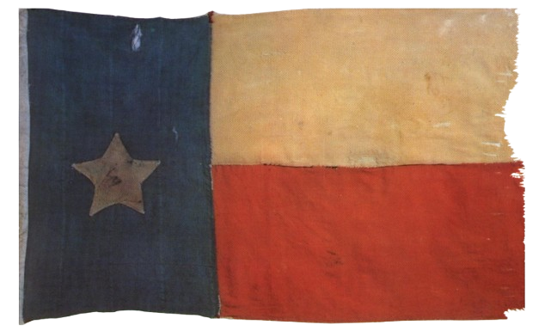
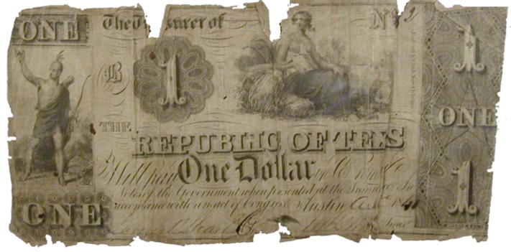
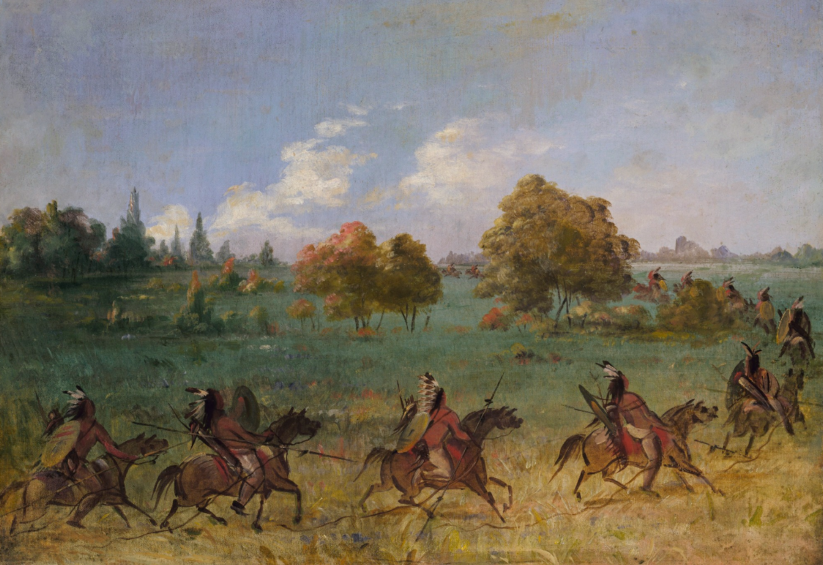
Challenges Facing the Republic of Texas
1836 - 1835
A one-dollar bill from the Republic of Texas
The Portal to Texas History
The Republic of Texas flag
The Portal to Texas History
A Comanche War Party
The Smithsonian American Art Museum
Notes:
Texas Treasury Department. Republic of Texas One-Dollar Bill. ca. 1836-46. Paper bill. University of North Texas Libraries, The Portal to Texas History; crediting Fort Bend Museum https://texashistory.unt.edu/ark:/67531/metapth2297
Flag. Physical object. University of North Texas Libraries, The Portal to Texas History, https://texashistory.unt.edu; crediting Star of the Republic Museum. https://texashistory.unt.edu/ark:/67531/metapth31714/
Catlin, George. Comanche War Party on the March, Fully Equipped. ca. 1846-1848. Oil on canvas, 20 x 27 3/8 in. (50.8 x 69.4 cm). Smithsonian American Art Museum, Gift of Mrs. Joseph Harrison, Jr., 1985.66.596. https://americanart.si.edu/artwork/comanche-war-party-march-fully-equipped-4014

Slide 7
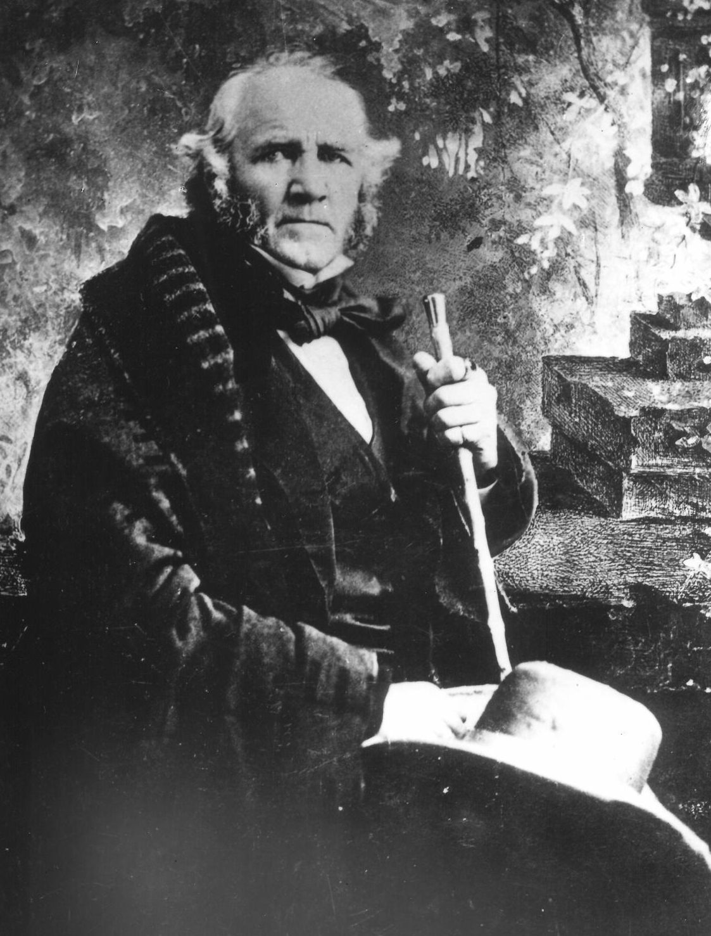
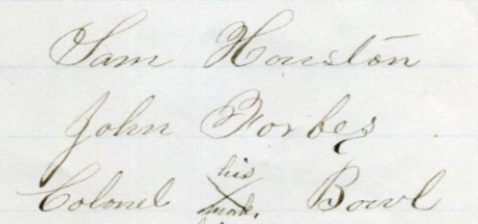
2. Texas’ First President:
Sam Houston
1836 - 1838
The signatures of Sam Houston, Nacogdoches politician John Forbes, and the mark of Cherokee Chief Bowl on a peace treaty between the Cherokee and Texas government.
The Portal to Texas History
A photograph of General Sam Houston
The Portal to Texas History
Notes:
[Documents relating to the Texas Cherokees], text, Date Unknown; (https://texashistory.unt.edu/ark:/67531/metapth41766/: accessed April 23, 2025), University of North Texas Libraries, The Portal to Texas History, https://texashistory.unt.edu; crediting Oklahoma Historical Society.
Raba, Ernst Wilhelm, 1874-1951. [General Sam Houston], photograph, Date Unknown; (https://texashistory.unt.edu/ark:/67531/metapth459990/: accessed April 23, 2025), University of North Texas Libraries, The Portal to Texas History, https://texashistory.unt.edu; crediting San Antonio Conservation Society.

Slide 8
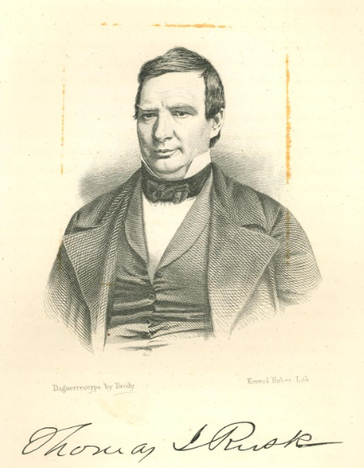
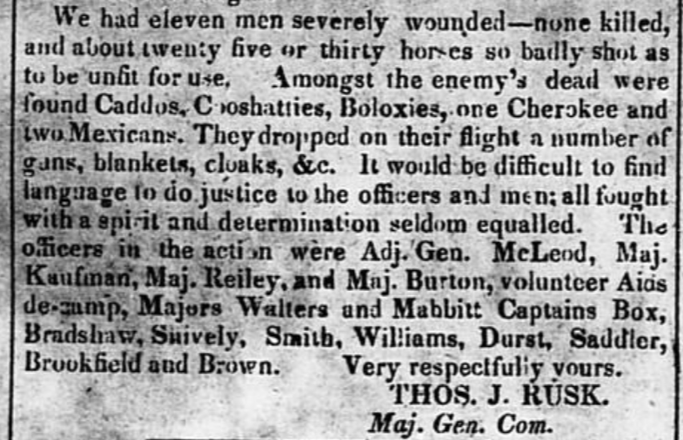
3) The Córdova Rebellion
August – October 1838
Thomas J. Rusk’s report of the Córdova Rebellion as printed in the Telegraph and Texas Register
The Portal to Texas History
Thomas J. Rusk
The Portal to Texas History
Notes:
Cruger & Moore. Telegraph and Texas Register (Houston, Tex.), Vol. 4, No. 10, Ed. 1, Saturday, November 3, 1838, newspaper, November 3, 1838; Houston, Texas. (https://texashistory.unt.edu/ark:/67531/metapth48018/: accessed April 23, 2025), University of North Texas Libraries, The Portal to Texas History, https://texashistory.unt.edu; crediting The Dolph Briscoe Center for American History.
Portrait of Thomas J. Rusk, physical object, Date Unknown; (https://texashistory.unt.edu/ark:/67531/metapth31822/: accessed April 23, 2025), University of North Texas Libraries, The Portal to Texas History, https://texashistory.unt.edu; crediting Star of the Republic Museum.

Slide 9
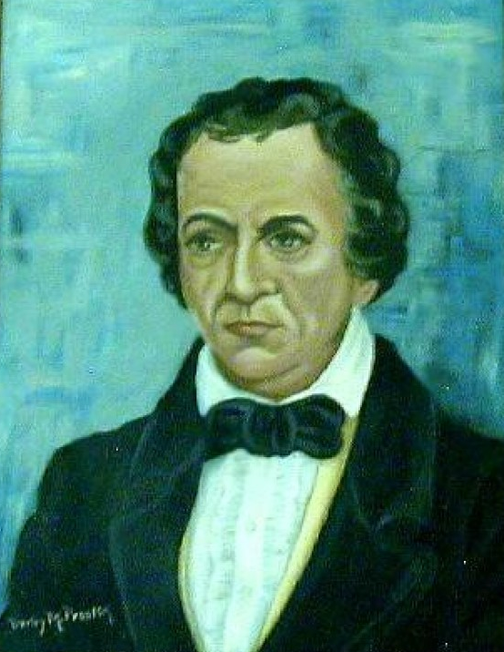
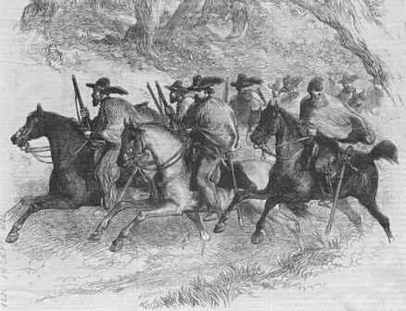
4) Texas’ Second President:
Mirabeau Lamar
1838 - 1841
Mirabeau Lamar
The Portal to Texas History
The Texas Rangers in Pursuit of the Comanches
The University of Texas at Arlington Library
Notes:
The Texas Rangers in Pursuit of the Comanches, circa 1845. The Culver Pictures Collection. Rangers Attack Comanches on Walnut Creek | Texas in Turmoil: Mapping Interethnic Violence, 1821-79
Frame that holds image of Mirabeau Lamar., physical object, Date Unknown; (https://texashistory.unt.edu/ark:/67531/metapth305/: accessed April 23, 2025), University of North Texas Libraries, The Portal to Texas History, https://texashistory.unt.edu; crediting Fort Bend Museum.

Slide 10
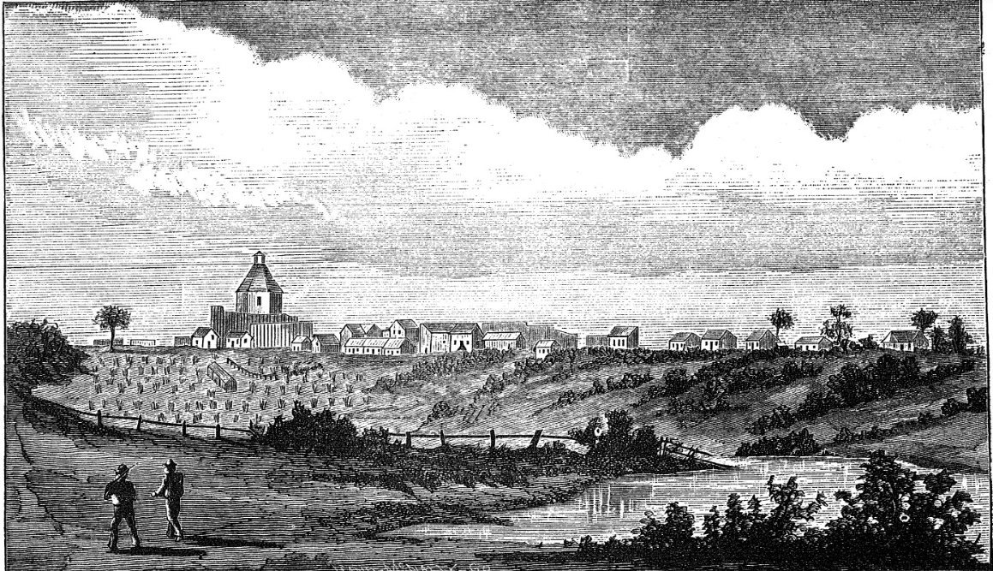
5) The Council House Fight
March 19, 1840
An Illustration of San Antonio, 1840
The Portal to Texas History
Notes:
Thrall, Homer S., 1819-1894. A Pictorial History of Texas, From the Earliest Visits of European Adventurers, to A.D. 1879., book, 1879; St. Louis, Missouri. (https://texashistory.unt.edu/ark:/67531/metapth5828/: accessed April 18, 2025), University of North Texas Libraries, The Portal to Texas History, https://texashistory.unt.edu;

Slide 11
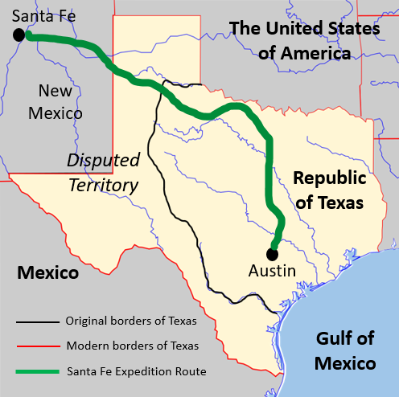
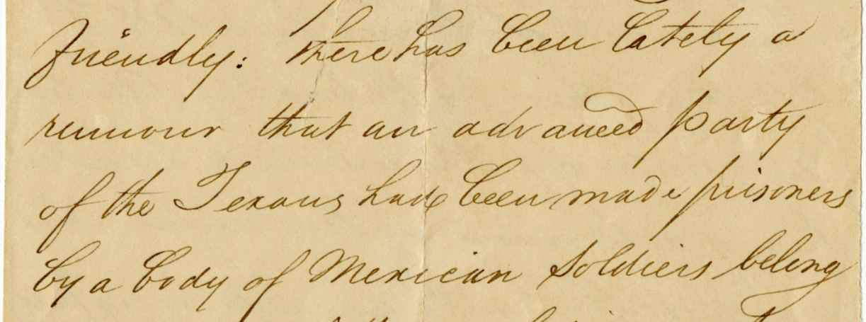
6) The Santa Fe Expedition
June - October 1841
A letter from one of the expeditioners which states, “There has been lately a rumor that an advanced party of the Texans has been made prisoners by a body of Mexican soldiers . . .”
The Portal to Texas History
Notes:
[Copy of Letter from Galveston to Messrs. Meyer & Sons of New York - December 10, 1841], letter, December 10, 1841; (https://texashistory.unt.edu/ark:/67531/metapth586976/: accessed April 25, 2025), University of North Texas Libraries, The Portal to Texas History, https://texashistory.unt.edu; crediting Southwestern University.
Map of the Santa Fe Expedition Route. This image was created using the Wikimedia Commons image: A Blank Map of Texas and edited to include information about the Mexican borders of Texas, and all entities that Texas shared a border with in 1840. This file is licensed under the Creative Commons Attribution-Share Alike 2.5 Generic, 2.0 Generic and 1.0 Generic license. https://commons.wikimedia.org/wiki/File:Texas_blank_map.svg

Slide 12
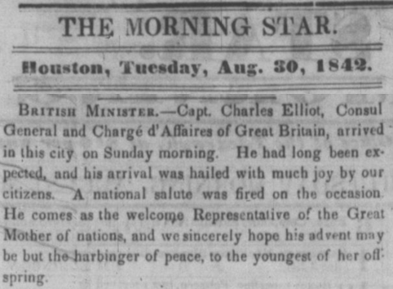
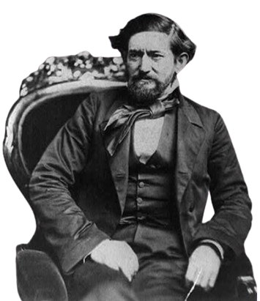
7) Sam Houston’s Second Presidency
1841 - 1844
A newspaper article about the arrival of a British diplomat in Texas.
The Portal to Texas History
John Coffee Hays led the Texas Rangers against the Mexican troops occupying San Antonio.
The Library of Congress
Notes:
Brady, Mathew B. John Coffee Hays, 3/4-length portrait, seated in chair and facing left. ca. 1857. Photograph. Library of Congress Prints and Photographs Division. https://www.loc.gov/item/2002712549/
The Morning Star. (Houston, Tex.), Vol. 4, No. 388, Ed. 1 Tuesday, August 30, 1842, newspaper, August 30, 1842; Houston, Texas. (https://texashistory.unt.edu/ark:/67531/metapth1497807/: accessed April 23, 2025), University of North Texas Libraries, The Portal to Texas History, https://texashistory.unt.edu

Slide 13
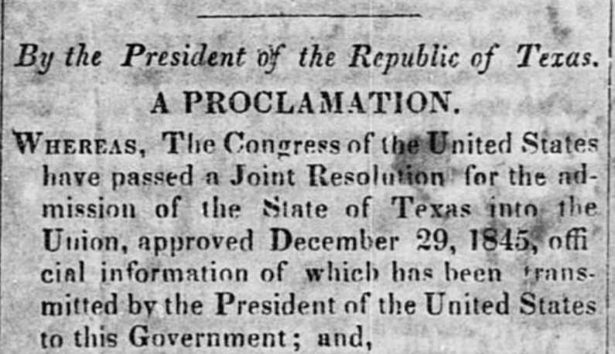
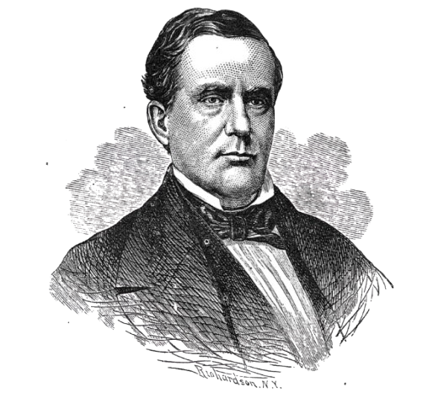
7) The Last President of Texas:
Anson Jones
1844 - 1846
The introduction to an article printed in the Texas Democrat newspaper of Austin announcing the U.S. acceptance of Texas annexation.
The Portal to Texas History
Anson Jones
The Portal to Texas History
Notes:
Thrall, Homer S., 1819-1894. A Pictorial History of Texas, From the Earliest Visits of European Adventurers, to A.D. 1879., book, 1879; St. Louis, Missouri. (https://texashistory.unt.edu/ark:/67531/metapth5828/: accessed April 18, 2025), University of North Texas Libraries, The Portal to Texas History, https://texashistory.unt.edu
Ford, John S. The Texas Democrat (Austin, Tex.), Vol. 1, No. 1, Ed. 1, Wednesday, January 21, 1846, newspaper, January 21, 1846; Austin, Texas. (https://texashistory.unt.edu/ark:/67531/metapth48303/: accessed April 23, 2025), University of North Texas Libraries, The Portal to Texas History, https://texashistory.unt.edu; crediting The Dolph Briscoe Center for American History.

Slide 14


Exit Ticket:
Follow the directions to complete your exit ticket
Read each statement in the graphic organizer.
Circle or highlight FOUR statements that are true for the Republic of Texas.
Share with a partner.

Slide 15
Share with the class 2
One significant challenge the Republic of Texas faced was that ______

