Slide 1
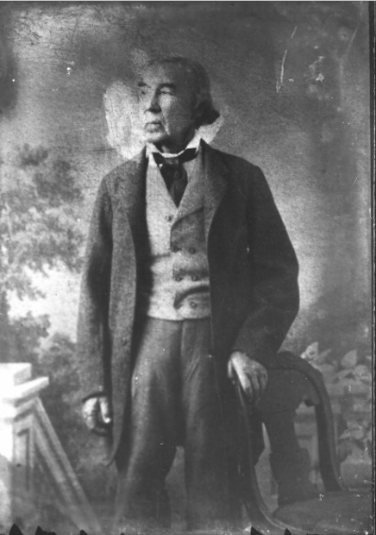
Unit 6:
The Republic of Texas
Lesson 5:
Who’s Who of the Republic of Texas
José Antonio Navarro
The Portal to Texas History
Notes:
Raba, Ernst Wilhelm, 1874-1951. [Jose Antonio Navarro Portrait], photograph, Date Unknown; (https://texashistory.unt.edu/ark:/67531/metapth460098/: accessed May 23, 2025), University of North Texas Libraries, The Portal to Texas History, https://texashistory.unt.edu; crediting San Antonio Conservation Society.

Slide 2
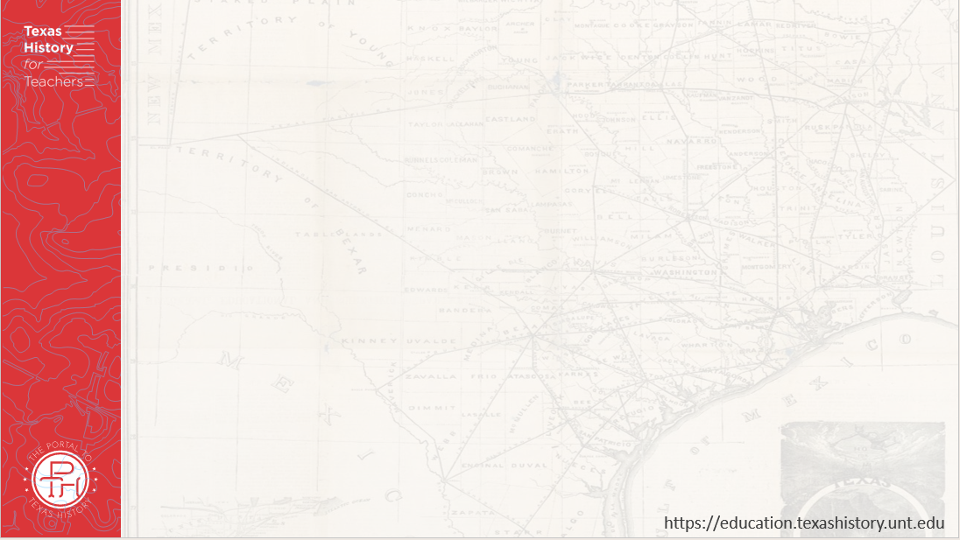
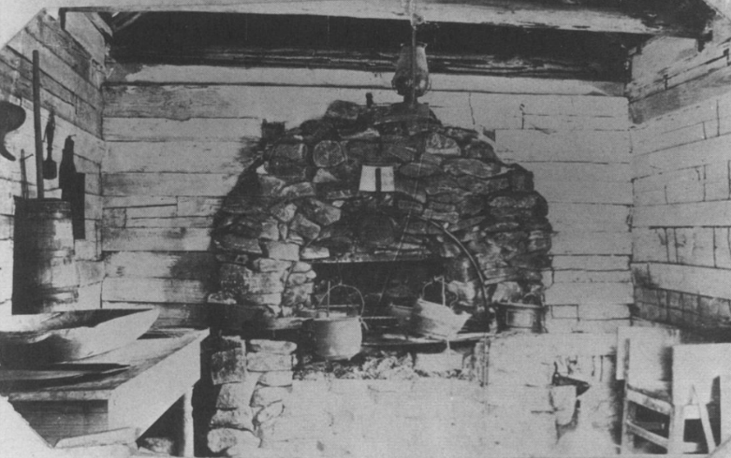
Warm-up
Use the image below to complete your warm-up
Notes:
Roberts, Madge Thornall, 1929-. Star of Destiny: The Private Life of Sam and Margaret Houston, book, 1993; Denton, Texas. (https://texashistory.unt.edu/ark:/67531/metadc28332/: accessed May 23, 2025), University of North Texas Libraries, The Portal to Texas History, https://texashistory.unt.edu; crediting UNT Press.

Slide 3


Share with the class:
One thing I observe about the image is _________
One thing I can infer about daily life in Texas in the 1800s is ______________

Slide 4

Essential Question
Who were some of the key people of the Republic of Texas and why were they significant?

Slide 5

In Today’s Lesson
We will study key people who took part in the Republic of Texas, identifying important information about their lives and their significance to the Republic of Texas era.
I will use the reading or readings provided to record significant information about people from the Republic of Texas.

Slide 6

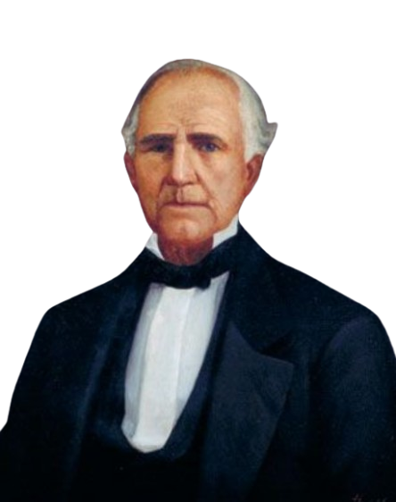
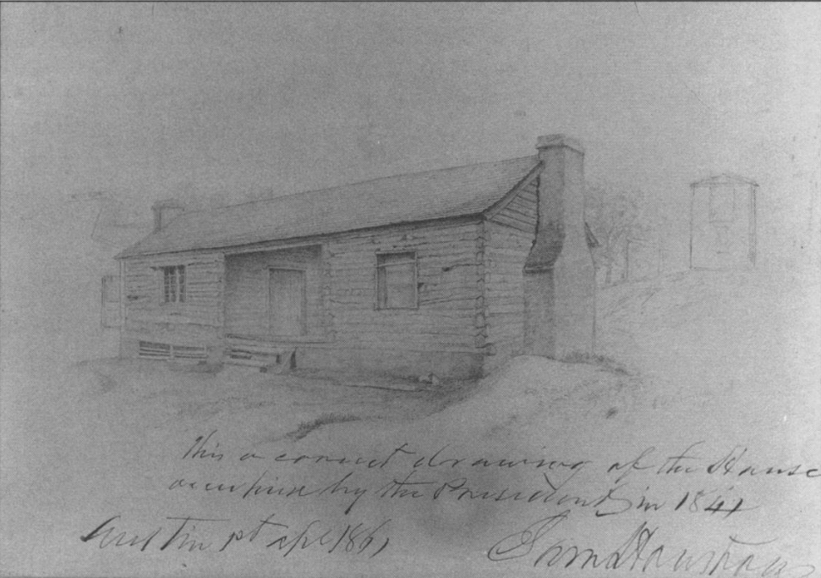
Sam Houston
Houston’s presidential house in Austin during his second term. At the bottom of this sketch Houston wrote, “This is a correct drawing of the house occupied by the president in 1841.”
The Portal to Texas History
Sam Houston
The State Preservation Board
Notes:
Roberts, Madge Thornall, 1929-. Star of Destiny: The Private Life of Sam and Margaret Houston, book, 1993; Denton, Texas. (https://texashistory.unt.edu/ark:/67531/metadc28332/: accessed May 23, 2025), University of North Texas Libraries, The Portal to Texas History, https://texashistory.unt.edu; crediting UNT Press.
Huddle, William H. Sam Houston. 1888. Oil on canvas. Capitol Historical Artifact Collection, State Preservation Board. Background removed. https://tspb.texas.gov/prop/tc/tc-collection/governors/index.html.

Slide 7
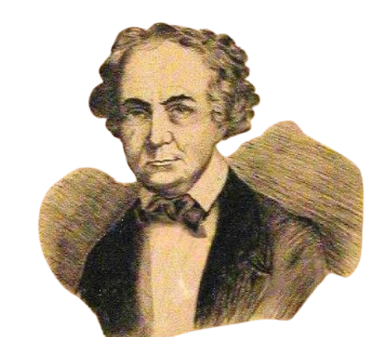
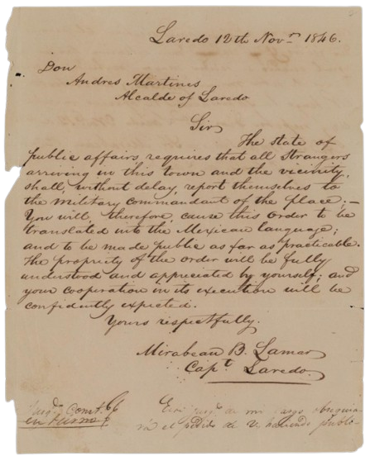
Mirabeau Lamar
Mirabeau Lamar
The Portal to Texas History
A letter written by Lamar during his time as the military commander of Laredo, 1846.
The Portal to Texas History
Notes:
[Letter from Mirabeau Lamar to Alcalde Martinez, November 12, 1846], letter, November 12, 1846; (https://texashistory.unt.edu/ark:/67531/metapth875836/: accessed May 23, 2025), University of North Texas Libraries, The Portal to Texas History, https://texashistory.unt.edu; crediting St. Mary's University Louis J. Blume Library.
[Illustration of Mirabeau B. Lamar], physical object, 1936; (https://texashistory.unt.edu/ark:/67531/metapth1152/: accessed May 23, 2025), University of North Texas Libraries, The Portal to Texas History, https://texashistory.unt.edu; crediting Fort Bend Museum.

Slide 8
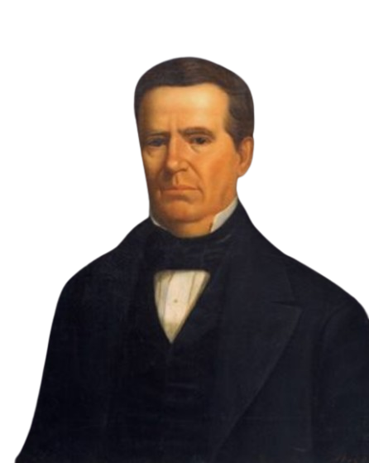
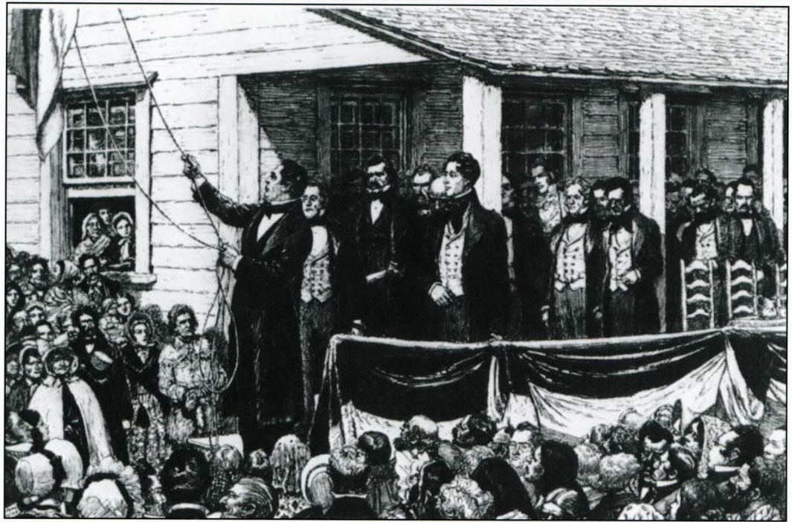
Anson Jones
Anson Jones
The State Preservation Board
An illustration of the Annexation ceremony on February 19, 1846. President Anson Jones lowered the Republic of Texas flag declaring, “The Republic of Texas is no more.”
The Portal to Texas History
Notes:
Texas. Legislature. Legislative Council. The Texas Capitol: A History of the Lone Star Statehouse, book, 2016; Austin, Texas. (https://texashistory.unt.edu/ark:/67531/metapth902948/: accessed April 24, 2025), University of North Texas Libraries, The Portal to Texas History, https://texashistory.unt.edu; crediting UNT Libraries Government Documents Department.
Huddle, William H. Anson Jones. 1888. Oil on canvas. Capitol Historical Artifact Collection, State Preservation Board. https://tspb.texas.gov/prop/tc/tc-collection/governors/index.html.

Slide 9
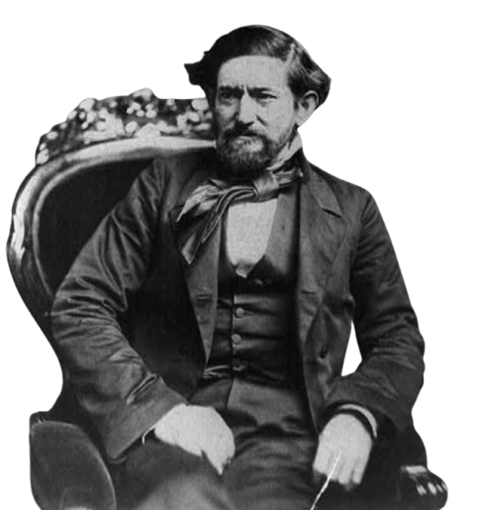
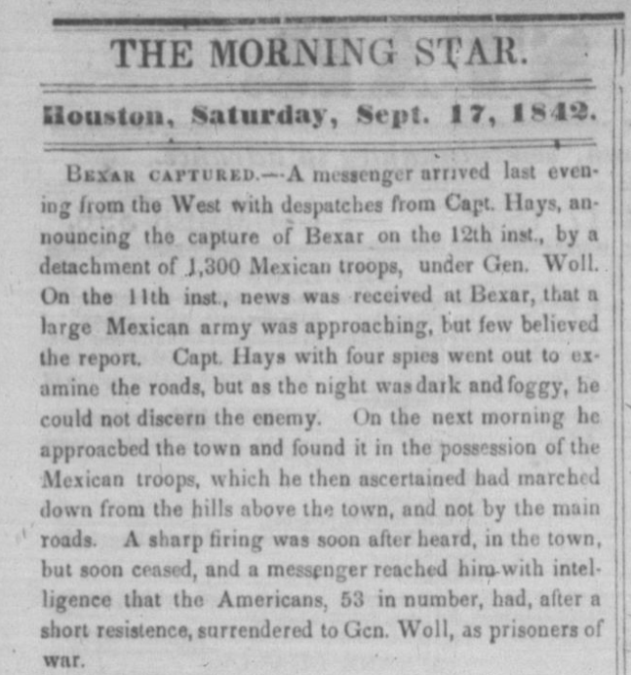
John “Jack” Coffee Hays
Captain John Coffee Hays
The Library of Congress
The Portal to Texas History
Notes:
The Morning Star. (Houston, Tex.), Vol. 4, No. 396, Ed. 1 Saturday, September 17, 1842, newspaper, September 17, 1842; Houston, Texas. (https://texashistory.unt.edu/ark:/67531/metapth1497815/: accessed May 23, 2025), University of North Texas Libraries, The Portal to Texas History, https://texashistory.unt.edu;
Brady, Mathew B. John Coffee Hays, 3/4-length portrait, seated in chair and facing left. ca. 1857. Photograph. Library of Congress Prints and Photographs Division. https://www.loc.gov/item/2002712549/

Slide 10
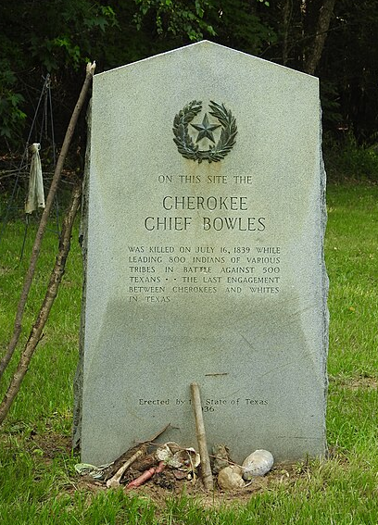
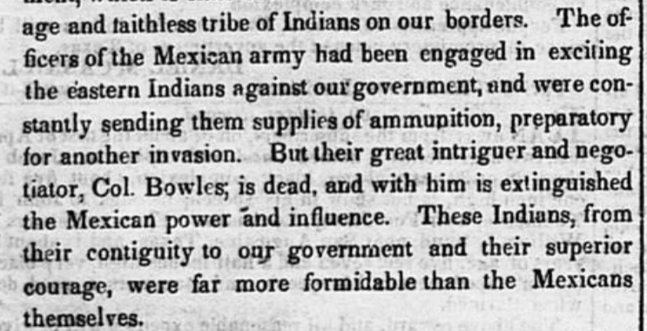
Chief Bowles
Taken from an article published in the Houston Telegraph and Texas Register on August 7, 1839, about the Battle of the Neches in which Chief Bowles was killed.
The Portal to Texas History
The headstone marking the gravesite of Chief Bowles.
Notes:
Cruger & Moore. Telegraph and Texas Register (Houston, Tex.), Vol. 5, No. 8, Ed. 1, Wednesday, August 7, 1839, newspaper, August 7, 1839; Houston, Texas. (https://texashistory.unt.edu/ark:/67531/metapth48065/: accessed May 23, 2025), University of North Texas Libraries, The Portal to Texas History, https://texashistory.unt.edu; crediting The Dolph Briscoe Center for American History.
The grave of Cherokee Chief Bowles. On this site the Cherokee Chief Bowles was killed on July 16, 1839 while leading 800 Indians of various tribes in battle against 500 Texans. The last engagement between Cherokees and whites in Texas.
Erected by the State of Texas 1936. This file is licensed under the Creative Commons Attribution-Share Alike 2.0 Generic license. https://commons.wikimedia.org/wiki/File:Cherokee_Chief_Bowles_(41052530354).jpg

Slide 11
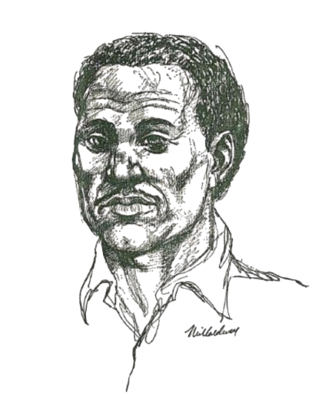
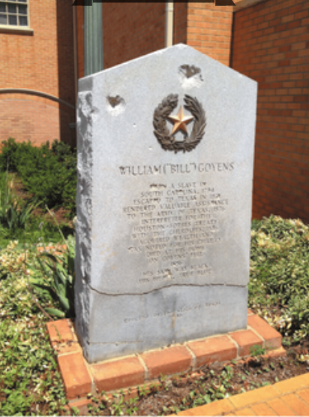
William Goyens
William Goyens
Texas State Historical Association
The memorial marker of William Goyens at the Old Spanish Cemetery in Nacogdoches, Texas
Notes:
Memorial Marker information for William “Bill” Goyens. Birth1794 Moore County, North Carolina, USA
Death1856 (aged 61–62)Nacogdoches, Nacogdoches County, Texas, USA
CenotaphRead MoreOld Spanish Cemetery
Nacogdoches County, Texas, USAShow MapGPS-Latitude: 31.6035107, Longitude: -94.6562298
Memorial ID259785139 · View Source
William “Bill” Goyens (1794-1856) - Find a Grave Memorial
Drawing, William Goyens by Neil Caldwell. Courtesy of the Naylor Company. Image available on the Internet and included in accordance with Title 17 U.S.C. Section 107. Texas State Historical Association article: William Goyens: Early Nacogdoches Settler and Businessman
Goyens, William

Slide 12
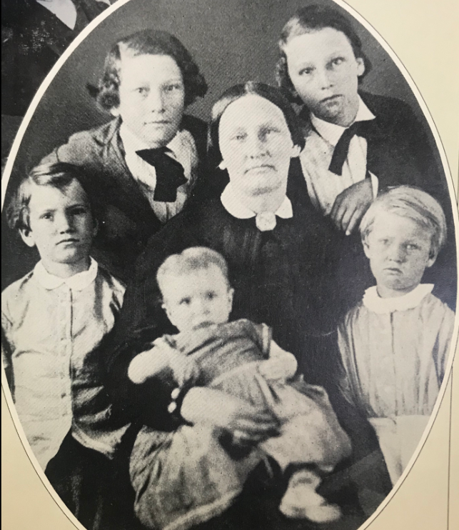
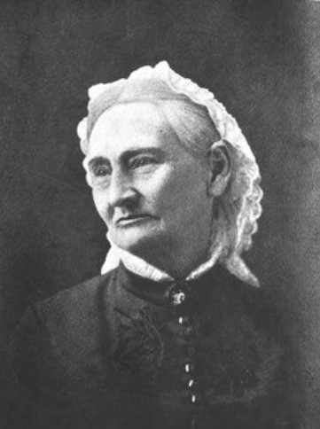
Mary (Adams) Maverick
A portrait of Mary Maverick in her later years
Mary Ann Adams Maverick and her children
Notes:
Mary Ann Adams Maverick – Her children and her portrait
Birth16 Mar 1818Tuscaloosa, Tuscaloosa County, Alabama, USA
Death24 Feb 1898 (aged 79)San Antonio, Bexar County, Texas, USA
BurialCity Cemetery #1
San Antonio, Bexar County, Texas, USAShow MapGPS-Latitude: 29.4203639, Longitude: -98.4672208
PlotSec E, Plot 28Memorial ID16319678 · View Source
Mary Ann Adams Maverick (1818-1898) - Find a Grave Memorial

Slide 13
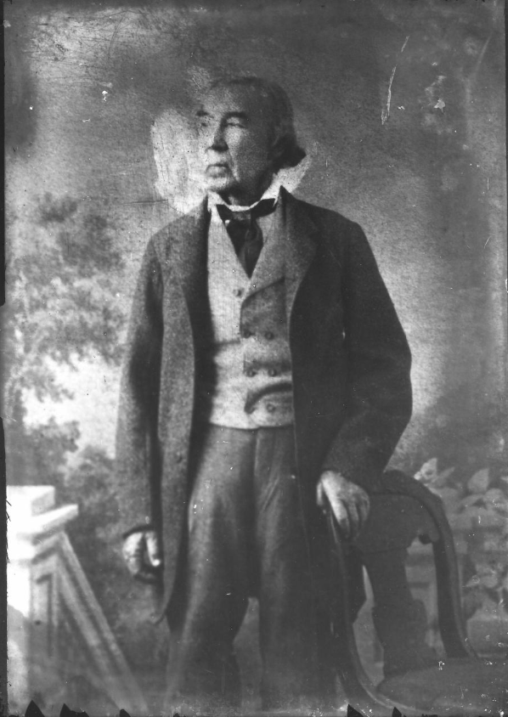
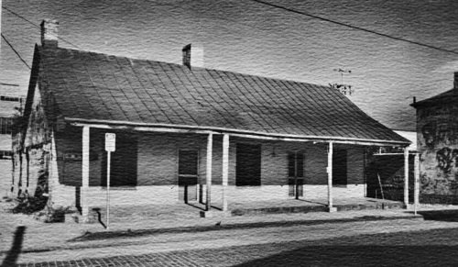
José Antonio Navarro
The José Antonio Navarro house on Laredo Street in San Antonio
The Texas Historical Commission
The Portal to Texas History
José Antonio Navarro
The Portal to Texas History
Notes:
Texas Historical Commission. [Jose Antonio Navarro House], photograph, Date Unknown; (https://texashistory.unt.edu/ark:/67531/metapth674635/: accessed May 23, 2025), University of North Texas Libraries, The Portal to Texas History, https://texashistory.unt.edu; crediting Texas Historical Commission.
Raba, Ernst Wilhelm, 1874-1951. [Jose Antonio Navarro Portrait], photograph, Date Unknown; (https://texashistory.unt.edu/ark:/67531/metapth460098/: accessed May 23, 2025), University of North Texas Libraries, The Portal to Texas History, https://texashistory.unt.edu; crediting San Antonio Conservation Society.

Slide 14
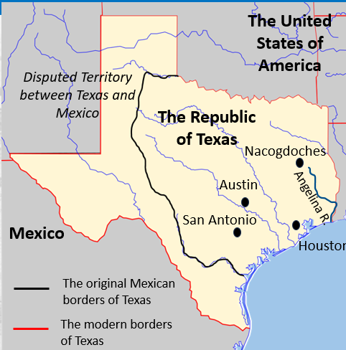
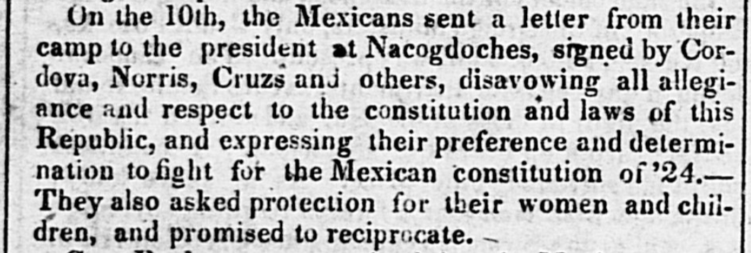
Vicente Córdova
An excerpt of a newspaper article about the Córdova Rebellion from the Telegraph and Texas Register of Houston, Saturday September 29, 1838
The Portal to Texas History
The Córdova Rebellion took place in and around Nacogdoches in east Texas
Notes:
Cruger & Moore. Telegraph and Texas Register (Houston, Tex.), Vol. 4, No. 5, Ed. 1, Saturday, September 29, 1838, newspaper, September 29, 1838; Houston, Texas. (https://texashistory.unt.edu/ark:/67531/metapth48012/: accessed May 7, 2025), University of North Texas Libraries, The Portal to Texas History, https://texashistory.unt.edu; crediting The Dolph Briscoe Center for American History.
Blank Map of Texas edited to show historical and contemporary boundaries of Texas, key human geographic features including cities and rivers, and the countries and bodies of water bordering Texas. Permission is granted to copy, distribute and/or modify this document under the terms of the GNU Free Documentation License, Version 1.2 or any later version published by the Free Software Foundation; with no Invariant Sections, no Front-Cover Texts, and no Back-Cover Texts. A copy of the license is included in the section entitled GNU Free Documentation License. This file is licensed under the Creative Commons Attribution-Share Alike 3.0 Unported license. https://commons.wikimedia.org/wiki/File:Texas_blank_map.svg

Slide 15
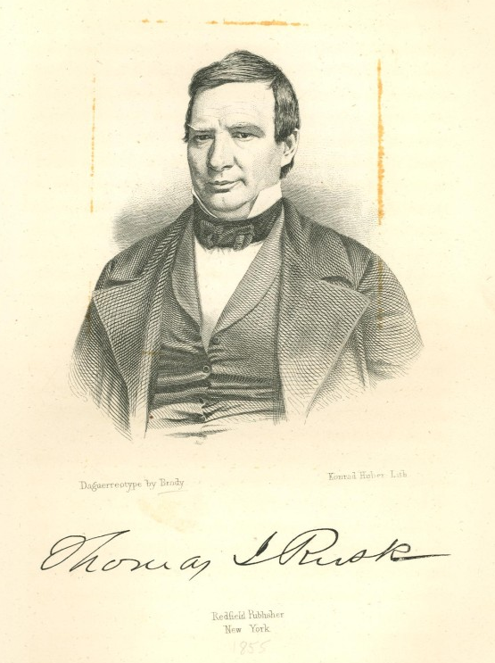
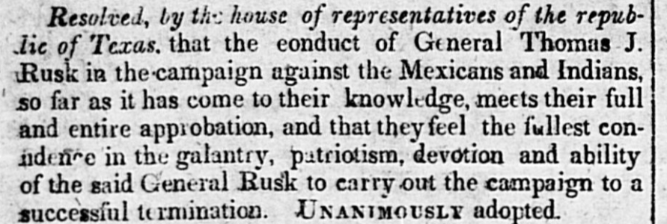
Thomas J. Rusk
An excerpt of a newspaper article from the Houston Telegraph and Texas Register on November 17, 1838. The article detailed the decisions of the Texas House of Representatives from its meeting on the morning of November 9, 1838.
The Portal to Texas History
Thomas Jefferson Rusk
The Portal to Texas History
Notes:
Cruger & Moore. Telegraph and Texas Register (Houston, Tex.), Vol. 4, No. 13, Ed. 1, Saturday, November 17, 1838, newspaper, November 17, 1838; Houston, Texas. (https://texashistory.unt.edu/ark:/67531/metapth48020/: accessed May 23, 2025), University of North Texas Libraries, The Portal to Texas History, https://texashistory.unt.edu; crediting The Dolph Briscoe Center for American History.
Portrait of Thomas J. Rusk, physical object, Date Unknown; (https://texashistory.unt.edu/ark:/67531/metapth31822/: accessed May 23, 2025), University of North Texas Libraries, The Portal to Texas History, https://texashistory.unt.edu; crediting Star of the Republic Museum.

Slide 16
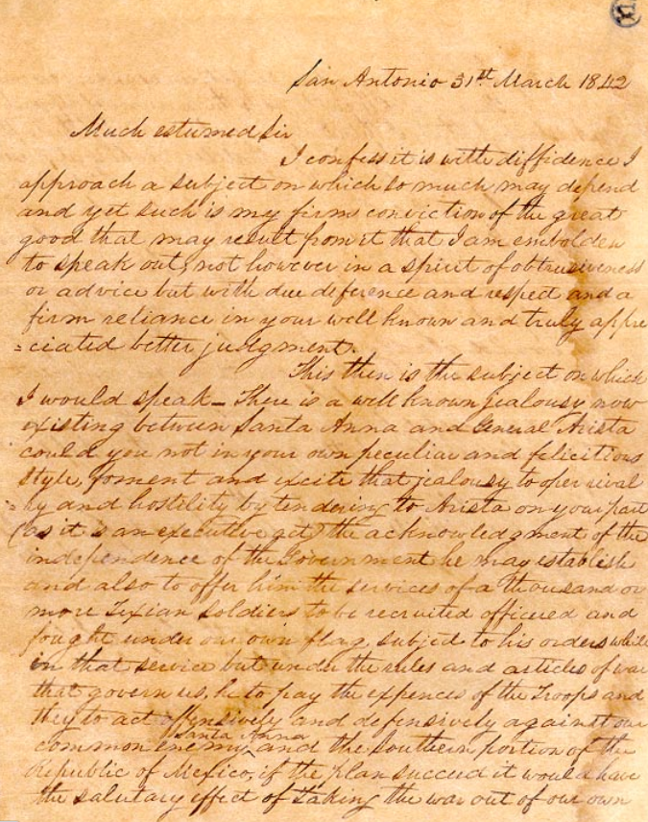
Alexander Somervell
A letter from Alexander Somervell to Sam Houston not long after Mexico’s first invasion of Texas and occupation of San Antonio in March 1842.
The Texas State Library and Archives Commission
Notes:
Alexander Somervell to Sam Houston, March 31, 1842. Alexander Somervell to Sam Houston, March 31, 1842 | Texas State Library

Slide 17
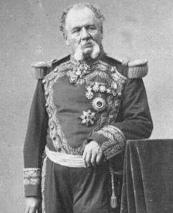
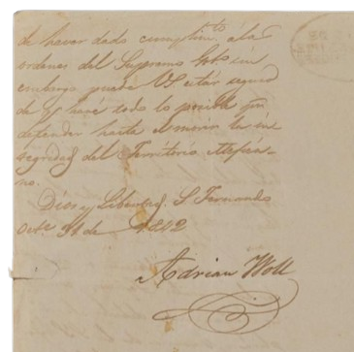
Adrián Woll
A portion of a letter from Woll to the Ayuntamiento of Laredo after his invasion of Texas and occupation of San Antonio.
The Portal to Texas History
General Adrián Woll
The Texas State Historical Association
Notes:
[Letter from General Adrián Woll to the Laredo Ayuntamiento, October 31, 1842], letter, 1842-10~; (https://texashistory.unt.edu/ark:/67531/metapth872377/: accessed May 23, 2025), University of North Texas Libraries, The Portal to Texas History, https://texashistory.unt.edu; crediting St. Mary's University Louis J. Blume Library.
Portrait of Adrián Woll. Image available on the Internet and included in accordance with Title 17 U.S.C. Section 107. Woll, Adrian

Slide 18
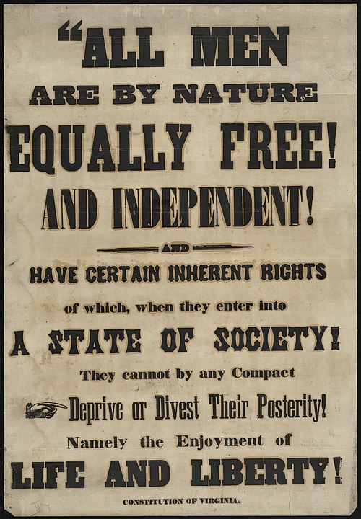
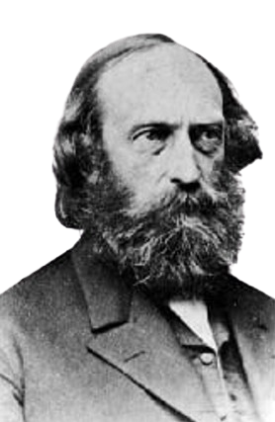
Stephen Pearl Andrews
Andrews supported the anti-slavery abolitionist movement.
The Boston Public Library
Stephen Pearl Andrews
The Texas State Historical Commission
Notes:
A photograph of Stephen Pearl Andrews. The Texas State Historical Commission. Photograph, Portrait of Stephen Pearl Andrew. Image available on the Internet and included in accordance with Title 17 U.S.C. Section 107. Andrews, Stephen Pearl
An abolitionist broadside. Boston Public Library Rare Books Department. Antislavery Collection. All men are by nature equally free and independent and have certain inherent rights of which, when they enter into a state of society, They cannot by any compact deprive or divest their posterity! Namely the enjoyment of life and liberty - Digital Commonwealth

Slide 19
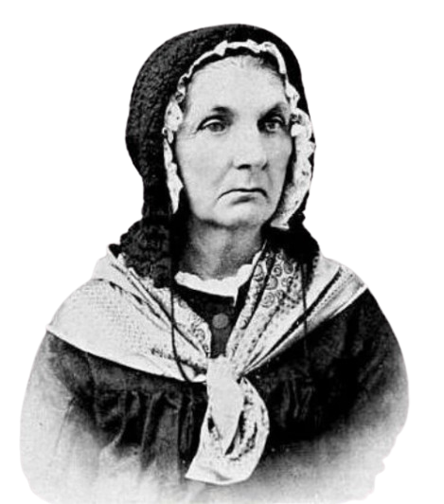
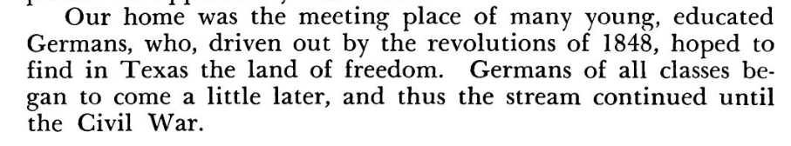
Rosa Kleberg
An excerpt of “Some of my Early Experiences in Texas” by Rosa Kleberg, published in the Texas Historical Association Quarterly, April 1898.
The Portal to Texas History
Rosa Kleberg
The Portal to Texas History
Notes:
Wooten, Mattie Lloyd. Women Tell the Story of the Southwest, book, 1940; San Antonio, Texas. (https://texashistory.unt.edu/ark:/67531/metapth1013890/: accessed May 23, 2025), University of North Texas Libraries, The Portal to Texas History, https://texashistory.unt.edu; Previously published in the Texas Historical Association Quarterly, Vol. I, No. 4, April 1898, pp. 297-302; Also Vol. II, No. 2, October 1898, pp. 170-173
Photograph, Portrait of Rosalie von Roeder Kleberg. The Life of Philippine Sophie Caroline Luise Rosalie von Roeder Kleberg: A Texas Pioneer. Image available on the Internet and included in accordance with Title 17 U.S.C. Section 107. Kleberg, Rosalie Von Roeder

Slide 20



Exit Ticket
Follow the directions below to complete your exit ticket
Choose two people from today’s lesson.
Complete the graphic organizer based on your knowledge of the two people you chose.
Share with a partner.

Slide 21
Share with the class: 2
I think ______ and ______ would have been friends / opponents because _____ ______________________

