Slide 1
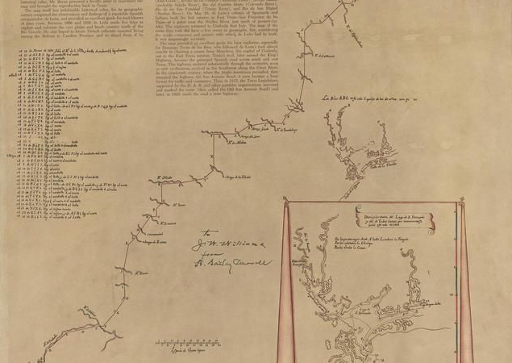




Unit 3 : Spanish Colonial Era
Lesson 2:
How do we know what we know?
Notes:
Alonso De Leon’s Last Expedition into Texas in 1690. The Portal to Texas History. https://texashistory.unt.edu/ark:/67531/metapth493023/.

Slide 2

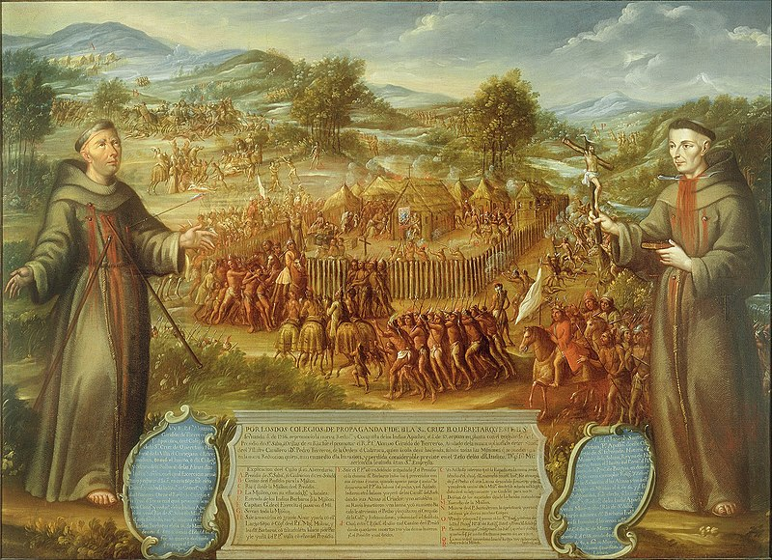
Warm-up Use the image below to complete your warm-up
https://education.texashistory.unt.edu
Notes:
The Destruction of the Saint Sabá Mission in the Province of Texas and the Martyrdom of the Priests, Fray Alonso Giraldo de Terreros and Fray José de Santiesteban. Attributed to José de Páez (1720 - ca. 1790) – painter (Mexican) Circa 1758
This is a faithful photographic reproduction of a two-dimensional, public domain work of art. The work of art itself is in the public domain for the following reason: The author died in 1790, so this work is in the public domain in its country of origin and other countries and areas where the copyright term is the author's life plus 100 years or fewer. This work is in the public domain in the United States because it was published (or registered with the U.S. Copyright Office) before January 1, 1929. https://commons.wikimedia.org/wiki/File:Attributed_to_Jos%C3%A9_de_P%C3%A1ez_-_The_Destruction_of_the_Saint_Sab%C3%A1_Mission_in_the_Province_of_Texas_and_the_Martyrdom_of_the_Priests,..._-_Google_Art_Project.jpg

Slide 3
Share with the class
One thing I noticed about the image was __________
Based on the image, I infer that ___________
https://education.texashistory.unt.edu

Slide 4
Essential Questions
How do we know what we know about the Spanish Colonial Era?
Which points of view are most and least represented in the materials, and why?
https://education.texashistory.unt.edu

Slide 5
In today’s lesson…
We will examine a variety of primary source materials related to one event at one Spanish mission in Texas.
I will make inferences about life at the mission from various points of view based on text evidence in each excerpt.
https://education.texashistory.unt.edu

Slide 6
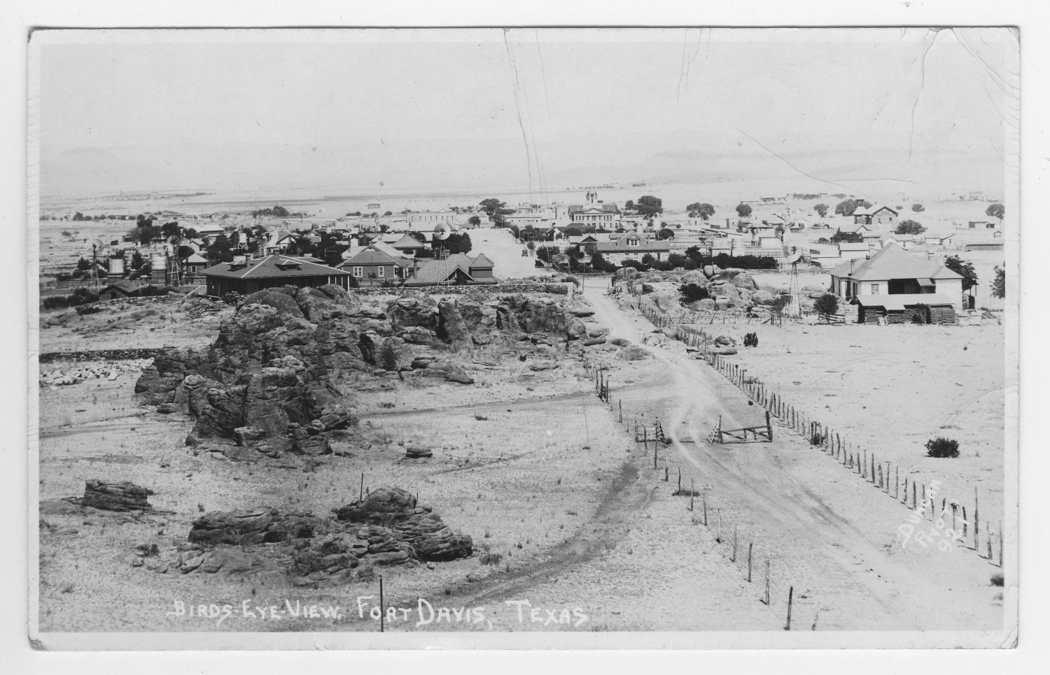
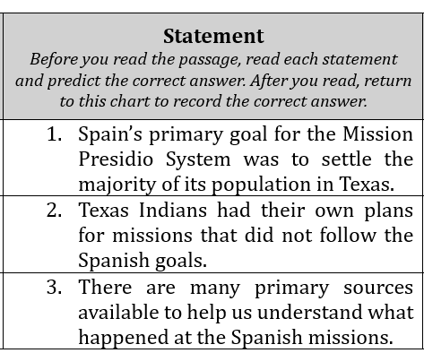
Part I: Reading Guide & Introductory Passage
Read each statement on your worksheet.
Predict the answer in the “Pre-Reading Response” column.
https://education.texashistory.unt.edu

Slide 7
All the primary source excerpts in this lesson were taken from a book published in 1959 by Lesley Bird Simpson called “The San Sabá Papers.” This book provides a compilation of primary sources regarding the conflict at the San Sabá mission.
https://education.texashistory.unt.edu

Slide 8
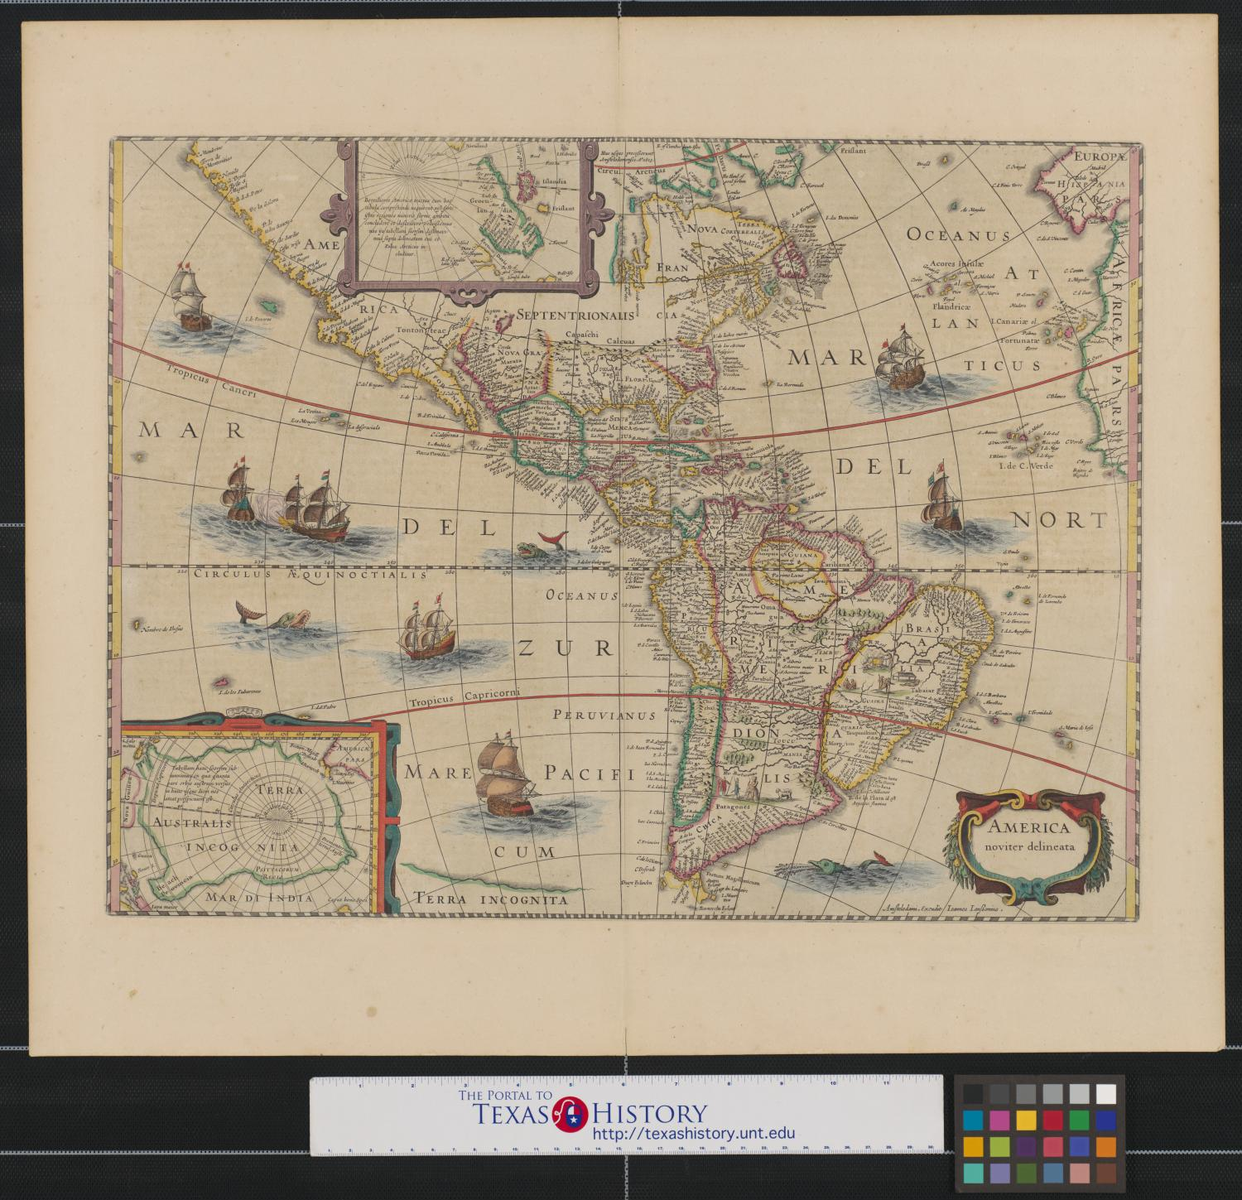
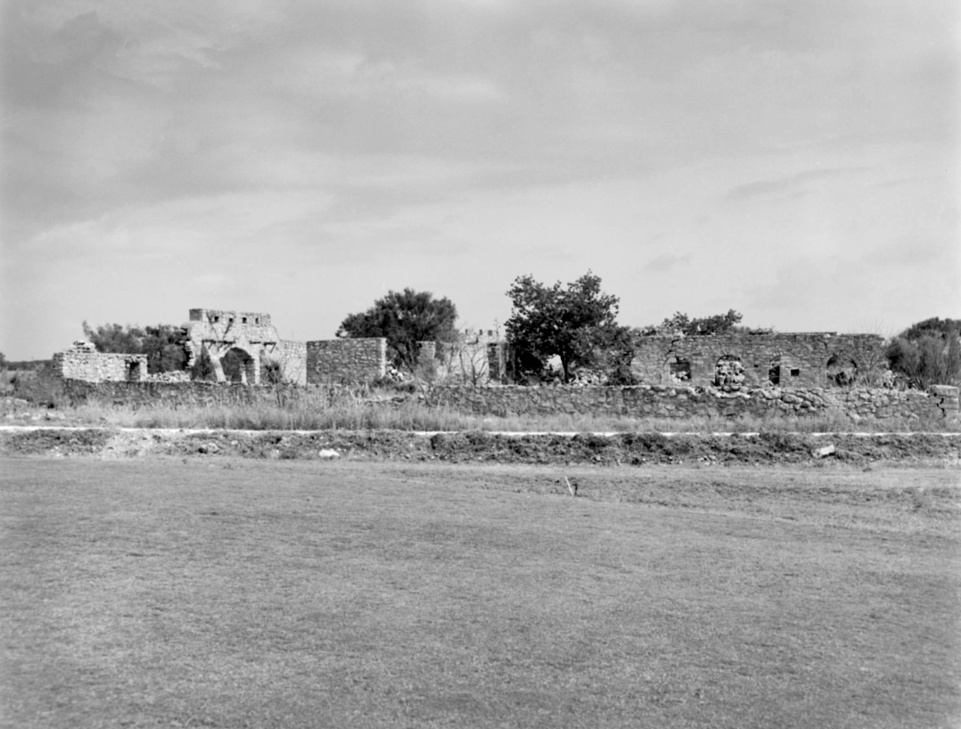
Part I: Reading Guide & Introductory Passage 2
Read the passage introducing today’s lesson.
After you read, return to the Reading guide to answer the “Post-Reading Response” True or False questions.
Provide your justification for your answer – explain how you know your answer is correct.
The ruins of the presidio at the San Sabá mission.
The Portal to Texas History, The University of North Texas
https://education.texashistory.unt.edu
Notes:
Texas Historical Commission. Presidio San Luis de Las Amarillas Real Presidio de San Saba. 4 x 5 in. The Portal to Texas History. https://texashistory.unt.edu/ark:/67531/metapth666804/.

Slide 9
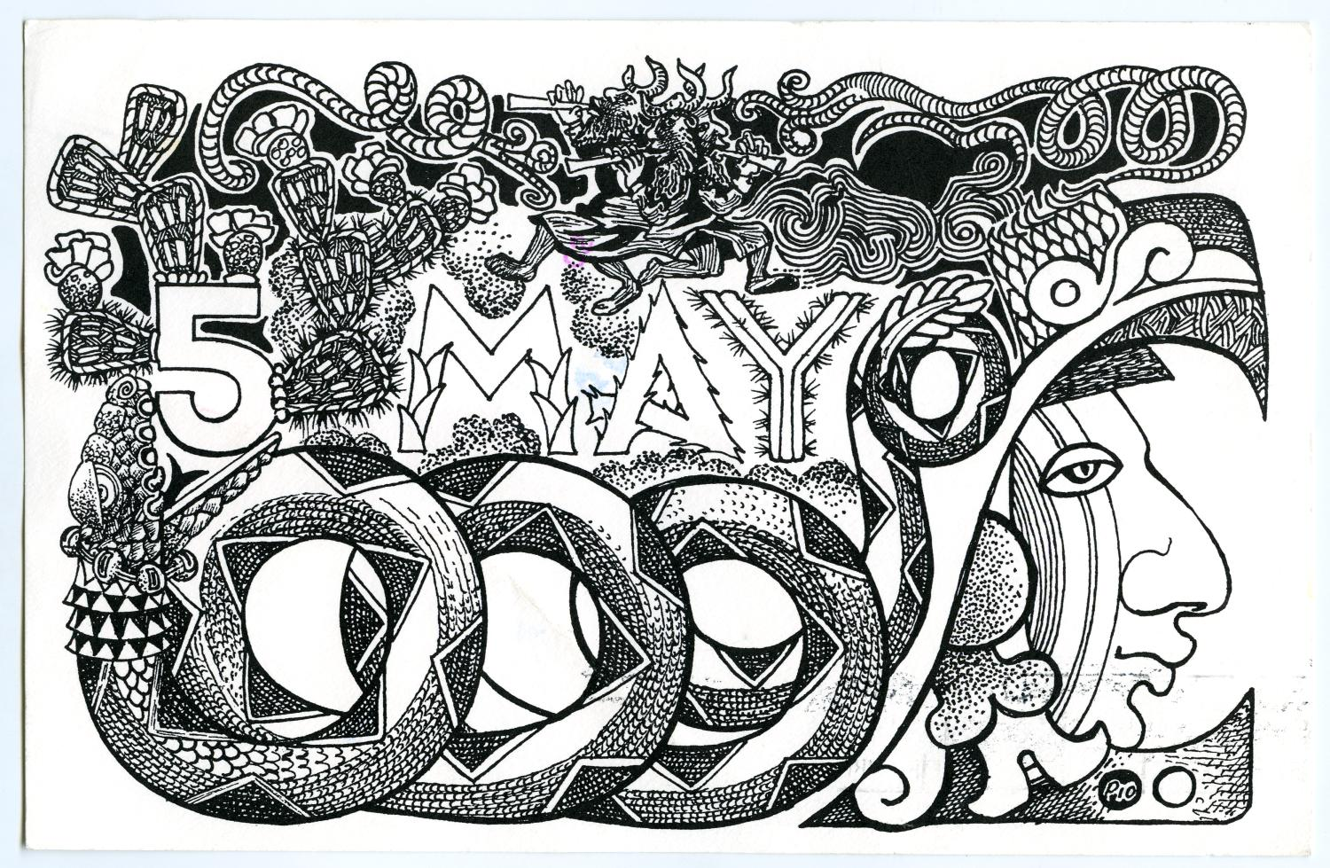

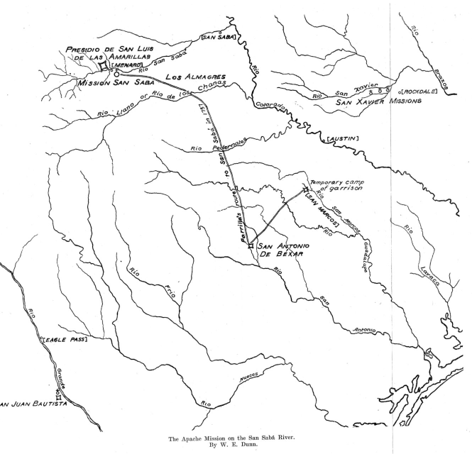
Part II: Primary Source Activity
Read the excerpts from “The San Sabá Papers” and answer the corresponding questions.
A map: “The Apache Mission on the San Sabá River”
The Southwestern Historical Quarterly
https://education.texashistory.unt.edu
Notes:
Texas State Historical Association. The Southwestern Historical Quarterly, Volume 17, July 1913 - April, 1914, periodical, 1914; Austin, Texas. (https://texashistory.unt.edu/ark:/67531/metapth101061/: accessed October 3, 2024), University of North Texas Libraries, The Portal to Texas History, https://texashistory.unt.edu; crediting Texas State Historical Association.

Slide 10
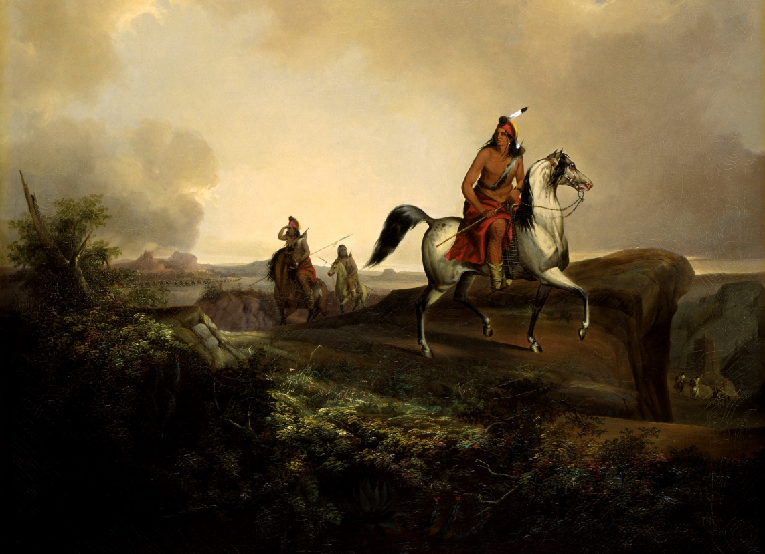
Part III: Analyze and Infer
Answer the questions by analyzing and making inferences about the excerpts you read.
A painting of Apache warriors by John Mix Stanley
The Smithsonian American Art Museum
https://education.texashistory.unt.edu
Notes:
Stanley, John Mix. Black Knife, an Apache Warrior. 1846. Oil on canvas, 42 ½ x 52 in. (107.8 x 132,1 cm). Smithsonian American Art Museum. https://americanart.si.edu/artwork/black-knife-apache-warrior-22852.

Slide 11
Exit Ticket Use the image below to complete your exit ticket
https://education.texashistory.unt.edu
Notes:
The Destruction of the Saint Sabá Mission in the Province of Texas and the Martyrdom of the Priests, Fray Alonso Giraldo de Terreros and Fray José de Santiesteban. Attributed to José de Páez (1720 - ca. 1790) – painter (Mexican) Circa 1758
This is a faithful photographic reproduction of a two-dimensional, public domain work of art. The work of art itself is in the public domain for the following reason: The author died in 1790, so this work is in the public domain in its country of origin and other countries and areas where the copyright term is the author's life plus 100 years or fewer. This work is in the public domain in the United States because it was published (or registered with the U.S. Copyright Office) before January 1, 1929. https://commons.wikimedia.org/wiki/File:Attributed_to_Jos%C3%A9_de_P%C3%A1ez_-_The_Destruction_of_the_Saint_Sab%C3%A1_Mission_in_the_Province_of_Texas_and_the_Martyrdom_of_the_Priests,..._-_Google_Art_Project.jpg

Slide 12
Share with the class 2
The image provides the __________ point of view.
Evidence that supports my conclusion is _____
https://education.texashistory.unt.edu

Slide 13
Share with the class 3
This image might be different if it were presented from the American Indian point of view because ______________
https://education.texashistory.unt.edu

