Slide 1
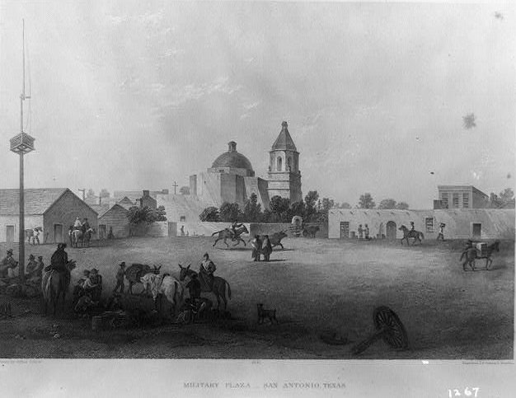
Unit 3:
The Spanish Colonial Era
Lesson 9:
Looking Ahead
Notes:
Military Plaza - San Antonio, Texas. January 1, 1970. Engraving. Library of Congress. https://www.loc.gov/pictures/item/2021651282/.

Slide 2






Looking Ahead
Warm-up
https://education.texashistory.unt.edu

Slide 3

Warm-up:
Follow the directions to complete your warm-up
Read the excerpt from a San Antonio newspaper in 1813.
Consider the scenario and the question.
Record your answer.
Discuss with a partner.
https://education.texashistory.unt.edu

Slide 4
Share with the class
In 1813, life in San Antonio is ______________
One option to make things better could be ______
https://education.texashistory.unt.edu

Slide 5
Essential Questions
How did the Spanish Colonial Era affect Texas and its population?
How did Texas pose a challenge to the government of Mexico in 1821?
https://education.texashistory.unt.edu

Slide 6
In today’s lesson…
We will examine the social and economic situation in Texas in 1821 and identify the specific challenges that Texas posed to the newly formed government of Mexico.
I will read primary source excerpts to identify specific challenges related to Texas and answer comprehension questions about each excerpt.
https://education.texashistory.unt.edu

Slide 7
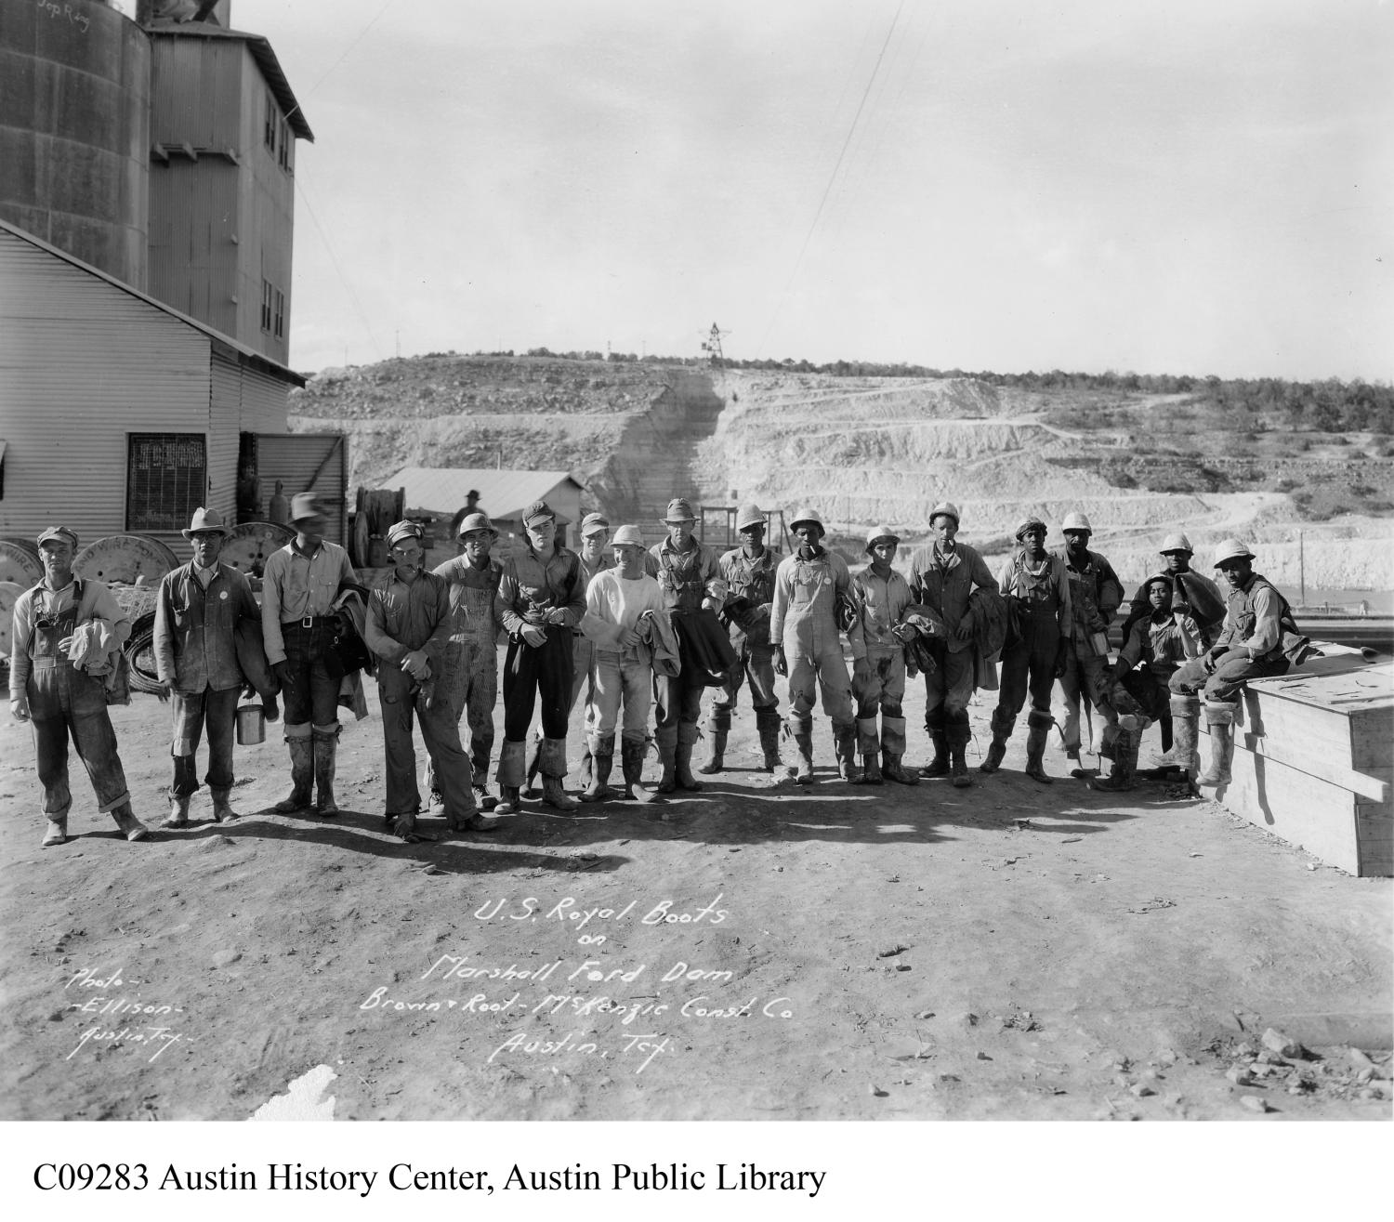
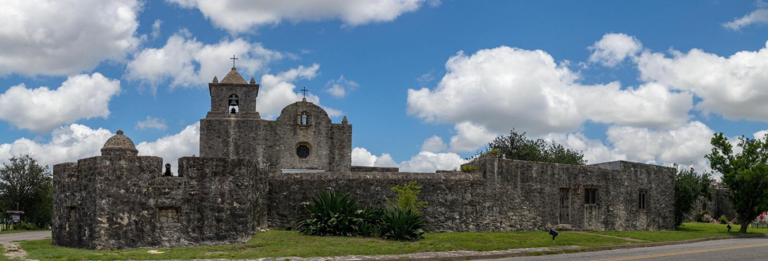
Transitioning to a New Era
The Presidio at La Bahía.
The Portal to Texas History.
https://education.texashistory.unt.edu
Notes:
Hicks, William. Presidio La Bahia. June 24, 2018. Photograph. University of North Texas Libraries, The Portal to Texas History, https://texashistory.unt.edu. https://texashistory.unt.edu/ark:/67531/metapth1025137/.

Slide 8
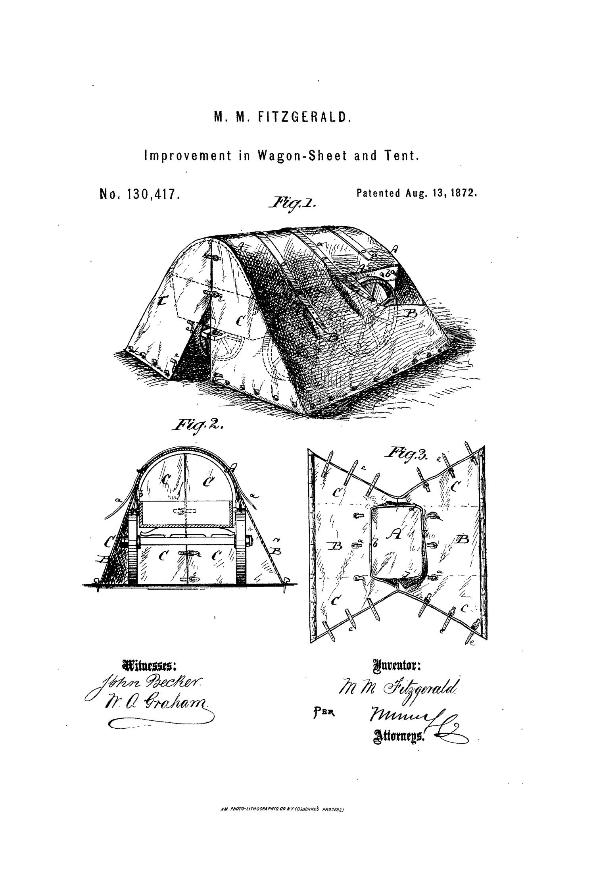
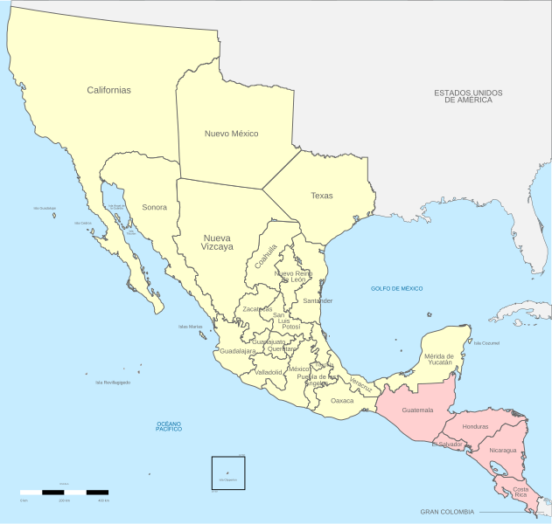
What’s Going on in Texas?
https://education.texashistory.unt.edu
Notes:
Map of the Political Divisions of Mexico, 1821. Instituto Nacional de Estadística y Geografía . This file is licensed under the Creative Commons Attribution-Share Alike 3.0 Unported license. https://commons.wikimedia.org/wiki/File:Political_divisions_of_Mexico_1821_(location_map_scheme).svg

Slide 9

Mexico, We Have a Problem.
https://education.texashistory.unt.edu

Slide 10
Looking Ahead
Exit Ticket
https://education.texashistory.unt.edu

Slide 11

Exit Ticket:
Follow the directions to complete your exit ticket.
Circle or highlight which action you think Mexico is most likely to take to address its concerns about Texas.
Explain why you think Mexico would take that action.
Discuss with a partner.
https://education.texashistory.unt.edu

Slide 12
Share with the class 2
I think Mexico will probably ______
I think Mexico will take this action because ______
https://education.texashistory.unt.edu

