Slide 1
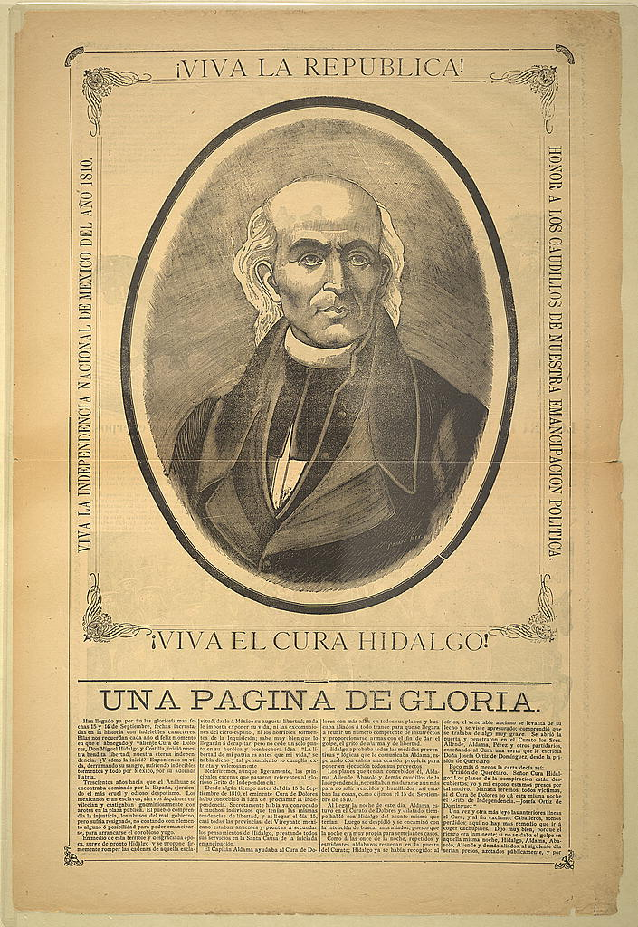
Unit 3:
The Spanish Colonial Era
Lesson 7:
The War for Mexican Independence and the Filibusters
Notes:
Antonio Vanegas Arroyo , Publisher, and José Guadalupe Posada. Viva la república! Viva el Cura Hidalgo! Una página de gloria. Mexico, None. [Mexico city: antonio vanegas arroyo, between 1890 and 1913] Photograph. https://www.loc.gov/item/99615902/

Slide 2

The War for Mexican Independence and Filibusters
Warm-up
https://education.texashistory.unt.edu

Slide 3




Warm-up:
Follow the directions to complete your warm-up
Make predictions about what you think we will see in today’s lesson about the War for Mexican Independence.
Record your responses in the boxes provided.
Share your responses with a partner.
https://education.texashistory.unt.edu

Slide 4
Share with the class
I think people might have wanted to fight this war because _________
I think ________ will probably be fighting in this war because _____
I think the outcome of the war will be that _______ will win.
https://education.texashistory.unt.edu

Slide 5
Essential Questions
What were the key events and who were the significant people of the War for Mexican Independence? What was the result of the war, and how did it affect Texas?
https://education.texashistory.unt.edu

Slide 6
In today’s lesson…
We will read five short passages explaining the causes, events, people, outcome, and significance of the War for Mexican Independence.
I will read each passage, use the context to determine vocabulary meanings, and answer a comprehension question.
https://education.texashistory.unt.edu

Slide 7
Introduction
https://education.texashistory.unt.edu

Slide 8
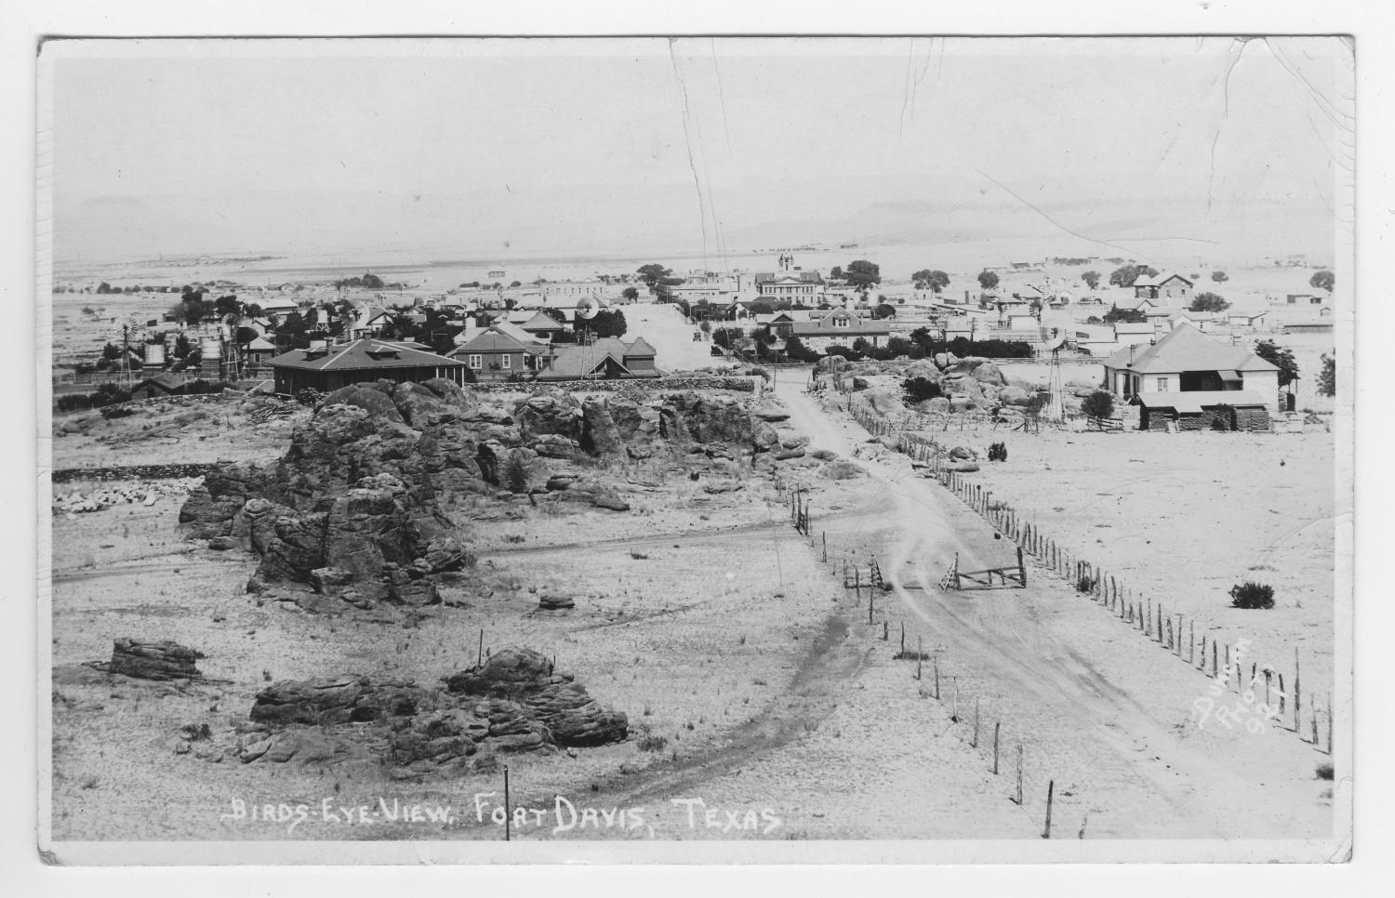
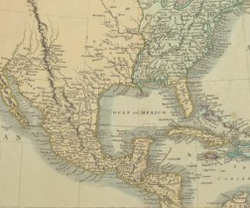
What was going on in Texas?
Map of North America, 1806
The Portal to Texas History
https://education.texashistory.unt.edu
Notes:
Cary, John, ca. 1754-1835. A new map of North America from the latest authorities., map, 1806; London, England. (https://texashistory.unt.edu/ark:/67531/metapth187373/: accessed November 11, 2024), University of North Texas Libraries, The Portal to Texas History, https://texashistory.unt.edu; crediting University of Texas at Arlington Library.

Slide 9
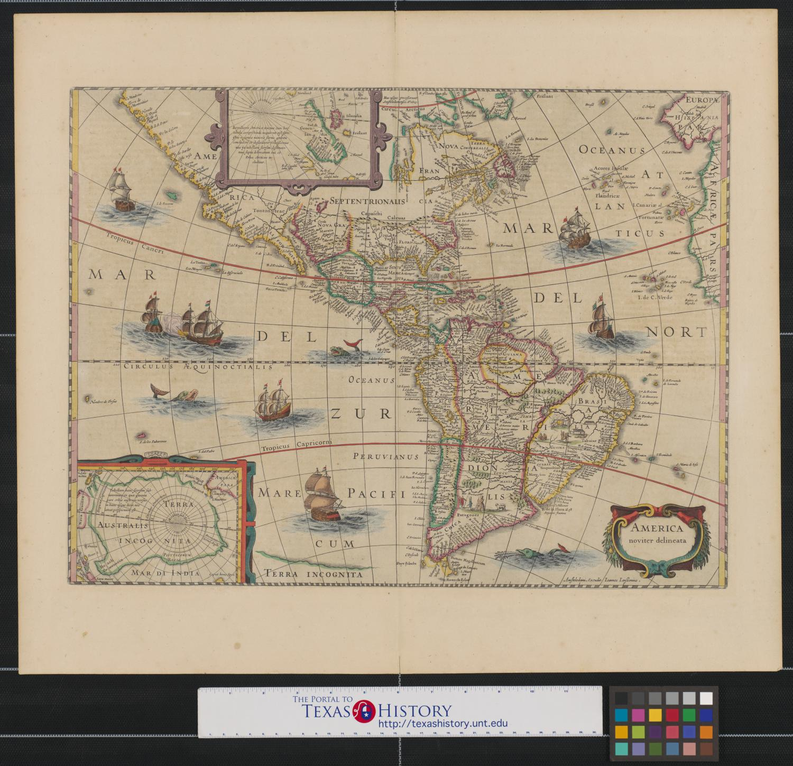
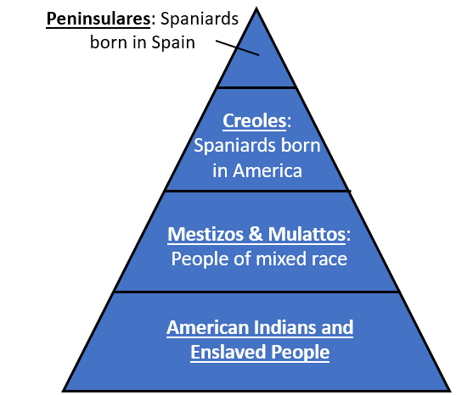
What was going on in New Spain?
https://education.texashistory.unt.edu

Slide 10
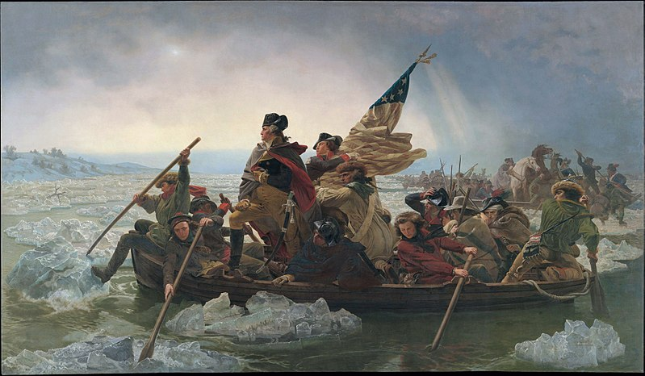
What was going on in the world?
George Washington crossing the Delaware River during the American Revolution. The Metropolitan Museum of Art.
https://education.texashistory.unt.edu
Notes:
Washington Crossing the Delaware by Emanuel Leutze. Metropolitan Museum of Art. This file is made available under the Creative Commons CC0 1.0 Universal Public Domain Dedication. https://commons.wikimedia.org/wiki/File:Washington_Crossing_the_Delaware_MET_DP245003FXD.jpg

Slide 11
Causes of the War for Mexican Independence
https://education.texashistory.unt.edu

Slide 12
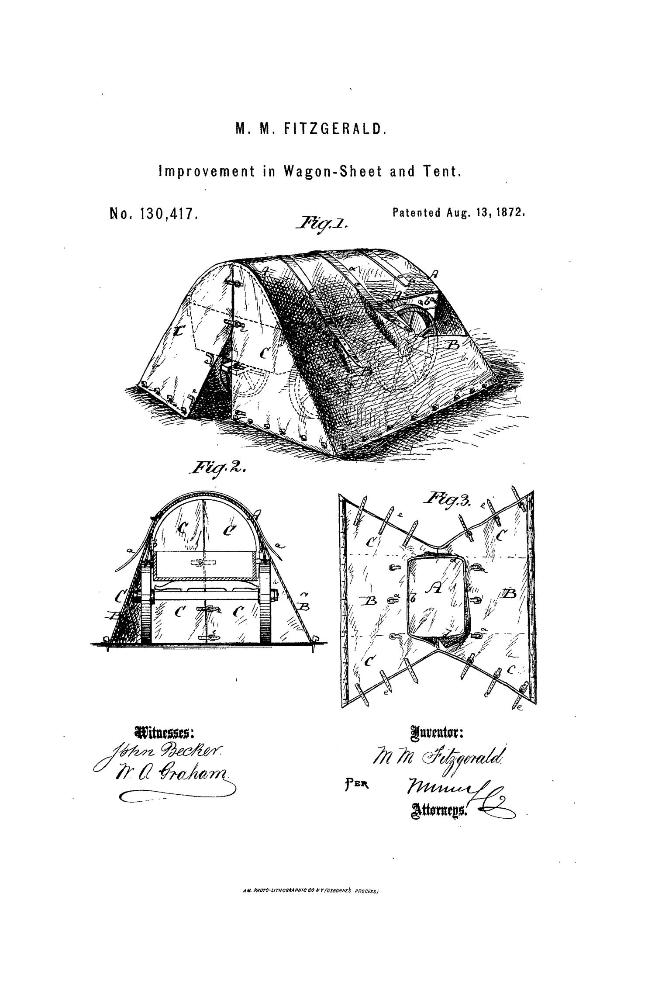
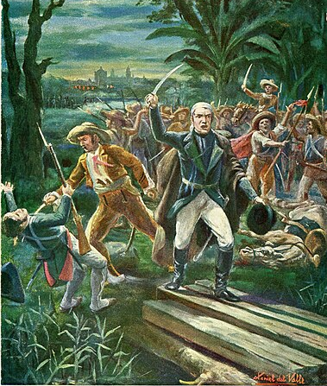
1910 Mexican postcard depicting General José María Morelos, leader of the Mexican War of Independence, breaking out of the siege of Cuautla on May 2, 1812.
https://education.texashistory.unt.edu
Notes:
Morelos breaks into the siege of Cuautla, 2-5-1812, Daniel del Valle & Buznego y Cía (1910) a postcard by Daniel del Valle. https://commons.wikimedia.org/wiki/File:Morelos_irrumpe_en_el_sitio_de_Cuautla,_2-5-1812,_Daniel_del_Valle_%26_Buznego_y_C%C3%ADa_(1910).jpg

Slide 13
The War Begins!
https://education.texashistory.unt.edu

Slide 14
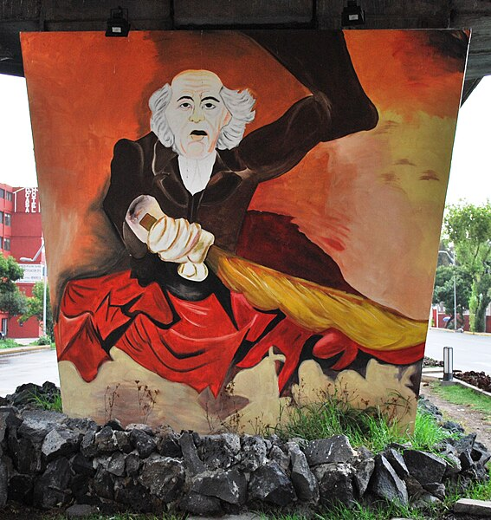
Street art at the intersection of Congreso de la Union and Servando de Mier in Mexico City depicting Father Miguel Hidalgo leading the call to revolution.
https://education.texashistory.unt.edu
Notes:
Mural with Father Miguel Hidalgo under the bridge over the intersection of Congreso de la Union and Servando de Mier in Mexico City, 2009. This file is licensed under the Creative Commons Attribution-Share Alike 3.0 Unported license. https://commons.wikimedia.org/wiki/File:HidalgoBridgeCongresoDF.JPG

Slide 15
Filibusters in Texas
https://education.texashistory.unt.edu

Slide 16
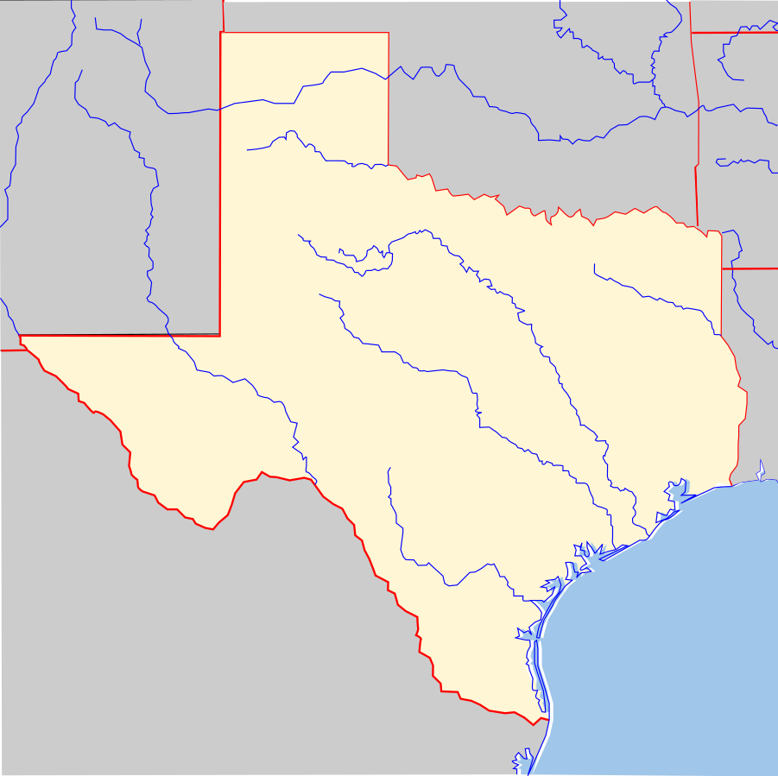
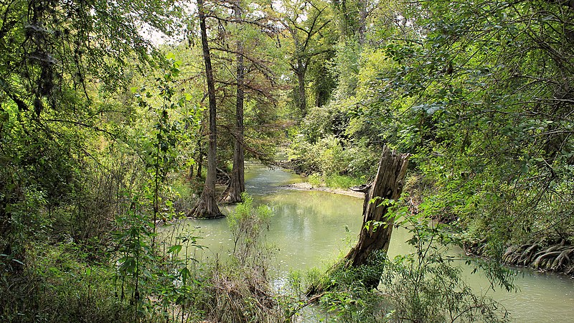
Medina, Texas
The Battle of Medina
The Medina River
Medina, Texas
https://education.texashistory.unt.edu
Notes:
Blank map of Texas, edited to include the approximate location of Medina, Texas. This file is licensed under the Creative Commons Attribution-Share Alike 3.0 Unported license. https://commons.wikimedia.org/wiki/File:Texas_blank_map.svg
The Medina River at Medina River Natural Area in San Antonio, Texas, United States. 2015. Photograph by Larry D. Moore. This file is licensed under the Creative Commons Attribution 4.0 International license
https://commons.wikimedia.org/wiki/File:Medina_River_Natural_Area.jpg

Slide 17
The War Ends!
https://education.texashistory.unt.edu

Slide 18
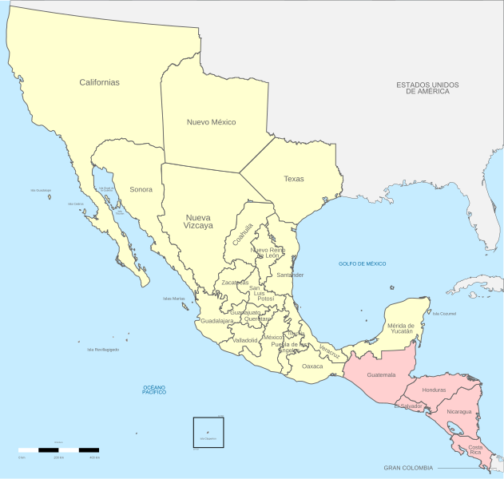
Mexican Independence
The Treaty of Córdoba ends the war!
https://education.texashistory.unt.edu
Notes:
Political divisions of Mexico 1821 (location map scheme) This file is licensed under the Creative Commons Attribution-Share Alike 3.0 Unported license. https://commons.wikimedia.org/wiki/File:Political_divisions_of_Mexico_1821_(location_map_scheme).svg

Slide 19


The War for Mexican Independence and Filibusters
Exit Ticket
https://education.texashistory.unt.edu

Slide 20
Exit Ticket:
Follow the directions to complete your Exit Ticket
What were TWO significant effects of the War for Mexican Independence?
Record your responses in the boxes provided.
Share your responses with a partner.
https://education.texashistory.unt.edu

Slide 21
Share with the class 2
One significant effect of the War for Mexican Independence was __(read one response)__
Another significant effect of the War for Mexican Independence was __(read one response)__
https://education.texashistory.unt.edu

