Slide 1

Mind Map
Sub-topic
1
Additional information
Sub-topic
2
Main Topic
Additional information
Sub-topic
3
Additional information
Additional information
https://education.texashistory.unt.edu

Slide 2

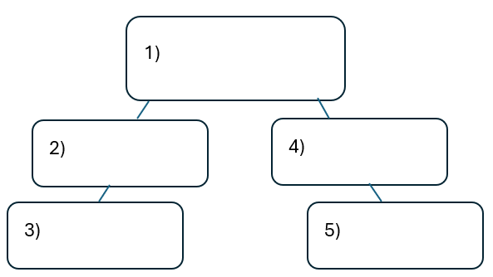


Warm-up:
Follow the directions on your warm-up
Use the word bank provided to fill in the small mind map on your warm-up.
Place each term where you think it fits best in your mind map.
Discuss with a partner.
https://education.texashistory.unt.edu

Slide 3
Share with the class
I think the primary topic in box number one is _______
I think the subtopic in box number two is ____, and box number three is ____
I think the subtopic in box number four is ____, and box number five is ____
https://education.texashistory.unt.edu

Slide 4
Essential Question
How do the key terms and concepts from Unit 3: The Spanish Colonial Era connect to each other?
https://education.texashistory.unt.edu

Slide 5
In today’s lesson…
We will make connections between key terms and concepts within all of Unit 3: The Spanish Colonial Era
I will create a Mind Map using terms and concepts from the class slides presentation.
https://education.texashistory.unt.edu

Slide 6
Topic & Subtopics
ONE of these items is the primary unit topic. The other two are subtopics. Choose the primary unit topic and write it in the middle of your paper. Write the other two around the main topic. Leave plenty of space.
Mission Presidio System
War for Mexican Independence
Spanish Colonial Era
https://education.texashistory.unt.edu

Slide 7
Add to your mind map
Place each item below where it fits on your mind map. Keep in mind, you can write some items in more than one place.
Goals
Causes
Effects
Missions
Events
https://education.texashistory.unt.edu

Slide 8
Make Connections 1
Connect each item below to one of the topics on your Mind Map.
There may be more than one place that these items connect. Be ready to explain where you put each one.
French Threat
Convert Texas Indians
Caste System
Want equality
East Texas
Father Miguel Hidalgo y Costilla
https://education.texashistory.unt.edu

Slide 9
Make Connections 2
Connect each item below to one of the topics on your Mind Map.
There may be more than one place that these items connect. Be ready to explain where you put each one.
Assimilate Texas Indians
Overthrow Spanish government
Corpus Christi de la Isleta
Los Adaes
Filibusters
San Antonio
https://education.texashistory.unt.edu

Slide 10
Make Connections 3
Connect each item below to one of the topics on your Mind Map.
There may be more than one place that these items connect. Be ready to explain where you put each one.
Strengthen Spain’s claim to TX
Louisiana Purchase
First TX capital
Philip Nolan
East Texas
1st TX mission
https://education.texashistory.unt.edu

Slide 11
Make Connections 4
Connect each item below to one of the topics on your Mind Map.
There may be more than one place that these items connect. Be ready to explain where you put each one.
Midpoint to East Texas
Caddo Tribe
Gutiérrez-Magee Expedition
Mustang thief & trader
Camino Real
Damián Massanet
https://education.texashistory.unt.edu

Slide 12
Make Connections 5
Connect each item below to one of the topics on your Mind Map.
There may be more than one place that these items connect. Be ready to explain where you put each one.
Lack of support
Canary Islanders
San Sabá
Captured San Antonio
Margil de Jesús
El Paso
https://education.texashistory.unt.edu

Slide 13
Make Connections 6
Connect each item below to one of the topics on your Mind Map.
There may be more than one place that these items connect. Be ready to explain where you put each one.
1718
TX Indians disinterested
2nd Capital of TX
Battle of Medina
Comanchería
Grito de Dolores
https://education.texashistory.unt.edu

Slide 14
Make Connections 7
Connect each item below to one of the topics on your Mind Map.
There may be more than one place that these items connect. Be ready to explain where you put each one.
Comanche attacks
Mexican people won freedom
1821
Spanish Texas weaker than ever
Spain closes missions
Mexico becomes a country
https://education.texashistory.unt.edu

Slide 15

Create Connections 6
Now take a few minutes to add any information you can think of to your Mind Map.
You can add facts, descriptions, explanations, cultural information, or anything else you can think of.
https://education.texashistory.unt.edu

Slide 16
Exit Ticket
Complete the sentence summarizing the main idea from our unit.
Discuss with a partner.
https://education.texashistory.unt.edu

Slide 17
Share your response
The ___________ is primarily characterized by __________
https://education.texashistory.unt.edu

