Slide 1
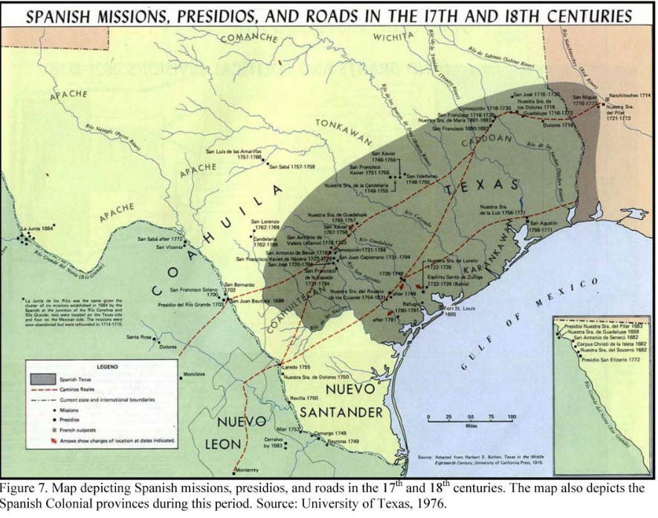
Unit 3:
The Spanish Colonial Era
Lesson 13:
Study Guide
Notes:
Spanish Missions, Presidios, and Roads in the 17th and 18th Centuries, In Adobe in Texas. by Ralph Newlan, 7. Coraopolis, PA: Michael Baker Inc., 2008. University of North Texas Libraries, The Portal to Texas History, https://texashistory.unt.edu; crediting UNT Libraries Government Documents Department. https://texashistory.unt.edu/ark:/67531/metapth1223086/.

Slide 2






Study Guide Review
Warm-up
https://education.texashistory.unt.edu

Slide 3

Warm-up:
Follow the directions to complete your warm-up
Read the list of social studies topics in the chart.
Circle or highlight any items that you think are likely to be on the unit 3 test.
Share with a partner.
https://education.texashistory.unt.edu

Slide 4
Share with the class
One thing that I think is likely to be on the unit 3 test is _______________
https://education.texashistory.unt.edu

Slide 5
Essential Question
What significant information do we need to know to be successful on the unit 3 test?
https://education.texashistory.unt.edu

Slide 6
In today’s lesson…
We will identify and review significant information for our upcoming test.
I will use my previous work and notes to complete my study guide. I will match information, create short answer responses, and answer practice test questions.
https://education.texashistory.unt.edu

Slide 7
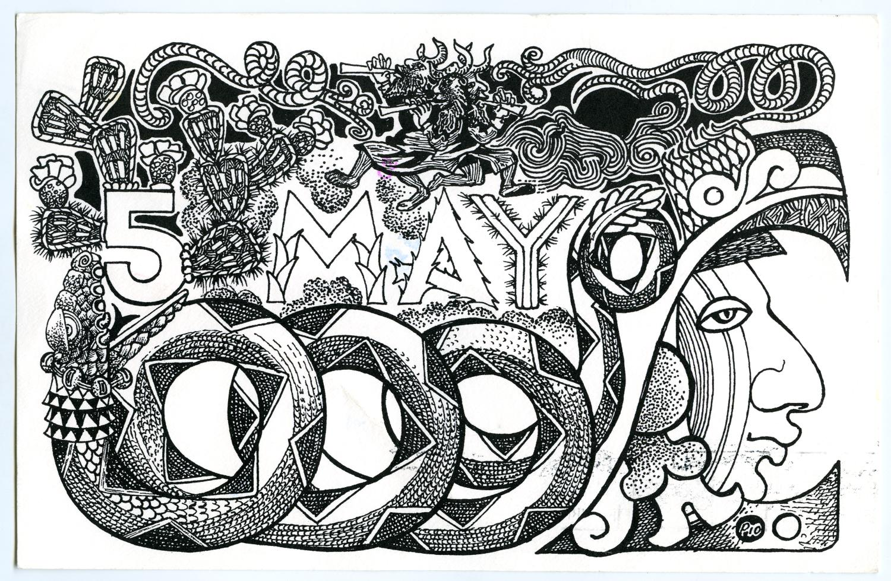
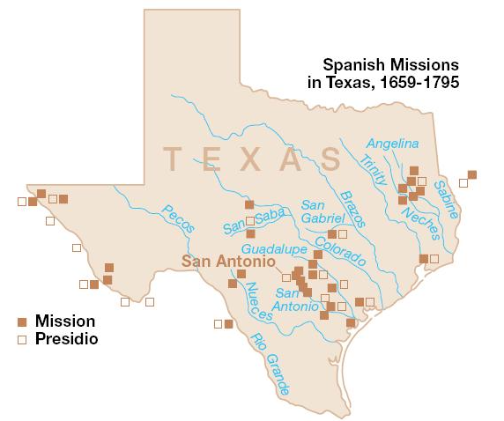
Part I: Key Terms & Definitions
Choose the correct term for each definition in the chart.
https://education.texashistory.unt.edu
Notes:
US National Park Service. Spanish Missions in Texas, 1659-1795. Map. Wikimedia Commons. https://commons.wikimedia.org/wiki/File:Spanish_Missions_in_Texas.JPG.

Slide 8
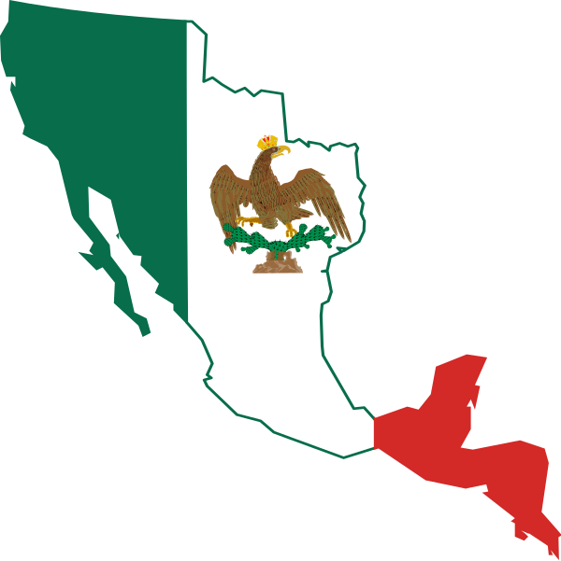
Part II: Matching
Match the event on the left with its correct effect on the right.
https://education.texashistory.unt.edu
Notes:
Flag map of the First Mexican Empire (1821–1823) This file is licensed under the Creative Commons Attribution-Share Alike 3.0 Unported license. https://commons.wikimedia.org/wiki/File:Flag_map_of_the_First_Mexican_Empire_(1821%E2%80%931823).svg

Slide 9
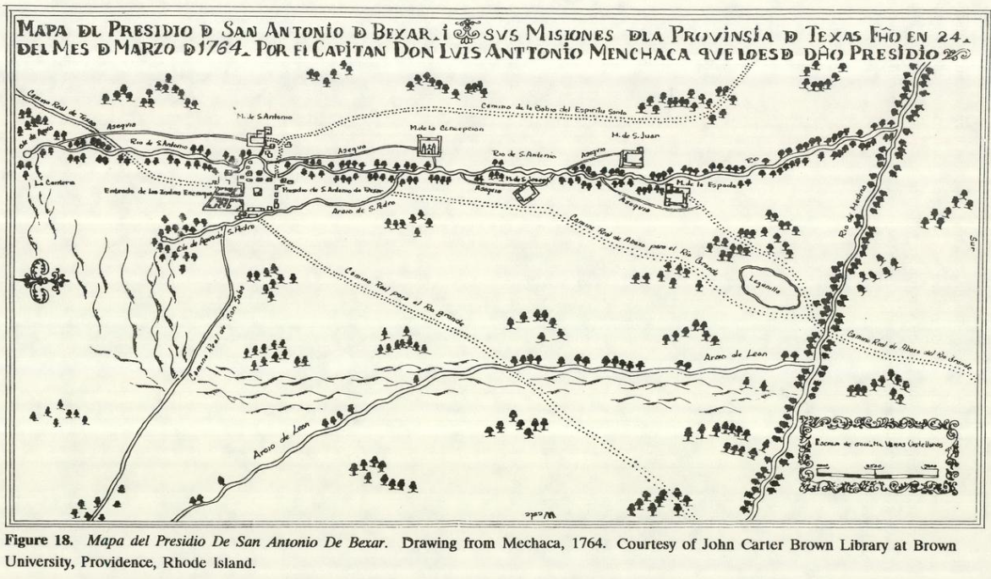
Part III: Practice Test Questions
The practice test questions are based on the types of questions on the 8th grade social studies STAAR.
Map of Presidio San Antonio de Bexar.
The Portal to Texas History.
https://education.texashistory.unt.edu
Notes:
Mapa del Presidio De San Antonio De Bexar, In A Texas Legacy: The Old San Antonio Road And The Caminos Reales: A Tricentennial History, 1691-1991. by A. Joachim McGraw, John Wilburn Clark, and Elizabeth A. Robbins, eds., 140. Austin, TX: Texas State Department of Highways and Public Transportation, 1991. University of North Texas Libraries, The Portal to Texas History, https://texashistory.unt.edu; crediting UNT Libraries Government Documents Department. https://texashistory.unt.edu/ark:/67531/metapth1364735

Slide 10
Study Guide Review
Exit Ticket
https://education.texashistory.unt.edu

Slide 11
Exit Ticket:
Follow the directions to complete your warm-up
Assess your knowledge and preparation for the test
Respond to the prompts about your knowledge of unit 3 content.
Share with a partner.
https://education.texashistory.unt.edu

Slide 12
Share with the class 2
One thing the study guide helped me remember or understand is: _________
One thing I still have a question about is ______
One thing I will do to prepare for this test is ________
https://education.texashistory.unt.edu

