Slide 1
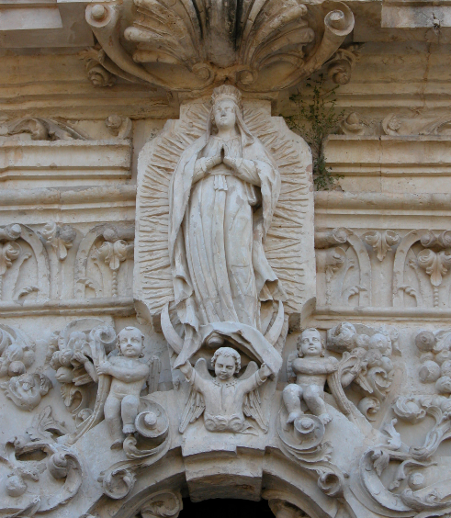
Unit 3:
The Spanish Colonial Era
Lesson 6:
Texas Missions
Notes:
Belden, Dreanna. Detail of the church at Mission San Jose. May 4,2005. The Portal to Texas History. https://texashistory.unt.edu/ark:/67531/metapth3540/.

Slide 2




Warm-up
Follow the directions to complete your warm-up
Respond to the prompts on your warm-up.
Discuss with a partner
https://education.texashistory.unt.edu

Slide 3

Share with the class
One thing we know about the Mission Presidio System in Texas is __________
One problem we know that occurred at some Texas missions was ________
One question I have about the Texas missions is __________
https://education.texashistory.unt.edu

Slide 4
Essential Question
What are the key people, places, events, and information related to significant Spanish missions in Texas?
https://education.texashistory.unt.edu

Slide 5
In today’s lesson…
We will examine significant information related to seven prominent Spanish missions established in Texas during the Spanish Colonial era.
I will work with my group to research one mission. I will present my findings to the class and take notes on the significant information when other groups present.
https://education.texashistory.unt.edu

Slide 6
This Assignment has two parts:
Part One: Group Project & Presentation.
You will be assigned to a group. Your group will be assigned one Spanish mission in Texas. As a group you will read a passage about your mission and use the reading to create a slideshow presentation about your mission.
You will follow the directions on the slideshow to complete this presentation. You will then present your mission to the class.
Part Two: Individual Note Taking & Engagement
While other groups are presenting, you will take notes on key information about each mission. You will be respectful and attentive of each presentation and take accurate notes, asking questions when appropriate.
https://education.texashistory.unt.edu

Slide 7
Student Group Presentation Slideshow Instructions for Part One:
You have been assigned to report on one Spanish mission in Texas. Follow the instructions to complete this group project.
Step 1: Group Role Assignments
Each person in your group will choose one of the elements of Texas history on the next slide.
Type the name of each group member under their choice.
https://education.texashistory.unt.edu

Slide 8
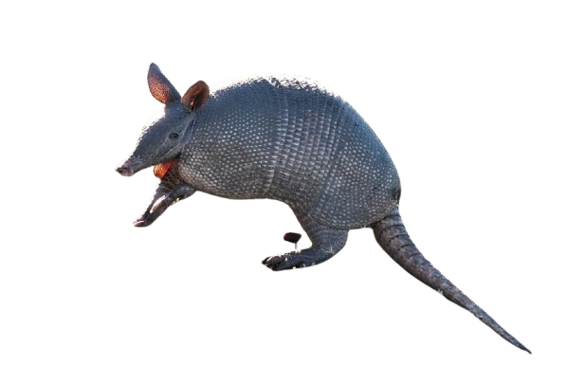
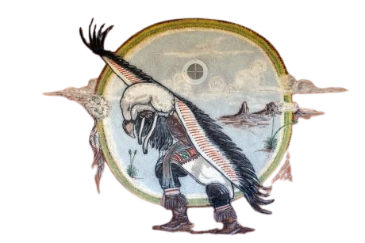
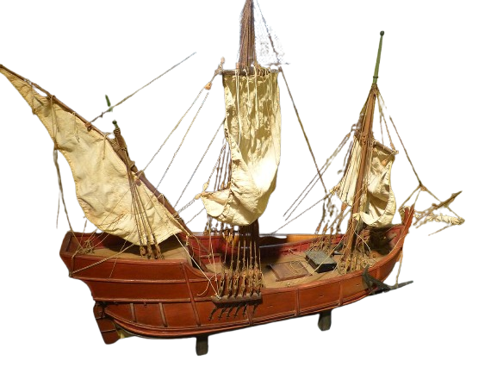
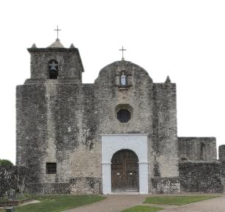
Choose one image below from Texas history and type your name in the box beneath it.
Student Name
Student Name
Student Name
Student Name
https://education.texashistory.unt.edu
Notes:
Highsmith, Carol M, photographer. Wall art at the Tigua Indian Cultural Center at the Ysleta del Sur Pueblo, which celebrates more than 300 years of tribal history in El Paso, Texas. El Paso United States Texas, 2014. -02-14. Photograph. https://www.loc.gov/item/2014630705/.
Tatu (dasypus novemcinctus), Uruguay, 2020. This file is licensed under the Creative Commons Attribution 4.0 International license. Background of image removed for use in this presentation. https://commons.wikimedia.org/wiki/File:Tatu_(dasypus_novemcinctus),_Uruguay,_2020.jpg
Las Palmas Casa de Colon - Museum Modell Pinta. Photograph by Wolfgang Sauber. This file is licensed under the Creative Commons Attribution-Share Alike 4.0 International license. https://commons.wikimedia.org/wiki/File:Las_Palmas_Casa_de_Colon_-_Museum_Modell_Pinta.jpg
Highsmith, Carol M, photographer. A portion of the Presidio Nuestra Senora de Loreto de la Bahia, known more commonly as Presidio La Bahia, or simply La Bahia, a fort constructed by the Spanish Army that became the nucleus of the city of Goliad, Texas. United States Texas Goliad, 2014. -04-05. Photograph. https://www.loc.gov/item/2014633490/.

Slide 9
What are your assigned slides?
Type your 2 slide numbers into the box below your name.
Slides 8 & 9
Name of Missions
Images
Slides 10 & 11
People at the mission
Slides 12 & 13
Challenges at the mission
Achievements at the mission
Slides 14 & 15
Interesting Facts
Outcome
https://education.texashistory.unt.edu
Notes:
Highsmith, Carol M, photographer. Wall art at the Tigua Indian Cultural Center at the Ysleta del Sur Pueblo, which celebrates more than 300 years of tribal history in El Paso, Texas. El Paso United States Texas, 2014. -02-14. Photograph. https://www.loc.gov/item/2014630705/.
Tatu (dasypus novemcinctus), Uruguay, 2020. This file is licensed under the Creative Commons Attribution 4.0 International license. Background of image removed for use in this presentation. https://commons.wikimedia.org/wiki/File:Tatu_(dasypus_novemcinctus),_Uruguay,_2020.jpg
Las Palmas Casa de Colon - Museum Modell Pinta. Photograph by Wolfgang Sauber. This file is licensed under the Creative Commons Attribution-Share Alike 4.0 International license. https://commons.wikimedia.org/wiki/File:Las_Palmas_Casa_de_Colon_-_Museum_Modell_Pinta.jpg
Highsmith, Carol M, photographer. A portion of the Presidio Nuestra Senora de Loreto de la Bahia, known more commonly as Presidio La Bahia, or simply La Bahia, a fort constructed by the Spanish Army that became the nucleus of the city of Goliad, Texas. United States Texas Goliad, 2014. -04-05. Photograph. https://www.loc.gov/item/2014633490/.

Slide 10
Student Group Presentation Slideshow Instructions 2
Step 2: The Reading
As a group, read the passage that goes with your assigned mission.
  The passage is NOT included in these slides
Each person can take turns reading one sentence or one paragraph at a time.
You are encouraged to take quick notes, specifically about the portion of the presentation which you are assigned to cover.
https://education.texashistory.unt.edu

Slide 11
Student Group Presentation Slideshow Instructions 3
Step 3: Completing Your Slides
Look at your assigned slides (refer to your slide #3)
The directions for each of your slides are to the left of your slide.
Follow the directions to complete your slide.
You will present your information to the class. Review your information so you are comfortable with your part of the presentation.
https://education.texashistory.unt.edu

Slide 12
Grading Rubric
The grade is based on individual work. There is no group grade.
Grades are earned according to the following criteria:
Component | Description | Points
Information | The information in your presentation should be accurate, informative, and as detailed as possible. | 5
Material Presentation | Each person in the group should have slides that are neat and organized. | 5
Oral Presentation | Each person who presents should speak loudly, slowly, and clearly for their portion of the presentation. | 5
Engagement | When other students are presenting, you are listening closely, taking notes, and completing your work for each mission being presented. | 5
https://education.texashistory.unt.edu

Slide 13
Group Presentations!
https://education.texashistory.unt.edu

Slide 14
Part Two: Individual Note Taking & Engagement
https://education.texashistory.unt.edu

Slide 15
Individual Note Taking & Engagement
As each group presents their mission to the class, you will listen and take notes on the significant information of each mission.
  The mission’s name and date of founding
  The specific goal for the mission
  The people of the mission
  The challenges and achievements of the mission
  An interesting fact about the mission
  The outcome of the mission
https://education.texashistory.unt.edu

Slide 16
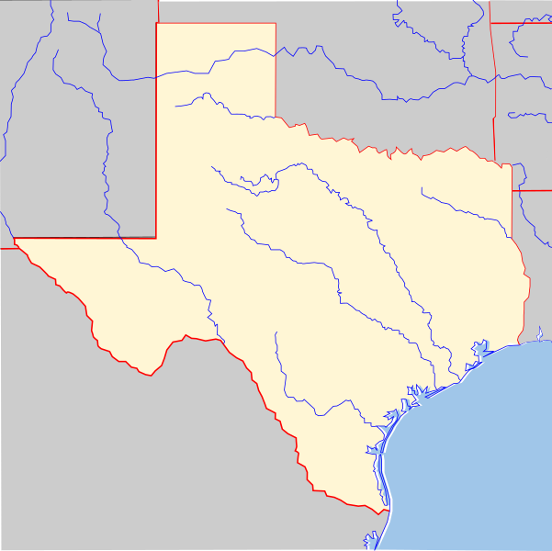
Mapping the Missions
You will mark the approximate location of each mission on your map and label the mission with its most common name.
https://education.texashistory.unt.edu

Slide 17
Exit Ticket
Follow the directions to complete your exit ticket
Respond to the prompts on your exit ticket.
Discuss with a partner
https://education.texashistory.unt.edu

Slide 18
Share with the class 2
One challenge that we have learned about at the missions is __________
One achievement that we have learned about at the missions is ________
I think the Mission Presidio System in Texas will ultimately succeed / fail . Evidence that supports my claim is
https://education.texashistory.unt.edu

