Slide 1

Student Presentation Texas Missions
https://education.texashistory.unt.edu

Slide 2
Student Group Presentation Slideshow Instructions
You have been assigned to report on one Spanish mission in Texas. Follow the instructions to complete this group project.
Step 1: Group Role Assignments
Each person in your group will choose one of the elements of Texas history on the next slide.
Type the name of each group member under their choice.
https://education.texashistory.unt.edu

Slide 3
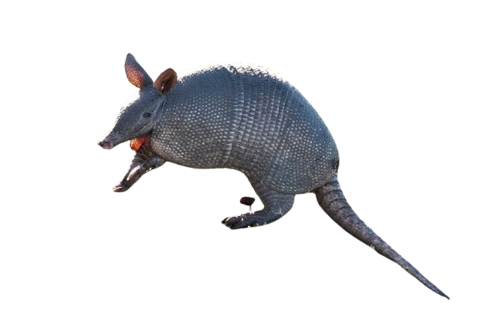
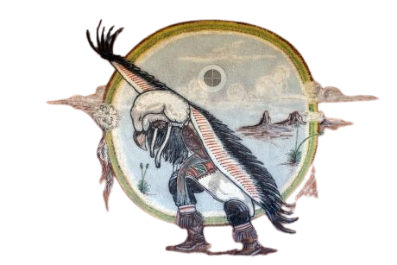
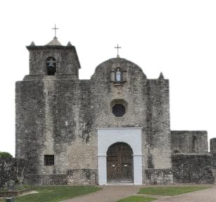
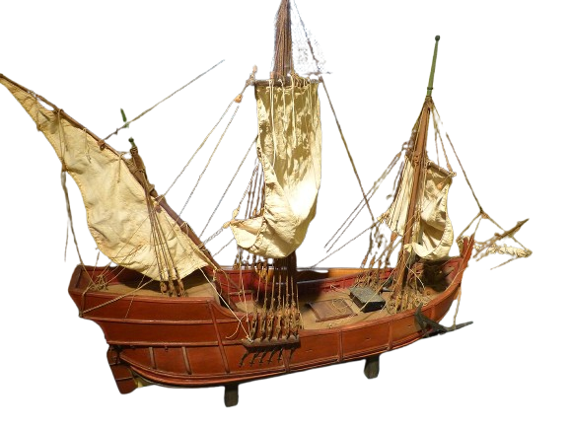
Choose one image below from Texas history and type your name in the first box below it.
https://education.texashistory.unt.edu
Name
Name
Slides:
Slides:
Name
Name
Slides:
Slides:
Notes:
Highsmith, Carol M, photographer. Wall art at the Tigua Indian Cultural Center at the Ysleta del Sur Pueblo, which celebrates more than 300 years of tribal history in El Paso, Texas. El Paso United States Texas, 2014. -02-14. Photograph. https://www.loc.gov/item/2014630705/.
Highsmith, Carol M, photographer. A portion of the Presidio Nuestra Senora de Loreto de la Bahia, known more commonly as Presidio La Bahia, or simply La Bahia, a fort constructed by the Spanish Army that became the nucleus of the city of Goliad, Texas. United States Texas Goliad, 2014. -04-05. Photograph. https://www.loc.gov/item/2014633490/.
Tatu (dasypus novemcinctus), Uruguay, 2020. This file is licensed under the Creative Commons Attribution 4.0 International license. Background of image removed for use in this presentation. https://commons.wikimedia.org/wiki/File:Tatu_(dasypus_novemcinctus),_Uruguay,_2020.jpg
Las Palmas Casa de Colon - Museum Modell Pinta. Photograph by Wolfgang Sauber. This file is licensed under the Creative Commons Attribution-Share Alike 4.0 International license. https://commons.wikimedia.org/wiki/File:Las_Palmas_Casa_de_Colon_-_Museum_Modell_Pinta.jpg

Slide 4
Student Group Presentation Slideshow Instructions 2
Step 2: The Reading
As a group, read the passage that goes with your assigned mission.
The passage is NOT included in these slides
Each person can take turns reading one sentence or one paragraph at a time.
https://education.texashistory.unt.edu

Slide 5
Student Group Presentation Slideshow Instructions 3
Step 3: Completing Your Slides
Look at your assigned slides (refer to your slide #3)
The directions for your slide are to the left of your slide.
Follow the directions to complete your slide.
You will present your information to the class. Review your information so you are comfortable with your part of the presentation.
https://education.texashistory.unt.edu

Slide 6
Grading Rubric
The grade is based on individual work. There is no group grade.
Grades are earned according to the following criteria:
Component | Description | Points
Information | The information in your presentation should be accurate, informative, and as detailed as possible. | 5
Material Presentation | Each person in the group should have slides that are neat and organized. | 5
Oral Presentation | Each person who presents should speak loudly, slowly, and clearly for their portion of the presentation. | 5
Engagement | When other students are presenting, you are listening closely, taking notes, and completing your work for each mission being presented. | 5
https://education.texashistory.unt.edu

Slide 7
Your group presentation begins on the next slides. Follow the directions on your assigned slides to complete your portion of the presentation.
https://education.texashistory.unt.edu

Slide 8
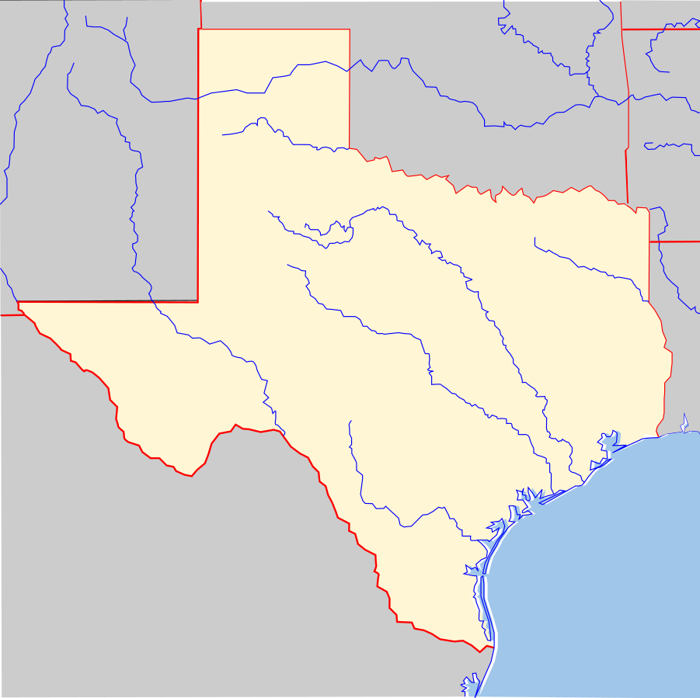
Name of Mission
Directions:
Date Founded: What year was this mission established? Write the year below “Date Founded.”
Map: Place a marker on the map in the approximate location of your mission. You can use the little black circle below these directions. Drag and drop the circle to the location.
Specific Goal: What was the primary goal or goals of this mission? Consider Spain’s reasons for establishing this mission.
Date Founded:
Specific Goal of this mission:
https://education.texashistory.unt.edu

Slide 9
Images
Directions:
Locate, copy, and paste at least 3 images related to your group’s mission.
Include a caption below each image stating what the image is. Make sure to type the full name of the mission and “Texas” in your google search.
Ideas for types of images you can include:
Maps or layouts of the buildings or the grounds
Photos, paintings, or other images of buildings or rooms.
People connected to the mission.
Images related to the mission and what it was known for.
Insert image here.
You may delete this box if necessary.
Insert image here.
You may delete this box if necessary.
Insert image here.
You may delete this box if necessary.
Caption explaining the image
Caption explaining the image
Caption explaining the image
https://education.texashistory.unt.edu

Slide 10
People at the mission (1)
Directions:
Texas Indians: In the blue box, replace the writing with the name of the tribe or tribes that were associated with this mission.
Find an accurate image of the tribe or tribes related to the mission, OR something related to the tribe or tribes.
Your image can relate to the people, their culture, shelter, clothing, food, or region of Texas, for example.
Texas Indians
Insert an image related to the tribe or tribes associated with your mission.
The Spanish founded this mission to convert, assimilate, and minister to the:
Name of Texas Indian tribe or tribes

Slide 11
People at the mission (2)
Directions:
Chart:
Name of Person: Type the name of the significant person in one square on the chart.
If you need to add an accent to any vowels you can copy the vowel you need here: á é í ó ú
What are they known for? Write what they are known for. Example: “He founded the mission” or “He was a soldier at the presidio.”
Note: There are 3 rows for names. If you do not need all three rows, you can delete a row by highlighting the entire row and clicking “Backspace.”
Spaniards
Name of Person | What are they known for?

Slide 12
Challenges at the mission
Directions:
Boxes:
In your own words, write a summary of each challenge that occurred at your mission.
If there are not 6 challenges at your mission, delete the additional boxes that you don’t need.
You must write at least 3 challenges that faced your mission.
Write your summary UNDER the title in each box. In other words, do not erase “Challenge #1” before you write in the box.
Challenge #1:
Challenge #2:
Challenge #3:
Challenge #4:
Challenge #5:
Challenge #6:

Slide 13
achievements of the mission
Directions:
Problem Boxes:
In your own words, write a brief summary of each achievement that occurred at your mission.
If there are not 6 achievements at your mission, delete the additional boxes that you don’t need.
Not every mission had achievements that are discussed in the readings. If you mission had no listed achievements, delete every box. You can copy / paste an image of a sad face for emphasis and humor.
Achievement #1:
Achievement #2:
Achievement #3:
Achievement #4:
Achievement #5:
Achievement #6:

Slide 14
Interesting Facts
Directions:
Interesting Facts: Write an interesting fact in each box on the slide.
If you do not see three interesting facts in your reading passage, you may conduct a google search to identify more interesting facts. Be sure to use a legitimate source of information like:
Texas State Historical Association
National Park Service
Home | Texas Historical Commission
Texas Beyond History
Interesting Fact #1:
Interesting Fact #2:
Interesting Fact #3:

Slide 15

Outcome
Directions:
Outcome parchment: Write what the outcome or result at your mission was.
Delete the writing on the parchment and replace it with your summary of the outcome.
Write the outcome of what happened to your mission here.
https://education.texashistory.unt.edu

Slide 16
Last Step:
When you are finished, you will delete slides 1, 2, 4 – 7, and 16.
You need to keep slide 3 showing the group member assignments, and the presentation slides: 8 – 15.
https://education.texashistory.unt.edu

