Slide 1
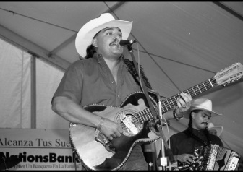
Unit 3:
Spanish Colonial Era
Lesson 8:
Texas Today
Notes:
Informedia. [Juan P. Moreno and his Tejano Band], photograph, [1997-07-31..1997-08-03]; (https://texashistory.unt.edu/ark:/67531/metapth301962/: accessed November 12, 2024), University of North Texas Libraries, The Portal to Texas History, https://texashistory.unt.edu; crediting UT San Antonio Libraries Special Collections.

Slide 2





Warm-up
Follow the directions below to complete your warm-up
Consider all the things you know that are popular or common in Texas Today.
Complete your chart based on the items you have thought about.
Share your responses with a partner.
https://education.texashistory.unt.edu

Slide 3
Share with the class: day 1
One thing I listed that is popular or common in Texas today is ______
This might be connected to the Spanish Colonial Era because _______
https://education.texashistory.unt.edu

Slide 4
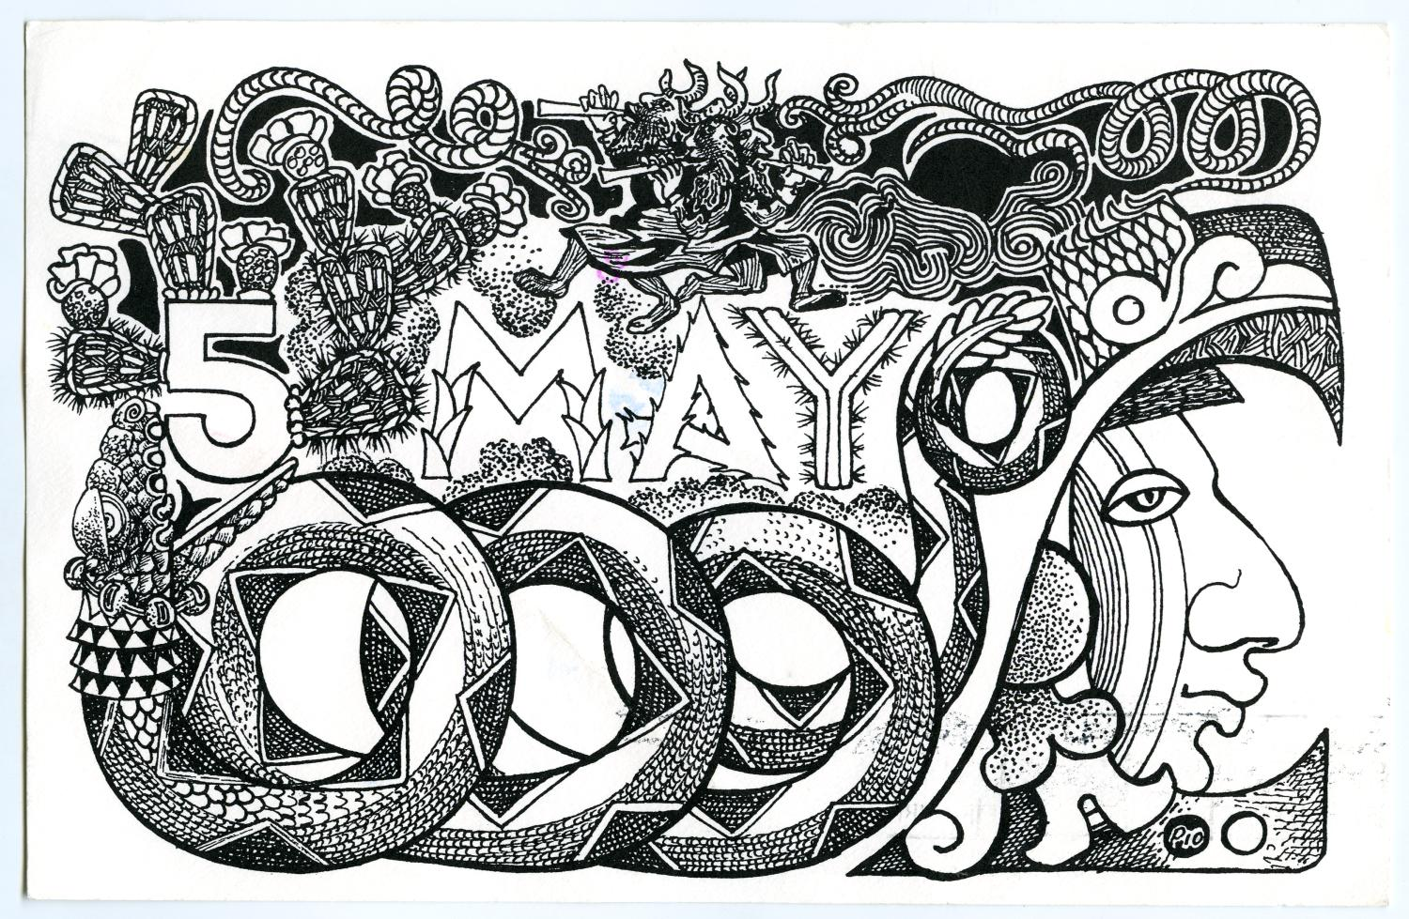
Essential Question
In what ways can we see evidence of the Spanish Colonial Era in our lives in Texas today?
https://education.texashistory.unt.edu

Slide 5
In Today’s Lesson
We will examine eight elements of modern Texas culture that originated during the Spanish Colonial Era.
I will use flashcards to study these elements. I will complete a chart describing each element and its relation to the Spanish Colonial Era. I will answer questions assessing my prior knowledge about the elements.
https://education.texashistory.unt.edu

Slide 6
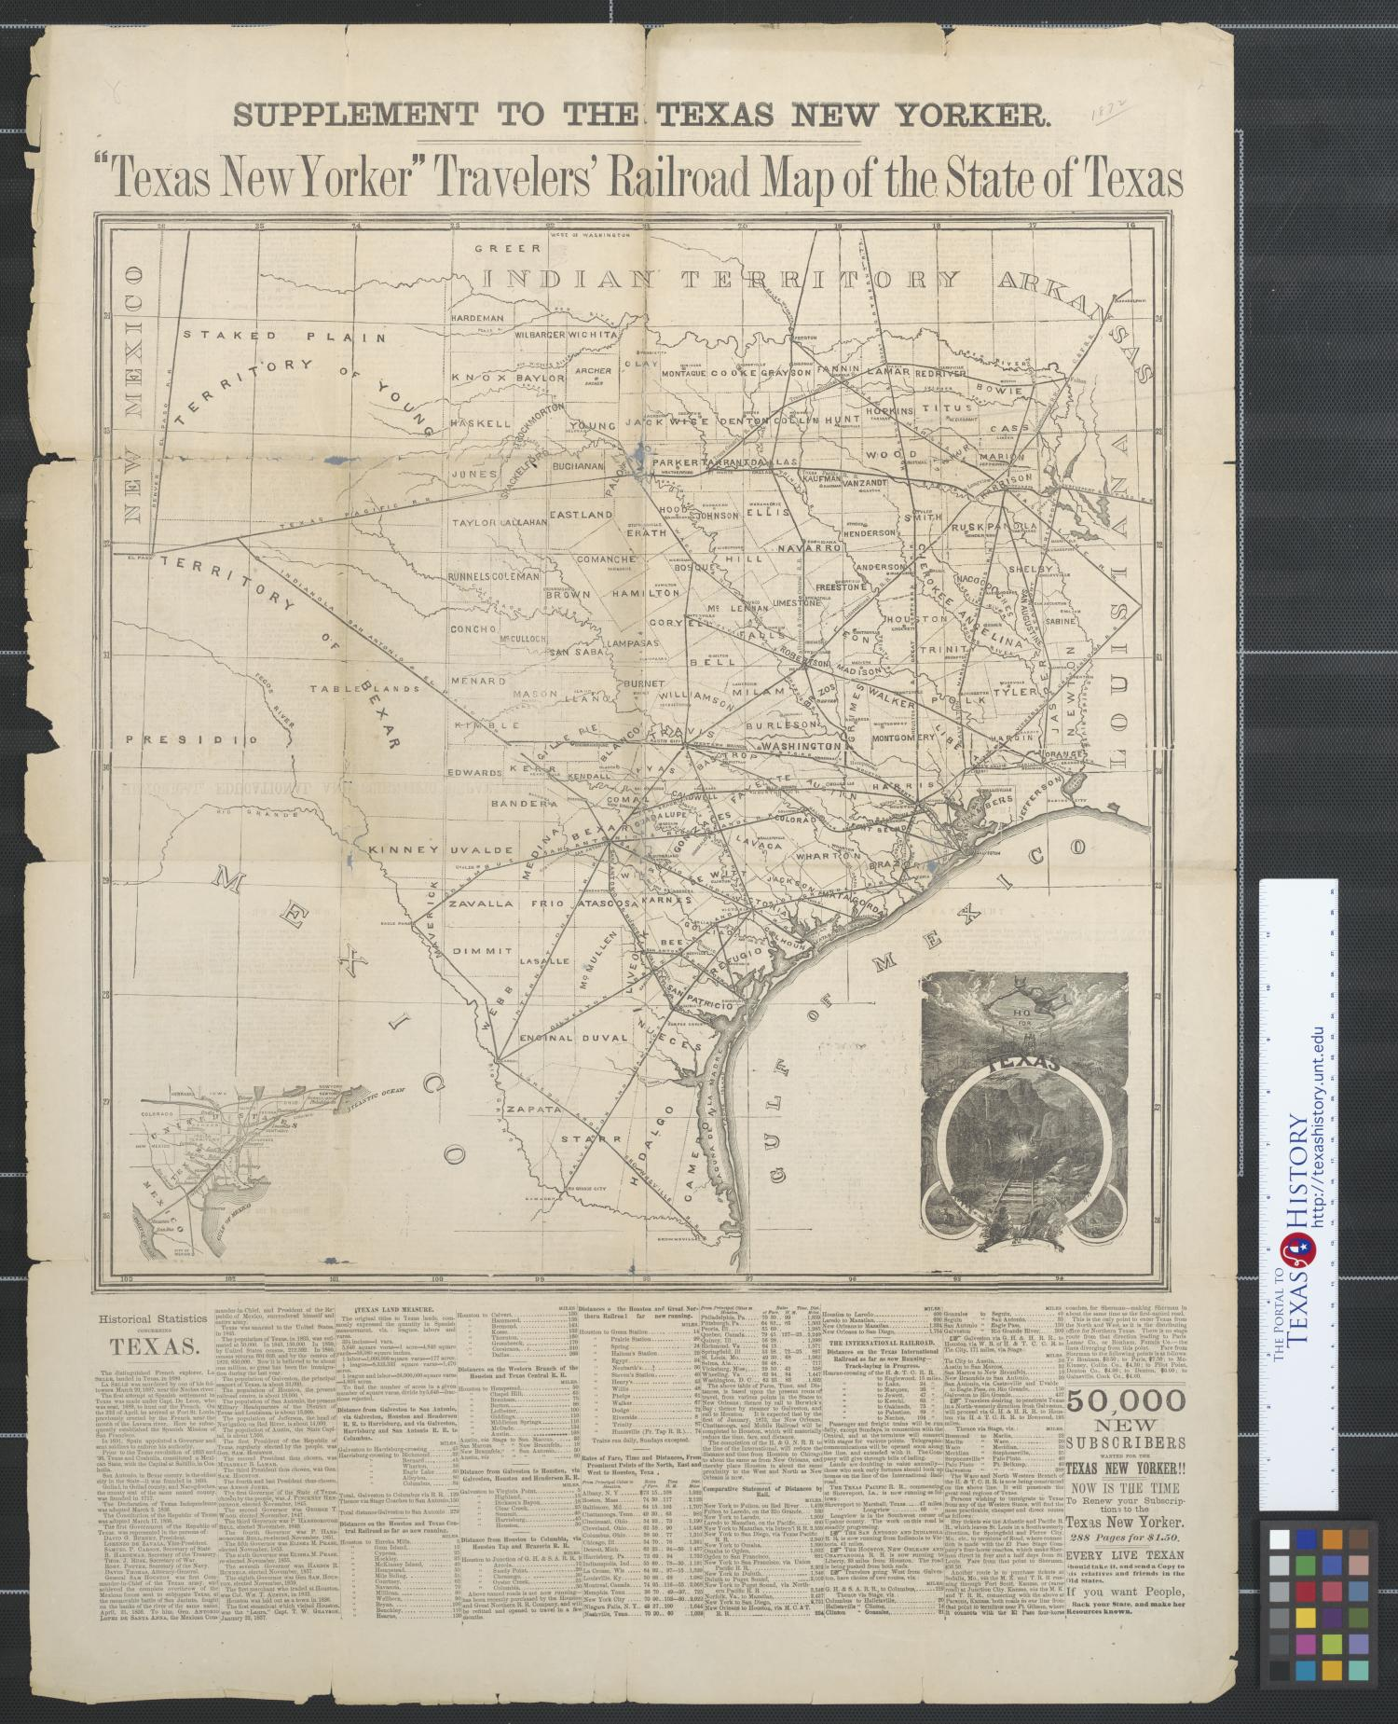
Spanish and Indigenous Influence in Texas Culture Today
Directions: There are eight flashcards that accompany this lesson. Each flashcard presents something that demonstrates an element of Spanish or Indigenous culture from the Spanish Colonial Era that still influences Texas today.
https://education.texashistory.unt.edu

Slide 7
Spanish and Indigenous Influence in Texas Culture Today 2
Use the flashcards available to investigate and report on information for this assignment. Record your information in the chart on your assignment.
https://education.texashistory.unt.edu

Slide 8
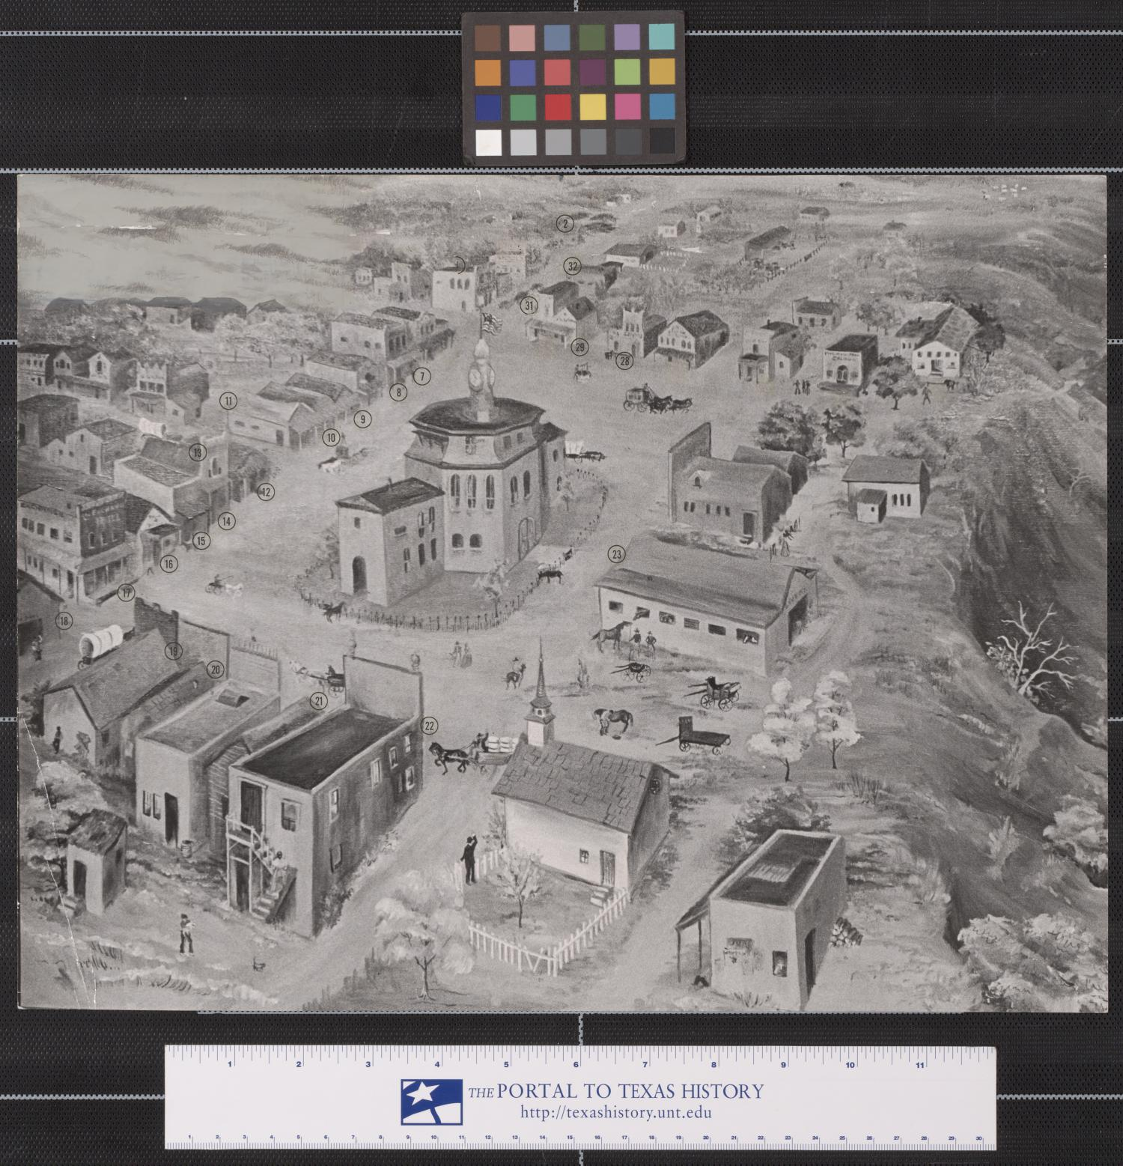
Share your responses
Question 1:
I was already familiar with _______
I already knew that ______
Something new I learned is _____
https://education.texashistory.unt.edu

Slide 9
Share your responses
Question 2:
I was not familiar with _______
https://education.texashistory.unt.edu

Slide 10
Share your responses
Question 3:
I was surprised by ________________ because __________
https://education.texashistory.unt.edu

Slide 11
Share your responses
Question 4:
One question I have is __________
https://education.texashistory.unt.edu

Slide 12
Exit Ticket
Follow the directions below to complete your exit ticket.
Use the word bank to fill in the blanks in the reading on your exit ticket.
Share your responses with a partner.
https://education.texashistory.unt.edu

Slide 13
Share with the class:11
There are a number of ways in which we can see evidence of Spanish influence from the Spanish Colonial Era in Texas today. One example of this is in the popularity of traditional Mexican and Indigenous foods like ___________, which are a thin, flat food made from corn or flour.
https://education.texashistory.unt.edu

Slide 14
Share with the class: 2 1
Another example is evident in a type of music called ___________, which blends Mexican, Spanish, German, and Czech styles of music.
https://education.texashistory.unt.edu

Slide 15
Share with the class: 3 1
__________ are another example of Spanish and Mexican culture in Texas today. These events include common vaquero and conquistador practices of roping, riding horses, and branding cattle.
https://education.texashistory.unt.edu

Slide 16
Share with the class: 4
A final example of Spanish Colonial influence in Texas today is that 30% of Texans today practice the __________ religion, which first came to Texas with the Spanish Mission Presidio System. In conclusion, evidence of Spanish influence from the Spanish Colonial Era exists in many aspects of life in Texas Today.
https://education.texashistory.unt.edu

