Slide 1
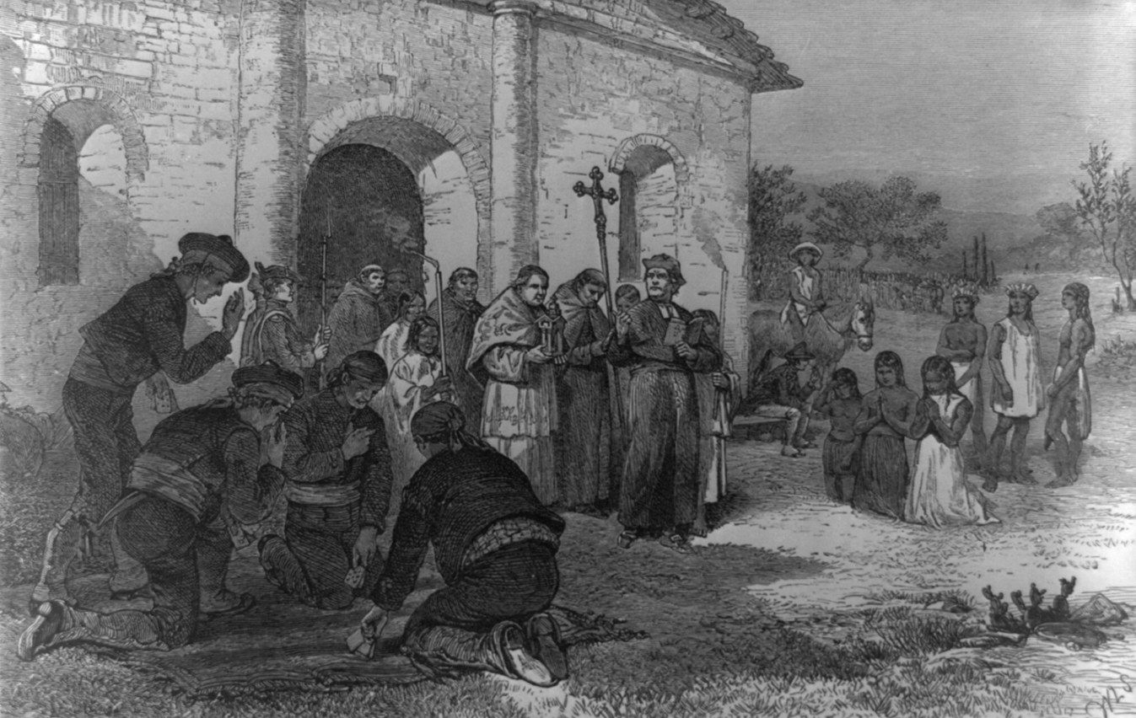
Unit 3:
The Spanish Colonial Era
Lesson 1:
The Big Picture
Notes:
“[Spanish Mission of the Alamo].” Library of Congress, January 1, 1970. https://www.loc.gov/pictures/item/2021630685/.

Slide 2





Warm-up:
Follow the directions below to complete your warm-up
Read each scenario on the left.
Imagine how you would respond.
Record your response on the right.
Discuss your responses with a partner.
https://education.texashistory.unt.edu

Slide 3
Share with the class: 1day 1
When the Spanish men arrive, I would probably __________
When they offer to trade, I would probably_______
When they start building shelters, I would probably __________
When they ask me to move into their shelters, I would probably_______
https://education.texashistory.unt.edu

Slide 4
Essential Question
What are the defining characteristics and significant events of the Spanish Colonial Era?
https://education.texashistory.unt.edu

Slide 5
In Today’s Lesson
We will identify key people, events, concepts, and major defining characteristics of Unit 3, the Spanish Colonial Era
I will read a passage about the unit, determine the meaning of new vocabulary in context, and answer comprehension questions about each paragraph and the main idea.
https://education.texashistory.unt.edu

Slide 6
Part I: Analyze an Image
Look at the image on your worksheet, or enlarged here, to answer the questions.
https://education.texashistory.unt.edu
Notes:
“[Spanish Mission of the Alamo].” Library of Congress, January 1, 1970. https://www.loc.gov/pictures/item/2021630685/.

Slide 7
Part II: Essential Ideas Reading Passage
After you read each paragraph, answer the question or questions presented on the following slides.
https://education.texashistory.unt.edu

Slide 8
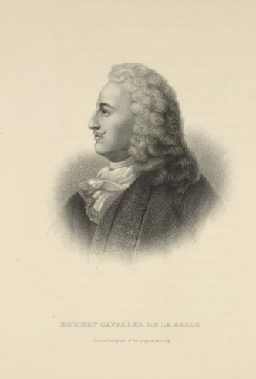


Essential Ideas Reading Paragraph 1
What caused Spain to turn its attention away from Texas?
What caused Spain to turn its attention back to Texas?
Robert Cavalier de La Salle.
New York Public Library
https://education.texashistory.unt.edu
Notes:
The Miriam and Ira D. Wallach Division of Art, Prints and Photographs: Print Collection, The New York Public Library. "Robert Cavalier de La Salle." New York Public Library Digital Collections. Accessed July 1, 2024. https://digitalcollections.nypl.org/items/2ad9f290-c606-012f-d1cb-58d385a7bc34.

Slide 9
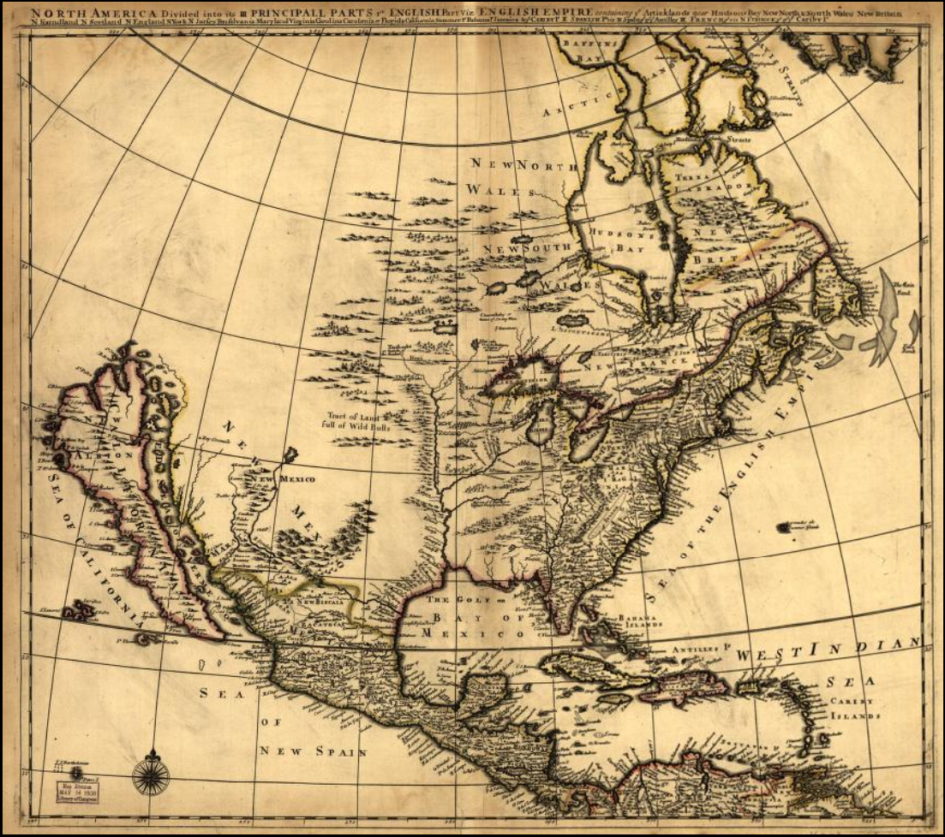
Essential Ideas Reading Paragraph 2
In what way was Texas still valuable to Spain? Explain
Map of North America, 1685
Library of Congress
https://education.texashistory.unt.edu
Notes:
Lea, Philip, Active. North America divided into its III principall sic parts. [S.l, 1685] Map. https://www.loc.gov/item/99446209/.

Slide 10
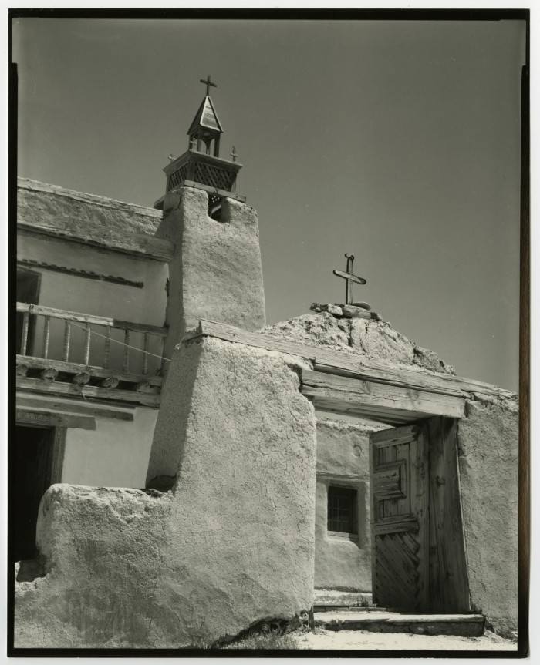
Essential Ideas Reading Paragraph 3
How did Spain plan to strengthen its claim to Texas?
What two goals did Spain have for this plan?
A Spanish mission in Texas
The Portal to Texas History
University of North Texas
https://education.texashistory.unt.edu
Notes:
Williams, Byrd M. (Byrd Moore), IV, 1951-. [Photograph of a Spanish mission], photograph, [1980,1990]; (https://texashistory.unt.edu/ark:/67531/metadc851535/: accessed September 27, 2024), University of North Texas Libraries, The Portal to Texas History, https://texashistory.unt.edu; crediting UNT Libraries Special Collections.

Slide 11
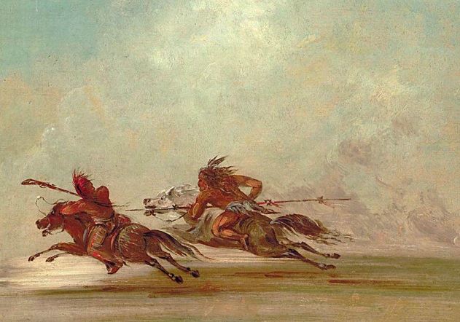
Essential Ideas Reading Paragraph 4
Explain one challenge facing Spain during the Spanish Colonial Era.
“War on the Plains” by George Catlin
Wikimedia Commons
https://education.texashistory.unt.edu
Notes:
English: "War on the Plains," by George Catlin, 1834. A Comanche Lancer and an Osage warrior do battle on the plains.
Date1834Sourcehttps://www.reddit.com/r/BattlePaintings/comments/ezf5z3/war_on_the_plains_george_catlin_1834_a_comanche/AuthorGeorge Catlin (1796–1872)
This work is in the public domain in its country of origin and other countries and areas where the copyright term is the author's life plus 70 years or fewer.
You must also include a United States public domain tag to indicate why this work is in the public domain in the United States. Note that a few countries have copyright terms longer than 70 years: Mexico has 100 years, Jamaica has 95 years, Colombia has 80 years, and Guatemala and Samoa have 75 years. This image may not be in the public domain in these countries, which moreover do not implement the rule of the shorter term. Honduras has a general copyright term of 75 years, but it does implement the rule of the shorter term. Copyright may extend on works created by French who died for France in World War II (more information), Russians who served in the Eastern Front of World War II (known as the Great Patriotic War in Russia) and posthumously rehabilitated victims of Soviet repressions (more information).

Slide 12

Part III: Vocabulary in Context
Match the terms from the reading with their best definition within the context of the reading on the previous page.
Reread portions of the reading passage to help complete this part of the work.
https://education.texashistory.unt.edu

Slide 13

Part IV: Comprehension Questions
Use the reading passage to answer the questions about the main ideas of this unit.
https://education.texashistory.unt.edu

Slide 14
Part IV: Comprehension Questions
Share with the class
Spain claimed to solidify its claim to Texas by ___________.
One goal for this plan was _____
A second goal for this plan was __________
https://education.texashistory.unt.edu

Slide 15
Part IV: Comprehension Questions
Share with the class 2
One struggle Spain faced during the Spanish Colonial Era was ___________.
https://education.texashistory.unt.edu

Slide 16
Exit Ticket
Read each “Cause” statement on the left and each “Effect” statement on the right.
Match each “Effect” statement with its correct “Cause” statement.
Discuss your answers with a partner.
https://education.texashistory.unt.edu

Slide 17
Share with the class 2
(Read the “Cause” statement”)
This caused
(Read the “Effect” statement)
You may need to add or adjust some words to make your response complete.
https://education.texashistory.unt.edu

