Slide 1
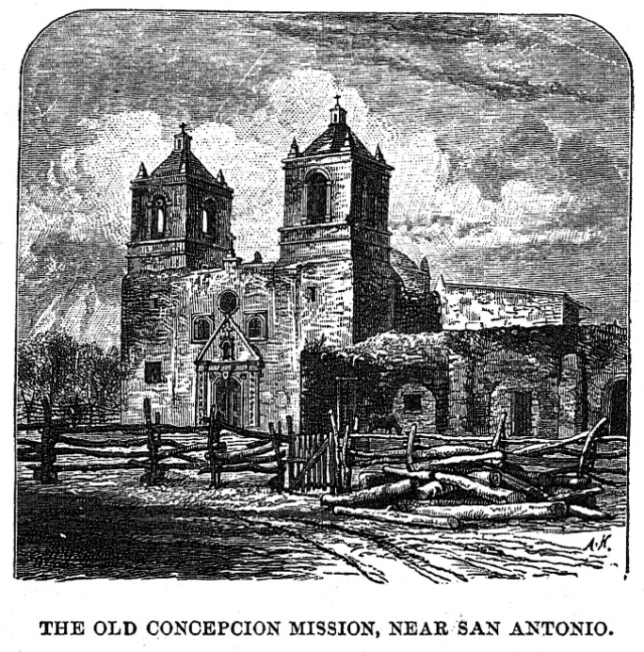
Unit 3:
The Spanish Colonial Era
Lesson 5:
The Mission Presidio System
Notes:
Thrall, Homer S., 1819-1894. A Pictorial History of Texas, From the Earliest Visits of European Adventurers, to A.D. 1879., book, 1879; St. Louis, Missouri. (https://texashistory.unt.edu/ark:/67531/metapth5828/: accessed October 16, 2024), University of North Texas Libraries, The Portal to Texas History, https://texashistory.unt.edu;

Slide 2
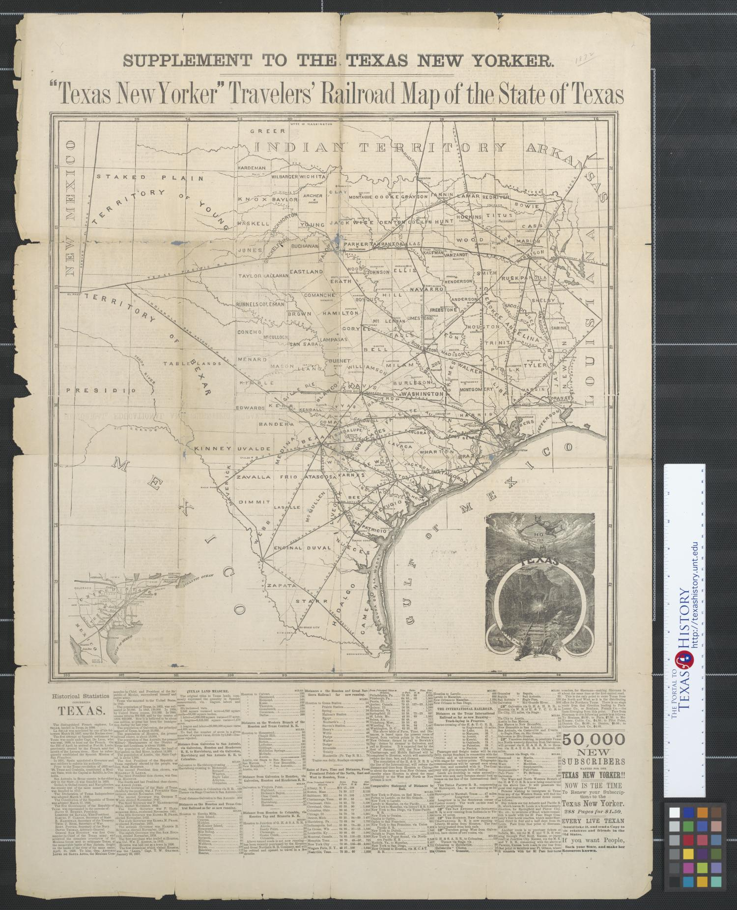



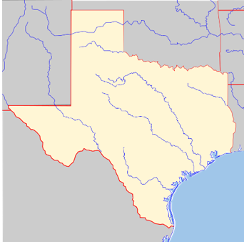



Warm-up
Follow the directions below to complete your warm-up
Read and consider the scenario.
Where would you establish the first Spanish mission in Texas?
Circle the location on your map and explain your answer.
Share your response with a partner.
https://education.texashistory.unt.edu
Notes:
Blank Map of Texas. Wikimedia Commons. https://commons.wikimedia.org/wiki/File:Texas_blank_map.svg

Slide 3
Share with the class: day 1
Use cardinal directions to share your chosen location with the class (North, South, East, West, Northwest, etc.)
I suggest Spain build its first mission in _______
I chose this location because _______
https://education.texashistory.unt.edu

Slide 4
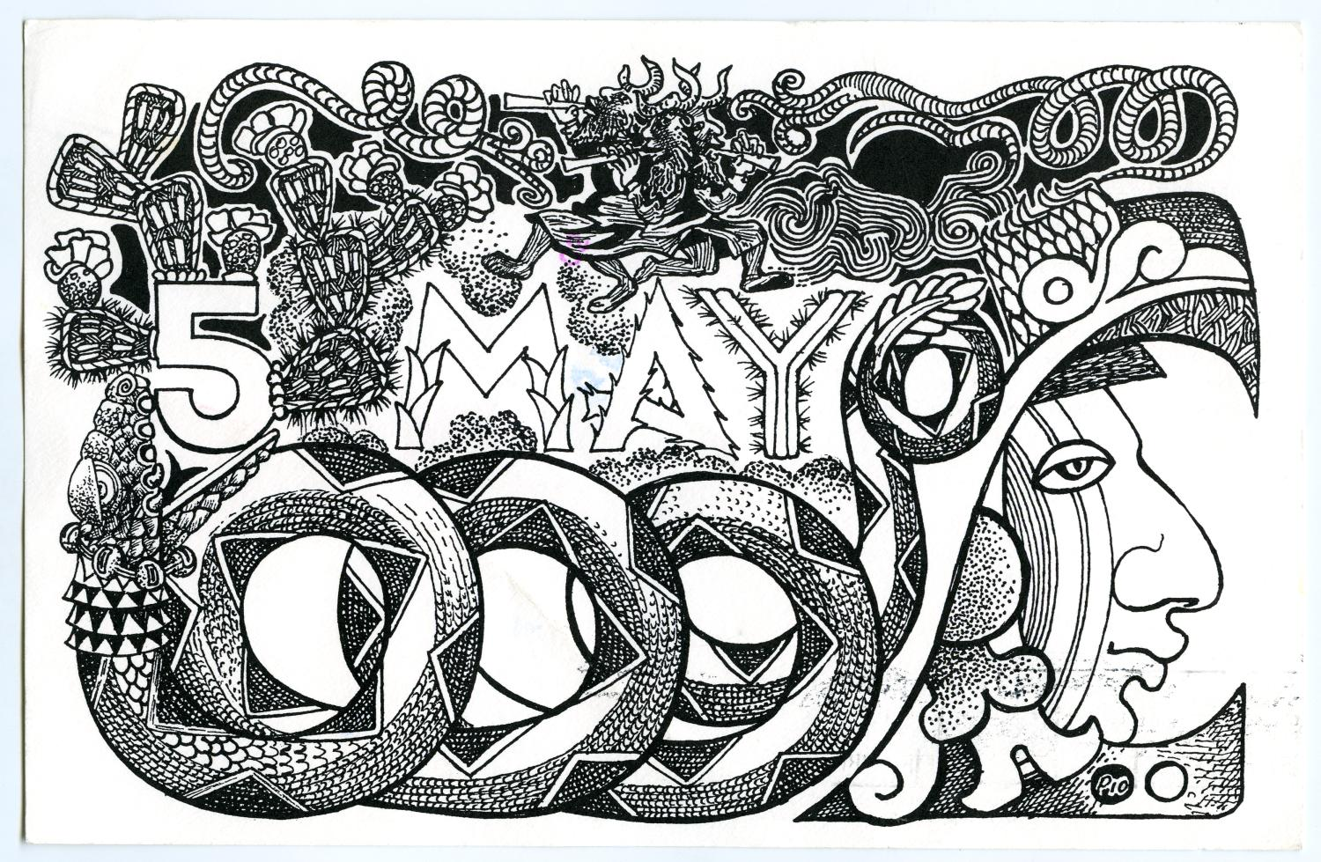
Essential Questions
What was the Mission Presidio System? What were Spain’s goals for the system in Texas? What happened with the first missions in Texas?
https://education.texashistory.unt.edu

Slide 5
In Today’s Lesson
We will examine the beginning of the Mission Presidio System in Texas.
I will read three short passages, identify and record the key information, the significance of each reading, and answer a comprehension question for each passage.
https://education.texashistory.unt.edu

Slide 6
The Mission Presidio System
Lesson
https://education.texashistory.unt.edu

Slide 7
The Mission Presidio System
Key Information
Religious settlements to convert Indians and military forts to protect the land from the French.
What do I need to write?
In the 1500s, Spain began establishing missions in Central Mexico to convert and assimilate American Indians into the Spanish religion and culture. Spain established presidios to protect those missions, and more importantly, to protect the resources around them, like silver mines.
In 1690, Spain expanded the Mission Presidio System into Texas to strengthen its claim to the land, keep the French out of the region, and convert Texas Indians to Catholicism. The Texas missions struggled for nearly 100 years until Spain finally began ending the mission system in Texas in 1794.
Significance
The Mission System failed to give Spain a strong presence in Texas.
Essential Question
What is one reason for the mission system’s failure in Texas?
https://education.texashistory.unt.edu

Slide 8
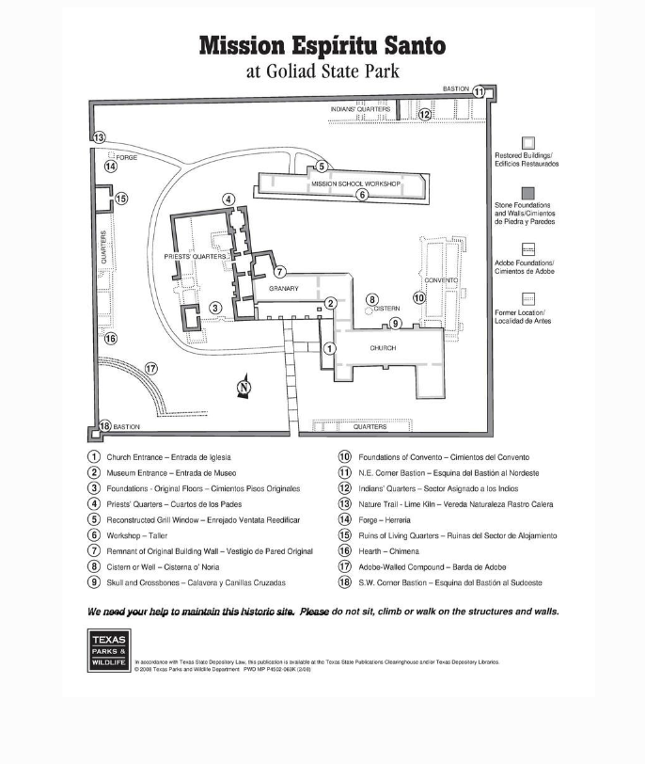
A Spanish Mission
One thing I notice about this mission is ____
One question I have about this mission is ___
The Portal to Texas History
https://education.texashistory.unt.edu
Notes:
Texas Parks and Wildlife Department. Mission Espiritu Santo at Goliad State Park. February 2008. The Portal to Texas History. https://texashistory.unt.edu/ark:/67531/metapth624182/.

Slide 9
East Texas Missions
Key Information
Spain established the first missions in East Texas to prevent the French from entering the region.
What do I need to write?
The French began establishing settlements east of Texas in Louisiana during the late 1600s and early 1700s. In order to prevent the French from moving into east Texas, the Spanish decided to establish a mission there in 1690 among the powerful and wealthy Caddo Confederacy. The mission was called San Francisco de los Tejas. It was founded for the Tejas Indians – a tribe within the Caddo Confederacy.
The Caddo were interested in trade with the Spanish. They were not interested in living in the missions or adopting the Spanish way of life. When disease spread through the missions killing many Caddo people, the Caddo forced the missionaries to abandon the East Texas missions and leave the area in 1693.
Significance
The Caddo drove out the Spanish because of disease and lack of interest.
Essential Question
Who had more power in the region – the Caddo or the Spanish? Explain your answer.
https://education.texashistory.unt.edu

Slide 10
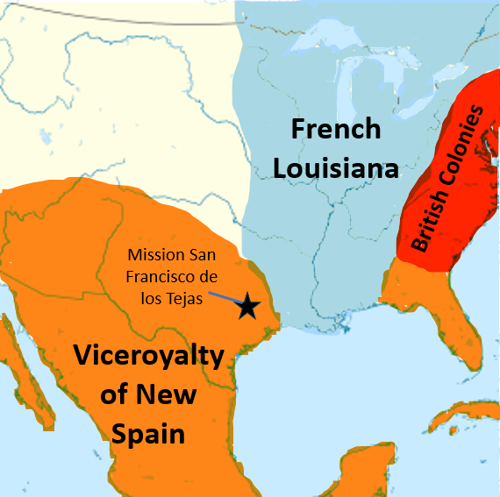
The First East Texas Mission:
San Francisco de los Tejas
One thing I notice about this map is ____
One question I have about this map is ___
https://education.texashistory.unt.edu
Notes:
Location Map of North America. Cropped to show the desired area and edited to show the location of European exploration and colonization during the Spanish Colonial Era. This file is licensed under the Creative Commons Attribution-Share Alike 3.0 Unported license. https://commons.wikimedia.org/wiki/File:North_America_laea_location_map.svg

Slide 11
San Antonio
Key Information
Spain founded San Antonio in 1718 as a midpoint on the route to east Texas.
What do I need to write?
Spain continued establishing missions in east Texas, despite their initial lack of success. The Spanish government really wanted to prevent the French from taking over that region.
Spain’s attempts to settle east Texas presented a new problem: east Texas was incredibly far from the more populated areas of Mexico. Moving people and supplies from central Mexico to east Texas was a long and difficult task. Travelers needed a place to rest halfway through the journey.
In 1718, Spain founded San Antonio as a midpoint on the route to the east Texas missions. The route became known as “El Camino Real” or the Royal Road.
Significance
San Antonio will go on to become an important city in Texas history.
Essential Question
Do you think Spain will establish missions in San Antonio too? Why or why not?
https://education.texashistory.unt.edu

Slide 12
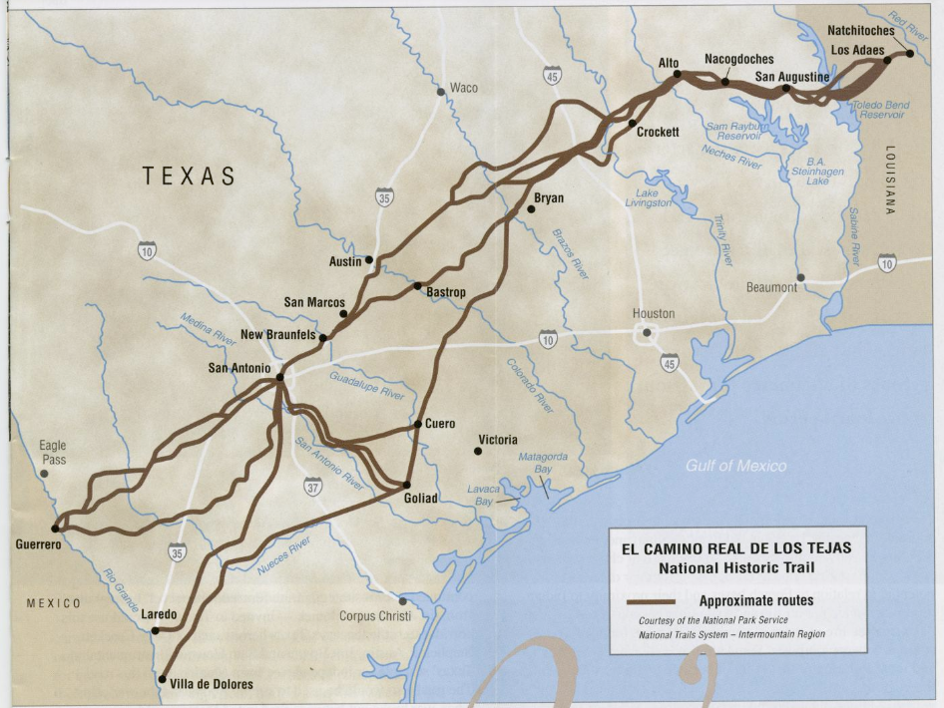
San Antonio
& El Camino Real
One thing I notice about this map is ____
One question I have about this map is ___
https://education.texashistory.unt.edu
Notes:
Texas. Department of Transportation. El Camino Real de los Tejas: National Historic Trail, pamphlet, 200X; Austin, TX. (https://texashistory.unt.edu/ark:/67531/metapth661997/: accessed October 25, 2024), University of North Texas Libraries, The Portal to Texas History, https://texashistory.unt.edu; crediting UNT Libraries Government Documents Department.

Slide 13
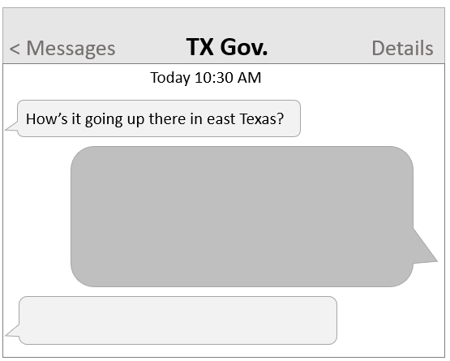
Exit ticket
Follow the directions below to complete your exit ticket.
Read the scenario and follow the instructions to complete the text message conversation.
How would you respond to the Spanish governor of Texas?
Share your response with a partner.
https://education.texashistory.unt.edu

Slide 14
Share with the class: 2 day 1
My response to the governor would be, “____”
His response would probably be, “________”
https://education.texashistory.unt.edu

