Slide 1
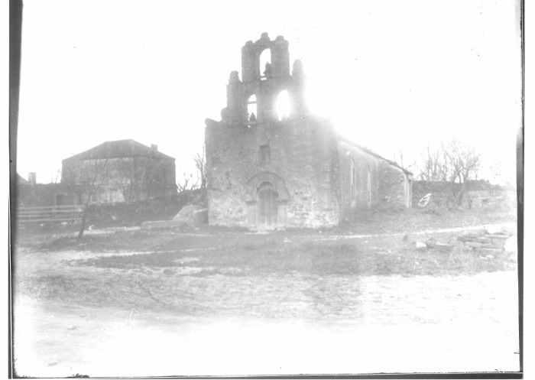
Unit 3:
The Spanish Colonial Era
Lesson 3 :
Vocabulary
Notes:
Raba, Ernst Wilhelm, 1874-1951. [Mission Espada], photograph, Date Unknown; (https://texashistory.unt.edu/ark:/67531/metapth459964/: accessed October 3, 2024), University of North Texas Libraries, The Portal to Texas History, https://texashistory.unt.edu; crediting San Antonio Conservation Society.

Slide 2




Warm-up:
Follow the directions to complete your warm-up
Write what you know about this unit so far - anything you can remember
Write what terms or phrases you think we are likely to see in this unit.
Share your responses with a partner.
https://education.texashistory.unt.edu

Slide 3
Share with the class
One thing I know about the Spanish Colonial Era so far is _______
One term or phrase we might see in this unit is _______
https://education.texashistory.unt.edu

Slide 4
Essential Question
What key terms do we need to know in order to be successful in this unit?
https://education.texashistory.unt.edu

Slide 5
In today’s lesson…
We will identify, define, and exemplify the key terms of Unit 3: The Spanish Colonial Era.
I will use the information and context of several short passages to identify and record the definition of each term and provide examples of the term in the context of our unit.
https://education.texashistory.unt.edu

Slide 6
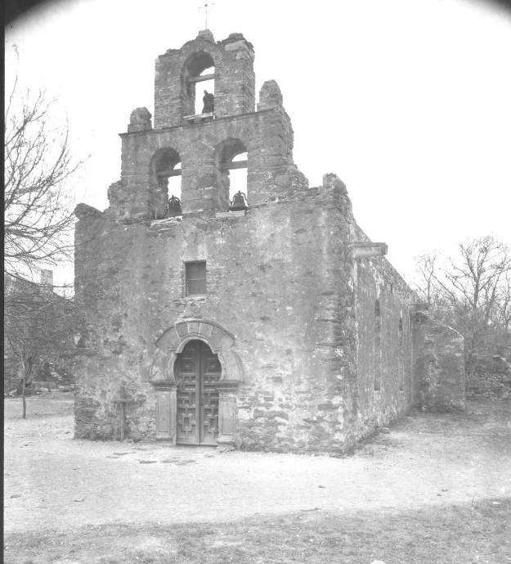
Mission (n)
In the 1690s, Spain decided to colonize Texas as part of its plan to keep the French out of the region. One way Spain attempted to accomplish this was by establishing missions throughout the region. The Spanish missions were religious settlements run by Catholic religious leaders called friars, or frays.
The missions had two goals. First, Spain hoped that having more people and settlements in Texas would prevent the French from moving into the area. Second, Spain hoped the missions could teach the Texas Indians the Spanish culture and way of life. Spain wanted the Indians to give up their Indigenous way of life and become Spanish subjects.
Mission Espada in San Antonio
The Portal to Texas History
University of North Texas
https://education.texashistory.unt.edu
Notes:
Raba, Ernst Wilhelm, 1874-1951. [Mission Espada], photograph, Date Unknown; (https://texashistory.unt.edu/ark:/67531/metapth460164/: accessed October 4, 2024), University of North Texas Libraries, The Portal to Texas History, https://texashistory.unt.edu; crediting San Antonio Conservation Society.

Slide 7
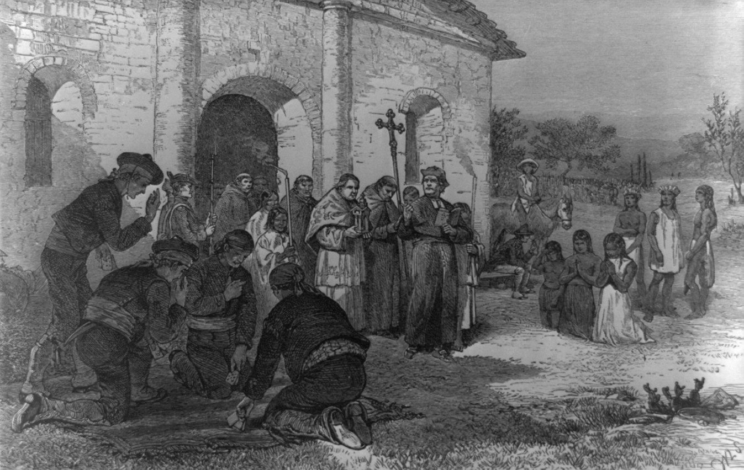
Assimilate (v)
One of the goals Spain had for its Texas missions was to assimilate Texas Indians into Spanish culture. Spain wanted the Texas Indians to give up their own culture and way of life so that they could fully adopt the Spanish culture instead.
Spain believed that assimilation would transform the Texas Indians into people who would willingly follow the rules of New Spain and, as a result, have less conflict with Spanish settlers in Texas.
The Texas Indians, however, were not interested in assimilating into Spanish culture. For centuries, they had developed their own traditions, languages, beliefs, and way of life. Texas Indians weren’t interested in giving all of that up to live in a completely different way according to Spanish expectations.
The Spanish Mission at the Alamo
Library of Congress
https://education.texashistory.unt.edu
Notes:
“[Spanish Mission of the Alamo].” Library of Congress, January 1, 1970. https://www.loc.gov/pictures/item/2021630685/.

Slide 8
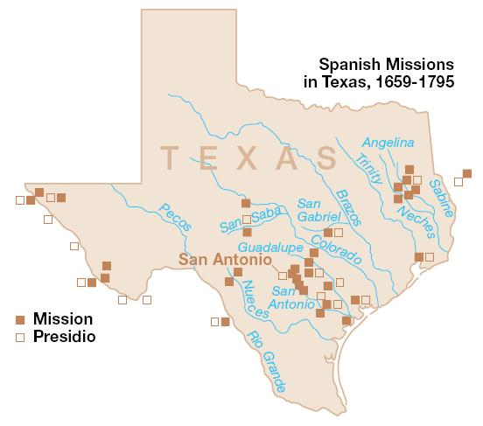
Presidio (n)
When the Spanish decided to colonize Texas, they established religious settlements known as missions hoping to teach the Texas Indians the Spanish way of life. In addition to the missions, they also established presidios. A presidio was a military fort where soldiers lived and worked.
The presidios were founded near the missions in Texas. Presidios like San Antonio de Bexar were established to protect missions like San Antonio de Valero. Additionally, they were intended to protect Texas from any potential French threat.
Spain hoped the Mission/Presidio System would solidify its claim to Texas, prevent the French from expanding into its northern frontier, and protect its colonies and resources around Mexico City.
https://education.texashistory.unt.edu
Notes:
Spanish Missions in Texas. This image or media file contains material based on a work of a National Park Service employee, created as part of that person's official duties. As a work of the U.S. federal government, such work is in the public domain in the United States. See the NPS website and NPS copyright policy for more information. https://commons.wikimedia.org/wiki/File:Spanish_Missions_in_Texas.JPG

Slide 9
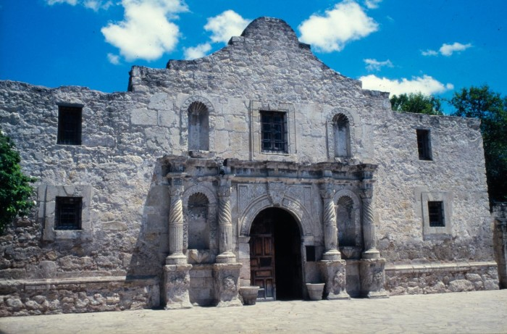
Founded (v)
The Spanish founded the first missions in East Texas in 1690. That might sound like a grammar error, but it’s not. To found means to establish. So, the Spanish founded, or established, the first missions in east Texas in 1690 primarily to prevent French expansion into east Texas.
East Texas was a very long way from the majority of New Spain’s population and resources in and around Mexico City. Traveling by land from Mexico City to the east Texas missions was a long and difficult journey. To address this problem, Spain founded San Antonio in 1718 as a halfway point between the missions in east Texas and the rest of New Spain.
One mission that was founded in San Antonio was called Mission San Antonio de Valero. Today, this mission is better known as “The Alamo.”
Mission San Antonio de Valero
Founded in 1718 in San Antonio
The Portal to Texas History
The University of North Texas
https://education.texashistory.unt.edu
Notes:
WBAP-TV (Television station : Fort Worth, Tex.). [The Alamo], photograph, 197X; (https://texashistory.unt.edu/ark:/67531/metadc1612428/: accessed October 4, 2024), University of North Texas Libraries, The Portal to Texas History, https://texashistory.unt.edu; crediting UNT Libraries Special Collections.

Slide 10
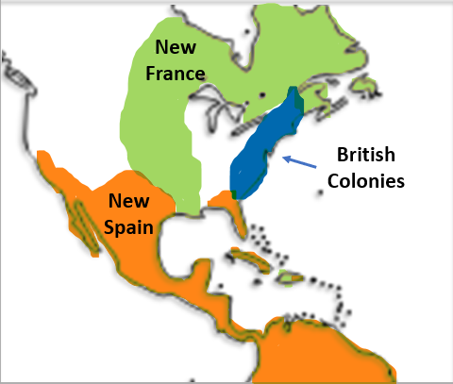
Buffer Zone (n)
In the 1600s, Spain had become incredibly wealthy primarily by mining silver around Mexico City. Spain established hundreds of silver mines throughout the region which produced more silver than all the other mines operating in the rest of the world at the time! The Spanish made great efforts to protect these incredibly profitable mines.
While Texas had no gold or silver, it was still valuable to Spain in another way. Texas provided a buffer zone, or a large, safe distance, between Spain’s silver mines in Mexico and the other European powers in North America.
The French had been exploring and colonizing to the northeast of New Spain along the Mississippi River for years. With their rivals coming closer and closer, the Spanish felt that their resources in Mexico were better protected with Texas serving as their buffer zone.
https://education.texashistory.unt.edu

Slide 11
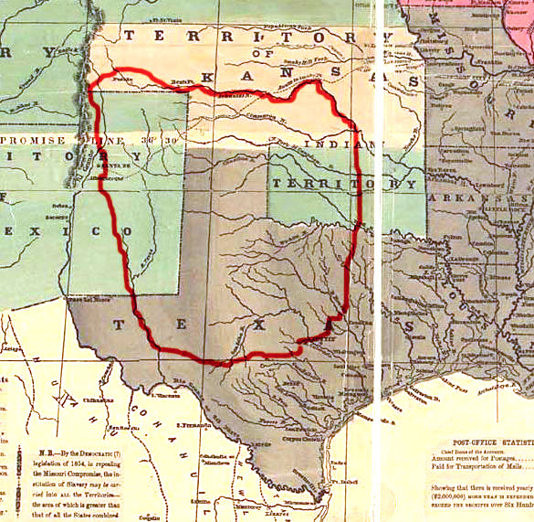
Raid (v)
When the Spanish began establishing missions and presidios in Texas, some Texas Indian tribes periodically attacked these Spanish settlements with the goal of capturing valuable resources like horses and weapons. These types of attacks were called raids.
One tribe that was particularly successful at carrying out raids on Spanish missions and presidios was the Comanche. The Comanche had originally been part of the Shoshone tribe in areas around modern-day Wyoming. Then, in the early 1500s a group of Shoshone separated from the larger tribe and eventually migrated into Texas by the 1700s. This group came to be known as the Comanche.
The Comanche were fierce warriors on horseback and very quickly began to dominate the Great Plains of Texas. The Spanish often referred to the region they controlled as Comancheria, or Comanche Land.
A map of the approximate area known as Comancheria.
https://education.texashistory.unt.edu
Notes:
Comancheria Map. Map showing approximately the area, known as Comancheria, occupied by the various Comanche tribes prior to 1850. It's made using "Reynolds's Political Map of the United States" (1856) from Library of Congress collection (public domain). I, the copyright holder of this work, release this work into the public domain. This applies worldwide.
In some countries this may not be legally possible; if so:
I grant anyone the right to use this work for any purpose, without any conditions, unless such conditions are required by law.
https://commons.wikimedia.org/wiki/File:Comancheria.jpg

Slide 12
Caste System (n)
One of the many challenges facing people in New Spain during the Spanish Colonial Era was Spain’s social Caste System in the Americas. A Caste System is a system that places people in different categories based on factors of birth like race or ethnicity. These categories are then ranked from highest to lowest. People in the top category have more privileges, power, and opportunities than those in lower categories.
In New Spain, the people at the top were those who had been born in Spain. They had the most power and opportunity in New Spain. Below them were Spaniards who were born in the Americas. And below American-born Spaniards were people of mixed race. At the very bottom of the caste system was enslaved people and American Indians.
Those at the bottom of the caste system had very few rights and little power or opportunity. Life for them was very difficult. Over time, anger and frustration built among the people at the bottom, leading New Spain closer and closer toward war.
Peninsulares: Spaniards born in Spain
Creoles: Spaniards born in America
Mestizos & Mulattos: People of mixed race
American Indians and Enslaved People
https://education.texashistory.unt.edu

Slide 13


Exit Ticket:
Follow the directions to complete your warm-up
Consider the terms listed in the chart.
Which terms do you think best connect with the major themes and ideas of this unit.
Share your responses with a partner.
https://education.texashistory.unt.edu

Slide 14
Share with the class 2
One term that I think is connected to this unit is ____________.
This term connects to the unit because ____________
https://education.texashistory.unt.edu

