Slide 1
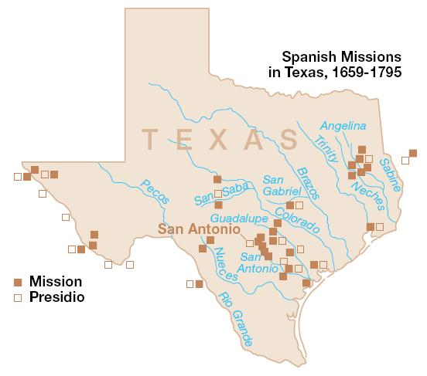
Unit 3 :
Spanish Colonial Era
Lesson 4:
What’s the Story?
Notes:
Spanish Missions in Texas. The map depicts the Spanish missions and presidios that were established within the boundaries of present day Texas in the 18th and 19th centuries. This is a product of the US National Park Service, and was taken from the website: http://www.nps.gov/archive/saan/maps/SAANmap4.pdf This image or media file contains material based on a work of a National Park Service employee, created as part of that person's official duties. As a work of the U.S. federal government, such work is in the public domain in the United States. See the NPS website and NPS copyright policy for more information

Slide 2

What’s the Story?
Warm-up
https://education.texashistory.unt.edu

Slide 3





Warm-up:
Follow the directions to complete your warm-up
Read each event that we will see in this unit.
Make your best educated guess:
  What might have caused the event?
  What might be the effect?
Discuss with a partner
https://education.texashistory.unt.edu

Slide 4
Share with the class
Choose one event to share. Read that event to the class, then use the sentence stems below to share your response
One thing that might have caused this is __________
One possible effect of this might be __________
https://education.texashistory.unt.edu

Slide 5
Essential Question
What are the defining characteristics and most significant events of the Spanish Colonial Era?
https://education.texashistory.unt.edu

Slide 6
In today’s lesson…
We will examine the events that take place during the Spanish Colonial Era and identify their significance to Texas history.
I will read short passages about each event and identify key information and explain why the event is significant.
https://education.texashistory.unt.edu

Slide 7

What’s the Story?
Lesson
https://education.texashistory.unt.edu

Slide 8
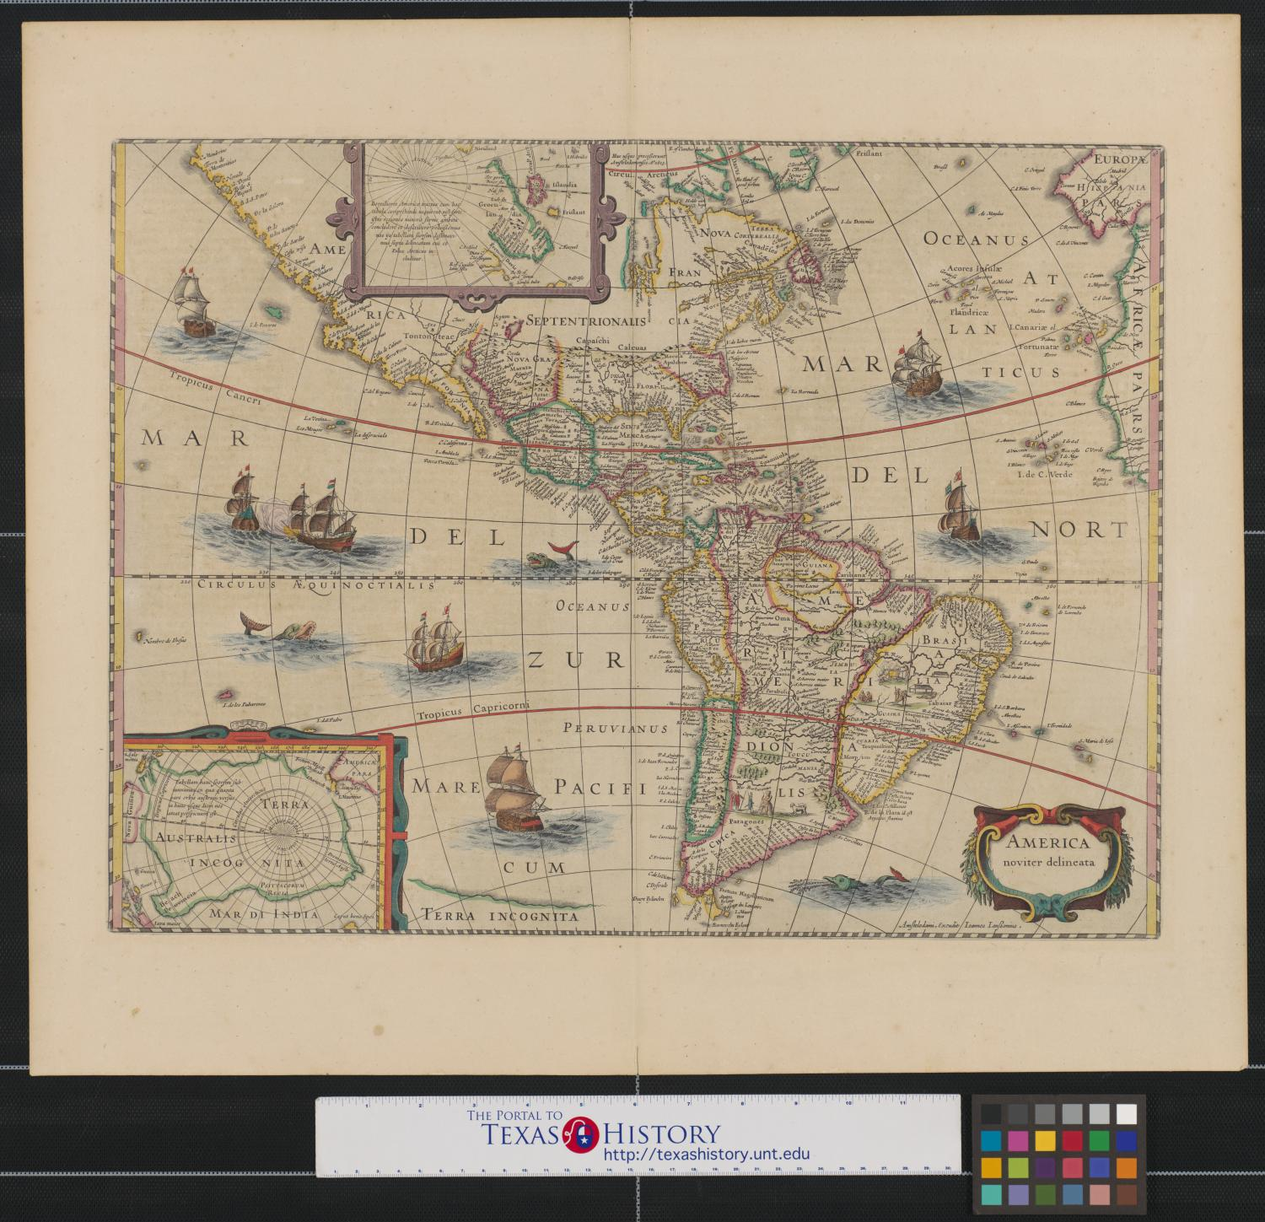
Directions for the Lesson
Read each short passage for information about an event or events from the Spanish Colonial Era.
Record information about each reading in the correct place on your timeline assignment.
Read the specific, step-by-step directions for Part I on your paper.
https://education.texashistory.unt.edu

Slide 9

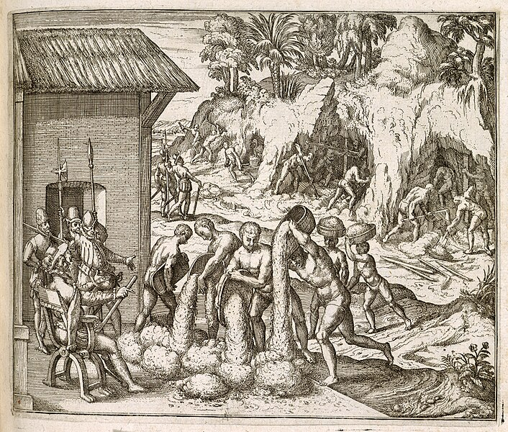
Breaking Down Each Reading
Title & Date
1)The Mission Presidio System Grade Level
After Robert La Salle arrived in 1685, Spain wanted to take steps to protect Texas from more French people coming into region. But what could Spain do? Approximately 100 years earlier, the Spanish had established missions and presidios near their silver mines in central Mexico. Soldiers at the presidios protected the mines and trade routes, while friars at the missions attempted to assimilate American Indians in Mexico into Spanish culture. As Spain turned its attention to Texas, the Spanish government decided to expand the Mission Presidio System into its northern frontier. The Spanish hoped that the Mission Presidio System would protect Texas from any possible French threat in the future.
How does the picture help us understand the reading?
Pay attention to people, places, events, and cause and effect relationships
What important information is in the caption?
Figure 1 Slaves from Guinea digging for gold and silver in mines, for the Spanish colonists in Hispaniola. Engraving by Theodor de Bry from Girolamo Benzoni's Americae pars quinta.
What are the most important events?
Why are they significant?
https://education.texashistory.unt.edu

Slide 10
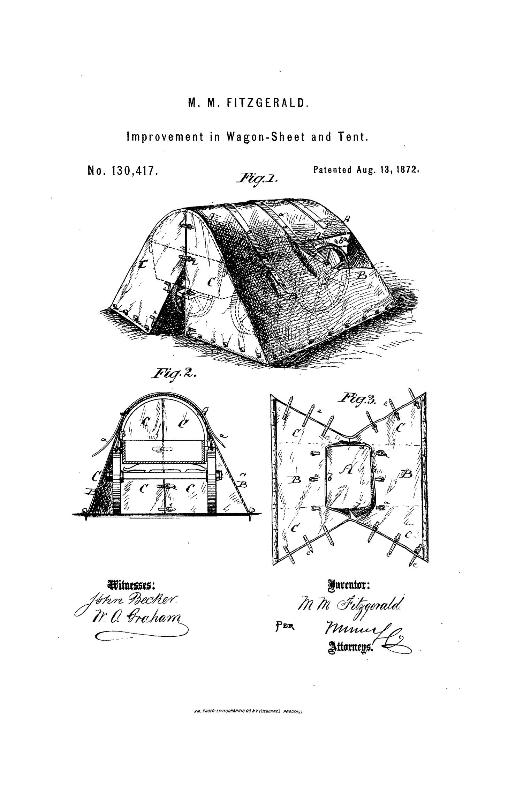
Read & Record Your Notes
Read the passage.
Record the title, date, the most important events, and the significance:
  Why is this important in history?
  How did it change things for the better or worse?
  What was the effect of this event?
  Tip: Determine the significance of each passage, then determine which key events support that significance.
https://education.texashistory.unt.edu

Slide 11
Share one topic with the Class
The title of this topic is ________
It occurred in ________.
(or) This event was ongoing.
The most significant events of this topic are ___________
This topic is significant to the Spanish Colonial Era because ____
https://education.texashistory.unt.edu

Slide 12
1) The Mission Presidio System
Slaves from Guinea digging for gold and silver in mines, for the Spanish colonists in Hispaniola.
Theodor de Bry from Girolamo Benzoni's Americae pars quinta. The British Library
https://education.texashistory.unt.edu
Notes:
Slaves from Guinea digging for gold and silver in mines, for the Spanish colonists in Hispaniola. Engraving by Theodor de Bry from Girolamo Benzoni's Americae pars quinta. Johann Theodore De Bry. 1595. Originally published/produced in Frankfurt, 1595 (1617 ?) Held and digitized by the British Library, and uploaded to Flickr Commons https://commons.wikimedia.org/wiki/File:Slaves_from_Guinea_digging_for_gold_and_silver_in_mines_in_Hispaniola_-_America_(1595),_A2_-_BL.jpg

Slide 13
2) The Mission Presidio System in Texas
Spanish Missions in Texas
The U.S. National Parks Service
https://education.texashistory.unt.edu
Notes:
Spanish Missions in Texas. The map depicts the Spanish missions and presidios that were established within the boundaries of present day Texas in the 18th and 19th centuries. This is a product of the US National Park Service, and was taken from the website: http://www.nps.gov/archive/saan/maps/SAANmap4.pdf This image or media file contains material based on a work of a National Park Service employee, created as part of that person's official duties. As a work of the U.S. federal government, such work is in the public domain in the United States. See the NPS website and NPS copyright policy for more information

Slide 14
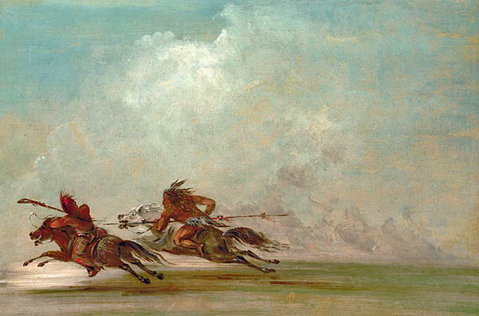
3) The Apache and Comanche in Texas
War on the Plains
George Catlin, 1834
https://education.texashistory.unt.edu
Notes:
War on the Plains. George Catlin. 1834. This work is in the public domain in its country of origin and other countries and areas where the copyright term is the author's life plus 70 years or fewer. https://commons.wikimedia.org/wiki/File:Comanche_Osage_fight.jpg

Slide 15
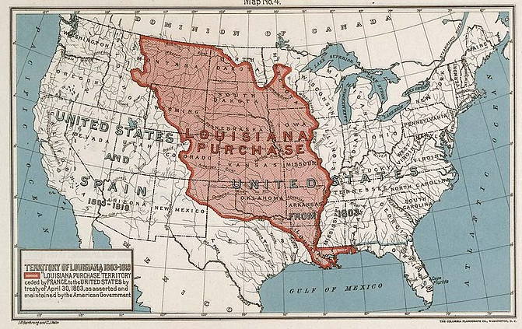
4) The Louisiana Purchase 1803
Map of the Louisiana Purchase Territory.
The National Archives and Records Administration
https://education.texashistory.unt.edu
Notes:
Map of the Louisiana Purchase Territory. Department of the Interior. General Land Office. 1849-7/16/1946. This media is available in the holdings of the National Archives and Records Administration, cataloged under the National Archives Identifier (NAID) 594889 This image is a work of a Bureau of Land Management* employee, taken or made as part of that person's official duties. As a work of the U.S. federal government, the image is in the public domain in the United States. https://commons.wikimedia.org/wiki/File:Map_of_the_Louisiana_Purchase_Territory_-_NARA_-_594889.jpg

Slide 16
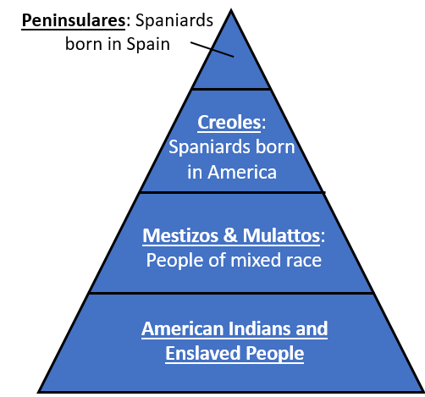
5) The War for Mexican Independence 1810 - 1821
The Caste System of New Spain
https://education.texashistory.unt.edu
Notes:
The Caste System of New Spain. Created by Texas History for Teachers, the Portal to Texas History, The University of North Texas.

Slide 17
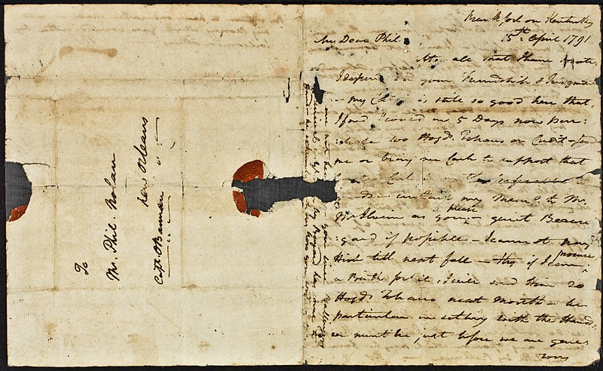
6) The Filibusters in Texas
Communication between filibusters: A letter from James Wilkinson to Philip Nolan, 1791. The Newberry Collection
https://education.texashistory.unt.edu
Notes:
James Wilkinson letter to Philip Nolan, 1791. Everett D. Graff Collection of Western Americana . The Newberry makes its collections available for any lawful purpose, commercial or non-commercial, without licensing or permission fees to the library, subject to the following terms and conditions: https://www.newberry.org/rights-and-reproductions This work is in the public domain in its country of origin and other countries and areas where the copyright term is the author's life plus 100 years or fewer. https://commons.wikimedia.org/wiki/File:James_Wilkinson_letter_to_Philip_Nolan,_1791_(NBY_18237).jpg

Slide 18
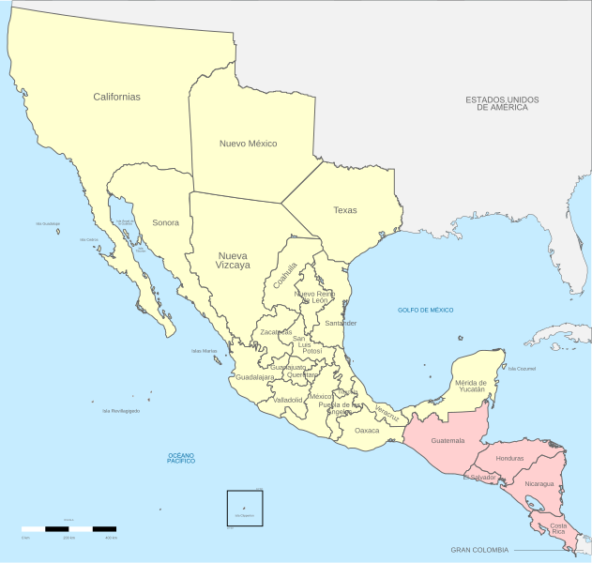
7) A New Country: The United Mexican States
Political Divisions of 1821 Mexico
Instituto Nacional de Estadistica y Geografía
https://education.texashistory.unt.edu

Slide 19
What’s the Story?
Exit Ticket
https://education.texashistory.unt.edu

Slide 20
Exit Ticket:
Follow the directions to complete your warm-up
Read the comprehension question
Choose the best answer
Discuss with a partner
https://education.texashistory.unt.edu

Slide 21
Share with the class 2
Read the answer choice that provides the best summary of the defining characteristics of the Spanish Colonial Era.
https://education.texashistory.unt.edu

