Slide 1
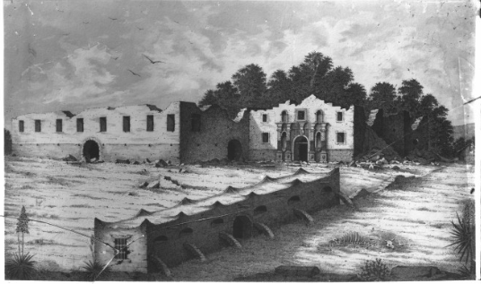
Unit 5: The Texas Revolution
EXTENSION Lesson:
The Alamo
Notes:
Raba, Ernst Wilhelm, 1874-1951. [The Alamo illustration], photograph, Date Unknown; (https://texashistory.unt.edu/ark:/67531/metapth459953/: accessed February 18, 2025), University of North Texas Libraries, The Portal to Texas History, https://texashistory.unt.edu; crediting San Antonio Conservation Society.

Slide 2
Warm-up: Follow the directions to complete your warm-up
Imagine you are in the Alamo during the siege.
Complete the prompts in the graphic organizer from the point of view of someone inside the Alamo.
Share with a partner.

Slide 3
Share with the class
“I’m not sure what day it is, I think it’s March 2, 1836, and I’m here at the Alamo. This experience has been really difficult! I want to write down what has been going on and my thoughts about it all, so here goes: ______”

Slide 4
Essential Questions
What were the key events in chronological order of the Siege and Battle of the Alamo?
What might the experience have been like for the people inside the Alamo?

Slide 5
In today’s lesson…
We will examine a timeline of the events of the Siege and Battle of the Alamo from the point of view of the people inside the Alamo.
I will identify key locations of the events on a map of the Alamo compound and create a written or visual representation of the chronological events of the Alamo.

Slide 6
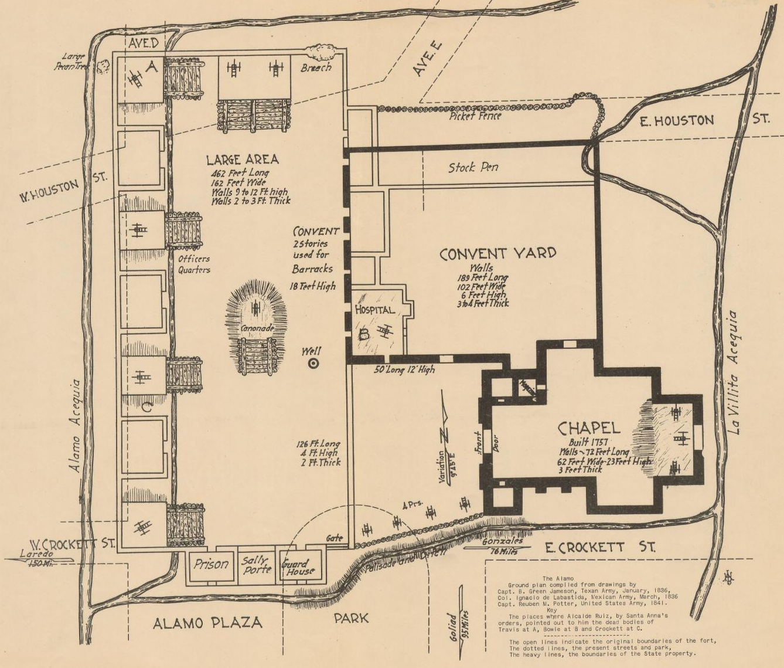
Part I: The Timeline of the Alamo
The timeline of the events of the Alamo gives a day-by-day account of what the people inside the Alamo experienced, according to the historical record.
A Map of the Alamo
Star of the Republic Museum, The Portal to Texas History
Notes:
"The Alamo", map, Date Unknown; (https://texashistory.unt.edu/ark:/67531/metapth30285/: accessed March 21, 2025), University of North Texas Libraries, The Portal to Texas History, https://texashistory.unt.edu; crediting Star of the Republic Museum.

Slide 7
Part I: The Timeline of the Alamo 2
Read the directions on your worksheet under “Part 1: Map of the Alamo.”
A Map of the Alamo
Star of the Republic Museum, The Portal to Texas History
Notes:
"The Alamo", map, Date Unknown; (https://texashistory.unt.edu/ark:/67531/metapth30285/: accessed March 21, 2025), University of North Texas Libraries, The Portal to Texas History, https://texashistory.unt.edu; crediting Star of the Republic Museum.

Slide 8
Part II: The Events of the Alamo
Directions: You will choose ONE activity to demonstrate the events of the Alamo from the perspective of the defenders or civilians inside the Alamo. Use the “Timeline of the Alamo” to guide your work.
Option 1: Create a storyboard
Option 2: Create a collection of journal entries

Slide 9
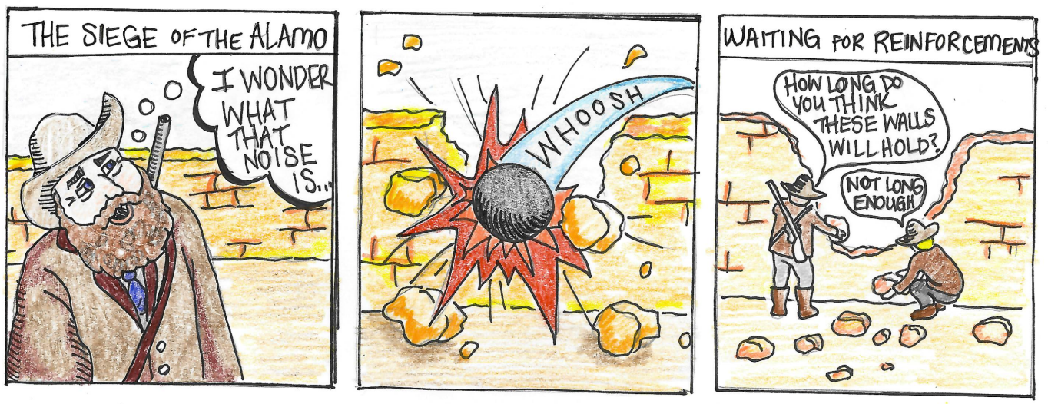
Option 1: Create a Storyboard
Read the explanation of the Storyboard Activity on the second page of your worksheet.
Notes:
Storyboard Example of the Siege of the Alamo. Illustrated by Courtney Abubakar. Texas History for Teachers. The University of North Texas.

Slide 10
Option 2: Create a Collection of Journal Entries
Read the explanation of the Journal Activity on the second page of your worksheet.
March 1, 1836
We had a mighty surprise late this evening when we thought we were under attack . . . Turns out, it was reinforcements from Gonzales!! Not nearly enough, but it’s a start. I have to believe more will come!

Slide 11
Exit Ticket: Follow the directions to complete your exit ticket
Read the excerpt of an article about the Alamo from a Texas newspaper in 1836.
Consider: Is the information mostly fact or opinion? Write your response
Share with a partner.

Slide 12
Share with the class 2
The information in the article is primarily fact / opinion.
Evidence from the article that supports my claim is _______

