Slide 1
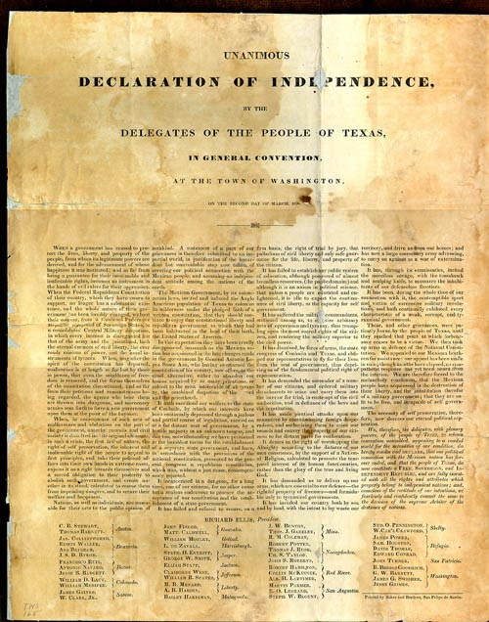
Unit 5: The Texas Revolution
Extension Lesson:
The Texas Declaration of Independence
Notes:
Declaration of Independence of Texas, 1836. Texas State Library and Archives Commission. Declaration of Independence of Texas, 1836 | Texas State Library

Slide 2




Warm-up Follow the directions to complete your warm-up
Imagine you are a delegate at the Constitutional Convention of 1836, and you are writing the Declaration of Independence.
What topics should you include? Choose any and all that you think appropriate.
Discuss with a partner

Slide 3

Share with the class
If I were helping to write the Texas Declaration of Independence, one topic I would want to include is _____

Slide 4

Essential Questions
What were the primary topics and major themes of the Texas Declaration of Independence? What are the similarities and differences between this document and the U.S. Declaration of Independence?

Slide 5

In today’s lesson…
We will analyze excerpts from the Texas Declaration of Independence and compare them to the U.S. Declaration of Independence.
I will analyze and compare excerpts from each document, answer comprehension questions, and complete a matching activity, matching excerpts of grievances with their modern translation.

Slide 6
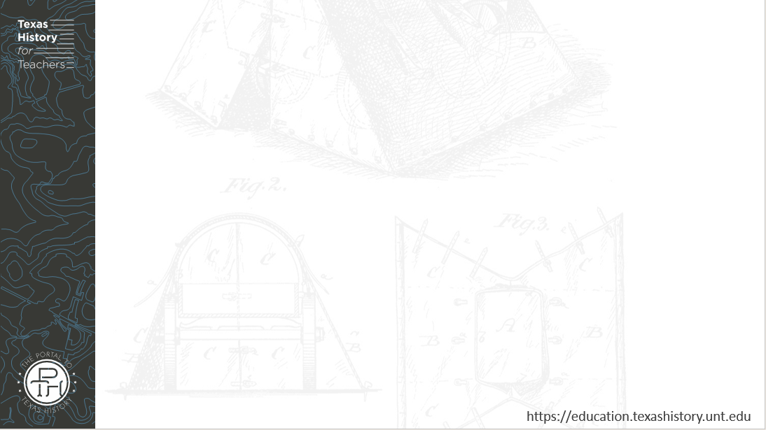
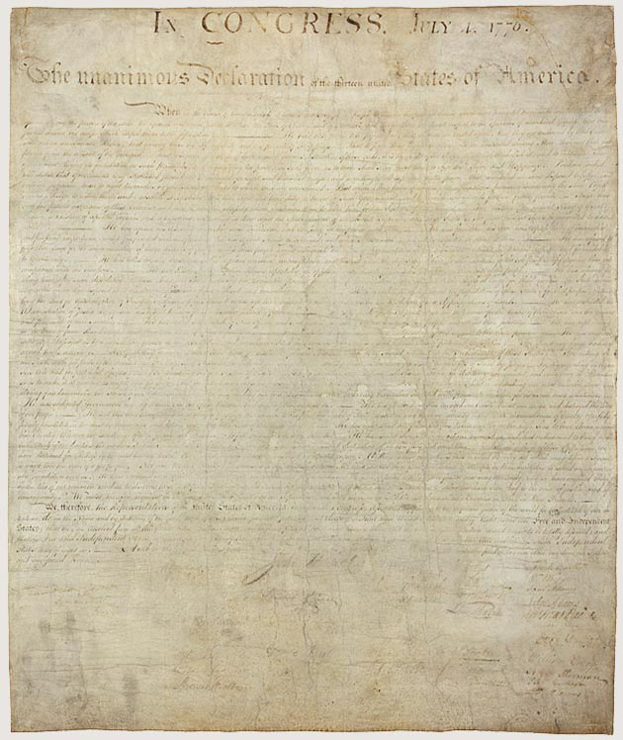
Part I: Introduction
Texas Declaration of Independence
Texas State Library and Archives Commission
Declaration of Independence of the United States
The National Archives
Notes:
Declaration of Independence of Texas, 1836. Texas State Library and Archives Commission. Declaration of Independence of Texas, 1836 | Texas State Library
The Declaration of Independence, A transcription. National Archives. Declaration of Independence: A Transcription | National Archives

Slide 7
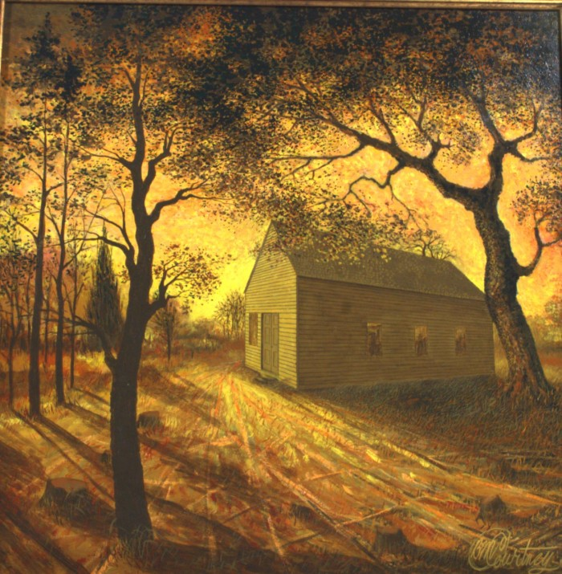
Part II: Causes for Separation
“Dawn of the Signing”
A painting of Independence Hall, the building at Washington-on-the-Brazos where the Convention of 1836 was held.
Star of the Republic Museum
The Portal to Texas History
Notes:
"Dawn of the Signing", artwork, Date Unknown; (https://texashistory.unt.edu/ark:/67531/metapth30230/: accessed March 18, 2025), University of North Texas Libraries, The Portal to Texas History, https://texashistory.unt.edu; crediting Star of the Republic Museum.

Slide 8
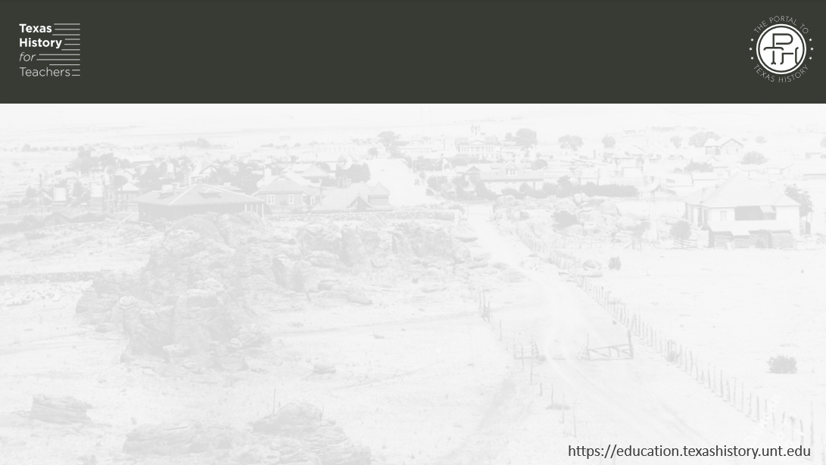
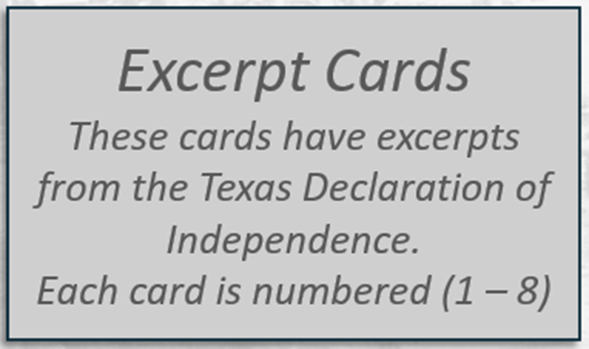
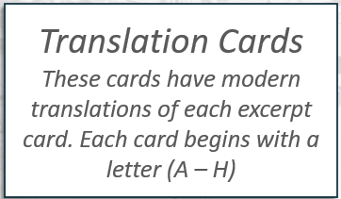
Part III: Grievances Part I: Matching

Slide 9
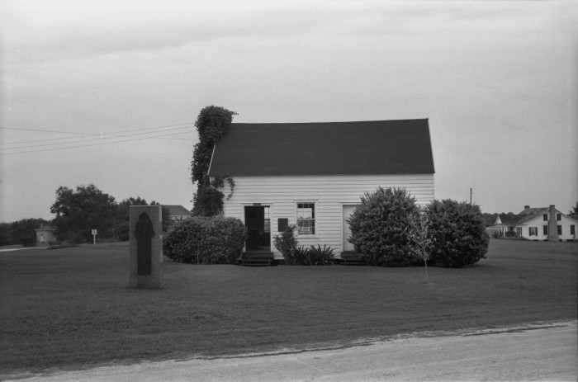
Part III: Grievances Part II: Comprehension Questions
A replica of Independence Hall, where the Constitutional Convention of 1836 was held at Washington-on-the-Brazos.
The Texas Historical Commission.
The Portal to Texas History
Notes:
Utley, Robert M. [Washington-on-the-Brazos, (Restoration of early capitol)], photograph, October 1958; (https://texashistory.unt.edu/ark:/67531/metapth675374/: accessed March 18, 2025), University of North Texas Libraries, The Portal to Texas History, https://texashistory.unt.edu; crediting Texas Historical Commission.

Slide 10
Exit Ticket Follow the directions to complete your exit ticket
Use the prompts in your exit ticket to write your own brief Declaration of Independence based on information you learned today.
Discuss with a partner

Slide 11
Share with the class 2
(Read from your response on your exit ticket)

