Slide 1
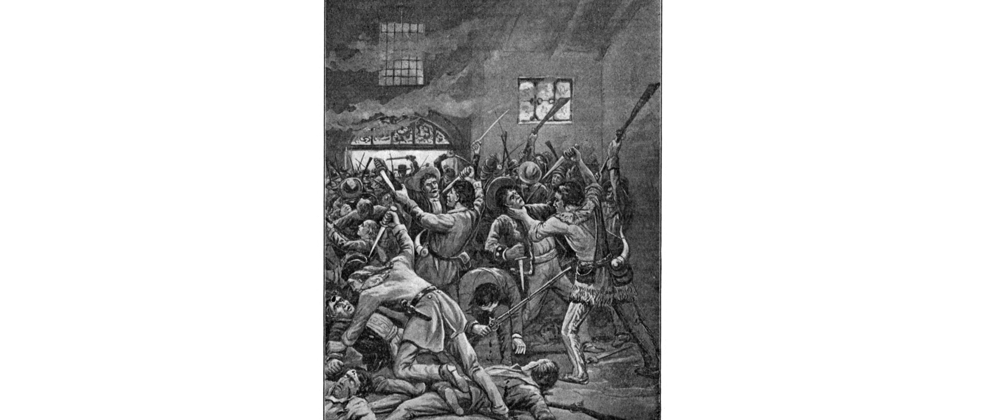
Unit 5 : The Texas Revolution
Lesson 6:
Events of the Revolution
Notes:
Littlejohn, E. G., 1862-. Texas History Stories: The Alamo, Remember Goliad, Story of San Jacinto., periodical, 1901; Richmond, Virginia. (https://texashistory.unt.edu/ark:/67531/metapth14381/: accessed February 25, 2025), University of North Texas Libraries, The Portal to Texas History, https://texashistory.unt.edu; crediting UNT Libraries Special Collections.

Slide 2





Warm-up Follow the directions to complete your warm-up
Follow the three steps listed in the chart, starting with step 1 (in the middle.)
Choose one event we have learned about and write it in the middle.
Write what caused the event in step 2 and the effect of the event in step 3.
Share with a partner.

Slide 3

Share with the class
I chose _(name of event)_
One cause of this event was _______
One effect of this event was _______

Slide 4

Essential Question
What is the most significant information about the key events of the Texas Revolution?

Slide 5

In today’s lesson…
We will examine the most significant information about key events from the Texas Revolution.
I will take notes about the date, location, details, and significance of each event on my worksheet using a graphic organizer.

Slide 6
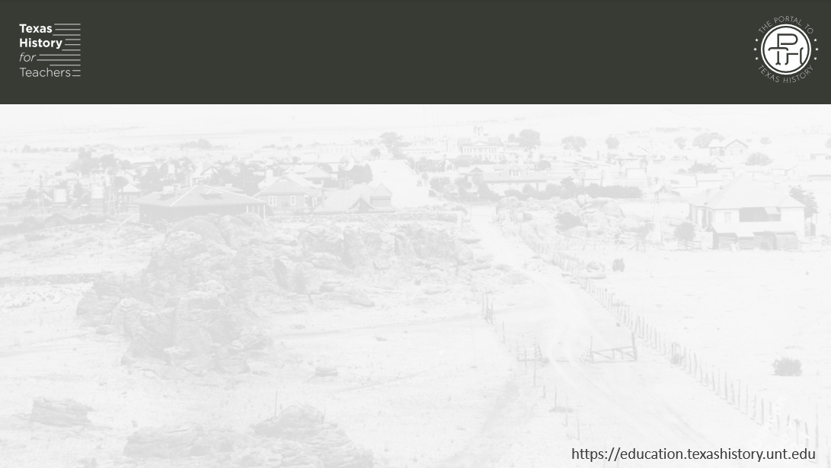
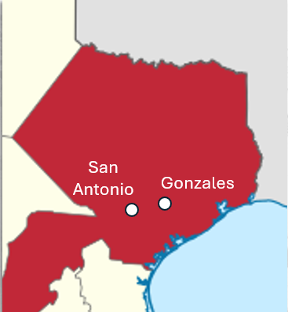
Battle of Gonzales
When: October 2, 1835
Where: Gonzales
What: The first battle of the Texas Revolution
Notes:
Locator map of Coahuila y Texas state in Mexico, edited focus on Texas and show the location of San Antonio and Gonzales. This file is licensed under the Creative Commons Attribution-Share Alike 4.0 International license. https://commons.wikimedia.org/wiki/File:Coahuila_y_Texas_in_Mexico_(1824).svg

Slide 7
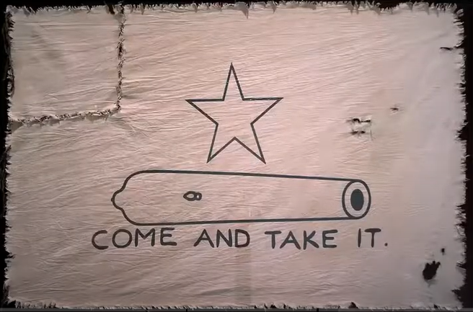
Battle of Gonzales 2
Why: The Mexican army was ordered to retrieve a cannon that Mexico had lent the town years earlier. The people refused to return the cannon, and a fight broke out.
The Gonzales militia flew this flag at the Battle of Gonzales.
The Texas Historical Commission
Notes:
The Come and Take it Flag. The Texas Historical Commission. Flags of the Texas Revolution | Texas Historical Commission

Slide 8
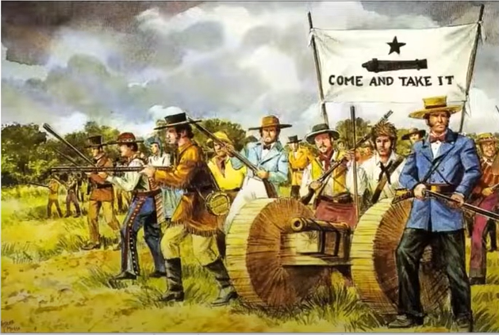
Battle of Gonzales 3
Outcome: The outnumbered Mexican army was forced to retreat from Gonzales.
Significance: This battle started the Texas Revolution
The Battle of Gonzales
The Texas Historical Commission
Notes:
The Battle of Gonzales. The Texas Historical Commission. Flags of the Texas Revolution | Texas Historical Commission

Slide 9
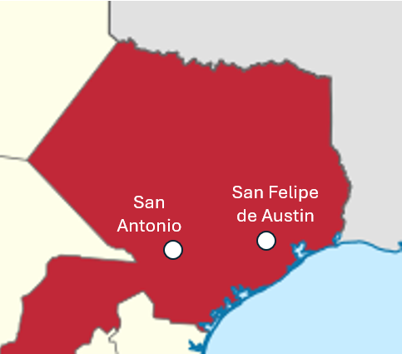
The Consultation 1
When: November 1835
Where: San Felipe de Austin
What: A Meeting to discuss issues related to possible war with Mexico
Notes:
Locator map of Coahuila y Texas state in Mexico, edited focus on Texas and show the location of San Antonio and San Felipe de Austin. This file is licensed under the Creative Commons Attribution-Share Alike 4.0 International license. https://commons.wikimedia.org/wiki/File:Coahuila_y_Texas_in_Mexico_(1824).svg

Slide 10
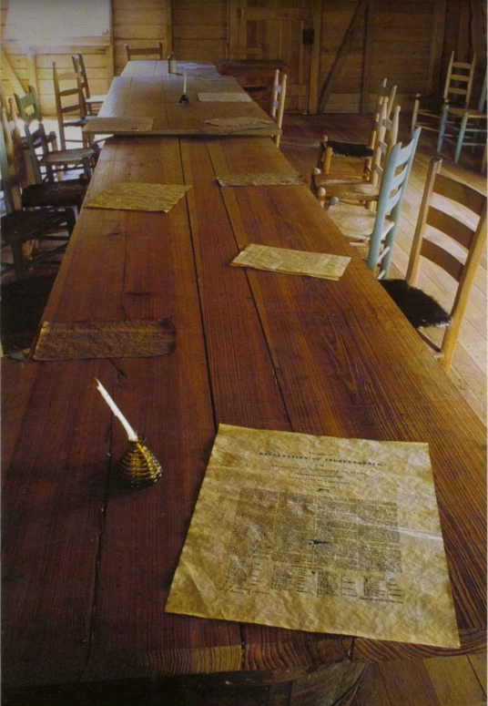
The Consultation 2
Outcome:
Delegates couldn’t agree on whether to fight for independence or a return to the Constitution of 1824.
Created a provisional government, an army under Sam Houston, and a militia under Stephen F. Austin.
A reproduction of the meeting room at San Felipe de Austin. The Portal to Texas History
Notes:
Texas. Parks and Wildlife Department. Interpretive Guide to: Washington-On-the-Brazos State Historic Site, pamphlet, 2013; Austin, TX. (https://texashistory.unt.edu/ark:/67531/metapth661961/: accessed February 18, 2025), University of North Texas Libraries, The Portal to Texas History, https://texashistory.unt.edu; crediting UNT Libraries Government Documents Department.

Slide 11
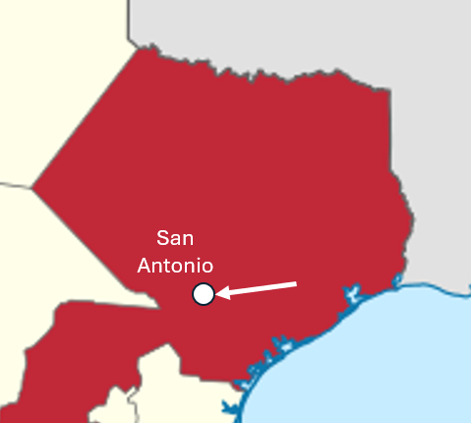
San Antonio The Texians Take San Antonio
When: December 1835
Where: San Antonio
What: The Texian militia marched to San Antonio in late October, laid siege to the centralist troops in San Antonio under General Cos, driving them out of the city in early December 1835.
Notes:
Locator map of Coahuila y Texas state in Mexico, edited focus on Texas and show the location of San Antonio and an arrow showing the direction the Texian militia marched to San Antonio. This file is licensed under the Creative Commons Attribution-Share Alike 4.0 International license. https://commons.wikimedia.org/wiki/File:Coahuila_y_Texas_in_Mexico_(1824).svg

Slide 12
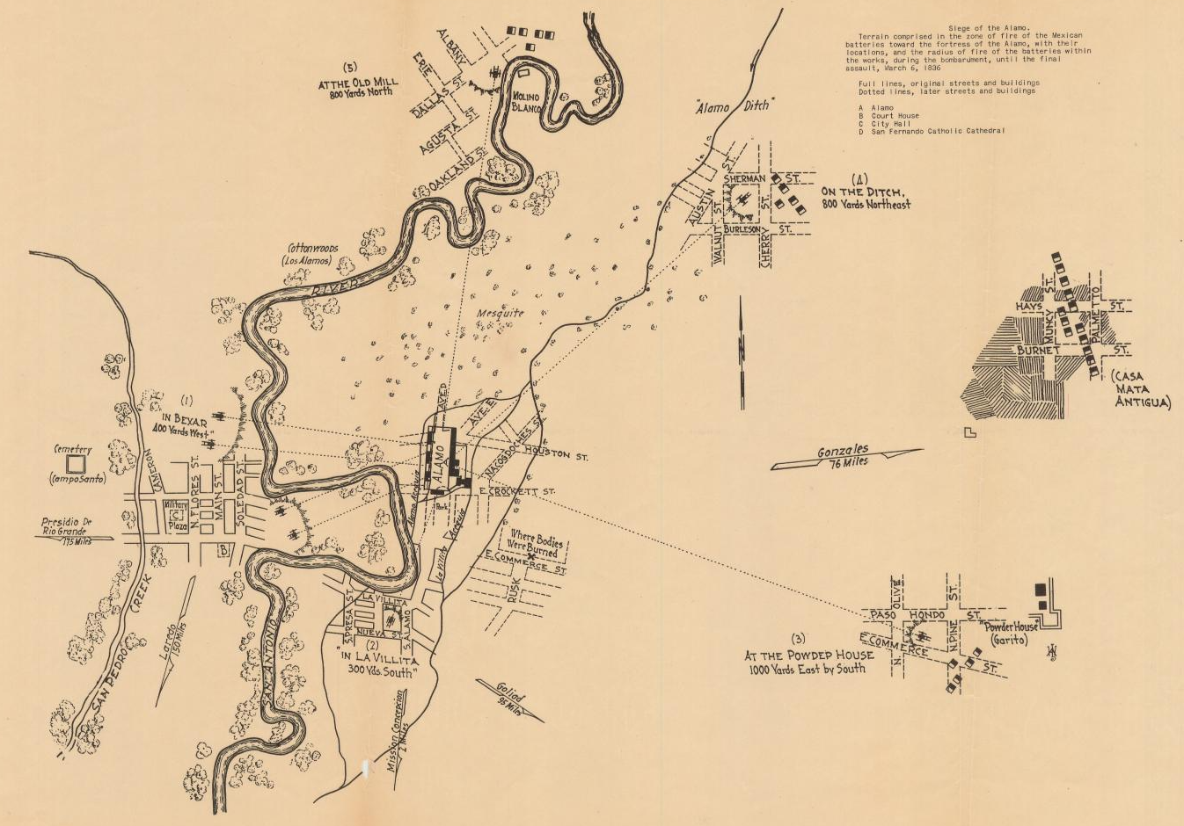
The Alamo The Siege of the Alamo 1
When: February 23 – March 5, 1836
What:
Santa Anna arrived with part of his army (2,500 troops.)
Texas troops and civilians retreated to the Alamo.
Santa Anna began a thirteen-day siege of the Alamo
The Siege of the Alamo
The Portal to Texas History
Notes:
"Siege of the Alamo", map, Date Unknown; (https://texashistory.unt.edu/ark:/67531/metapth30279/: accessed March 13, 2025), University of North Texas Libraries, The Portal to Texas History, https://texashistory.unt.edu; crediting Star of the Republic Museum.

Slide 13
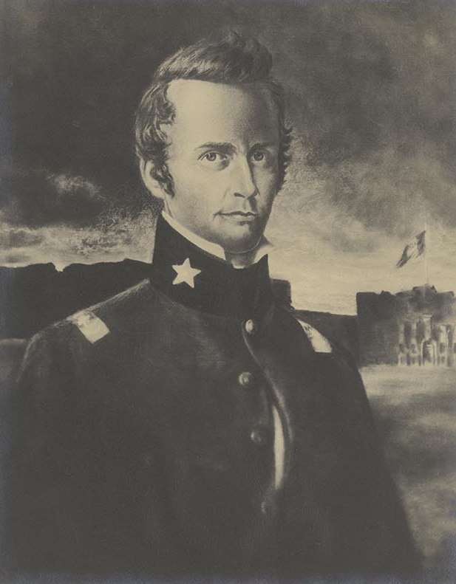
The Alamo The Siege of the Alamo 2
Who
William B. Travis: Commanded the army
William B. Travis
Texas State Library and Archives
Notes:
Portrait of William B. Travis by McArdle. The McArdle Scrapbooks Dawn at the Alamo. Texas State Library and Archives. Portrait of William B. Travis by McArdle | Texas State Library

Slide 14
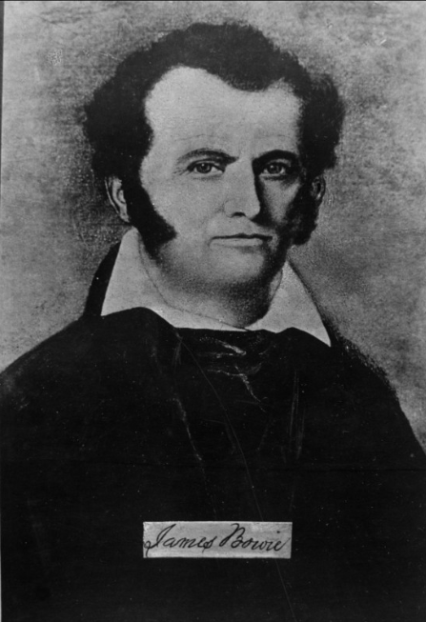
The Alamo The Siege of the Alamo 3
Who
James Bowie: Commanded the militia
James Bowie
The Portal to Texas History
Notes:
Portrait of William B. Travis by McArdle. The McArdle Scrapbooks Dawn at the Alamo. Texas State Library and Archives. Portrait of William B. Travis by McArdle | Texas State Library
Portrait of a Man, photograph, Date Unknown; (https://texashistory.unt.edu/ark:/67531/metapth55639/: accessed March 7, 2025), University of North Texas Libraries, The Portal to Texas History, https://texashistory.unt.edu; crediting Hardin-Simmons University Library.

Slide 15
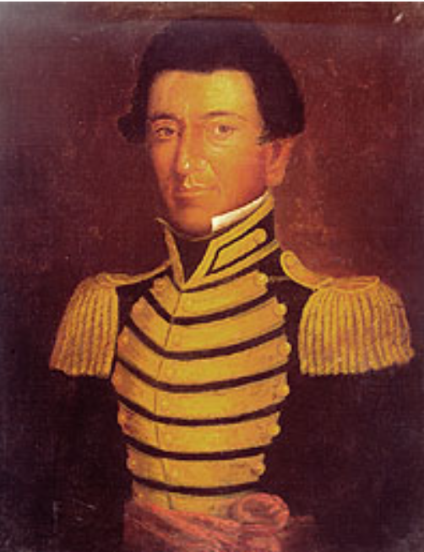
The Alamo The Siege of the Alamo 4
Who
Juan Seguín: Tejano soldier who acted as a courier for Travis
Juan Seguín
Texas State Library and Archives
Notes:
Juan Seguin. Giants of Texas History. Texas State Library and Archives. Juan Seguin | Texas State Library

Slide 16
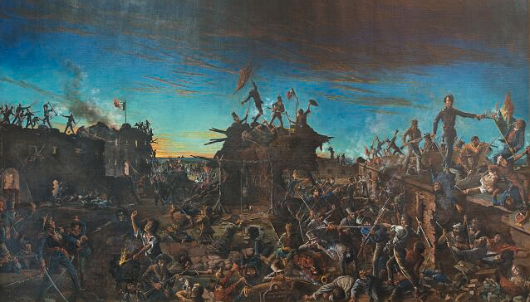
The Alamo The Battle of the Alamo 5
When: March 6, 1836
What:
Santa Anna launched his attack at 5 am
All Texans fighting at the Alamo were killed
Santa Anna’s army suffered approximately 400 killed
“Dawn at the Alamo” by Henry Arthur McArdle
The Library of Congress
Notes:
Highsmith, Carol M. Painting, ‘Dawn at the Alamo,’ by Henry Arthur McArdle, Hanging in the Senate Chamber of the Texas State Capitol in Austin, Texas. April 17, 2014. Library of Congress Prints and Photographs Division. https://www.loc.gov/pictures/resource/highsm.27909/

Slide 17
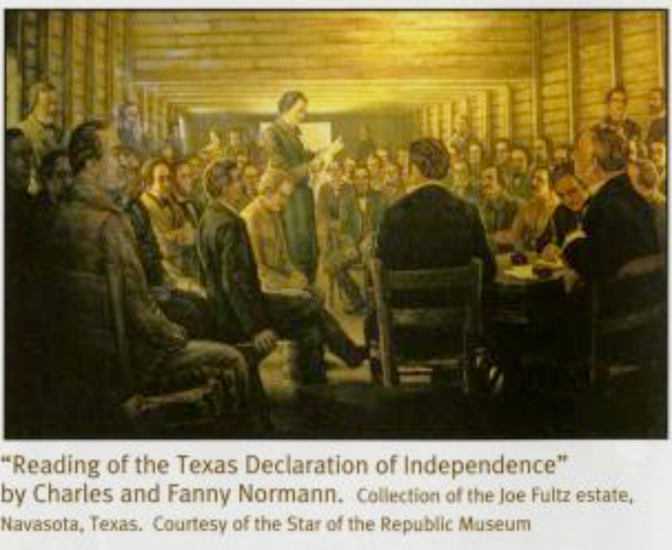
The Constitutional Convention of 1836
When: March 1 – 17, 1836
What:
George Childress directed the committee that wrote the Texas Declaration of Independence
Wrote the Constitution of the Republic of Texas
Provisional Government:
David G. Burnet: President
Lorenzo de Zavala: Vice President
Sam Houston: Commander of the Army
The Portal to Texas History
Notes:
Texas. Parks and Wildlife Department. Interpretive Guide to: Washington-On-the-Brazos State Historic Site, pamphlet, 2013; Austin, TX. (https://texashistory.unt.edu/ark:/67531/metapth661961/: accessed February 18, 2025), University of North Texas Libraries, The Portal to Texas History, https://texashistory.unt.edu; crediting UNT Libraries Government Documents Department.

Slide 18
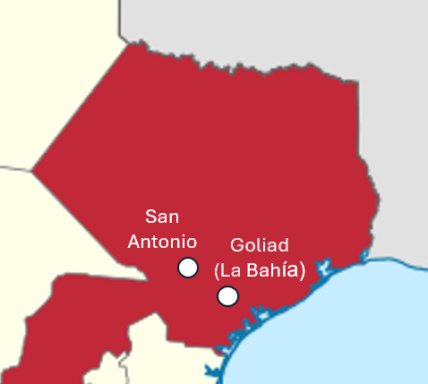
The Goliad Massacre
When: March 27, 1836
Where: Goliad (La Bahía)
What:
The Texas army under James Fannin surrendered at the Battle of Coleto Creek on March 19
Almost all Texian prisoners were executed by order of Santa Anna.
Notes:
Locator map of Coahuila y Texas state in Mexico, edited focus on Texas and show the location of San Antonio and San Felipe de Austin. This file is licensed under the Creative Commons Attribution-Share Alike 4.0 International license. https://commons.wikimedia.org/wiki/File:Coahuila_y_Texas_in_Mexico_(1824).svg

Slide 19
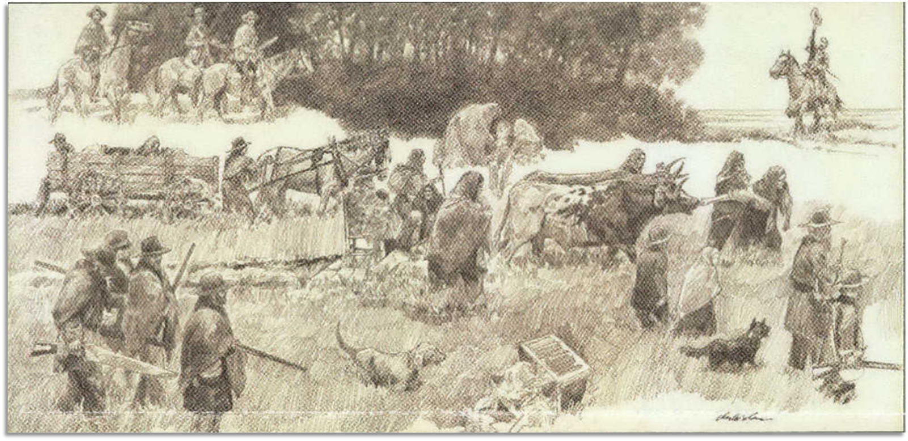
The Runaway Scrape
When: March – April 1836
What:
Texans fled east toward Louisiana as Santa Anna’s army pursued the Texas army under Sam Houston.
The Runaway Scrape
The Star of the Republic Museum
The Portal to Texas History
Notes:
Star of the Republic Museum (Washington, Tex.). Star of the Republic Museum Notes, Volume 43, Number 2, 2018, periodical, 2018; Washington, Texas. (https://texashistory.unt.edu/ark:/67531/metapth1115241/: accessed February 25, 2025), University of North Texas Libraries, The Portal to Texas History, https://texashistory.unt.edu; crediting UNT Libraries Government Documents Department.

Slide 20
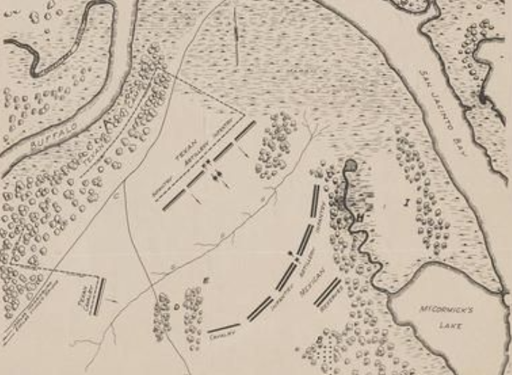
The Battle of San Jacinto
When: April 21, 1836
What:
Sam Houston fought Santa Anna’s divided army, defeating them in 18 minutes.
Santa Anna was captured and forced to surrender.
Map of the Battle of San Jacinto
The Portal to Texas History
Notes:
Map of the Battlefield of San Jacinto, map, 1938?; (https://texashistory.unt.edu/ark:/67531/metapth493074/: accessed February 25, 2025), University of North Texas Libraries, The Portal to Texas History, https://texashistory.unt.edu; crediting Hardin-Simmons University Library.

Slide 21
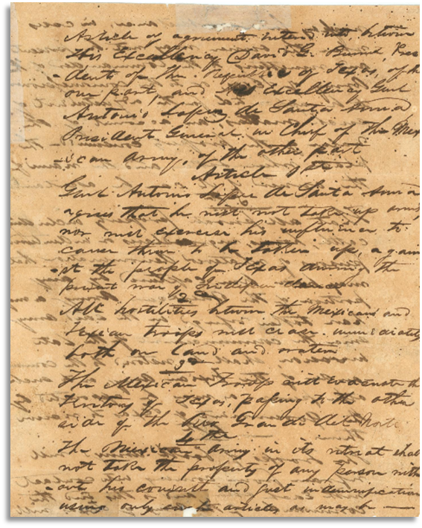
The Treaties of Velasco
When: May 14, 1836
What:
Public treaty: Texas was independent of Mexico, and the southern border was the Rio Grande.
Private treaty: Santa Anna promised to get Mexico to recognize Texas independence. (He didn’t carry out his promise)
The Treaty of Velasco
The Portal to Texas History
Notes:
Treaty of Velasco. 1836. Text. University of North Texas Libraries, The Portal to Texas History; crediting Star of the Republic Museum. https://texashistory.unt.edu/ark:/67531/metapth31159/.

Slide 22
Exit Ticket Follow the directions to complete your exit ticket
Choose one event that we have learned today.
Create a True/False statement for that event.
Explain why your statement is true or false.
Share with a partner.

Slide 23
Share with the class 2
Read your True or False Statement to the class. (Allow the class to answer)
This statement is true / false because _______________

