Slide 1
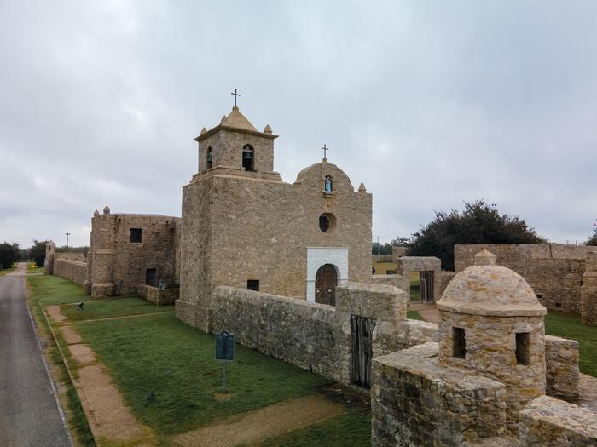
Unit 5: The Texas Revolution
Extension Lesson:
The Goliad Massacre
The Presidio La Bahía at Goliad
Notes:
Hicks, William. [Presidio La Bahia: Aerial Exterior], photograph, December 15, 2021; (https://texashistory.unt.edu/ark:/67531/metapth1490439/: accessed March 21, 2025), University of North Texas Libraries, The Portal to Texas History, https://texashistory.unt.edu; .

Slide 2
Warm-up Follow the directions below to complete your warm-up
Consider the often-extreme actions and events that take place during a war.
What rules do you think should be followed during a war, and why?
Share with a partner.

Slide 3
Share with the class:
One rule that I think should exist during a war is ___________
This rule should exist because ________

Slide 4
Essential Question
What were the causes, effects, key events, and significance of the Goliad Massacre?

Slide 5
In Today’s Lesson
We will examine important information about the Goliad Massacre, including its causes and effects, key events, and primary significance to the Texas Revolution.
I will watch a short video about the Goliad Massacre and summarize key details and information from the video on my viewing guide worksheet.

Slide 6
The Goliad Massacre Video
You will watch a video about the Goliad Massacre in this lesson. Use your worksheet as a viewing guide to record significant information about each topic covered in the video.
Click here for the video

Slide 7
Share Your Responses to Each Video Topic

Slide 8
Exit Ticket Follow the directions below to complete your exit ticket
Read the list of five statements on your exit ticket.
Which TWO statements provide the most accurate significance of the Goliad Massacre?
Share with a partner.

Slide 9
Share with the class: 2
One reason the Goliad Massacre was significant was that _________
Another reason the Goliad Massacre was significant was that ______

