Slide 1
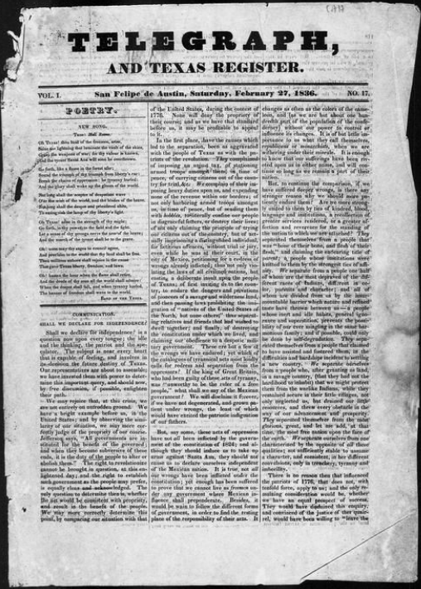
Unit 5: The Texas Revolution
Lesson 2:
How do we know what we know?
Notes:
Baker & Bordens. Telegraph and Texas Register (San Felipe de Austin [i.e. San Felipe], Tex.), Vol. 1, No. 17, Ed. 1, Saturday, February 27, 1836, newspaper, February 27, 1836; San Felipe de Austin, Texas. (https://texashistory.unt.edu/ark:/67531/metapth47887/: accessed February 18, 2025), University of North Texas Libraries, The Portal to Texas History, https://texashistory.unt.edu; crediting The Dolph Briscoe Center for American History.

Slide 2
Warm-up Follow the directions below to complete your warm-up
Match the type of primary source material on the left with a quote that might be found in the material on the right.
Share your response with a partner

Slide 3
Share with the class:
A / An __(type of source)_ would probably contain the quote ________________

Slide 4
Essential Questions
What types of primary source materials are typically used to learn first-hand information about this era? What information can we learn from each of these types of sources?

Slide 5
In Today’s Lesson
We will examine three primary source materials related to events that occurred during the Texas Revolutionary Era.
I will use the primary source materials to make observations and inferences about significant people and events of the era.

Slide 6
In the Historical Record
The History of the Texas Revolution was recorded in many different ways. Information about the war was recorded in newspapers in Texas, Mexico, and the United States, in official government and military documents, in journals, diaries, and letters between soldiers and their families, and in interviews conducted during and after the war. Use the primary sources in this lesson to get a glimpse into the events of and opinions on the war. Pay attention to the different types of resources, the author, the intended audience, and the points of view being provided.

Slide 7
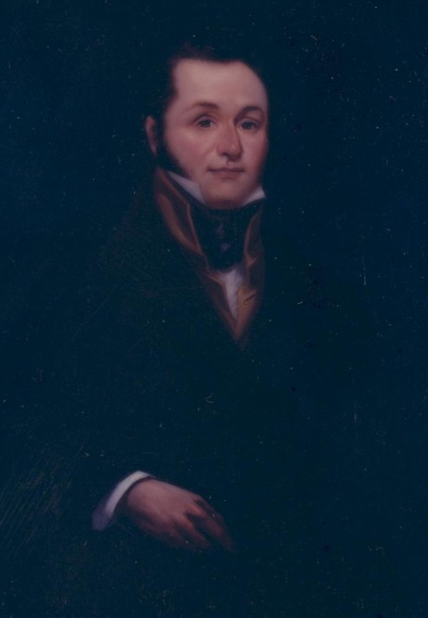
Excerpt #1 The Arrest of Lorenzo de Zavala
Lorenzo de Zavala served in the Mexican government as the Minister to France from 1834 to 1835. He resigned when the centralists overthrew the federalist government and moved to Texas.
Portrait of Lorenzo de Zavala
By Larry Wheeler
The Portal to Texas History
Notes:
Wheeler, Larry. Portrait of Lorenzo de Zavala, artwork, 1980; (https://texashistory.unt.edu/ark:/67531/metapth3002/: accessed February 19, 2025), University of North Texas Libraries, The Portal to Texas History, https://texashistory.unt.edu; crediting San Jacinto Museum of History.

Slide 8
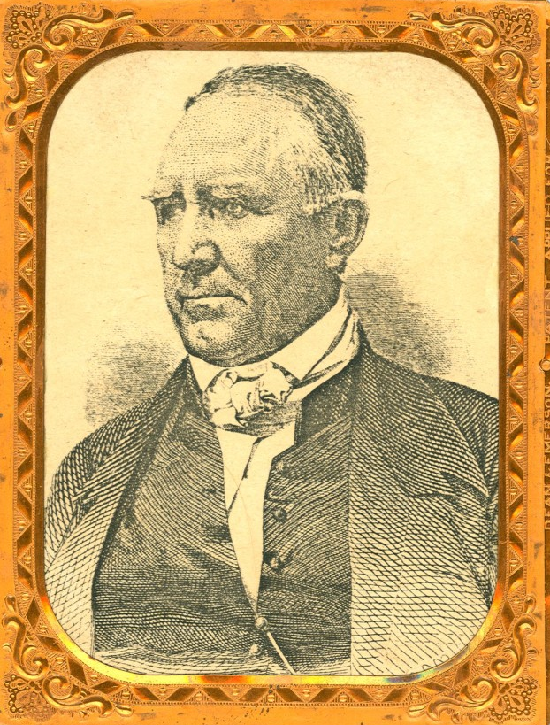
Excerpt #2 Sam Houston’s Army Orders
Sam Houston as born in Virginia and grew up in Tennessee. He served in the U.S. Congress and as the governor of Tennessee before immigrating to Texas in 1832. He led the Anglo and Tejano army in the Texas Revolution.
Portrait of Sam Houston
The Portal to Texas History
Notes:
Sam Houston, physical object, Date Unknown; (https://texashistory.unt.edu/ark:/67531/metapth32932/: accessed February 19, 2025), University of North Texas Libraries, The Portal to Texas History, https://texashistory.unt.edu; crediting Star of the Republic Museum.

Slide 9
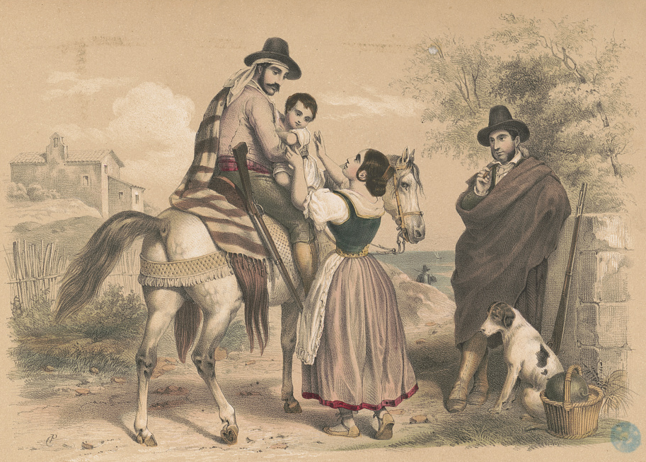
Excerpt #3 “A Lady of Texas”
The Texas Revolution affected almost all Texans, whether they were fighting in the battles or not. Women of Texas often played a role in providing necessary materials for the troops and taking care of farms and businesses during the war.
Woman Beside a Man on a Horse with Child.
The Library of Congress
Notes:
Woman beside man on horse with child / CP monogram. , None. [Place not identified: publisher not identified, between 1830 and 1850] Photograph. https://www.loc.gov/item/2004669486/.

Slide 10
Exit Ticket Follow the directions below to complete your exit ticket
Choose ONE point of view from the six presented in the chart.
Circle or highlight your chosen point of view.
Write a short journal entry talking about the growing issues in Texas from your chosen point of view.

Slide 11
Share with the class:
I am writing from the point of view of _____________.
This person might say the following: _________________________

