Slide 1
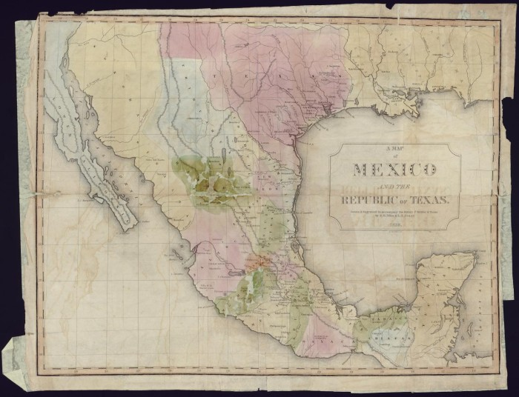
Unit 5: The Texas Revolution
Lesson 12:
Looking Ahead
Notes:
"A Map of Mexico and the Republic of Texas", map, Date Unknown; (https://texashistory.unt.edu/ark:/67531/metapth31647/: accessed April 2, 2025), University of North Texas Libraries, The Portal to Texas History, https://texashistory.unt.edu; crediting Star of the Republic Museum.

Slide 2
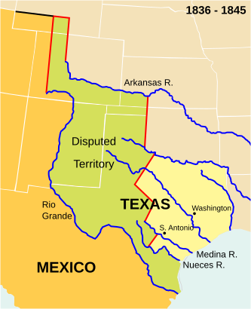
Warm-up Follow the directions below to complete your warm-up
Use the map on your warm-up (shown bigger here) to complete your work.
Share with a partner.
Notes:
Map of the Republic of Texas 1836 – 1845. This is a retouched picture, which means that it has been digitally altered from its original version. Modifications: Placement of the "Nueces R." label made it look like it was for the Medina river rathe rthna the Nueces. Moved and added "Medina R." label. The original can be viewed here: Wpdms republic of texas.svg Permission is granted to copy, distribute and/or modify this document under the terms of the GNU Free Documentation License, Version 1.2 or any later version published by the Free Software Foundation; with no Invariant Sections, no Front-Cover Texts, and no Back-Cover Texts. A copy of the license is included in the section entitled GNU Free Documentation License.

Slide 3
Share with the class:
One thing I noticed about the map was ________
One question I have about the map is ________

Slide 4
Essential Questions
What challenges did Texas face after the Texas Revolution? What was one way Texas attempted to address these issues?

Slide 5
In Today’s Lesson
We will examine four specific challenges that Texas faced following the Texas Revolution and examine a primary source excerpt giving one point of view of how Texas tried to address these challenges.
I will answer questions about each challenge, making inferences and predictions about the likely significance and outcome of each one.

Slide 6
So, Texas is Independent... Now What?
Notes:
Map of the Republic of Texas 1836 – 1845. This is a retouched picture, which means that it has been digitally altered from its original version. Modifications: Placement of the "Nueces R." label made it look like it was for the Medina river rathe rthna the Nueces. Moved and added "Medina R." label. The original can be viewed here: Wpdms republic of texas.svg Permission is granted to copy, distribute and/or modify this document under the terms of the GNU Free Documentation License, Version 1.2 or any later version published by the Free Software Foundation; with no Invariant Sections, no Front-Cover Texts, and no Back-Cover Texts. A copy of the license is included in the section entitled GNU Free Documentation License.
https://commons.wikimedia.org/wiki/File:Wpdms_republic_of_texas-2008-19-11.svg

Slide 7
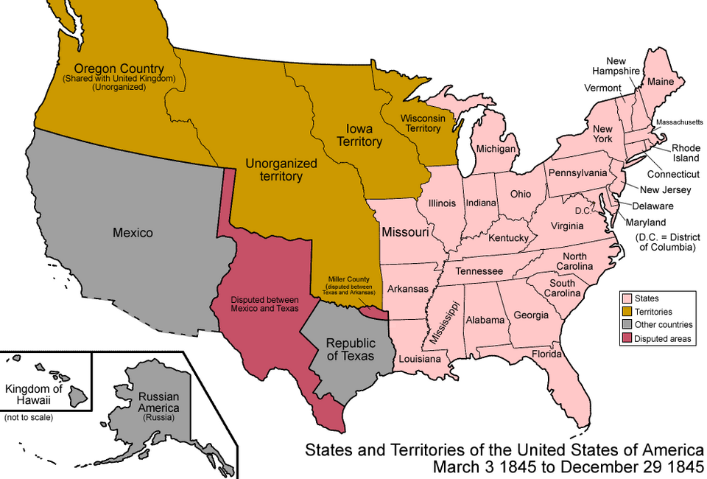
Addressing the Challenges in Texas
Notes:
Map of the States and Territories of the United States of America, 1845. Permission is granted to copy, distribute and/or modify this document under the terms of the GNU Free Documentation License, Version 1.2 or any later version published by the Free Software Foundation; with no Invariant Sections, no Front-Cover Texts, and no Back-Cover Texts. A copy of the license is included in the section entitled GNU Free Documentation License. https://commons.wikimedia.org/wiki/File:United_States_1845-03-1845-12.png

Slide 8
Exit Ticket Follow the directions below to complete your exit ticket
Answer the three questions on your exit ticket based on the information from today’s lesson.
Share with a partner.

Slide 9
Share with the class: 2
One challenge Texas faced after it won its independence in 1836 was _________
Texas tried to strengthen its position after it won its independence by ______
One thing I predict will happen in the next unit: The Republic of Texas is ______

