Slide 1

Mind Map
Sub-topic
1
Additional information
Sub-topic
2
Main Topic
Additional information
Sub-topic
3
Additional information
Additional information
https://education.texashistory.unt.edu

Slide 2

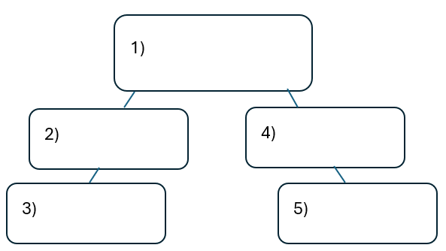


Warm-up:
Follow the directions on your warm-up
Use the word bank provided to fill in the small mind map on your warm-up.
Place each term where you think it fits best in your mind map.
Discuss with a partner.
https://education.texashistory.unt.edu

Slide 3
Share with the class
I think the primary topic in box number one is _______
I think the subtopic in box number two is ____, and box number three is ____
I think the subtopic in box number four is ____, and box number five is ____
https://education.texashistory.unt.edu

Slide 4
Essential Question
How do the key terms and concepts from Unit 5: The Texas Revolution connect to each other?
https://education.texashistory.unt.edu

Slide 5
In today’s lesson…
We will make connections between key terms and concepts within all of Unit 5: The Texas Revolution.
I will create a Mind Map using terms and concepts from the class slides presentation.
https://education.texashistory.unt.edu

Slide 6
Unit Topic & Subtopics
Which of the titles in the boxes below is the main topic of our unit?
Draw a circle in the middle of your Mind Map and write the main topic inside.
Write the remaining topics around the main topic. Connect each sub-topic to the main topic with a line.
Events
Causes
The Texas Revolution
https://education.texashistory.unt.edu

Slide 7
Make Connections
Connect each item below to the topic on your Mind Map.
Some items will connect directly to the main topic. Some will connect to other items from this slide.
Battle of Gonzales
The Goliad Massacre
Battle of the Alamo
The Runaway Scrape
The Battle of San Jacinto
Constitutional Convention of 1836
https://education.texashistory.unt.edu

Slide 8
Make Connections 2
Connect each item below to the topic on your Mind Map.
Some items will connect directly to the main topic. Some will connect to other items from this slide or previous slides.
Some items could be placed in more than one location on your map.
Abolished Constitution of 1824
Fannin’s surrender at Coleto Creek
Texas Declaration of Independence
Centralist government takeover
Santa Anna surrendered
First battle of the Texas Revolution
https://education.texashistory.unt.edu

Slide 9
Make Connections 3
Connect each item below to the topic on your Mind Map.
Some items will connect directly to the main topic. Some will connect to other items from this slide or previous slides.
Some items could be placed in more than one location on your map.
Created a provisional government
States lost rights and powers
William B. Travis commanded troops
Texans destroyed own towns
Juan Seguín
Texas government fled for safety
https://education.texashistory.unt.edu

Slide 10
Make Connections 5
Connect each item below to the topic on your Mind Map.
Some items will connect directly to the main topic. Some will connect to other items from this slide or previous slides.
Some items could be placed in more than one location on your map.
“Come and Take it” flag
Santa Anna captured
Centralist army moves quickly east
Battle on March 6, 1836
13-day siege
Santa Anna ordered execution of 400 prisoners
https://education.texashistory.unt.edu

Slide 11
Make Connections 6
Connect each item below to the topic on your Mind Map.
Some items will connect directly to the main topic. Some will connect to other items from this slide or previous slides.
Some items could be placed in more than one location on your map.
Texas Declaration of Independence
Provisional Texas President
Provisional Texas Vice President
Republic of Texas Constitution
Mission La Bahía
Treaties of Velasco
https://education.texashistory.unt.edu

Slide 12
Make Connections 4
Connect each item below to the topic on your Mind Map.
Some items will connect directly to the main topic. Some will connect to other items from this slide or previous slides.
Some items could be placed in more than one location on your map.
David G. Burnet
San Antonio
Sam Houston Army Commander
18-minute battle
Lorenzo de Zavala
George Childress
https://education.texashistory.unt.edu

Slide 13
Make Connections 1.0 6
Connect each item below to the topic on your Mind Map.
Some items will connect directly to the main topic. Some will connect to other items from this slide or previous slides.
Some items could be placed in more than one location on your map.
Civilians fled east
Mexico did not recognize independence
Disputes over Texas southern border
Republic of Texas established
A fight over a cannon
All defenders killed
https://education.texashistory.unt.edu

Slide 14

Create Connections 6
Now take a few minutes to add any information you can think of to your Mind Map.
You can add facts, descriptions, explanations, cultural information, or anything else you can think of.
https://education.texashistory.unt.edu

Slide 15
Exit Ticket
Complete the sentence summarizing the main idea from our unit.
Discuss with a partner.
https://education.texashistory.unt.edu

Slide 16
Share your response
The (1)____________ is primarily characterized by (2)_______________
https://education.texashistory.unt.edu

