Slide 1
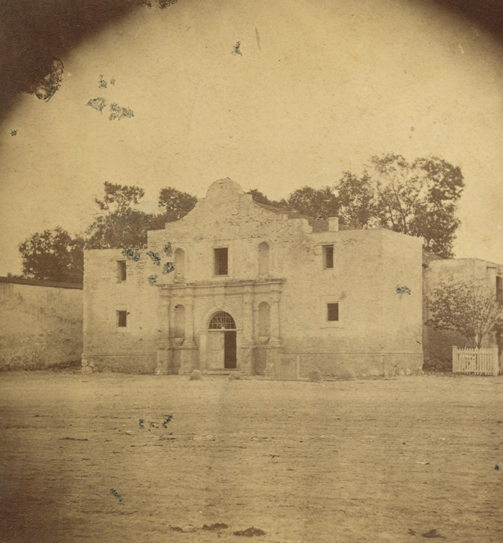
Unit 5: The Texas Revolution
Lesson 13:
Study Guide
Notes:
The Alamo. Photograph 8 x 8 cm. University of North Texas Libraries, The Portal to Texas History; crediting Star of the Republic Museum. https://texashistory.unt.edu/ark:/67531/metapth31110/

Slide 2
Warm-up Follow the directions below to complete your warm-up
Circle or highlight any and all topics, concepts, or terms that you expect to see on the unit 5 test based on what we have learned and discussed in class.
Share with a partner

Slide 3
Share with the class:
One topic that we will probably see on the Unit 5 test is _______

Slide 4
Essential Question
What significant information do we need to know to be successful on the unit 5 test for the Texas Revolution?

Slide 5
In Today’s Lesson
We will identify and review significant information for our upcoming test.
I will use my previous work and notes to complete my study guide. I will identify and match cause and effect relationships, create short answer responses, and answer practice test questions.

Slide 6
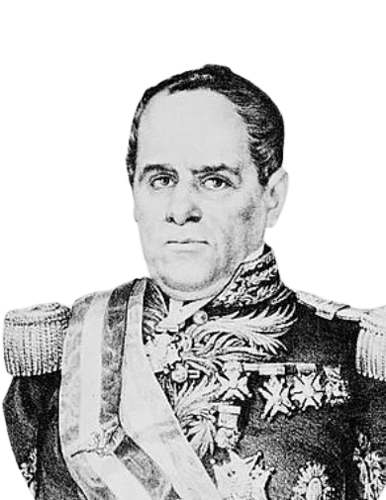
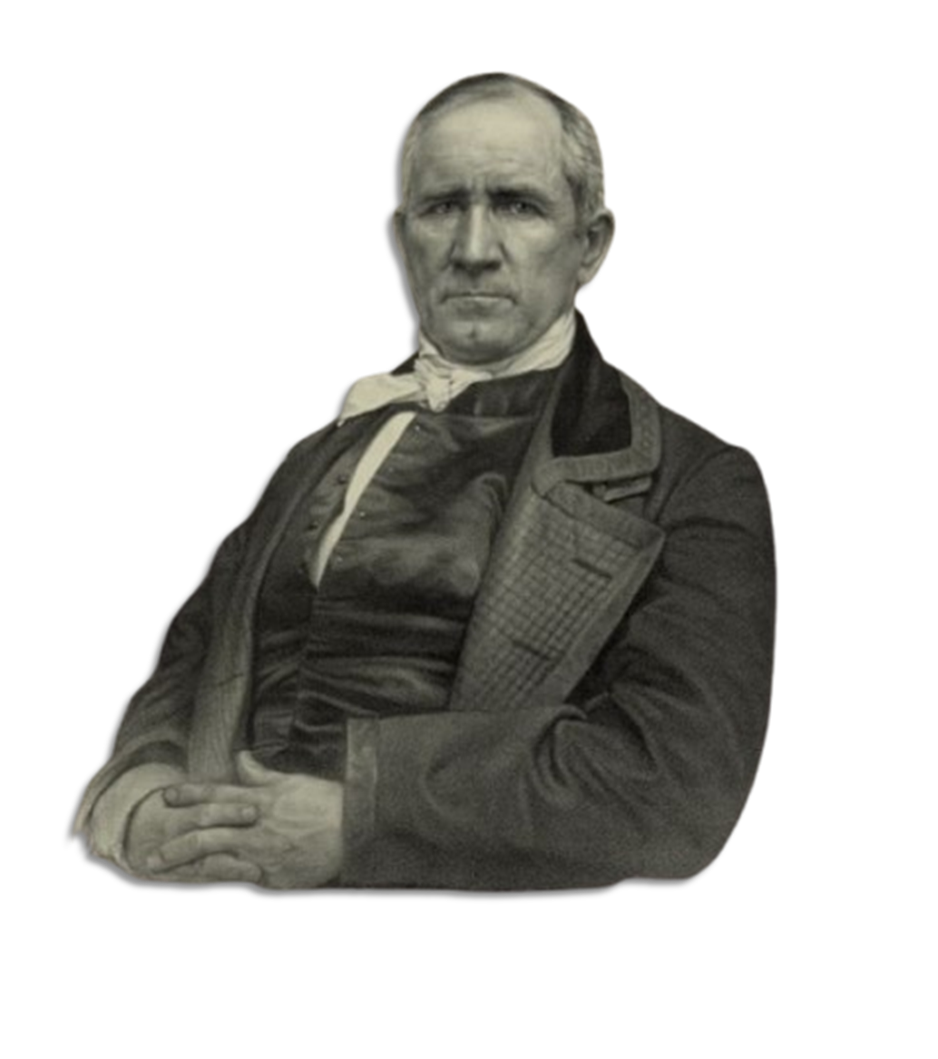
Part I: Key Terms and Definitions
Sam Houston
Library of Congress
Antonio López de Santa Anna Library of Congress
Notes:
Sam Houston. April 27, 1848. Photograph. Library of Congress Prints and Photographs Division. https://www.loc.gov/item/2003656937/
Antonio Lopez de Santa Anna, head-and-shoulders portrait, facing front. Mexico, None. [Between 1850 and 1876] [Photograph] Retrieved from the Library of Congress, https://www.loc.gov/item/2005683078/.

Slide 7
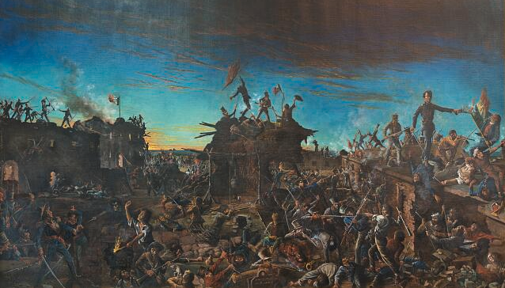
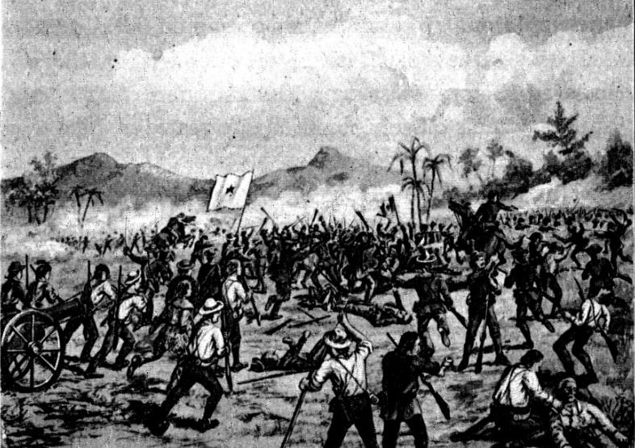
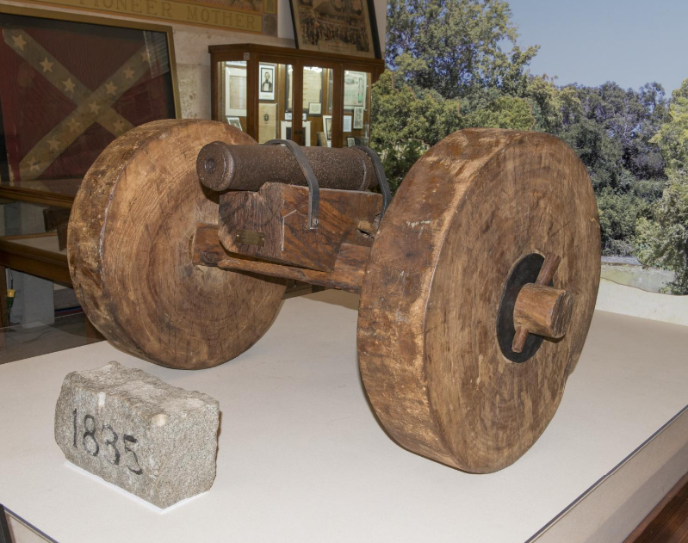
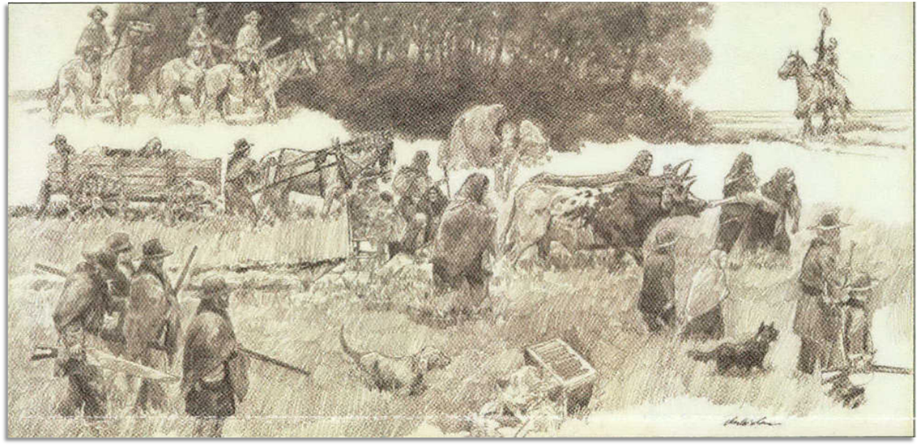
Part II: Timeline of the Revolution
Notes:
Highsmith, Carol M. Painting, ‘Dawn at the Alamo,’ by Henry Arthur McArdle, Hanging in the Senate Chamber of the Texas State Capitol in Austin, Texas. April 17, 2014. Library of Congress Prints and Photographs Division. https://www.loc.gov/pictures/resource/highsm.27909/.
Battle of San Jacinto. 1901. Texas History Stories: The Alamo, Remember Goliad, Story of San Jacinto by E. G. Little John. 42.Richmond, VA: B. F. Johnson Publishing Company, 1901. University of North Texas Libraries, The Portal to Texas History, https://texashistory.unt.edu/ark:/67531/metapth14381/.
Highsmith, Carol M. The "Come and Take It" cannon at the Gonzales Memorial Museum in Gonzales, Texas. April 23, 2014. Photograph. Library of Congress Prints and Photographs Division. https://www.loc.gov/item/2014632782/.
Star of the Republic Museum (Washington, Tex.). Star of the Republic Museum Notes, Volume 43, Number 2, 2018, periodical, 2018; Washington, Texas. (https://texashistory.unt.edu/ark:/67531/metapth1115241/: accessed February 25, 2025), University of North Texas Libraries, The Portal to Texas History, https://texashistory.unt.edu; crediting UNT Libraries Government Documents Department.

Slide 8
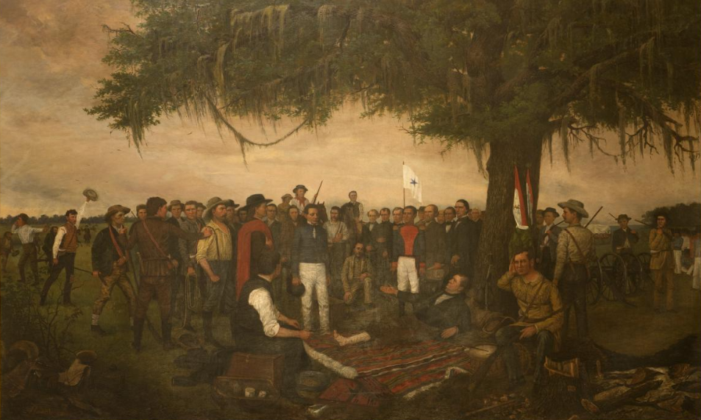
Part III: Matching
The Surrender of Santa Anna
Library of Congress
Notes:
Highsmith, Carol M, photographer. Painting, "Surrender of Santa Anna," by William Henry Huddle, in the South Foyer of the Texas Capitol, Austin, Texas. April 17, 2014. Photograph. Library of Congress Prints and Photographs Division. https://www.loc.gov/item/2014632129/

Slide 9
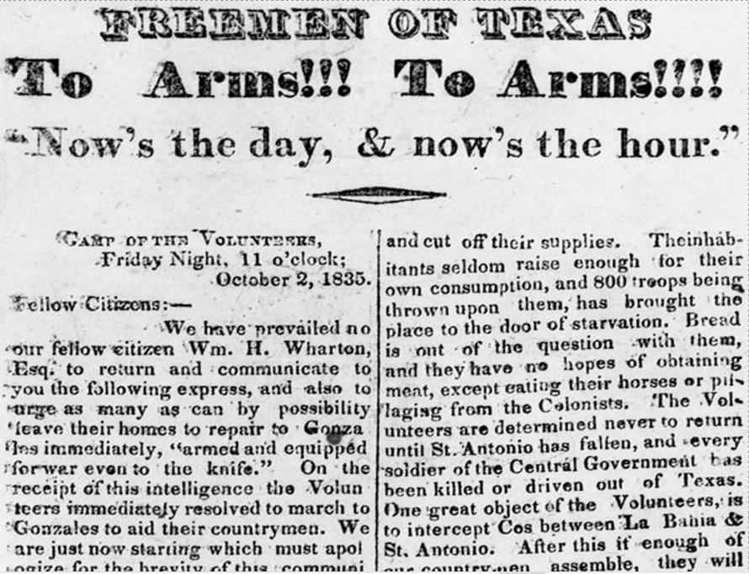
Part IV: Practice Test Questions
The Texas Republican Newspaper
The Portal to Texas History
Notes:
“We have prevailed on our fellow citizens… no loss on the American side.” Pp. 4 The Texas Republican (Brazoria, Texas) Vol. 1, No. 56, Ed. 1. Published October 10, 1835. https://texashistory.unt.edu/ark:/67531/metapth80274/

Slide 10
Exit Ticket 2 Follow the directions below to complete your exit ticket
Complete the graphic organizer assessing your knowledge and readiness for our unit 5 test.
Share with a partner

Slide 11
Share with the class: 2
(Choose one thing to share from your exit ticket)

