Slide 1
Road to the Texas Revolution
1824-1835
Lesson Overview
The Texas Revolution began well before 1836. It was not just one event that started the revolution, it was a series of small events. This lesson includes the following events:
The Mexican Constitution of 1824
1826 Fredonian Rebellion
1828 Mier y Teran Report
The Law of April 6, 1830
Disturbances at Anahuac 1832
Turtle Bayou Resolution - June 13, 1832
Battle of Velasco - June 25-26, 1832
Conventions of 1832 and 1833
December 1833 – Austin’s Arrest
1835 Battle of Gonzales
1835 Siege of San Antonio de Bexar
https://education.texashistory.unt.edu
Notes:
Student directions: Please create a Road to Revolution TIMELINE 1824–1835 using the guided notes provided by your teacher.

Slide 2

Essential Questions:
How does conflict cause political, economic, and social change?
Explain the lasting impact of the people and events leading to the Texas Revolution.
In what ways did the Mier y Teran Report and the Law of April 6, 1830 lead to the Texas Revolution?
https://education.texashistory.unt.edu
Notes:
Take a moment to allow the students to generalize these questions. Encourage them to write them down and focus on these as the lesson goes. They will be expected to answer these at the end of the lesson to apply their knowledge.

Slide 3


Mexican Constitution of 1824
The Federal Constitution of the United Mexican States was enacted on October 4, 1824, to establish a federalist form of government. The constitution limited the federal government's power and gave greater power to the individual states. This division of power is known as federalism. Both Tejanos and the Anglo-American settlers supported the Constitution of 1824 because it gave more power to the people, similar to the United States. The Constitution of 1824 also joined the two regions of Coahuila and Texas to form the new Mexican state of Coahuila y Tejas.
https://education.texashistory.unt.edu

Slide 4
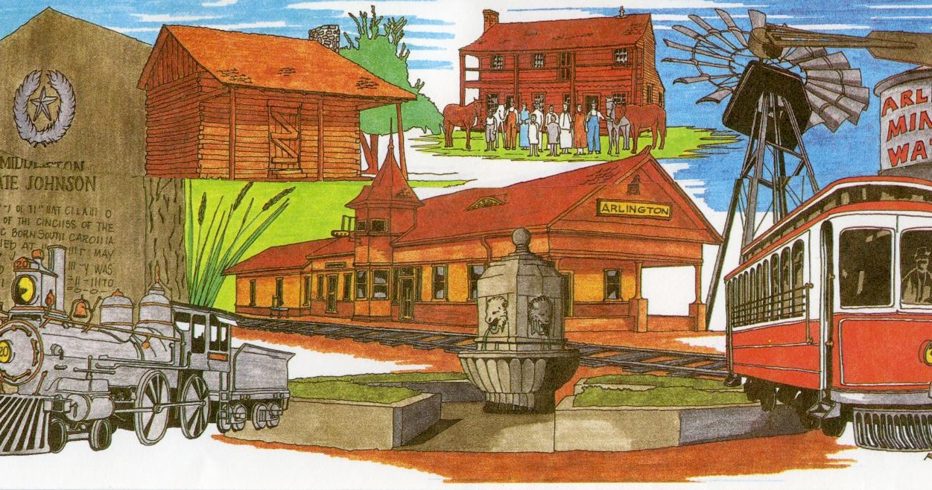
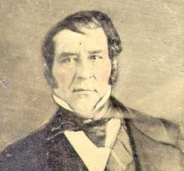
1826 - Fredonian Rebellion
Edwards and his brother were supposed to settle 800 families in East Texas near Nacogdoches. Hayden discovered that much of his land grant was already occupied with Mexican settlers, American squatters, and Cherokee Indians. Almost immediately, Edwards began angering people in the area when he posted notices declaring that anyone already living within the bounds of his grant had to
produce valid titles for their land. Anyone who could not prove legal ownership would have their land confiscated and sold. Then on December 21, 1826, Edwards and a small group of his men declared Nacogdoches to be independent of Mexico's rule; they called the new nation the Fredonian Republic. Edwards’ actions upset the Tejanos in San Antonio and Stephen F. Austin, who sent his militia to stop the rebellion. Edwards would escape to the United States. As a result of the rebellion, Mexico became suspicious of the Anglo colonists.
https://education.texashistory.unt.edu
Notes:
Have the students respond to Were the Edwards Brothers justified in doing what they did?

Slide 5

Think like a Historian:
Think - Pair - Share
Using the guided questions, analyze the primary source letter written by Stephen F. Austin to one of the Fredonia Rebels, B.J. Thompson
Support your claims using text evidence.
Primary source letter from Stephen F. Austin to One of the Fredonian Rebels
Source:
Eugene Barker, ed., Annual Report of the American Historical Association for the Year 1919: The Austin Papers, (Washington, D.C.: Government Printing Office, 1924), 3 vols., Vol 1, Part 2, pp. 423-429
Document Analysis Questions:
Think – Read the letter and complete questions 1-4 independently.
Pair – With one other partner, collaborate and answer questions 5 and 6.
Share – In a group setting, share your answer to number 6. When it is not your turn to share, practice active listening.
https://education.texashistory.unt.edu
Notes:
Students should be familiar with primary source documents and have experience in interacting with such content. The students will need a printed copy of the “Letter from Stephen F. Austin to one of the Fredonia Rebels.” On this slide, have students analyze the letter by using the guided analysis questions. Allow students to work in small groups or with partners. Give students adequate time to form and opinion 4-6 minutes and facilitate a whole class discussion after the group time is up.
What was the purpose of this letter?
What was Stephen F. Austin’s overall tone in this letter?
What is Austin warning about in this statement? “...and I assure you that were it necessary they could march five thousand troops to that district in two months and you would find that every man in this colony able to bear arms would freely and cheerfully join them.”
In Austin’s final statement he makes the remark “but I am unwilling to believe that you have all run mad.” If you were the recipient of this letter, how would you react to that claim?
What three things did Austin instruct the Fredonia Rebels to do to clear things up with the Mexican government?
Do you think the Fredonia Rebels listened to Austin’s instructions? Explain your reasoning.

Slide 6
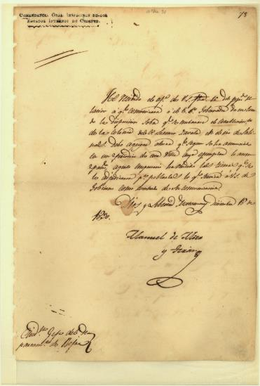
1828 – Mier y Teran Report
Because of the Fredonian Rebellion Mexico City sends General Mier y Teran in 1828 to check on Texas. Teran was impressed with the large farms, but he noted that Anglo-Americans outnumber the Mexicans 10 to 1 and spoke English instead of Spanish. Many Anglo-Americans didn’t respect Mexican law and there was more influence on Texas by the United States than Mexico. He recommended that Mexico City should act quickly to stop the Anglo invasion of Texas.
https://education.texashistory.unt.edu

Slide 7
Think like a Historian 2:
Think - Pair - Share
Using the guided questions on the handout, analyze the Articles of the Law of April 6, 1830 through the perspective of a Mexican Citizen and new American Colonist living in Tejas (Texas).
Remember to support your claim with text evidence.
At the suggestion of General Mier y Teran the Mexican Government outlined a new law simply called the Law of April 6, 1830 - Take a look at some of the Articles summarized below.
Summary of the six focus articles Law of April 6, 1830:
Article 3: The government may choose the new empresarios for Texas
Article 7: Natural Mexican citizens who want to move to Texas will be provided transportation and the best land.
Article 9: Americans could no longer migrate into Texas (unless they received special permission from Mexican officials).
Article 10: No more slaves will be allowed in Texas.
Article 11: Americans cannot live next to the United States. If they already are, they must move.
Article 14: 500,000 pesos will be used to build the new forts
https://education.texashistory.unt.edu
Notes:
Students should be familiar with primary source documents and have experience in interacting with such content. The students will need a printed copy of the “Articles of the Law of April 6, 1830” On this slide, have students analyze the articles by using the guided analysis questions. Allow students to work in small groups or with partners. Give students adequate time to form and opinion 4-6 minutes and facilitate a whole class discussion after the group time is complete.

Slide 8
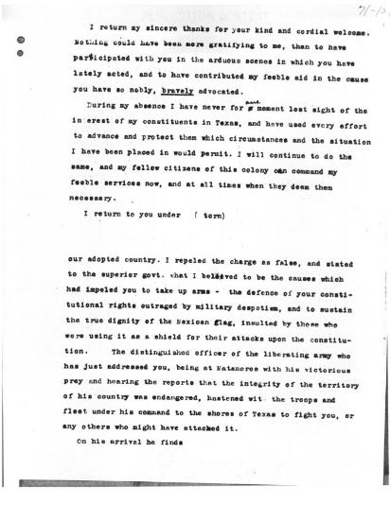
June 1832 - Disturbance at Anahuac
Col. Juan Davis Bradburn, along with Customs Inspector George Fisher, was sent by the Mexican Gov't to establish a military garrison at the port city of Anahuac to enforce the Law of April 6, 1830. Bradburn would also enforce the immigration ban on Anglo-Americans, attempted to end the smuggling, and collect tariffs on all American goods, resulting in an increase in the prices of goods that angered the colonists.
Bradburn was a true believer in the Centrist viewpoint, and his actions began to upset the Anglo-Americans. Tension peaked when Bradburn jailed William Barret Travis and his law partner Patrick Jack. They tried to trick Bradburn into releasing the runaway slaves he was hiding in their custody. The confrontation ended when a Mexican military commander from Nacogdoches arrived, realized the situation was explosive and relieved Bradburn of command.
https://education.texashistory.unt.edu

Slide 9
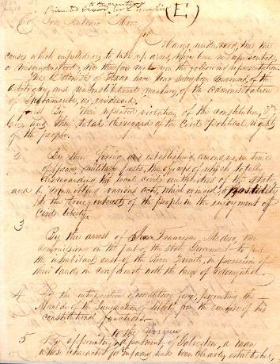
June 13, 1832 – Turtle Bayou Resolution
Because of Mexican Col. Juan Davis Bradburn's heavy-handed tactics enforcing the Law of April 6, 1830, the Anglo-Americans wrote the Turtle Bayou Resolutions in 1832, which explained their reasons for attacking Bradburn's men and the Fort at Velasco. The resolutions also opposed the Centralist government in Mexico City. They were against the ongoing civil war in Mexico and pledged to honor the Constitution of 1824. The colonists also began to align themselves with Santa Anna, who would soon be leading Mexico as a Federalist.
https://education.texashistory.unt.edu

Slide 10
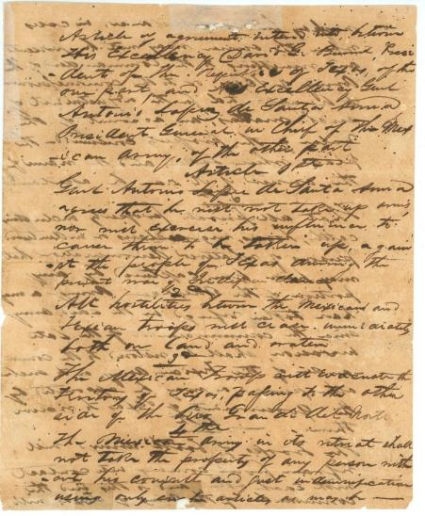
June 25-26, 1832 - Battle of Velasco
On June 25, 1832, a small militia of Texans led by John Austin sailed down the Brazos River to help reinforce Anahuac. Onboard was a cannon which alarmed the Mexican commander at Fort Velasco, who fired on the ship. The Anglo militia fired back; eventually, the Texans prevailed, and the Mexican soldiers surrendered the fort.
https://education.texashistory.unt.edu

Slide 11
The Convention of 1832
Because of the recent disturbances in Anahuac, the Battle of Velasco, and the Turtle Bayou Resolutions, fifty-five delegates, all Anglo-Americans representing the sixteen districts across Texas, met on October 1, 1832, in San Felipe de Austin. The Tejanos refused to send a delegate. The Anglo-Americans were unhappy with the conservative centrist government and sought reforms for Texas and silenced the rumors that Mexican Texas wanted to secede. Stephen F. Austin was elected president of the convention, and the convention adopted a series of resolutions-
  1. Provide a tariff exemption to Texas for another three years;
  2. Modified the Law of April 6, 1830, to permit immigration from the United States;
  3. Asked for lands for public schools.
  4. Adopted a motion to request Texas have separate statehood from Coahuila.
Because the Tejanos refused to participate, the resolutions were never presented to the Mexican government. Austin thought that the petition for statehood was premature, and since Santa Anna had not yet taken over the national government from conservative Anastasio Bustamante, Austin wanted to be cautious.
https://education.texashistory.unt.edu

Slide 12
The Convention of 1833
The Convention of 1833 met at San Felipe on April 1, 1833. Stephen F. Austin was visiting other Tejano settlements to secure their cooperation. Since the requests of the previous Convention of 1832 had not been formally approved by the Mexican government, this convention met again to petition the repeal of the anti-immigration section of the Law of April 6, 1830. In addition, the delegates asked for -
  Better defenses against American Indian attacks
  Judicial reform
  Improved mail service
  Tariff exemptions
The delegates also proposed splitting Coahuila and Texas and writing a new state constitution with the help of Sam Houston. This new constitution would closely follow the democratic ideals found in America. Once complete, the convention selected Juan Erasmo Seguín, Dr. James B. Miller, and Stephen F. Austin to present the petitions to the government; Seguín and Miller were unable to go. Austin went to Mexico City alone.
https://education.texashistory.unt.edu

Slide 13
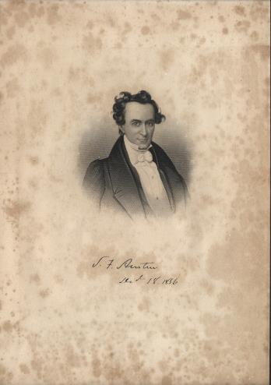
Austin heads to Mexico
Stephen F. Austin left Texas to present the petitions of the Convention of 1833 to the Mexican government. On his arrival in Mexico City in July 1833, Santa Anna was in the middle of a civil war and a cholera epidemic plagued the city, delaying Austin’s meeting with Santa Anna. Months passed, and Austin grew frustrated; he wrote a letter to the leaders in San Antonio de Bexar suggesting that Texas should organize as a separate state, under the provisions of the Acta Constitutive of May 7, 1824. Austin noted that Texas would be ruined forever if they did not take matters into their own hands.
Austin would eventually meet with Santa Anna, who would repeal the Law of April 6, 1830. In addition, the Mexican government promised to make significant reforms. Santa Anna did not approve separate statehood for Texas.
https://education.texashistory.unt.edu

Slide 14
1833 – Austin’s Arrest
Austin's letter was intercepted by the alcalde of San Antonio de Bexar, who sent Austin's letter to Mexican Vice-President Farias. The vice-president believed the letter to have treasonable intentions. So he had Austin arrested and taken back to Mexico City, where Austin was imprisoned and put in solitary confinement for three months. Austin was also denied the use of books or writing materials. No charges were ever brought against Austin, and no court would accept his case, sadly Austin remained a prisoner. In December 1834, Austin was released from prison and placed under house arrest in Mexico City. Then in July 1835, Austin was set free and soon returned to Texas.
Austin was absent from Texas for over two years.
https://education.texashistory.unt.edu

Slide 15
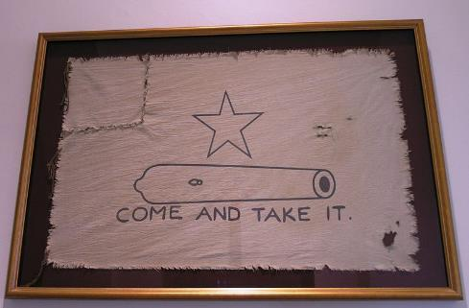
October 2, 1835 Battle of Gonzales
The first battle of the Texas Revolution was on October 2, 1835, when the citizens of Gonzales refused to give up a small cannon that was given to them by the Spanish for protection against American Indian raids. A small militia army led by John Henry Moore flew the “Come and Take It” flag as they would face off against Mexican Lieutenant Castaneda, who led 100 Mexican soldiers to retrieve the cannon. The Texan militia fired on the Mexican soldiers along Guadalupe River, and a short battle ensued. Realizing he was outnumbered, Castaneda retreats to return to San Antonio. As a result of this battle, the tensions between Anglo-American and Tejanos in Texas against Santa Anna's government grew more intense.
https://education.texashistory.unt.edu

Slide 16
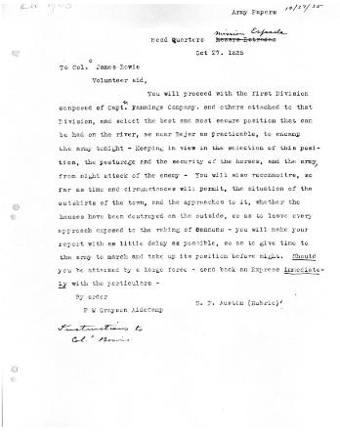
Siege of San Antonio
The Siege of San Antonio de Bexar was the first military campaign of the Texas Revolution. The Texans knew they needed to control San Antonio and sent Stephen F. Austin, elected the commander of the Texan army. When Austin arrived with the Texas militia in mid-October 1835, the discovered that Mexican General Martin Perfecto de Cos had occupied the city with troops loyal to Santa Anna. Cos would defend the city; the Texan army swelled to 600, surrounded the town, and began a month-long siege.
https://education.texashistory.unt.edu

Slide 17
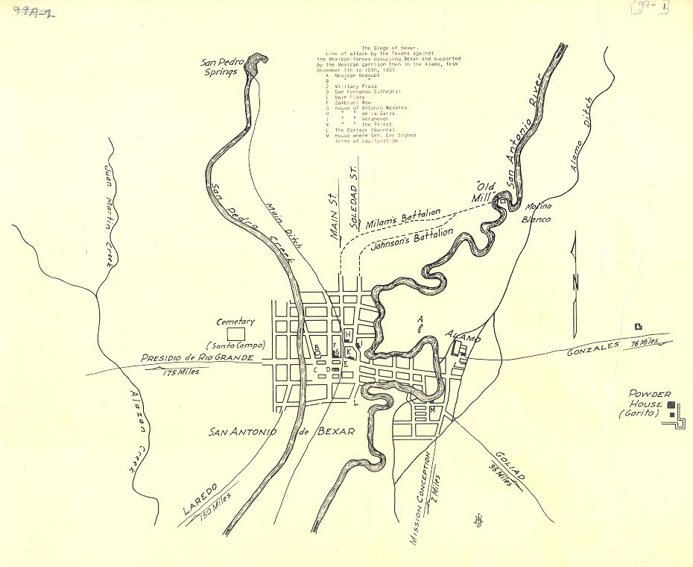
Siege of San Antonio Continued pt1
At dawn on December 5, 1835, the Texan army attacked the Mexican troops in San Antonio. The fighting was house-to-house, with the Texans slowly gaining control of the area. Over the course of several days, they inflicted about 150 casualties on the Mexicans. Running low on food and supplies, Mexican General Cos surrenders on December 9, 1835. The Texans ordered them to leave Texas, promise to never come back, and to swear to never oppose the Constitution of 1824.
https://education.texashistory.unt.edu

Slide 18
Siege of San Antonio Continued pt2
After the battle, most people in Texas believed that Mexican troops would stay out of the region for at least several months. It was the start of winter, and no one thought that the Mexican army would return any time soon.
Most of the Texas volunteers eventually returned to their homes, leaving San Antonio and Texas under the control of the Texans.
https://education.texashistory.unt.edu

Slide 19
Essential Questions
Apply your knowledge:
Think - Pair - Share
Using the lesson essential questions discussed at the beginning of the lesson and your newly gained perspective about the events of the Road to the Revolution, answer the following questions using text evidence.
Use notes and activities from this lesson to support your thinking process.
Essential Questions - Exit Ticket
How does conflict cause political, economic, and social change?
Explain the lasting impact of the people and events leading to the Texas Revolution.
In what ways did the Mier y Teran Report and the Law of April 6, 1830 lead to the Texas Revolution?
https://education.texashistory.unt.edu
Notes:
Revisit the lesson specific essential questions. Allow students to work with a partner or small group for 5-8 minutes to discuss possible answers to the questions. They may need to refer to notes or activities completed during the lesson. Bring all the students together after time is up to facilitate a whole group discussion over the essential questions.

