Slide 1
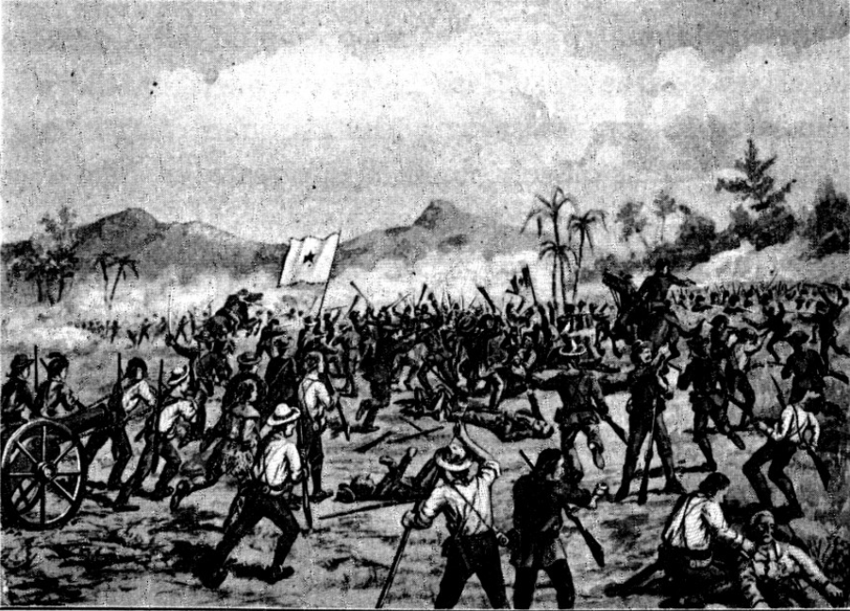
Unit 5: The Texas Revolution
Extension Lesson:
The Battle of San Jacinto
Notes:
Littlejohn, E. G., 1862-. Texas History Stories: The Alamo, Remember Goliad, Story of San Jacinto., periodical, 1901; Richmond, Virginia. (https://texashistory.unt.edu/ark:/67531/metapth14381/: accessed March 26, 2025), University of North Texas Libraries, The Portal to Texas History, https://texashistory.unt.edu; crediting UNT Libraries Special Collections.

Slide 2
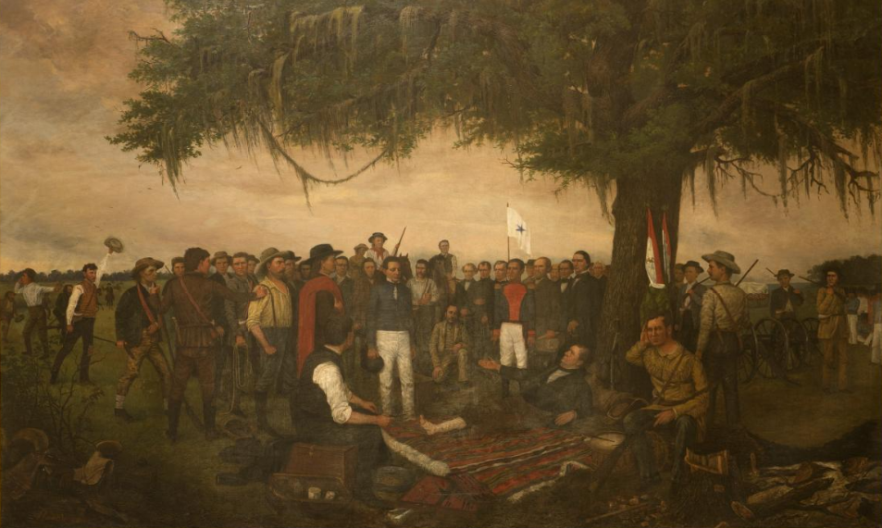
Warm-up Use the image here and on your paper to complete your warm-up
“The Surrender of Santa Anna” by William Henry Huddle
The Library of Congress
Notes:
Highsmith, Carol M, photographer. Painting, "Surrender of Santa Anna," by William Henry Huddle, in the South Foyer of the Texas Capitol, Austin, Texas. April 17, 2014. Photograph. Library of Congress Prints and Photographs Division. https://www.loc.gov/item/2014632129/

Slide 3
Share with the class
One thing I notice about the image is _______.
I think this image might be related to today’s lesson because ______

Slide 4
Essential Question
What were the causes, effects, and most significant events of the Battle of San Jacinto?

Slide 5
In today’s lesson…
We will analyze the causes, effects, key events, and significance of the Battle of San Jacinto.
I will watch a video about the Battle of San Jacinto, take notes on key information from the video, and answer questions related to the information in the video.

Slide 6
Video Vocabulary
Term | Definition
Improbable (adj) | Unlikely or unexpected
Vulnerable (adj) | In a position to be easily attacked; not completely safe.
A ridge (n) | A long, narrow, elevated area of land
Crest (n) | The highest point of elevated land, like a hill or ridge.
Barrage (n) | A continuous and heavy period of bombing or shooting in a war or battle, typically aimed at a specific area
Cavalry (n) | A branch of the military in which soldiers travel and fight on horses.

Slide 7
Before you watch
Read the instructions before you begin this segment.
Before you watch | After you watch | Statement
T / F | T / F | Sam Houston retreated from Santa Anna because he did not want to face the centralist army in battle.
T / F | T / F | Santa Anna divided his army in an attempt to move as quickly as possible to capture the Texas government and defeat Houston’s army.
T / F | T / F | The Texas victory at the Battle of San Jacinto was not the primary factor that ended the Texas Revolution.
T / F | T / F | The Texas Revolution was important in Texas history but had little influence on the history of the United States or Mexico.

Slide 8
While you watch
Read the directions before you begin this segment
Factors that contributed to the Texan Victory at San Jacinto

Slide 9
Click here to watch the video of the Battle of San Jacinto

Slide 10
After you watch Step 1
Before you watch | After you watch | Statement
T / F | T / F | Sam Houston retreated from Santa Anna because he did not want to face the centralist army in battle.
T / F | T / F | Santa Anna divided his army in an attempt to move as quickly as possible to capture the Texas government and defeat Houston’s army.
T / F | T / F | The Texas victory at the Battle of San Jacinto was not the primary factor that ended the Texas Revolution.
T / F | T / F | The Texas Revolution was important in Texas history but had little influence on the history of the United States or Mexico.

Slide 11
After you watch Step 2
Answer the questions about the Battle of San Jacinto based on the information presented in the video.
The Surrender of Santa Anna by William Henry Huddle
The Library of Congress

Slide 12
Exit Ticket Follow the directions on your paper to complete your exit ticket
Complete the sentence stems about the Battle of San Jacinto based on the information presented in the video.
Share with a partner

Slide 13
Share with the class 2
One important event that caused the Battle of San Jacinto was _________
One important piece of information about the Battle of San Jacinto is ____
One important effect of the Battle of San Jacinto was _______

