Slide 1
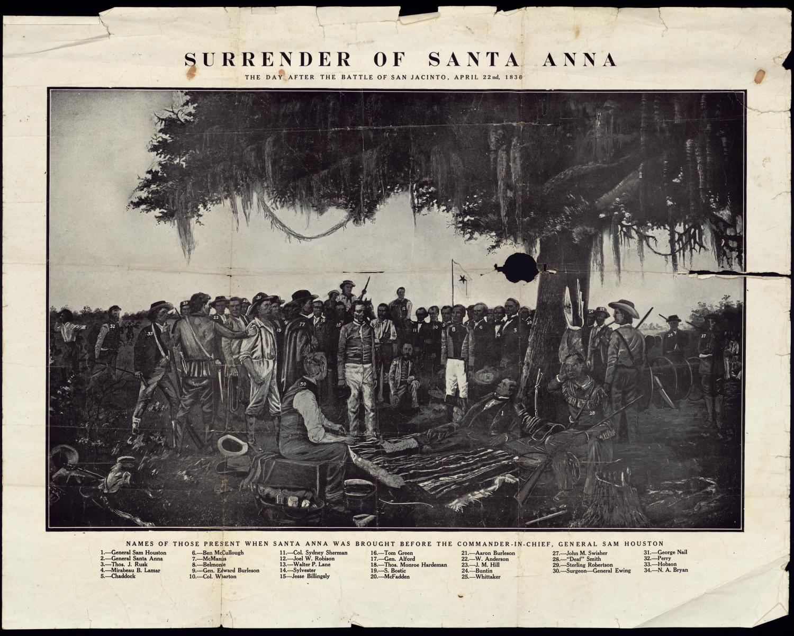

Introduction to the Texas Revolution – 1835
https://education.texashistory.unt.edu

Slide 2
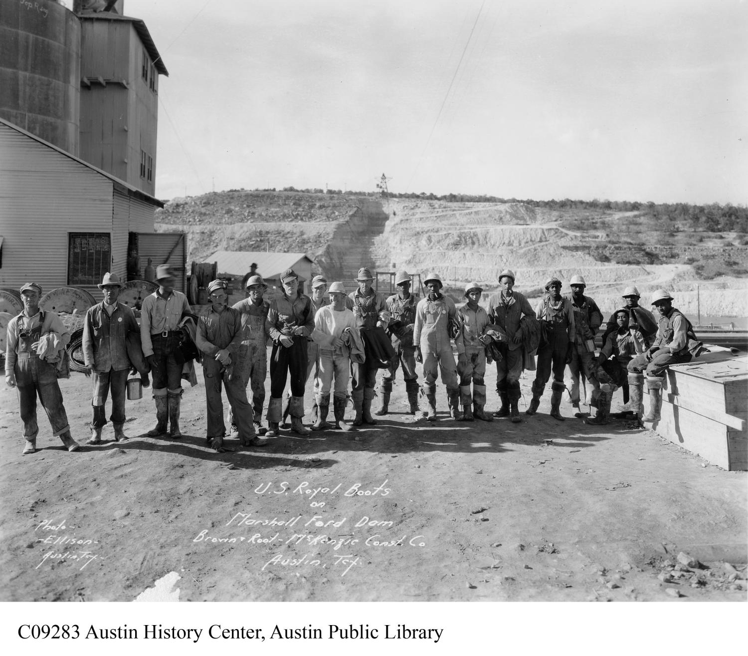
Essential Question
How did conflicts and instability within Mexico’s government lead to revolt among the Texas colonists?
https://education.texashistory.unt.edu

Slide 3
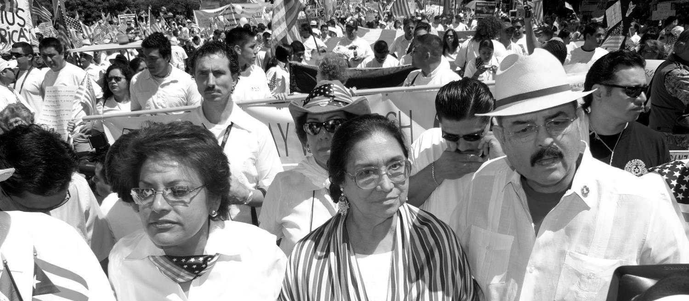
Hook Exercise: I need a little help…
Scenario: You are president of a club at school and in charge of organizing all materials needed for the big event coming up. You’ve already collected around 60% of the items needed through donations but you’re still missing a noticeable amount of supplies. You’ve reached out to your friends, neighbors, teachers, local businesses, and many others along the way and you are running out of contacts and time. With only one week to go before the big event, you decide to reach out one last time for more help and you know the perfect person! They know plenty of people and have connections to more local businesses. When this is all over, you’re going to owe them one BIG TIME!
Instructions: In the space provided on your paper, write a 3-4 sentence letter to a family member persuading them to help you finish collecting donations for your club’s event. Include the following explanations in your letter: why you need their help, what you need them to do, and how much time you have left to collect the items. Remember to add a closing statement.
https://education.texashistory.unt.edu

Slide 4
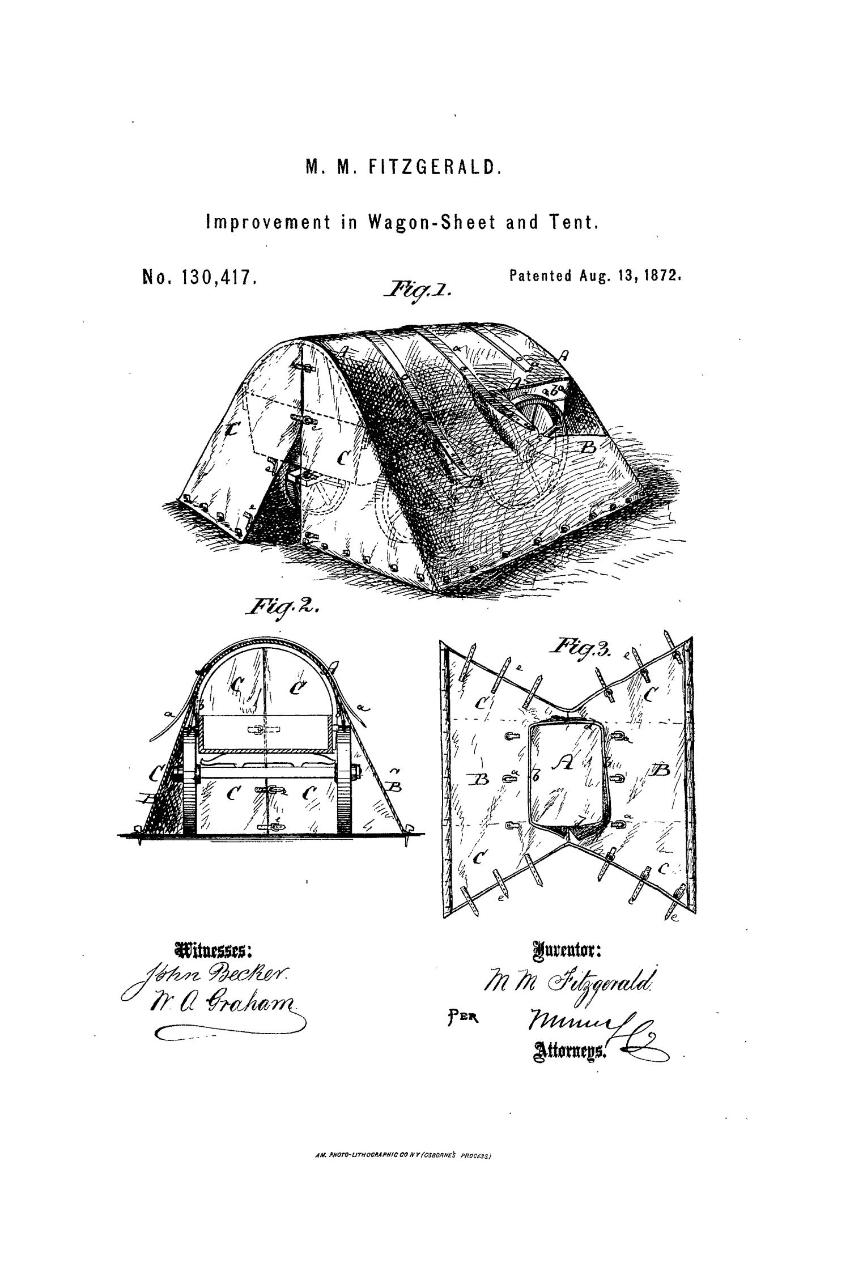
Background Information:
After Mexico defeated Spain in the Mexican War for Independence, they established a new government and a new set of laws known as the Federal Constitution of the United Mexican States (more commonly referred to as the Constitution of 1824). Early Anglo-American colonists settled in Texas under the newly established laws of the Republic of Mexico. However, the laws changed rapidly over the span of about 10 years and resulted in major conflict between two main groups: government officials who wanted all the power in the central government, known as Centralists, and government officials (including the Texians) who wanted the power to remain divided between states or provinces, known as the Federalists. On August 8, 1825 a group of Texians in San Jacinto met together to document the changes in the Mexican government. During their meeting, they wrote a letter of warning to all Texans titled “San Jacinto Resolutions” and published it in The Texas Republican (the local newspaper; the most modern form of media during that time).
Compare and contrast the select articles of the Mexican Constitution to the claims Texans made against the Mexican government in the San Jacinto Resolutions.
https://education.texashistory.unt.edu

Slide 5
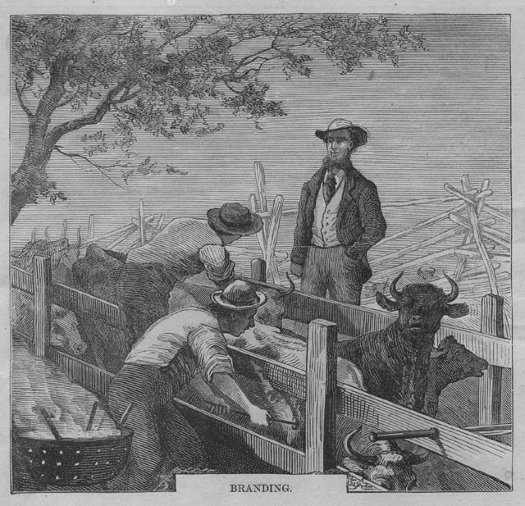
Analysis Questions:
Consider select analysis questions below as you view each document.
Based on the information in document “A”, which article gave states power? Support your answer with text evidence.
Compare the form of government outlined by the articles in document “A” to the United States government. Provide two examples below, one similarity and one difference.
In your opinion, do you think Anglo-American Colonists liked or disliked the similarities between the American government and the Mexican government? Explain your answer.
In your opinion, were the Texian claims in the San Jacinto Resolutions against the Mexican government justified? Explain your reasoning.
https://education.texashistory.unt.edu

Slide 6
Analyze Document A:
The Mexican Constitution of 1824
https://education.texashistory.unt.edu

Slide 7
Document A: The Mexican Constitution of 1824
Article | What it says:
Article 1 Established Mexico as a free nation. | The Mexican nation is forever free and independent of the Spanish government and of every other power.
Article 2 Established provinces (or state borders) within Mexico in order to establish federalism, or shared powers, among the states. | Its territory comprehends the former vice-royalty of New Spain, the captain-generalship of Yucatan, the former commandancies of the internal provinces of the East and West and Upper and Lower California with the lands annexed and the adjacent islands in both oceans. A constitutional law will be made for designating the boundaries of the Federation as soon as circumstances will permit.
Article 3 Established Catholicism as the official religion of Mexico. | The religion of the Mexican nation shall perpetually remain the Roman Catholic and Apostolic. The nation protects it by wise and just laws and prohibits the exercise of any other.
Article 4 (1) Established a democratic form of government giving power to the people through voting rights. (2) Divided power among the states and National government. | The Mexican nation adopts for the form of its government a popular representative and federal republic.
Article 6 Created a checks and balances system | The Supreme power of the Federation as to its exercise, is divided into the legislative, executive and judicial powers.
https://education.texashistory.unt.edu

Slide 8
Analyze Document B:
San Jacinto Resolutions August 8, 1835
https://education.texashistory.unt.edu

Slide 9
Document B: San Jacinto Resolutions
August 8, 1835, Part 1
(Section 1)
Whereas, we have heard with profound regret, that the federal republican government of Mexico, has been violently dissolved’ that the constitutions of the several free and independent States, composing that confederation, have been declared abrogate, and void; that the late President of the Republic, General Santa Ana, has been invested with extraordinary, dictatorial powers, and a central consolidated government has been established at the city of Mexico; that the civil militia of the nation has been disarmed and disbanded that some of our Sister States have been invaded by a military force and the blood of their citizens profusely shed [to] coerce them into submission to the new administration; and that a similar invasion is contemplated, and is now in preparation to be made upon Texas; therefore the citizens of the precinct of San Jacinto assembled to deliberate upon the solemn crisis in our public affairs, have adopted the following resolutions, as indicative of our views and feelings; and we do earnestly recommend the mature consideration of the same subject to our fellow citizens of Texas generally.
https://education.texashistory.unt.edu

Slide 10
Document B: San Jacinto Resolutions
August 8, 1835, Part 2
(Section 2)
Resolved, That the original, proper, and legitimate objects of Government, are the convenience, the happiness, and the prosperity of the people. . . That the dissolution of the government is virtually a dissolution of the political union . . .
(Section 3)
Resolved, that confiding in the correctness of the information we have received from various quarters, we consider the federal Republican Government of the United Mexican States, as, subverted, dissolved, annihilated; and that the allegiance of every citizen to that Government, is, necessarily, absolved, and of no more political or moral obligation.
(Section 4)
Resolved, that in these painful and embarrassing circumstances, it becomes the duty of every citizen to deliberate calmly, dispassionately, and with a full knowledge of facts, and to scrutinize with a zealous caution, the present condition, and the prospective well being of Texas, before he resolved to precipitate himself and his country in all the multiplied and tremendous horrors of a civil war.
https://education.texashistory.unt.edu

Slide 11
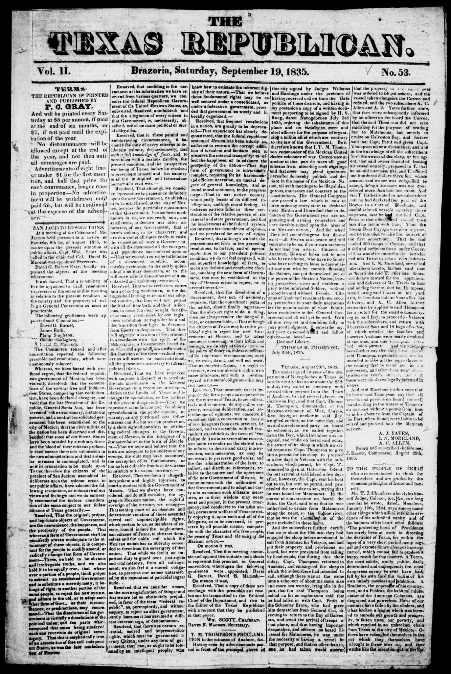
The Texas Republican
The Texas Republican:
Saturday, September 19, 1835
Weekly newspaper from the Brazoria, Texas area that includes local, state and national news along with notices and advertising. This particular newspaper contains the San Jacinto Resolutions to inform other Anglo-American settlers in Texas of the issues in Mexico’s government.
Brazoria County Area Newspapers
Situated in the Gulf Coast region of Texas, Brazoria County has seen publication of some of the earliest newspapers published in Texas. One of the earliest titles in this collection, the Texas Gazette and Brazoria Commercial Advertiser, began publication in 1832 and documents Texas' history when it was still a part of the United Mexican States, in the state of Coahuila y Tejas.
https://education.texashistory.unt.edu

Slide 12
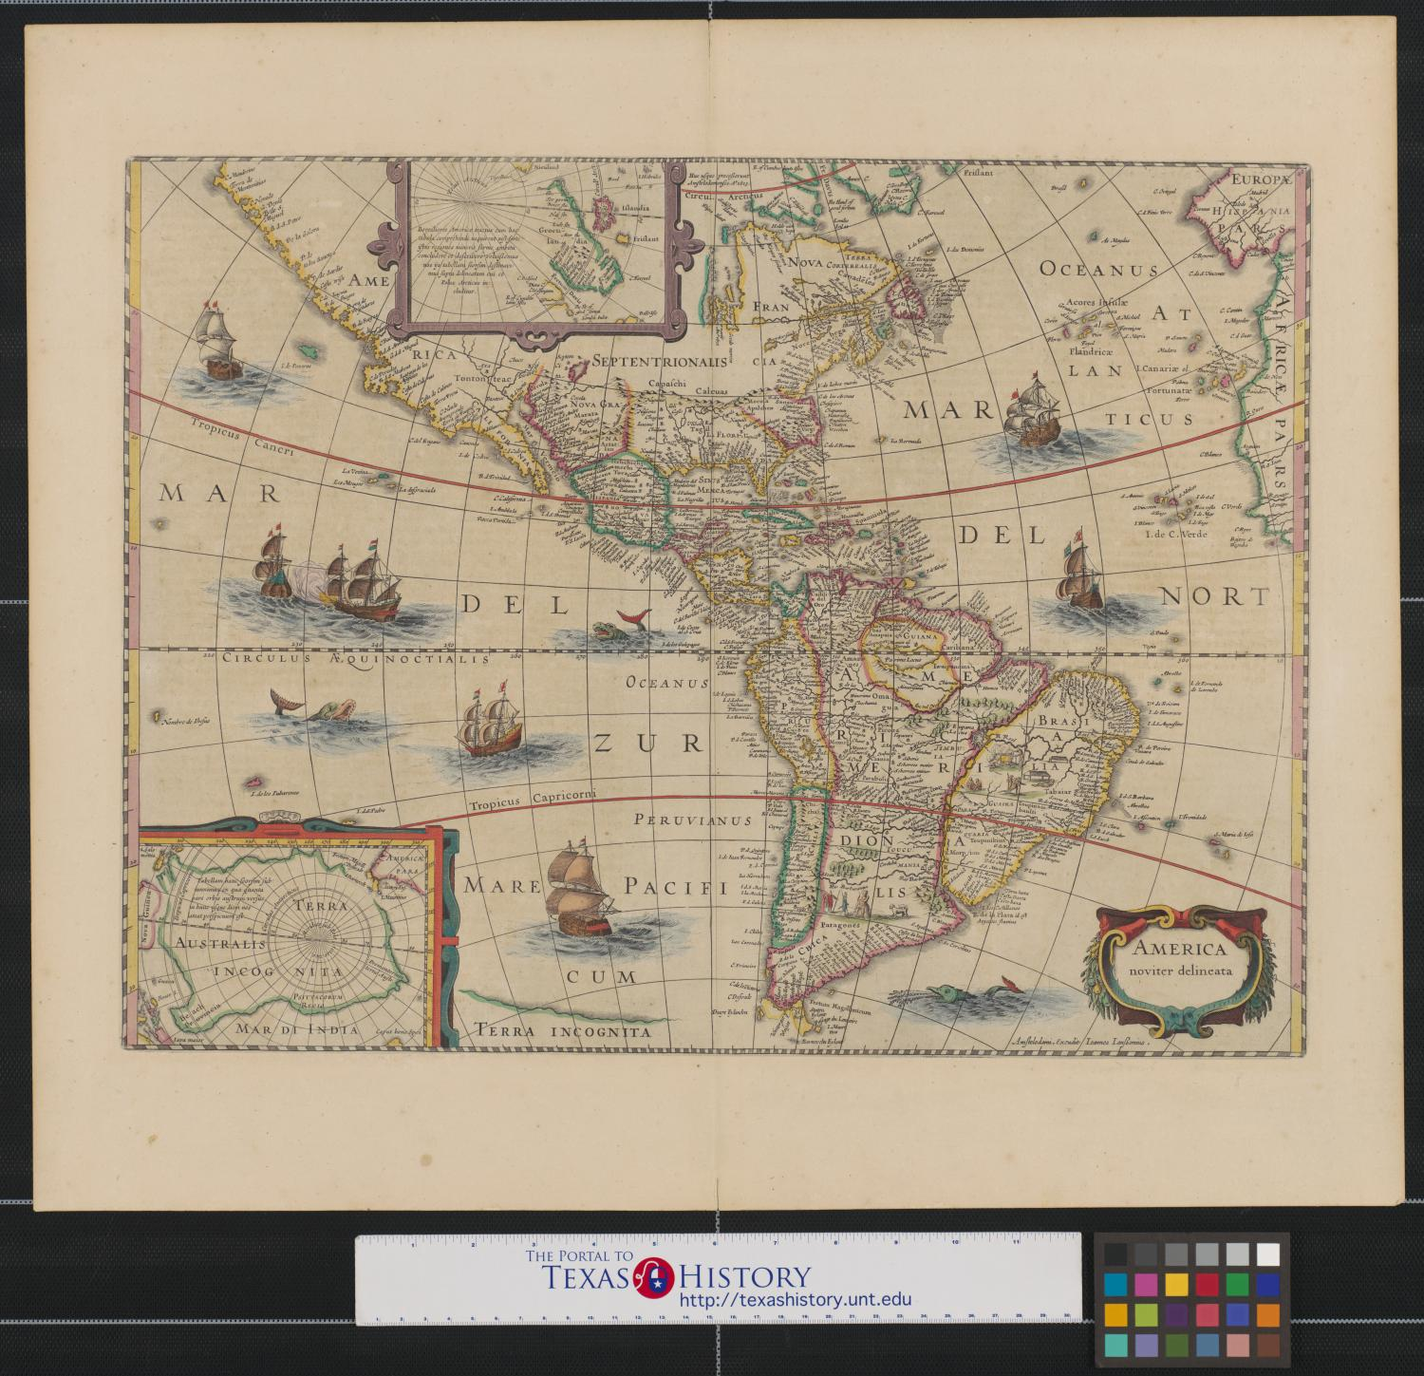

Document analysis instructions:
Think like a Historian:
Compare and Contrast The Constitution of 1824 vs. San Jacinto Resolutions
Source: Printed in the Texas Republican, September 19, 1835
With group members, analyze the articles of the Mexican Constitution of 1824 in comparison to the San Jacinto Resolutions and answer questions 1-7 under the document analysis section.
https://education.texashistory.unt.edu

Slide 13
Texas Declaration of Causes for Taking Up Arms Against Santa Anna
November 7, 1835
https://education.texashistory.unt.edu

Slide 14
Texas Declaration of Causes for Taking Up Arms Against Santa Anna
November 7, 1835, Part 1
Introduction:
Whereas, Gen. Antonio Lopez de Santa Anna, and other military chieftains, have by force of arms, overthrown the federal institutions of Mexico, and dissolved the social compact which existed between Texas and the other members of the Mexican Confederacy, now the good people of Texas, availing themselves of their natural rights, SOLEMNLY DECLARE,
https://education.texashistory.unt.edu

Slide 15
Texas Declaration of Causes for Taking Up Arms Against Santa Anna
November 7, 1835, Part 2
1st. That they have taken up arms in defense of their rights and liberties, which were threatened by encroachments of military despots, and in defense of the republican principles of the federal constitution of Mexico, of 1824.
2nd. That Texas is no longer morally or civilly bound by the compact of union; yet stimulated by the generosity and sympathy common to a free people, they offer their support and assistance to such of the members of the Mexican Confederacy as will take up arms against military despotism.
3rd. That they do not acknowledge that the present authorities of the nominal Mexican Republic, have the right to govern within the limits of Texas.
https://education.texashistory.unt.edu

Slide 16
Texas Declaration of Causes for Taking Up Arms Against Santa Anna
November 7, 1835, Part 3
4th. That they will not cease to carry on war against the said authorities, whilst their troops are within the limits of Texas.
5th. That they hold it to be their right, during the disorganization of the federal system, and the reign of despotism to withdraw from the union, to establish an independent government, or to adopt such measures as they may deem best calculated to protect their rights and liberties; but that they will continue faithful to the Mexican government so long as that nation is governed by the constitution and laws, that were framed for the government of the political association.
https://education.texashistory.unt.edu

Slide 17
Texas Declaration of Causes for Taking Up Arms Against Santa Anna
November 7, 1835, Part 4
6th. That Texas is responsible for the expenses of her armies, now in the field.
7th. That the public faith of Texas is pledged for the payment of any debts contracted by her agents.
8th. That she will reward by donations in land, all who volunteer their services in her present struggle, and receive them as citizens.
https://education.texashistory.unt.edu

Slide 18
Texas Declaration of Causes for Taking Up Arms Against Santa Anna
November 7, 1835, Part 5
Closing statement:
These declarations we solemnly avow to the world, and call God to witness their truth and sincerity, and invoke defeat and disgrace upon our heads, should we prove guilty of duplicity.
https://education.texashistory.unt.edu

Slide 19
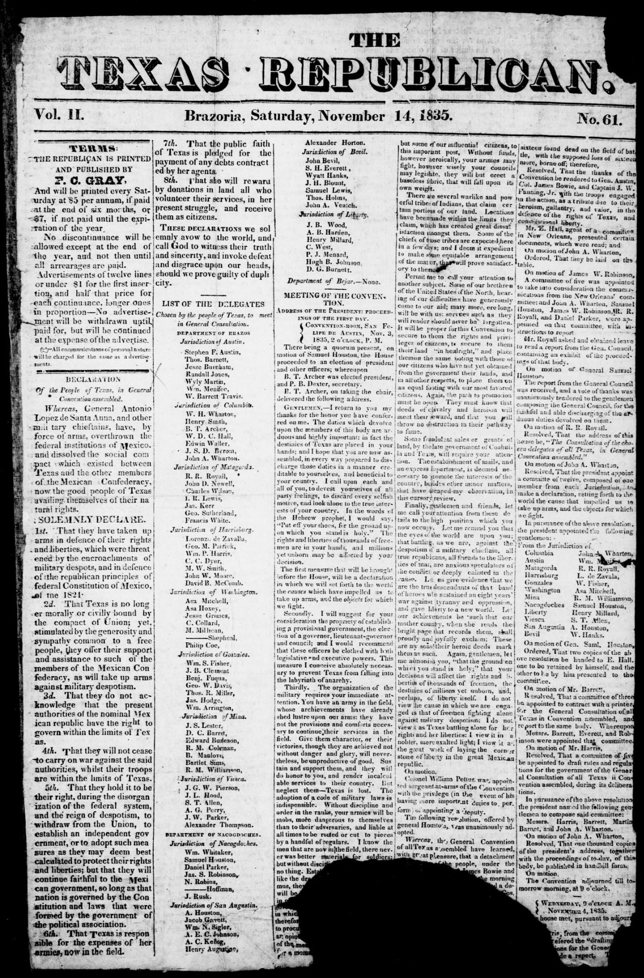
Document analysis, next steps:
Think like a Historian:
Taking up Arms
Source: “Declaration of the People of Texas in General Convention Assembled,” Journals of the Consultation Held at San Felipe de Austin, October 16, 1835 (Published by Order of Congress; Houston, 1838), 21-22.
With group members, analyze the “Texas Declaration of Causes for Taking Up Arms Against Santa Anna” and answer questions 1-6 under the document analysis section.
https://education.texashistory.unt.edu

Slide 20
Letter from Stephen F. Austin to Mary Austin Holley
January 7, 1836
https://education.texashistory.unt.edu

Slide 21
Letter from Stephen F. Austin to Mary Austin Holley
New Orleans, Jan 7, 1836, Part 1
(1) I hope to have the pleasure of seeing you soon, but it is not certain, as I may not be able to visit Lexington until I return from the Eastward as we are very much pressed for time. I am bound to Washington, New York etc. in company with Docr. B. T. Archer, and W. H. Wharton Esqr. We are commissioners for the Texan Government. Our principal object is to raise money means and men to sustain our cause.
(2) The War for Liberty goes on prosperously, so far, in Texas. It must, and will, end in Independence—a full Declaration will be made in March. That of 7th November was the first step, preparatory to the second and final one. The fact is, we have no other remedy left. By the last accounts the Central Government is established, and the Federal system totally destroyed. The Texans may, therefore, for the future, be considered an independent people, entirely separate from Mexico. We are young to set up for ourselves, but we are the sons of that great nation which has astonished the world by its deeds, and progress in the cause of liberty, light and truth. When I left Texas there was not an enemy within our limits, nor east of the River Bravo del Norte. Gen. Santanna, however, is marching on in person with all the force he can collect to annihilate us. We have no fears, but we must be ready for him. We need all the aid we can get in men and money, provisions, arms and ammunition.
https://education.texashistory.unt.edu

Slide 22
Letter from Stephen F. Austin to Mary Austin Holley
New Orleans, Jan 7, 1836, Part 2
(3) Large contributions have been made in the United States for the extension of Christianity over the South Sea Islands by means of Missionary societies. Is not our cause quite as important and sacred? We are trying to banish from our homes religious intolerance and despotism, and to establish in the place of it, liberty and freedom of conscience. How many thousands of pious families of all denominations might find a home and become the proprietors of the soil in Texas—the best soil and climate accessible to north Americans—if religious toleration were once firmly rooted there! Religion, morality, the arts and sciences, the great sources of liberty—which is in fact, the cause of mankind—all unite in calling upon the free, the generous, the enterprising and the pious, to step forward in aid of Texas. We expect aid from the religious portion of the community, and that the pulpit will pour out its fervent prayers to a just God for his blessing on our endeavors, and send its eloquent voice to the people in the cause of all free churches—the cause of truth and justice.
https://education.texashistory.unt.edu

Slide 23
Letter from Stephen F. Austin to Mary Austin Holley
New Orleans, Jan 7, 1836, Part 3
(4) Our fate will probably be decided in three months. Santa Anna is making a great effort. If he fail, it must be his last. Now is the time to aid us— now is the time of salvation. We need everything—provisions and money— and men well armed, officered, and provided. Their expenses will all be refunded at the close of the war, with interest, besides donations in land, The opening is a great one, if it were only a matter of speculation—it is glorious in its cause. A new republic is about to rear its independent banner over a country but lately a wilderness— There is magnificence in the idea—prosperity freedom and glory in the results.
(5) We shall stop one day at Louisville. I should like much to visit Lexington. Some of my much cherished schoolmates and companions of happy days still reside there: John McCalla, Pierce Butler the Todds etc. please remember me to them. Tell my Cousins E_________ and H____________ I hope it will not be long before they can live in Texas with such comforts as they merit. If we weather the storm untill June all will end well and prosperously. I have no doubt we shall, for we rely on aid from the people of the U. S.—but it must be prompt.
https://education.texashistory.unt.edu

Slide 24
Letter from Stephen F. Austin to Mary Austin Holley
New Orleans, Jan 7, 1836, Part 4
(6) There is a Louisiana Battalion; a Georgia Battalion; a Mississippi Battalion; an Alabama Battalion; and a Tennessee Battalion; why can there not be a Kentucky Battalion? It would be a fine opening for a military man of standing—a Lafayette service. They might go by land from Natchitoches, or by water from here. The former I prefer, as Mexican cruisers are on the coast. We are fitting out some to meet them, but our money is rather short.
(7) I have written hastily and must close, for I am at the end of the paper, but not at the end of the subject. It is a copious one, and I am perhaps rather enthusiastic in the view I take of it. My whole heart and soul is devoted to it. I am well.
S. F. A.
https://education.texashistory.unt.edu

Slide 25
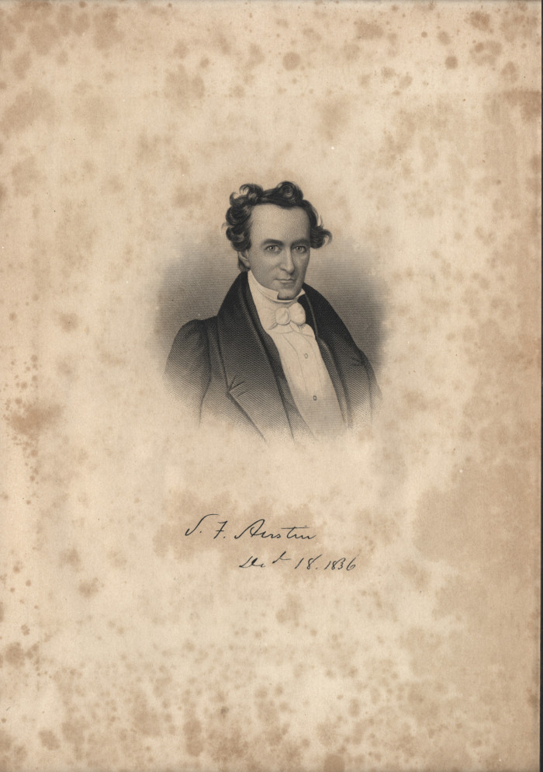
Document analysis directions:
Think like a Historian:
Primary source letter from Stephen F. Austin to Mary Austin Holley
Source: Eugene Barker, ed., The Austin Papers (Austin: University of Texas Press, 1927), 3 vols., Vol 3, pp. 300-301.
With group members, analyze the letter from Stephen F. Austin to Mary Austin Holley and answer questions 1-6 under the document analysis section.
https://education.texashistory.unt.edu

Slide 26
Exit Ticket
In your opinion, were the Texian volunteers prepared for a revolution? Explain your reasoning.
https://education.texashistory.unt.edu

