Slide 1
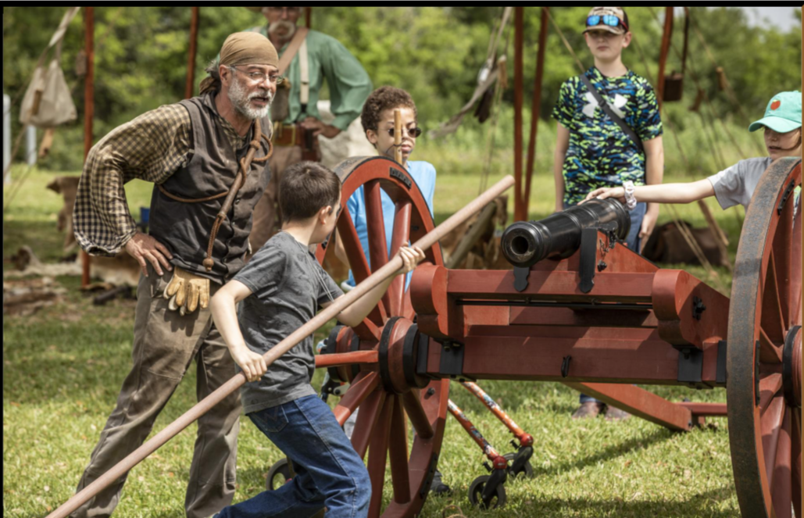
Unit 5: The Texas Revolution
Lesson 11:
Texas Today
Notes:
A Historical Demonstration at the Texas Historical Commission Historic Site for the Battle of San Jacinto. San Jacinto Battleground | Texas Historical Commission

Slide 2
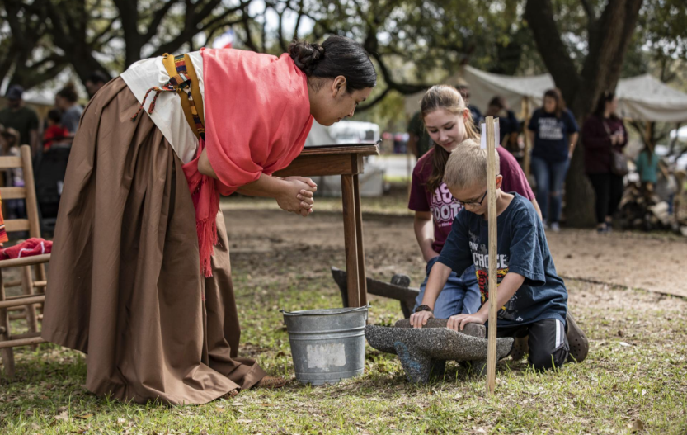
Warm-up: Answer the questions about the image on your warm-up
Notes:
Washington-on-the-Brazos Historic Site. The Texas Historical Commission. Washington-on-the-Brazos | Texas Historical Commission

Slide 3
Share with the class
One thing I observe about this image is ________
One way that I think this image relates to the Texas Revolution and today’s lesson, “Texas Today” is ________

Slide 4
Essential Question
What are some of the ways that Texans today work to preserve Texas history and educate the public about significant Texas historic sites?

Slide 5
In today’s lesson…
We will conduct online research about one historic site of the Texas Revolution that is preserved by the Texas Historical Commission (THC).
I will use the THC’s website to record significant information about my chosen historic site and create an agenda for a class field trip to the site.

Slide 6
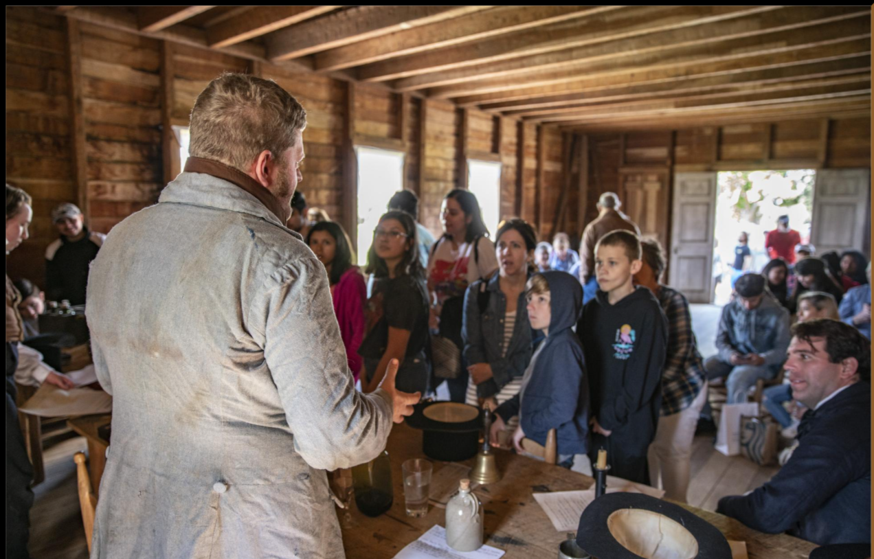
Preserving our History
A presentation to visitors at the Washington-on-the-Brazos State Historic Site
The Texas Historical Commission
Notes:
A presentation to visitors at the Washington-on-the-Brazos state historic site. The Texas Historical Commission. Washington-on-the-Brazos | Texas Historical Commission

Slide 7
Step 1: Choose one of the following historic sites

Slide 8
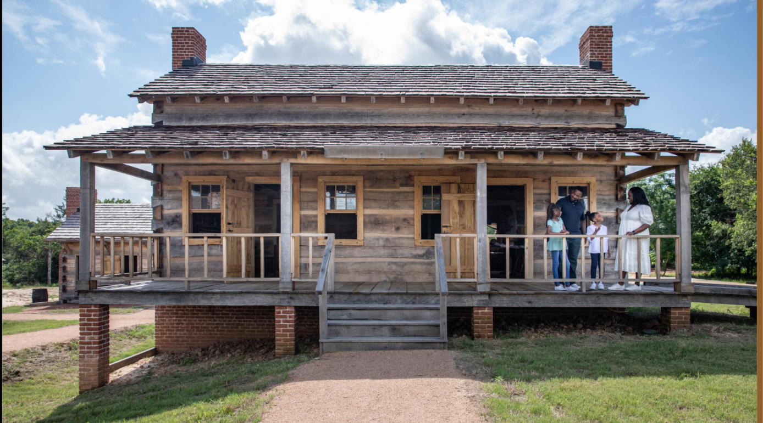
San Felipe de Austin Historic Site

Slide 9
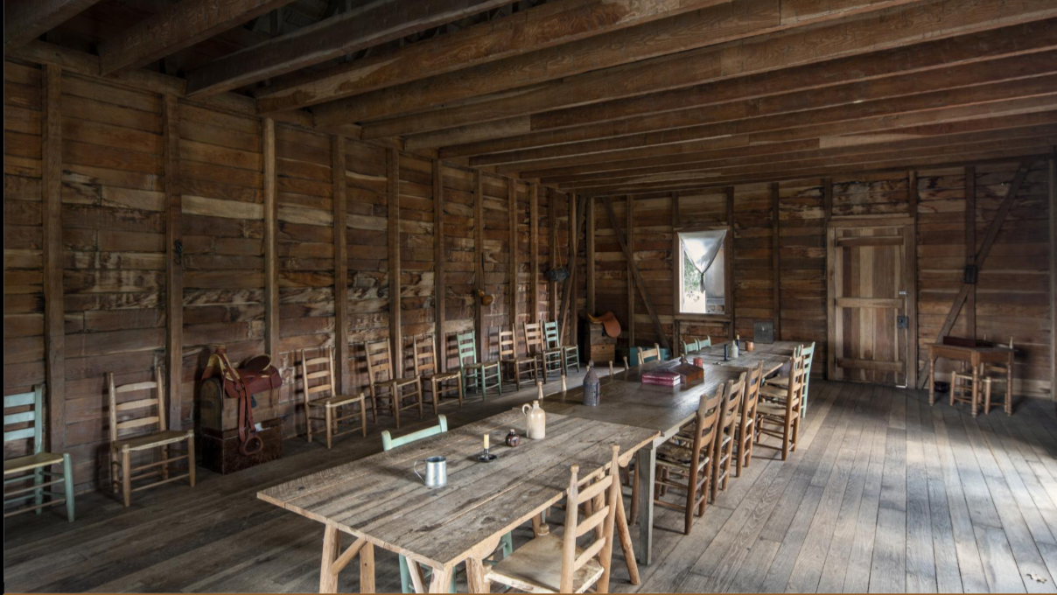
Washington-on-the-Brazos Historic Site
Notes:
A reproduction of the convention hall where the Texas Declaration of Independence was signed. Washington-on-the-Brazos state historic site. The Texas Historical Commission. Washington-on-the-Brazos | Texas Historical Commission

Slide 10
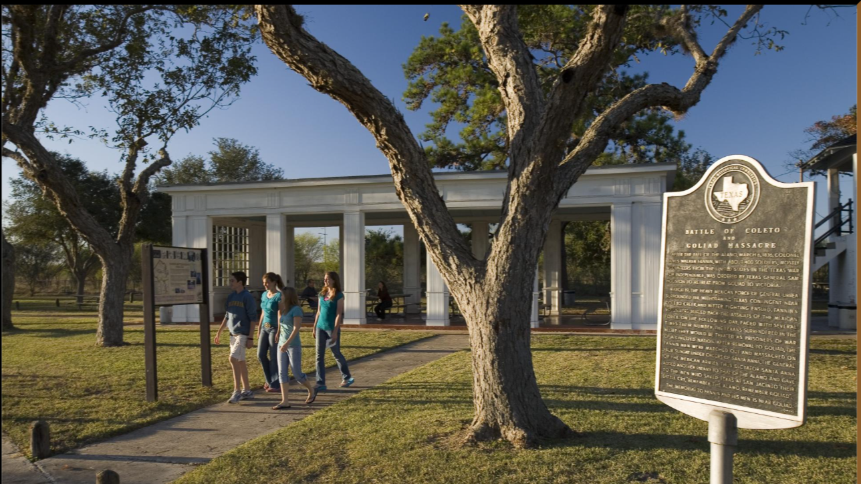
Fannin Battleground State Historic Site
Notes:
The Fannin Battleground State Historical Site. The Texas Historical Commission. Fannin Battleground | Texas Historical Commission

Slide 11
The San Jacinto State Historic Site

Slide 12
Step 2: Online Research

Slide 13
Online Research
Use the Texas Historical Commission webpage for your historic site to complete the remaining steps in your assignment.
thc.texas.gov
Notes:
The Texas Historical Commission Logo. Home | Texas Historical Commission

Slide 14
Exit Ticket: Answer the questions about the image on your exit ticket
Answer the questions on your warm-up about your chosen historical site based on what you learned in this lesson.
Share with a partner.

Slide 15
Share with the class 2
The Texas Historical Commission works to preserve the history of _(name of your site)_ by ______
The Texas Historical Commission works to educate the public about the history of _(name of your site)_ by ______

