Slide 1
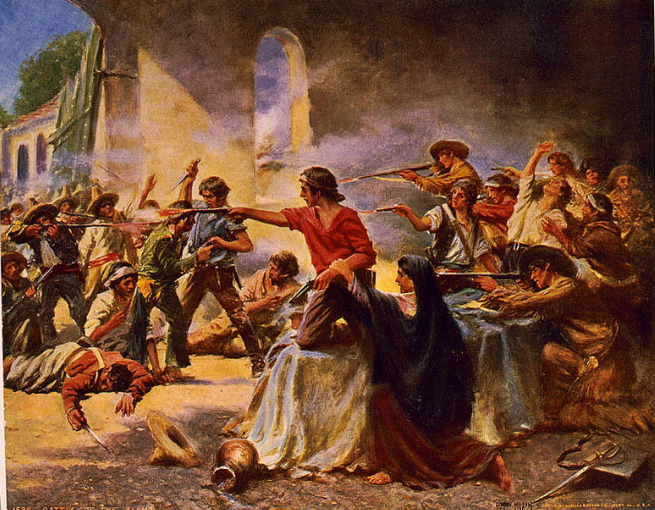
Unit 5: The Texas Revolution
Lesson 1:
The Big Picture
Notes:
Moran, Percy, Artist. Battle of the Alamo / Percy Moran. San Antonio Alamo Texas, ca. 1912. Photograph. https://www.loc.gov/item/92515472/

Slide 2

The Big Picture Warm-up

Slide 3




Warm-up: Follow the directions to complete your warm-up
Click here to watch the video: “Preview of the Texas Revolution.”
Write THREE significant pieces of information about this unit from the video.
Share your response with a partner.
Notes:
Video link: Texas History for Teachers: Preview of the The Texas Revolution - All Clips The Portal to Texas History

Slide 4
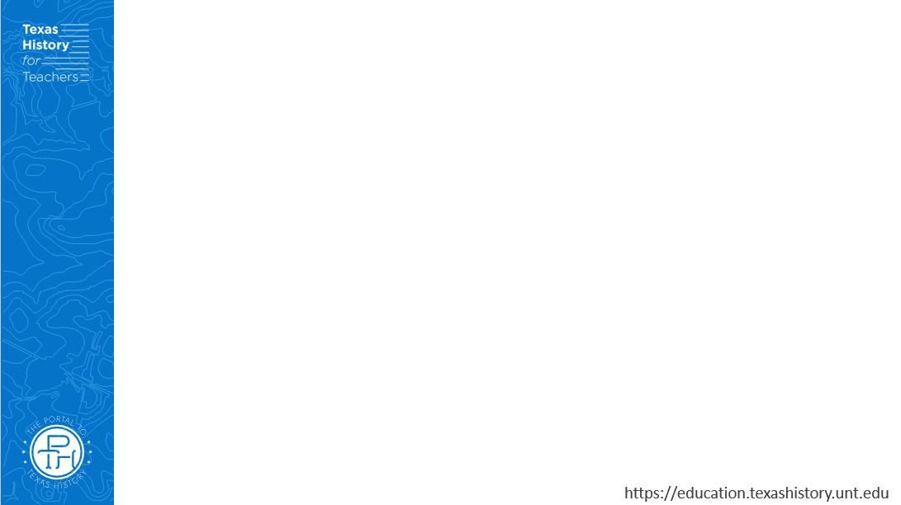
Share with the class
One significant piece of information about the Texas Revolution discussed in this video is ___________

Slide 5
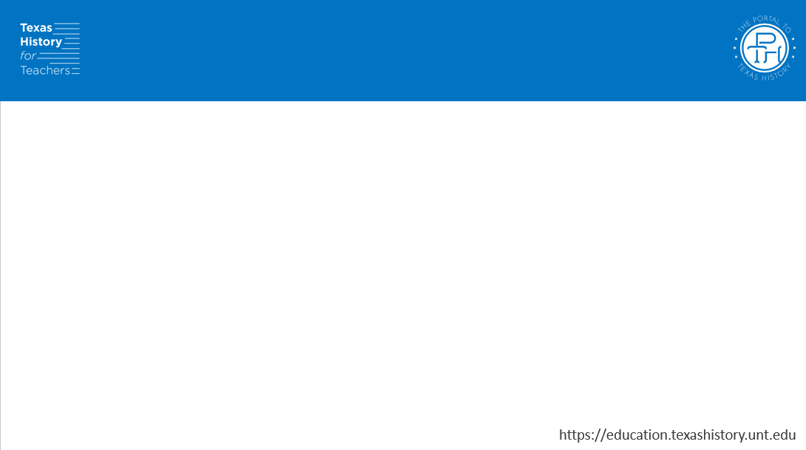
Essential Question
What are the key events, major themes, and defining characteristics of the Texas Revolutionary Era?

Slide 6
In today’s lesson…
We will identify the main ideas, themes, key events, and defining characteristics of the Texas Revolutionary Era.
I will analyze a primary source image, identify major themes and significant information related to this era, and answer comprehension questions based on a reading passage.

Slide 7
Part One: Analyze an Image

Slide 8
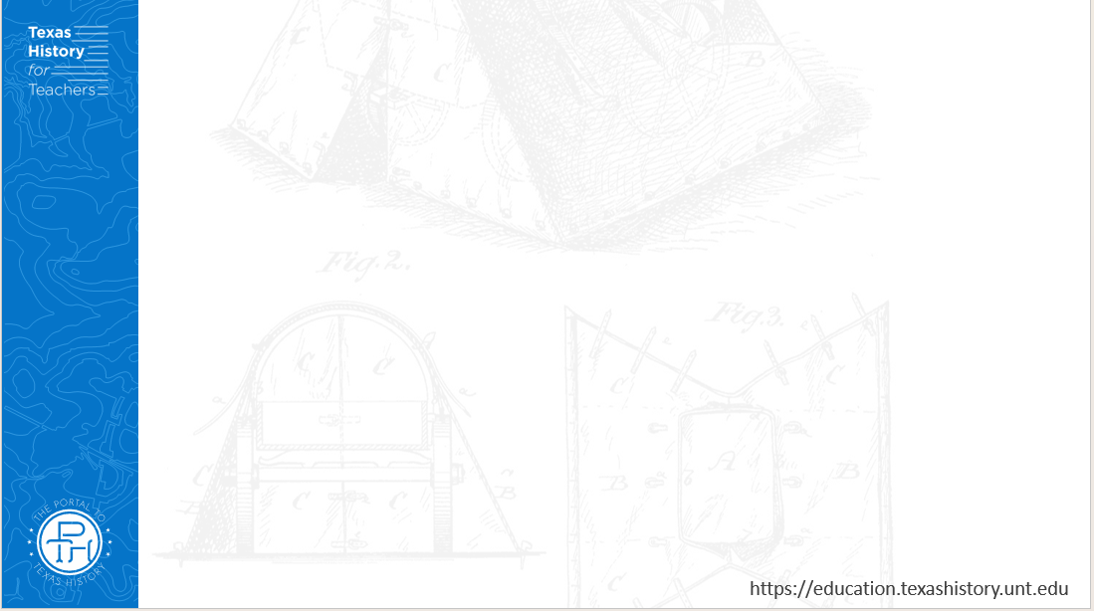
Analyze an Image
Notes:
Moran, Percy, Artist. Battle of the Alamo / Percy Moran. San Antonio Alamo Texas, ca. 1912. Photograph. https://www.loc.gov/item/92515472/

Slide 9
Part Two: Essential Ideas Reading Passage

Slide 10
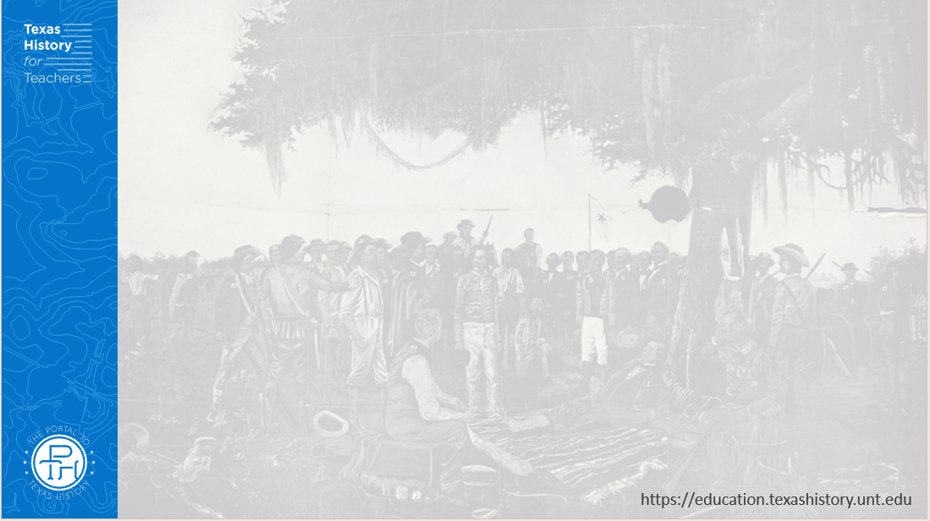
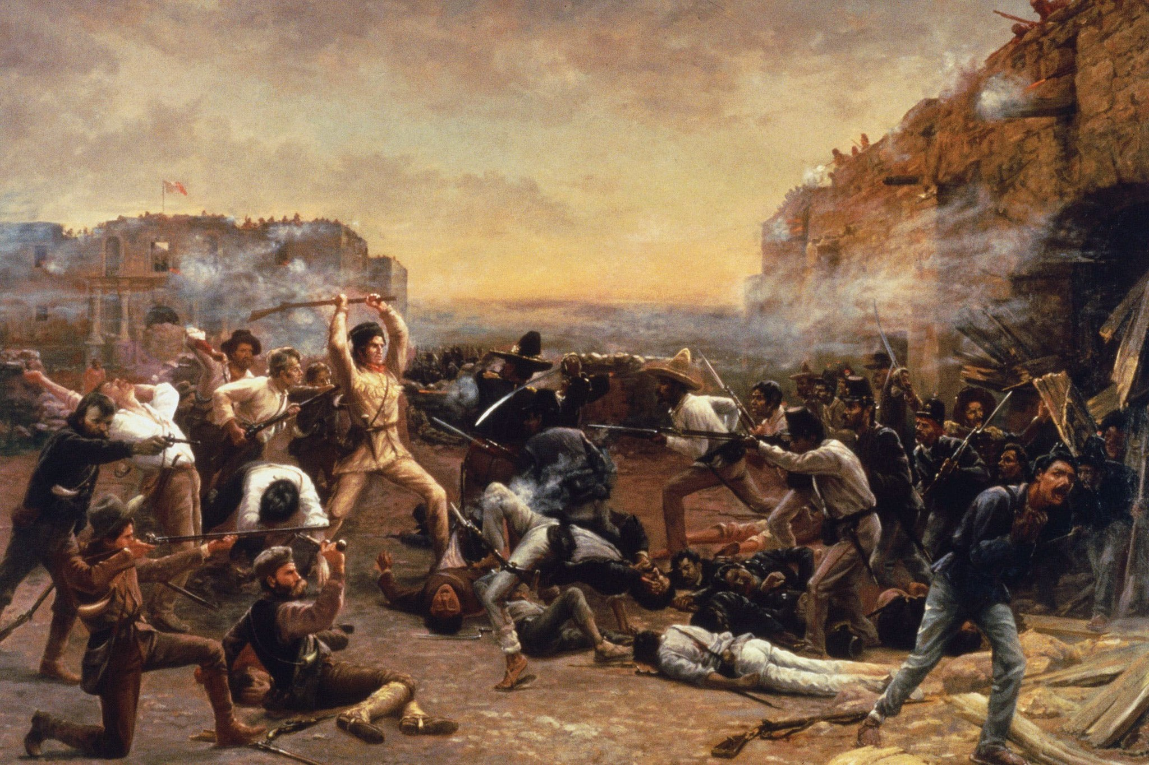
Essential Ideas Reading Passage
The Fall of the Alamo by Robert Jenkins Onderdonk
Notes:
The Fall of the Alamo. Robert Jenkins Onderdonk. 1903. Texas Governor’s Mansion in Austin. https://commons.wikimedia.org/wiki/File:FalloftheAlamo.jpg

Slide 11
Part Three: Big Picture Comprehension Questions

Slide 12
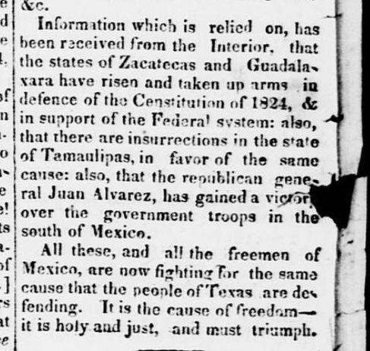
Big Picture Comprehension Questions
The Texas Republican (Brazoria, Texas) pp.2. Vol. 1, No. 56, Ed. 1. Published October 10, 1835
The Portal to Texas History
Notes:
The Texas Republican. (Brazoria, Tex.), Vol. 1, No. 56, Ed. 1, Saturday, October 10, 1835, newspaper, October 10, 1835; Brazoria, Texas. (https://texashistory.unt.edu/ark:/67531/metapth80274/: accessed February 18, 2025), University of North Texas Libraries, The Portal to Texas History, https://texashistory.unt.edu; crediting The Dolph Briscoe Center for American History.

Slide 13
The Big Picture Exit Ticket

Slide 14

Exit Ticket: Follow the directions to complete your exit ticket
Read each of the three opinions about the civil war in Mexico.
Consider the pros and cons of each opinion.
Record your thoughts in the boxes provided.
Share your response with a partner.

Slide 15
Share with the class 2
One opinion about the war is ____________
This could be a good option because ________
This could be a bad option because ________

