Slide 1
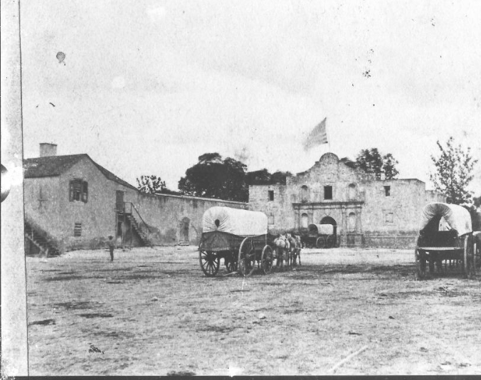
Unit 5 : The Texas Revolution
Lesson 3:
Vocabulary
Notes:
Raba, Ernst Wilhelm, 1874-1951. [Alamo with Team of Oxen], photograph, Date Unknown; (https://texashistory.unt.edu/ark:/67531/metapth459971/: accessed February 18, 2025), University of North Texas Libraries, The Portal to Texas History, https://texashistory.unt.edu; crediting San Antonio Conservation Society.

Slide 2
Warm-up Follow the directions to complete your warm-up
The chart shows 4 of the
new vocabulary terms we
will learn in this unit.
Complete the chart based on what you already know about these words. (if you don’t know a word yet that’s ok!)
Discuss with a partner

Slide 3
Share with the class
I don’t know the word _______ yet
I’ve heard of the word ______.
I think it means _______________.
I know the word _____. It means _____.

Slide 4
Essential Question
What key terms do we need to know to be successful in this unit?

Slide 5
In today’s lesson…
We will identify, define, and exemplify the key terms of Unit 5: The Texas Revolution.
I will use the information and context of several short passages to identify and record the definition of each term and provide examples of the term in the context of our unit.

Slide 6
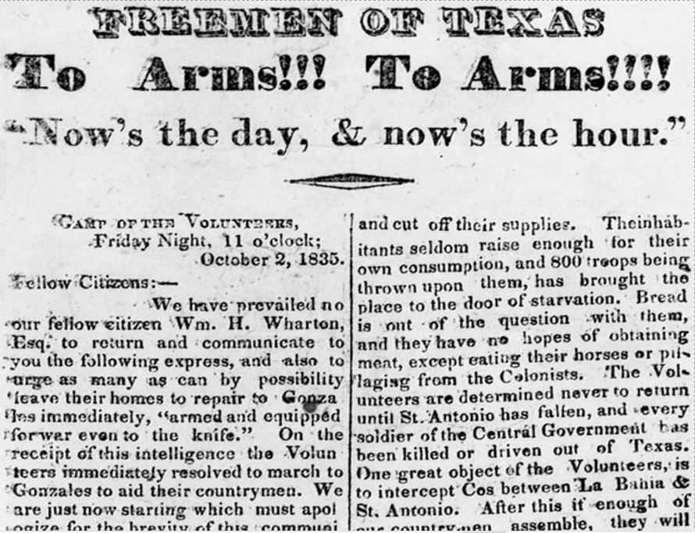
Revolution (n)
When civil war broke out in Mexico between the federalists and the centralists, many in Texas had different opinions about what the people of Texas should do.
Some wanted to avoid war, while others wanted to join the war hoping to return to the Federal Constitution of 1824. Others wanted to join the war to separate from Mexico entirely; this group wanted independence for Texas.
As the war against the centralist government progressed in Texas, more people in Texas leaned toward independence from Mexico. A war to change or overthrow your current government is called a revolution. In the Texas Revolution, some Anglos and Tejanos wanted to break from the centralist government of Mexico in order to create their own independent government for Texas.
The Texas Republican
October 2, 1835
The Portal to Texas History
Notes:
The Texas Republican. (Brazoria, Tex.), Vol. 1, No. 56, Ed. 1, Saturday, October 10, 1835, newspaper, October 10, 1835; Brazoria, Texas. (https://texashistory.unt.edu/ark:/67531/metapth80274/: accessed February 19, 2025), University of North Texas Libraries, The Portal to Texas History, https://texashistory.unt.edu; crediting The Dolph Briscoe Center for American History.

Slide 7
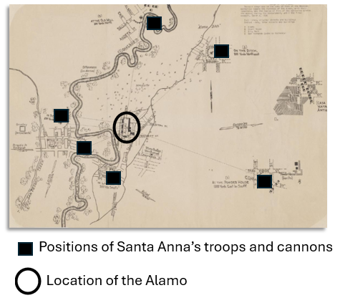
Siege (n)
When Santa Anna’s centralist army marched into San Antonio in 1836, the Anglo and Tejano troops there took shelter in an old Spanish mission known as the Alamo.
Santa Anna ordered his army to surround the Alamo. He didn’t want any people or supplies to enter or exit the Alamo. This strategy is called a siege. During a siege, one side of a war surrounds their enemy with the goal of waiting for them to run out of food and supplies and eventually surrender.
During the thirteen-day siege of the Alamo, Santa Anna ordered his troops to regularly bombard the Alamo. He hoped this would weaken the Texas troops and speed up their surrender. The defenders of the Alamo didn’t surrender, however, so after a nearly two-week siege, Santa Anna’s army attacked.
Notes:
Siege of the Alamo. ca. 1938. University of North Texas Libraries, The Portal to Texas History; crediting Hardin-Simmons University Library. Edited to highlight the location of the Alamo and Santa Anna’s troops and cannon placement during the siege. https://texashistory.unt.edu/ark:/67531/metapth493168/m1/1

Slide 8
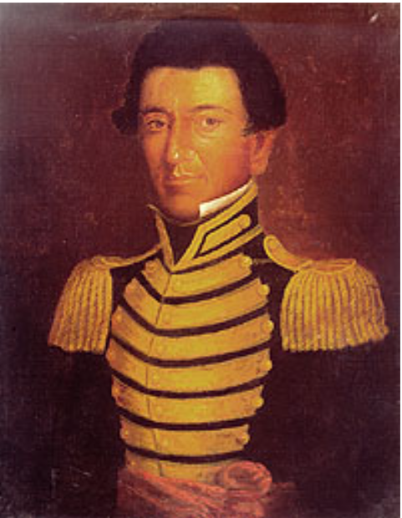
Courier (n)
When we want to send information or messages to people today, we can send them instantly through technology like a text message.
The people fighting in the Texas Revolution didn’t have technology as advanced as ours. When they needed to send some important information, they wrote a letter by hand and sent it with a courier. A courier was a person who delivered messages, typically traveling by horse.
During the siege of the Alamo, the Texas army leader William B. Travis sent a number of urgent messages asking for help. There were several different men who served as couriers for Travis’ letters. A Tejano soldier named Juan Seguín was one of the men who acted as a courier for Travis. Seguín delivered one of the letters Travis wrote during the siege of the Alamo requesting reinforcements.
Juan Seguín
Texas State Library and Archives Commission
Notes:
Juan Seguin. “Giants of Texas History” Texas State Library and Archives Commission. Juan Seguin | Texas State Library

Slide 9
Reinforcements (n)
When the civil war between the federalists and centralists broke out in several states in Mexico, Santa Anna was able to raise a large army of thousands of soldiers to subdue the rebellions. The people of Texas fighting his centralist forces did not have the same large army at their disposal.
The Anglos and Tejanos fighting against centralism in Texas often had to ask for reinforcements from around Texas to help them in their battles. Reinforcements are extra soldiers who can come to help fight.
Two significant examples of times the Texas troops called for reinforcements were when the citizens of Gonzales discovered that a part of the centralist army was coming to retrieve their cannon and when the defenders of the Alamo were under siege by Santa Anna’s larger forces.
Send more troops!

Slide 10
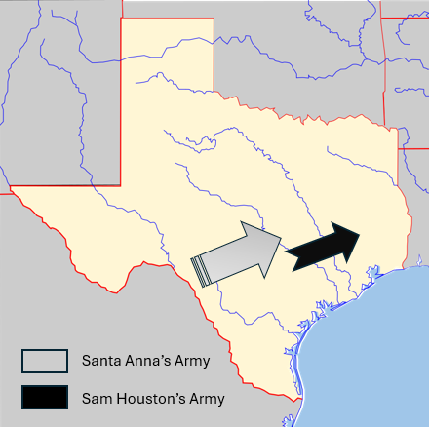
To retreat (v)
During the Texas Revolution, there was a long period of time when the Texian army was not prepared to face Santa Anna’s army in a direct conflict.
Santa Anna and his army pursued the Anglo and Tejano forces under the command of Sam Houston across Texas. Houston and his men continually retreated, or moved away from the enemy, for hundreds of miles for months. At the time, some people in Texas were unhappy about the retreat. They believed Houston should turn around and order his men to fight.
Houston knew that his troops weren’t ready, so the retreat continued until an opportunity arrived to take on Santa Anna and his army on more favorable terms. This opportunity would occur on April 21, 1836, near the San Jacinto River.
Notes:
Texas Blank Map. Edited to include the approximate location and direction of Sam Houston’s retreat from Santa Anna’s army. https://commons.wikimedia.org/wiki/File:Texas_blank_map.svg

Slide 11
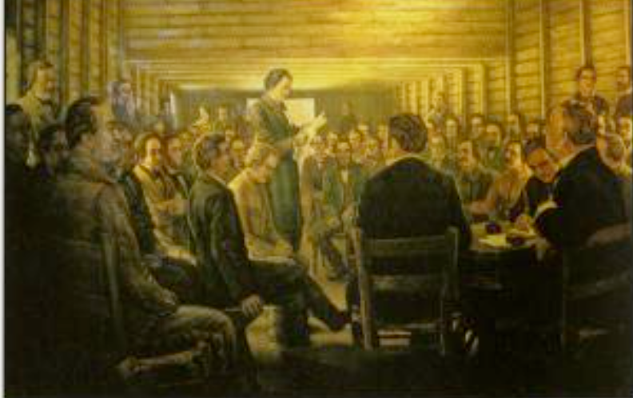
Delegate (n)
During the Texas Revolution, many Texians (Anglo-American residents of Texas) held meetings to discuss how best to carry out the war effort. Delegates from around Texas gathered at several different meetings to discuss important military and political issues. A delegate is an elected representative chosen to attend a special meeting to carry out specific tasks.
One example of delegates gathering at an important meeting occurred at the Convention of 1836 at a place called Washington-on-the-Brazos. A delegate named George Childress oversaw the committee that wrote the Texas Declaration of Independence at the Convention of 1836
These delegates also wrote the Constitution of the Republic of Texas and named Sam Houston the Commander-in-Chief of the Texian army. Texian delegates helped organize and carry out important tasks during the Texas Revolution.
Reading the Texas Declaration of Independence
The Portal to Texas History
Notes:
Texas. Parks and Wildlife Department. Interpretive Guide to: Washington-On-the-Brazos State Historic Site, pamphlet, 2013; Austin, TX. (https://texashistory.unt.edu/ark:/67531/metapth661961/: accessed February 18, 2025), University of North Texas Libraries, The Portal to Texas History, https://texashistory.unt.edu; crediting UNT Libraries Government Documents Department.

Slide 12
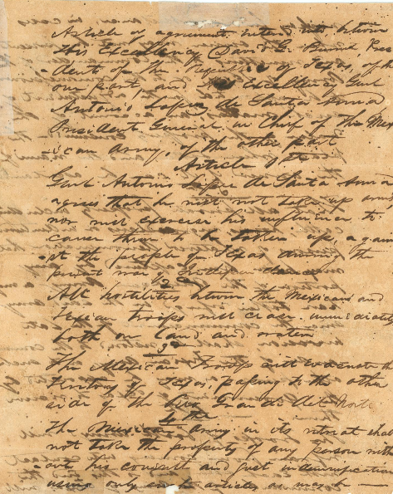
Treaty (n)
After months of hardships, challenges, and retreat from Santa Anna’s forces, Sam Houston’s troops encountered an opportunity at the San Jacinto River near present-day Houston, Texas. This opportunity would bring an end to the war.
The fighting that occurred between Houston’s troops and Santa Anna’s army at the Battle of San Jacinto forced Santa Anna to surrender.
This Texan victory at the Battle of San Jacinto ended the Texas Revolution and forced Santa Anna to sign the Treaties of Velasco. A treaty is a document that ends a war and sets the terms for peace. Sometimes, there will be more than one treaty involved in peace talks. The Texas Revolution ended with the Treaties of Velasco. One treaty was public, and one was a secret! But more on that later…
The Treaty of Velasco
The Portal to Texas History
Notes:
Treaty of Velasco. 1836. Text. University of North Texas Libraries, The Portal to Texas History; crediting Star of the Republic Museum. https://texashistory.unt.edu/ark:/67531/metapth31159/.

Slide 13
Exit Ticket Follow the directions to complete your exit ticket
The chart shows 16 words
related to social studies.
Based on what you know so far, which terms do you think are most closely related to this unit?
Circle or highlight all that apply
Discuss with a partner

Slide 14
Share with the class
I think _______ is related to the unit because __________
I think _______ is NOT related to the unit because _______________

