Slide 1
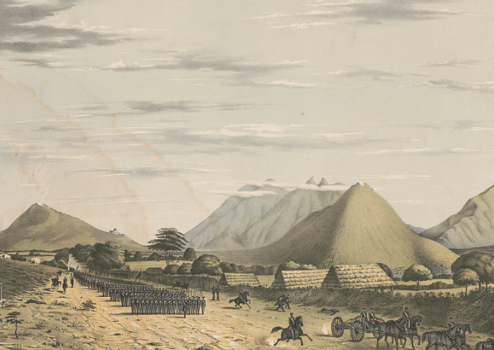
Unit 5:
The Texas Revolution
The Mexican Army on the March from Saltillo
Library of Congress
Lesson 4:
What’s the Story?
Notes:
G. & W. Endicott , Daniel Powers Whiting, and Frederick J Swinton. Heights of Monterey sic, from the Saltillo road looking towards the city. from the west / D.P. Whiting Capt. 7th Inf. ; on stone by F. Swinton. 1847. Tinted lithograph on sheet 46.3 x 59.7 cm. Library of Congress Prints and Photographs Division. https://www.loc.gov/item/2003664232/

Slide 2

What’s the Story?
Warm-up

Slide 3




Warm-up:
Follow the directions to complete your warm-up
Think about the Texan and Mexican armies during the Texas Revolution.
What do you think was ONE strength and ONE weakness for each army.
Write your best guess in the boxes provided.
Share with a partner.

Slide 4
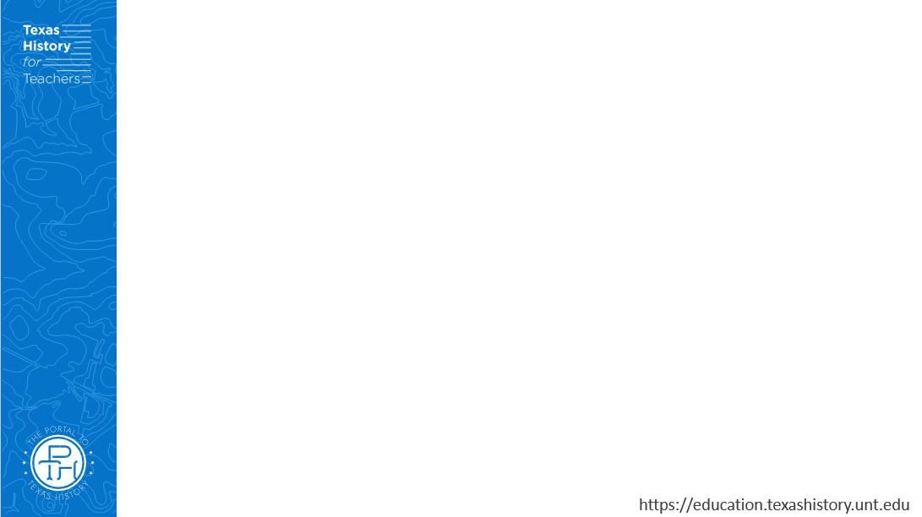
Share with the class
One possible strength of Santa Anna’s Centralist army might have been _____________
One possible weakness of Santa Anna’s Centralist army might have been _____________

Slide 5
Share with the class 2
One possible strength of Sam Houston's Texas army might have been _____________
One possible weakness of Sam Houston's Texas army might have been _____________

Slide 6
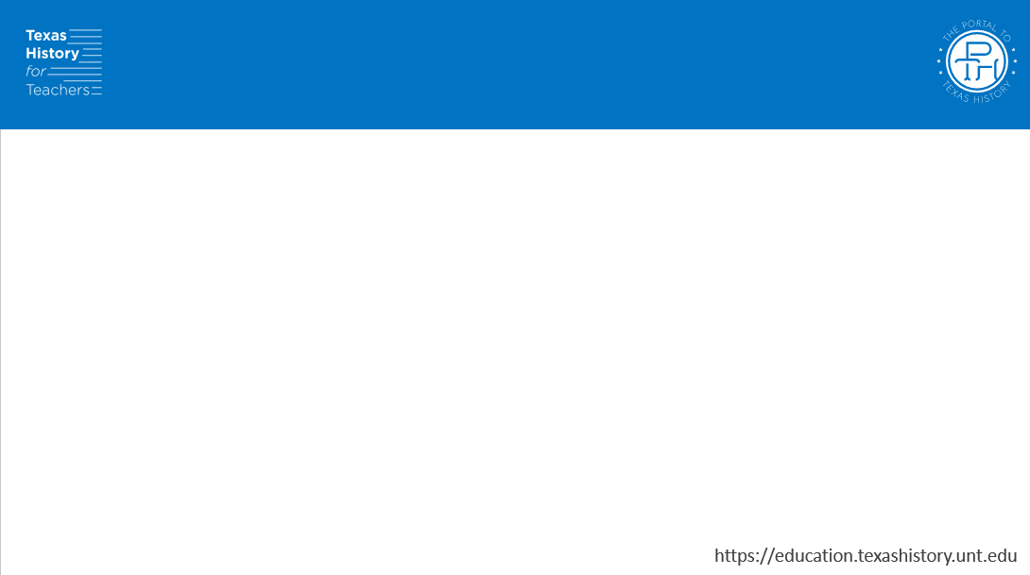
Essential Question
What are the defining characteristics and most significant events of the Texas Revolutionary Era?

Slide 7
In today’s lesson…
We will examine a chronology of the significant events that took place during the Texas Revolution and identify their significance to Texas history.
I will read short passages about each event, identify key information, explain cause and effect relationships, and determine how the event is significant to Texas history.

Slide 8



What’s the Story?
Lesson
https://education.texashistory.unt.edu

Slide 9
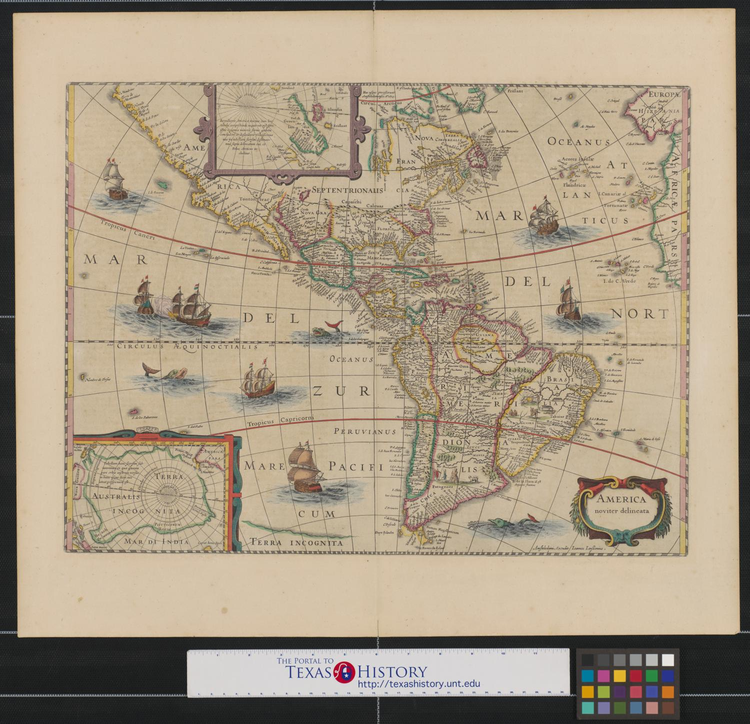
Directions for the Lesson
Read each short passage for information about an event or events from the Texas Revolutionary Era.
Record information about each reading in the correct place on your timeline assignment.
Read the specific, step-by-step directions for Part I on your paper.
https://education.texashistory.unt.edu

Slide 10

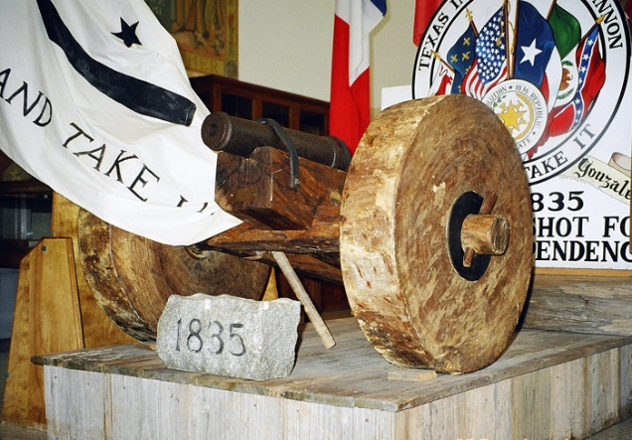
1. The Battle of Gonzales – October 2, 1835
The cannon and a reproduction of the “Come and Take it” flag
From the Battle of Gonzales
Notes:
The cannon and a reproduction of the “Come and Take It” flag from the Battle of Gonzales. Larry D. Moore. Deed - Attribution 4.0 International - Creative Commons https://commons.wikimedia.org/wiki/File:Gonzales_cannon_2005.jpg

Slide 11
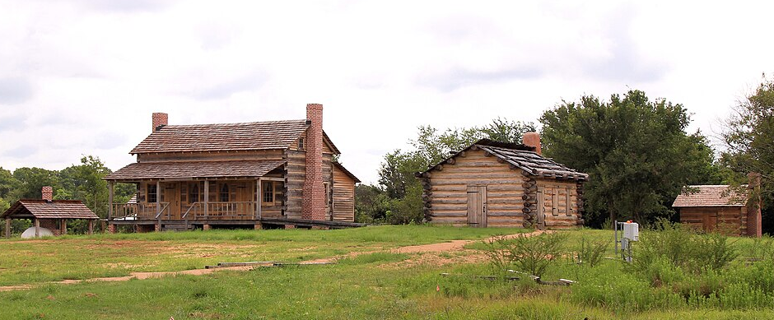
2. The Consultation – November 1835
Reproductions of log cabins at San Felipe de Austin
The Texas Historical Commission
Notes:
A replica of a section of the San Felipe de Austin township being built at the San Felipe de Austin State Historic Site in San Felipe, Texas, United States. Larry D. Moore, CC BY 4.0, Wikimedia Commons. This file is licensed under the Creative Commons Attribution 4.0 International license. https://commons.wikimedia.org/wiki/File:Replica_Cabins_San_Felipe_de_Austin_SHS_2021.jpg

Slide 12
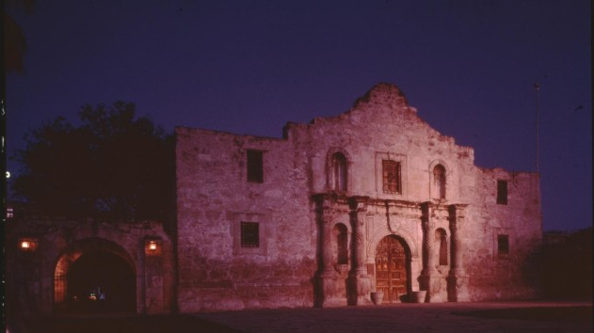
3. The Alamo – February 23 – March 6, 1836
The Alamo Today
The Portal to Texas History
Notes:
Texas Historical Commission. [The Alamo], photograph, Date Unknown; (https://texashistory.unt.edu/ark:/67531/metapth938306/: accessed February 25, 2025), University of North Texas Libraries, The Portal to Texas History, https://texashistory.unt.edu; crediting Texas Historical Commission.

Slide 13
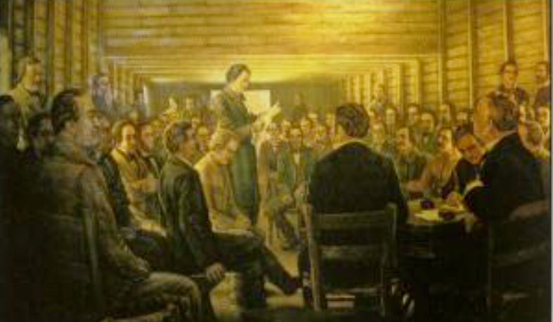
4. The Constitutional Convention of 1836
A painting depicting the Reading of the Texas Declaration of Independence
The Constitutional Convention of 1836
The Portal to Texas History
Notes:
Texas. Parks and Wildlife Department. Interpretive Guide to: Washington-On-the-Brazos State Historic Site, pamphlet, 2013; Austin, TX. (https://texashistory.unt.edu/ark:/67531/metapth661961/: accessed February 25, 2025), University of North Texas Libraries, The Portal to Texas History, https://texashistory.unt.edu; crediting UNT Libraries Government Documents Department.

Slide 14
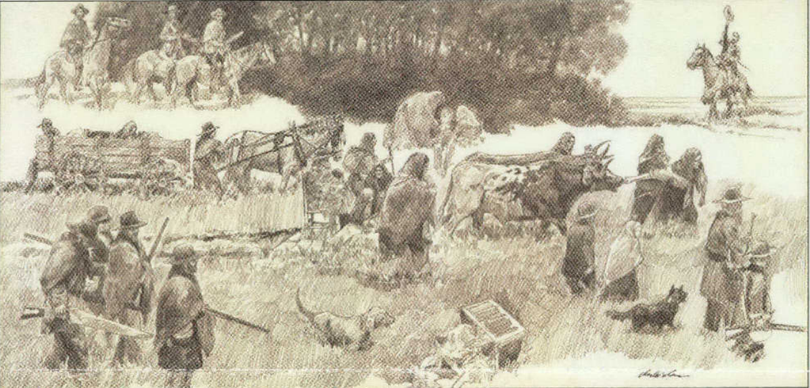
5. The Runaway Scrape – January to April 1836
The Runaway Scrape, by Charles Shaw
The Star of the Republic Museum
Notes:
Star of the Republic Museum (Washington, Tex.). Star of the Republic Museum Notes, Volume 43, Number 2, 2018, periodical, 2018; Washington, Texas. (https://texashistory.unt.edu/ark:/67531/metapth1115241/: accessed February 25, 2025), University of North Texas Libraries, The Portal to Texas History, https://texashistory.unt.edu; crediting UNT Libraries Government Documents Department.

Slide 15
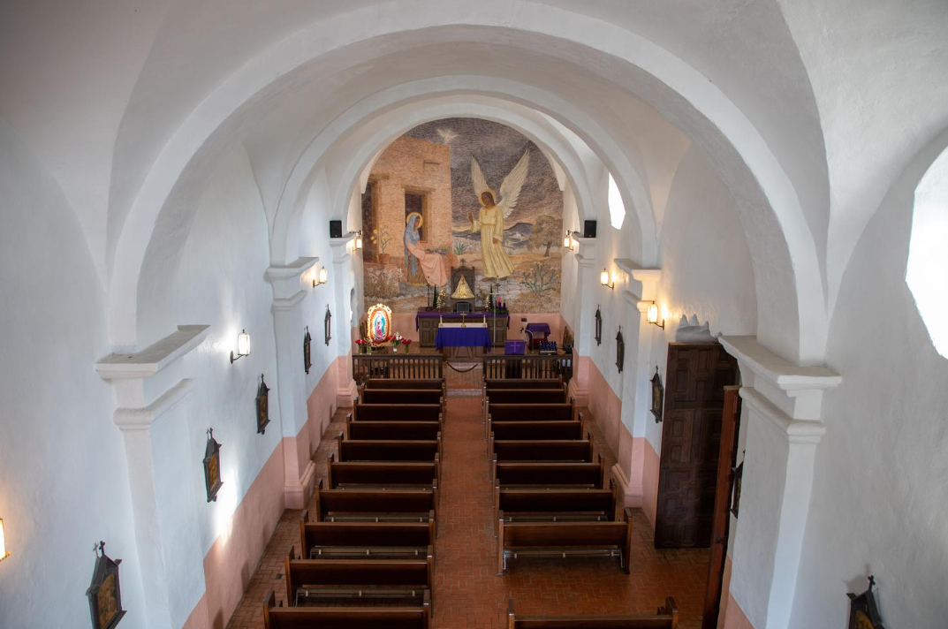
6. The Goliad Massacre – March 27, 1836
The chapel at la Bahía where Fannin’s men were temporarily held after their surrender.
The Portal to Texas History
Notes:
Hicks, William. Chapel Sanctuary: Presidio La Bahia. December 14, 2021. Photograph. University of North Texas Libraries, The Portal to Texas History, https://texashistory.unt.edu. https://texashistory.unt.edu/ark:/67531/metapth1490423/

Slide 16
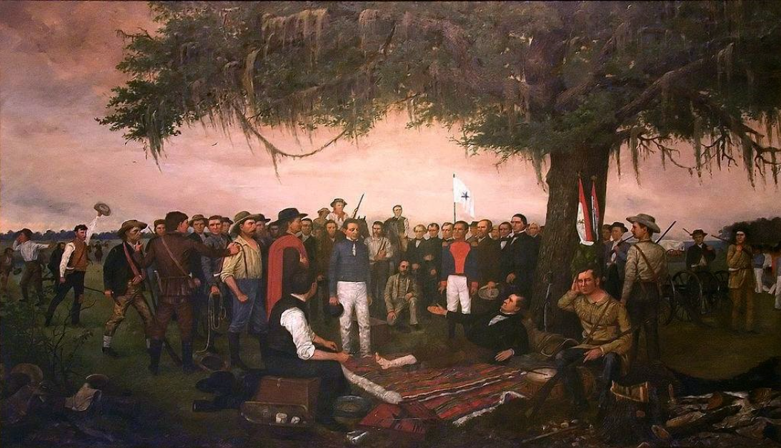
7. The Battle of San Jacinto – April 21, 1836
The Surrender of Santa Anna after the Battle of San Jacinto
The Texas State Preservation Board
Notes:
Surrender of Santa Anna, William Henry Huddle, oil on canvas, 1886. Capitol Historical Artifact Collection, State Preservation Board. Available at https://commons.wikimedia.org/w/index.php?title=File:SantaAnnaSurrender.jpg&oldid=825715357

Slide 17
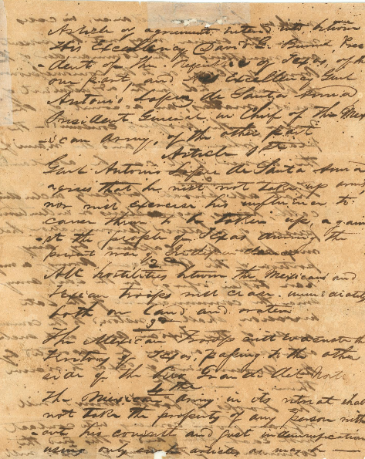
8. The Treaties of Velasco –
May 14, 1836
The Treaty of Velasco
The Portal to Texas History
Notes:
Treaty of Velasco. 1836. Text. University of North Texas Libraries, The Portal to Texas History; crediting Star of the Republic Museum. https://texashistory.unt.edu/ark:/67531/metapth31159/.

Slide 18
What’s the Story?
Exit Ticket

Slide 19
Exit Ticket:
Follow the directions to complete your Exit Ticket
You will choose to write about EITHER Sam Houston’s army OR Santa Anna’s army.
You will write about one strength OR one weakness of the army you chose.
Share with a partner.

Slide 20
Share with the class
One (strength) / (weakness) of (Sam Houston’s army) / (Santa Anna’s army) was _______
We saw evidence of this in today’s lesson when _________

