Slide 1
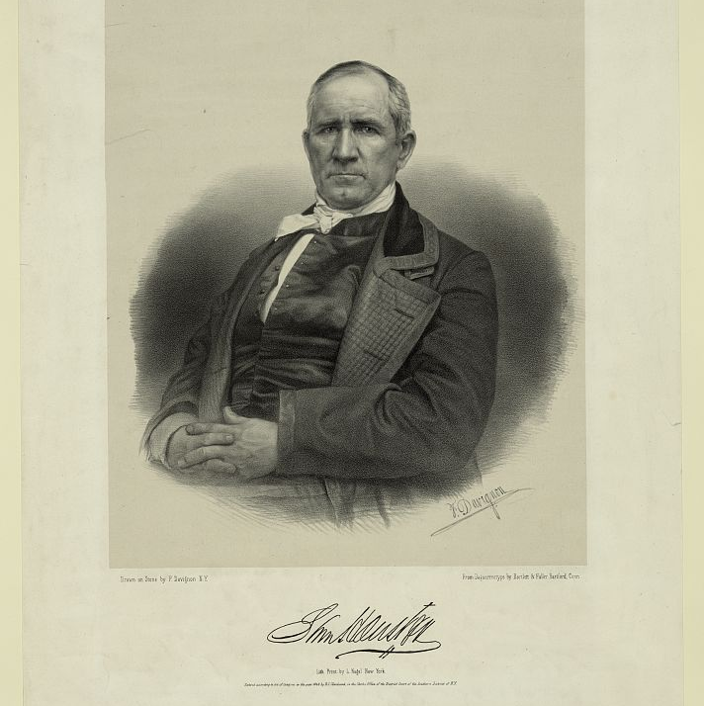
Unit 5: The Texas Revolution
Lesson 5:
Who’s Who of the Texas Revolution
Notes:
Sam Houston. , ca. 1848. Apr. 27. Photograph. https://www.loc.gov/item/2003656937/.

Slide 2
Warm-up Follow the directions below to complete your warm-up
Think of all the different groups of people who lived through the Texas Revolution.
Choose one point of view and complete the graphic organizer provided.
Share with a partner.

Slide 3
Share with the class:
The person I imagined was named _________.
One piece of information about him / her is ____

Slide 4
Essential Question
Who were some of the key people of the Texas Revolution and why were they significant?

Slide 5
In Today’s Lesson
We will study key people who took part in the Texas Revolution, identifying important information about their lives and their significance to the Texas Revolution.
I will use reading passages about each person to complete a chart summarizing and paraphrasing significant information about each person.

Slide 6
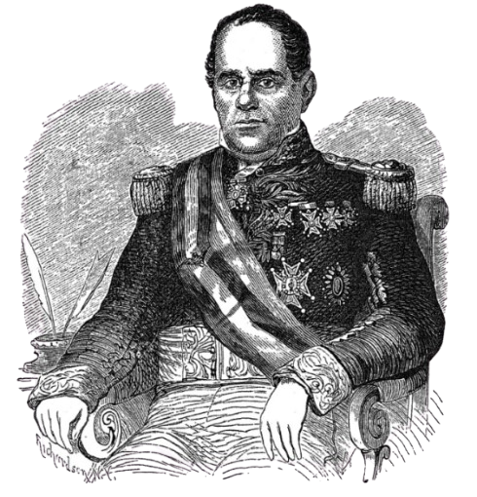
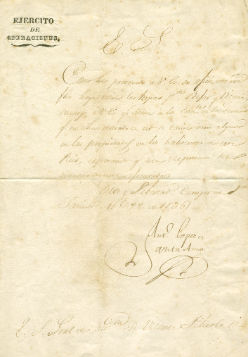
Antonio López de Santa Anna
Santa Anna’s letter ordering the retreat of his army on April 22, 1836.
The Portal to Texas History
Santa Anna
The Portal to Texas History
Notes:
Santa Anna, Antonio Lopez de. [Letter from Santa Anna Ordering Retreat of the Mexican Army, April 22, 1836]. Humanities Texas Grant. University of North Texas Libraries, The Portal to Texas History, https://texashistory.unt.edu; crediting The Dolph Briscoe Center for American History. https://texashistory.unt.edu/ark:/67531/metapth5928/m1/1. April 22, 1836.
Santa Anna. 1879. A Pictorial History of Texas, From the Earliest Visits of European Adventurers, to A.D. 1879. by Homer S. Thrall, 147. St. Louis, MO: N. D. Thomspon & Co., 1879. University of North Texas Libraries, The Portal to Texas History, https://texashistory.unt.edu/ark:/67531/metapth5828/.

Slide 7
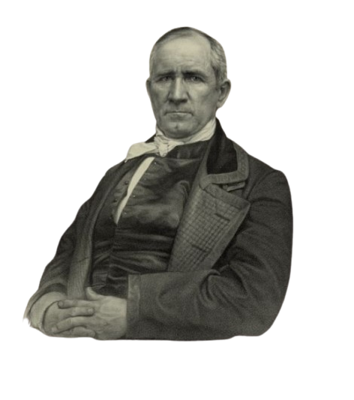
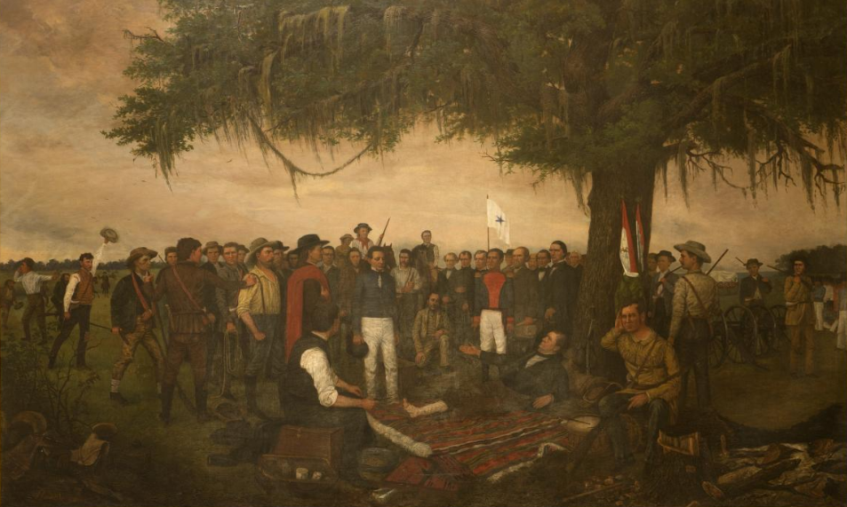
Sam Houston
A painting depicting Santa Anna’s surrender to Sam Houston, who was painted laying under the tree due to his leg injury.
Library of Congress
Sam Houston
Library of Congress
Notes:
Highsmith, Carol M, photographer. Painting, "Surrender of Santa Anna," by William Henry Huddle, in the South Foyer of the Texas Capitol, Austin, Texas. April 17, 2014. Photograph. Library of Congress Prints and Photographs Division. https://www.loc.gov/item/2014632129/
Sam Houston. April 27, 1848. Photograph. Library of Congress Prints and Photographs Division. https://www.loc.gov/item/2003656937/

Slide 8
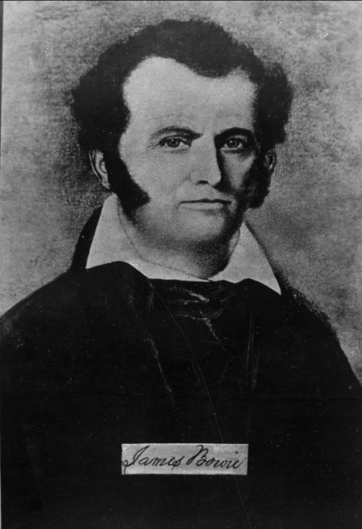
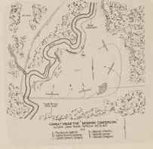
James “Jim” Bowie
Map of the Battle of Concepción under Colonel’s Bowie’s Battalion. The Portal to Texas History
James Bowie The Portal to Texas History
Notes:
Combat near the "Mission Concepcion," by Colonel James Bowie's Battalion, October 28, 1835., map, 1938?; (https://texashistory.unt.edu/ark:/67531/metapth492941/: accessed March 7, 2025), University of North Texas Libraries, The Portal to Texas History, https://texashistory.unt.edu; crediting Hardin-Simmons University Library.
Portrait of a Man, photograph, Date Unknown; (https://texashistory.unt.edu/ark:/67531/metapth55639/: accessed March 7, 2025), University of North Texas Libraries, The Portal to Texas History, https://texashistory.unt.edu; crediting Hardin-Simmons University Library.

Slide 9
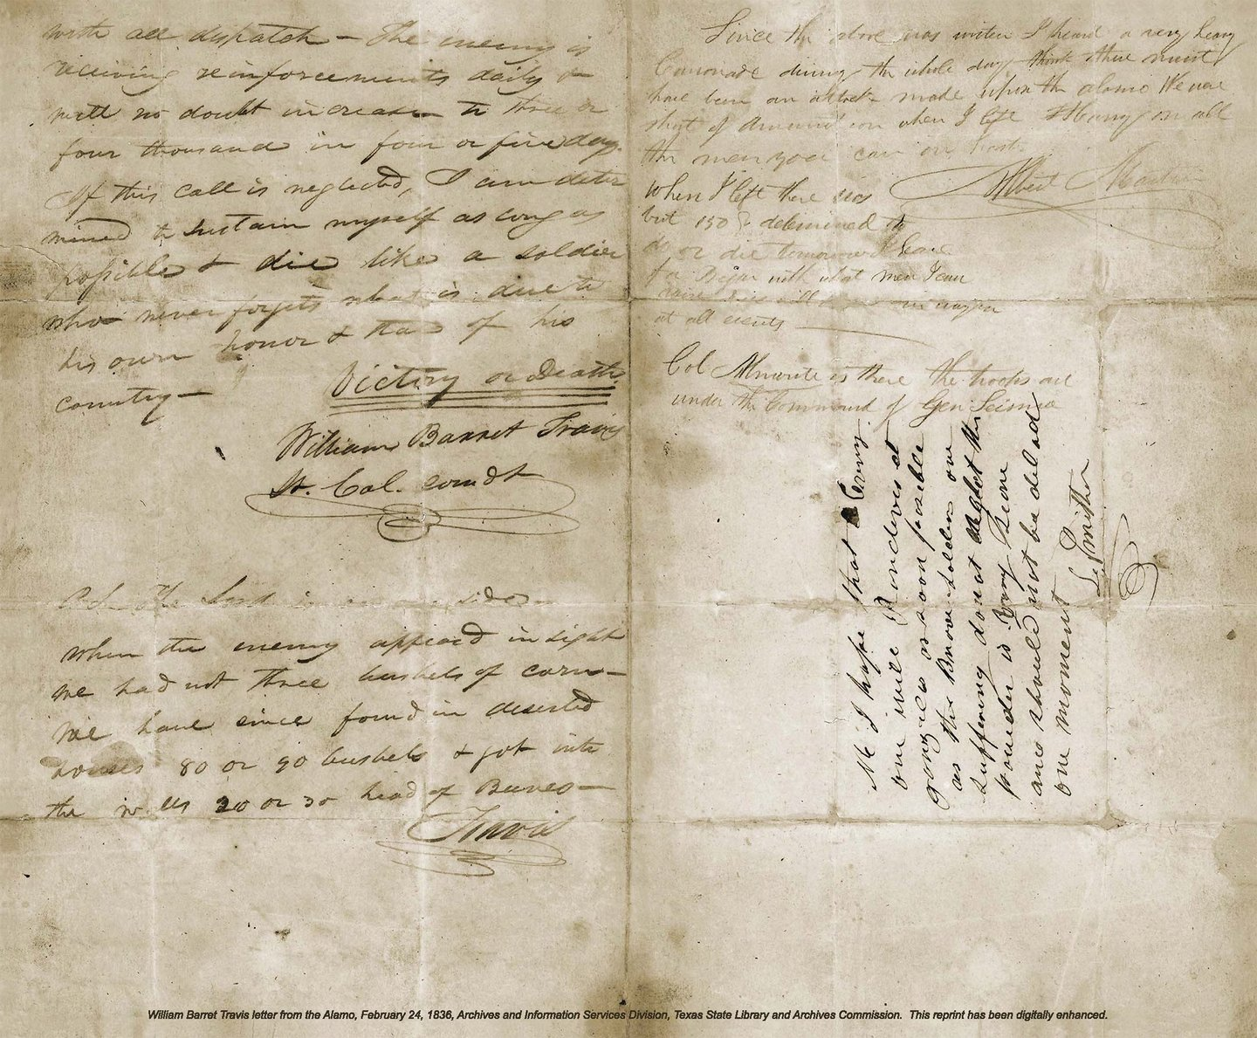
William Barret Travis
Travis’ famous “Victory or Death” letter
Texas State Library and Archives
William B. Travis
Texas State Library and Archives
Notes:
William B. Travis’ “Victory or Death” letter. Texas State Library and Archives. The Travis Letter | The Alamo
Portrait of William B. Travis by McArdle. The McArdle Scrapbooks Dawn at the Alamo. Texas State Library and Archives. Portrait of William B. Travis by McArdle | Texas State Library

Slide 10
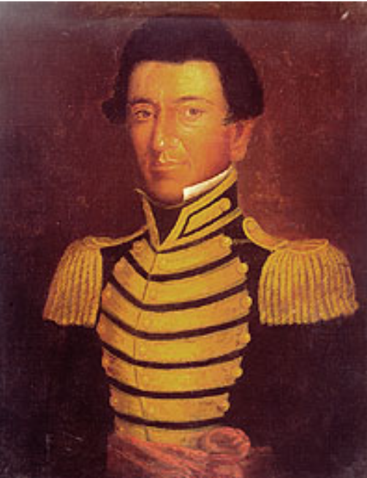
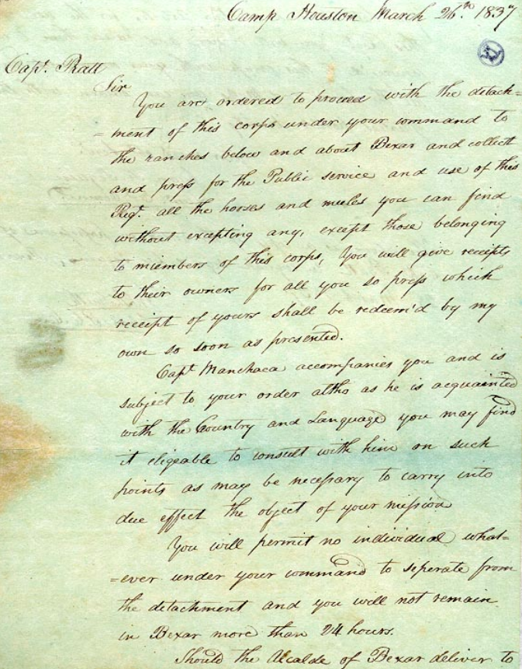
Juan Seguín
A letter written by Seguín after the war
Texas State Library and Archives
Juan Seguín
Texas State Library and Archives
Notes:
Juan Seguin. Giants of Texas History. Texas State Library and Archives. Juan Seguin | Texas State Library
Juan Seguín to Captain Pratt, March 26, 1837. Giants of Texas History. Juan Seguin. Juan Seguín to Captain Pratt, March 26, 1837 | Texas State Library

Slide 11
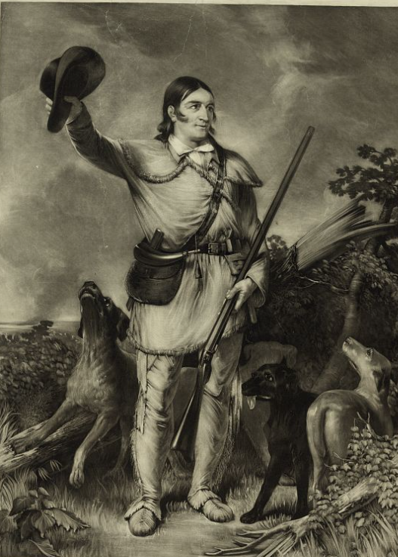
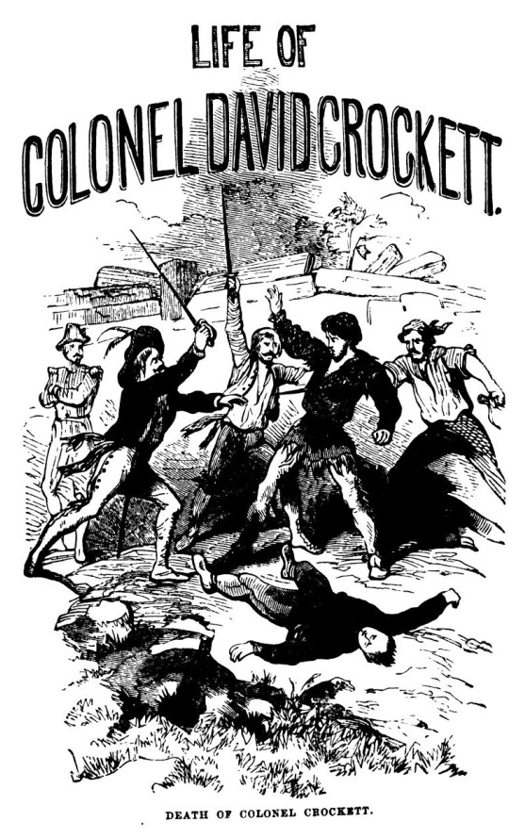
David “Davy” Crockett
Colonel Crockett
The Library of Congress
Crockett’s autobiography
The Portal to Texas History
Notes:
Stuart, C., Artist. Colonel Crockett / engraved by C. Stuart from the original portrait by J.G. Chapman. , ca. 1839. Photograph. https://www.loc.gov/item/93511184/.
Crockett, Davy. Life of Col. David Crockett, book, 1860; Philadelphia, Pennsylvania. (https://texashistory.unt.edu/ark:/67531/metapth29780/: accessed March 7, 2025), University of North Texas Libraries, The Portal to Texas History, https://texashistory.unt.edu; crediting Star of the Republic Museum.

Slide 12
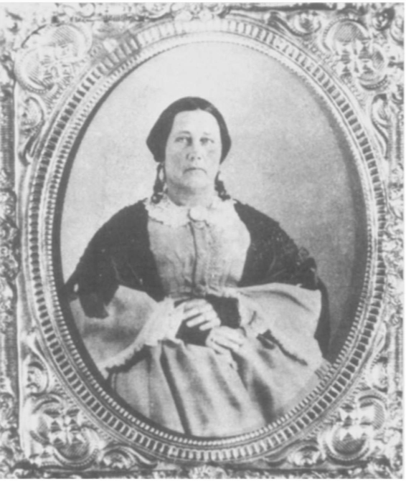
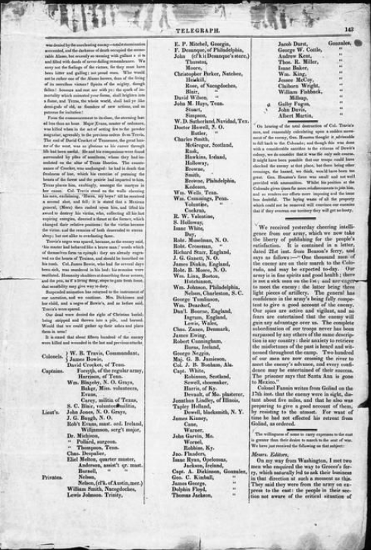
Susanna Dickinson
A newspaper article about the Alamo, including survivors like Susanna. March 24, 1836.
The Portal to Texas History
Susanna, years after the war.
The Portal to Texas History
Notes:
Baker & Bordens. Telegraph and Texas Register (San Felipe de Austin [i.e. San Felipe], Tex.), Vol. 1, No. 21, Ed. 1, Thursday, March 24, 1836, newspaper, March 24, 1836; San Felipe de Austin, Texas. (https://texashistory.unt.edu/ark:/67531/metapth47891/: accessed March 7, 2025), University of North Texas Libraries, The Portal to Texas History, https://texashistory.unt.edu; crediting The Dolph Briscoe Center for American History.
Carrington, Evelyn M. Women in Early Texas, book, 1993; Austin, Texas. (https://texashistory.unt.edu/ark:/67531/metapth296851/: accessed February 19, 2025), University of North Texas Libraries, The Portal to Texas History, https://texashistory.unt.edu; crediting Texas State Historical Association.

Slide 13
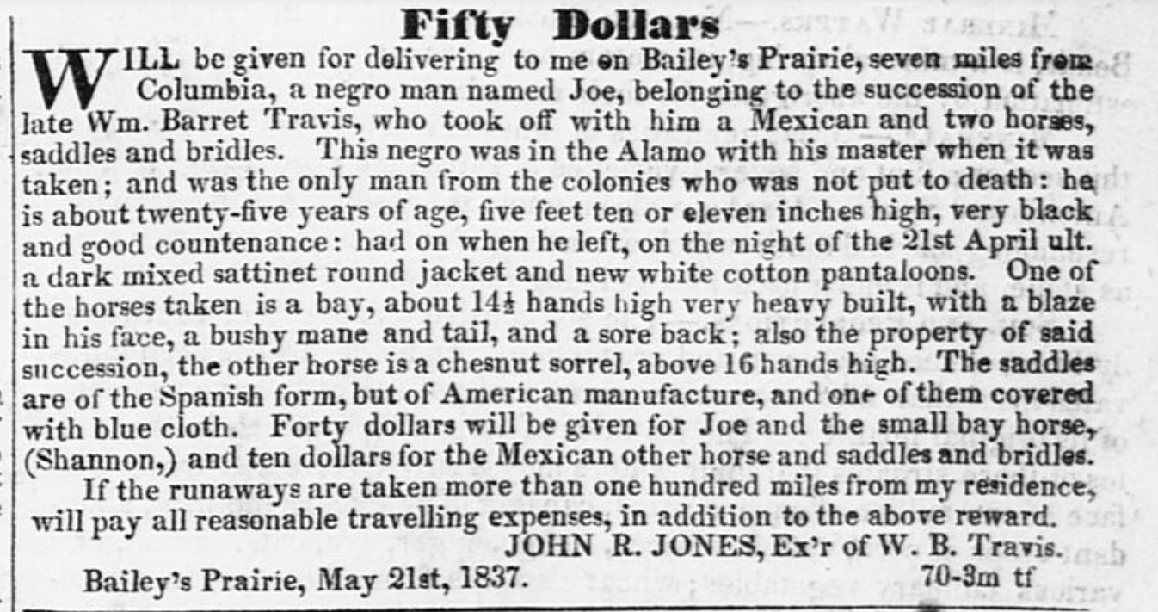
Joe
An ad that was placed after Joe escaped slavery in Texas offering a reward for his return.
The Portal to Texas History
Notes:
Cruger & Moore. Telegraph and Texas Register (Houston, Tex.), Vol. 2, No. 28, Ed. 1, Saturday, July 29, 1837, newspaper, July 29, 1837; Houston, Texas. (https://texashistory.unt.edu/ark:/67531/metapth47941/: accessed March 7, 2025), University of North Texas Libraries, The Portal to Texas History, https://texashistory.unt.edu; crediting The Dolph Briscoe Center for American History.

Slide 14
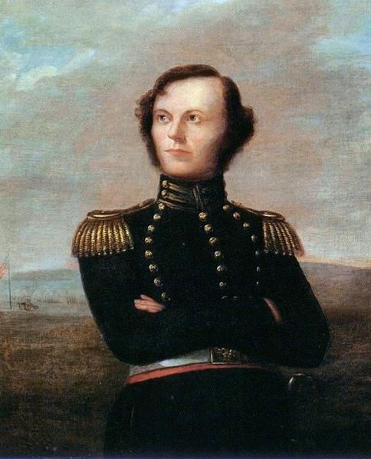
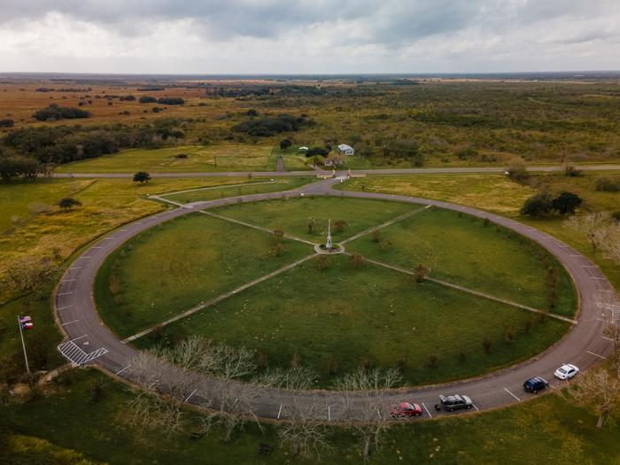
James Fannin
James W. Fannin
Dallas Historical Society
The Fannin Battleground State Historic Site
Marking the location of the Battle of Coleto Creek
The Portal to Texas History
Notes:
Portrait of James W. Fannin. Exploring the Alamo Legends by Wallace O. Chariton (Republic of Texas Press, 1990), Dallas Historical Society. This work is in the public domain in its country of origin and other countries and areas where the copyright term is the author's life plus 70 years or fewer. https://commons.wikimedia.org/wiki/File:JamesWFannin.jpg
Hicks, William. [Fannin Battleground State Historic Site: Aerial View], photograph, December 15, 2021; (https://texashistory.unt.edu/ark:/67531/metapth1490445/: accessed March 7, 2025), University of North Texas Libraries, The Portal to Texas History, https://texashistory.unt.edu; .

Slide 15
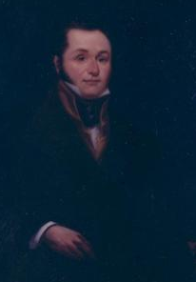
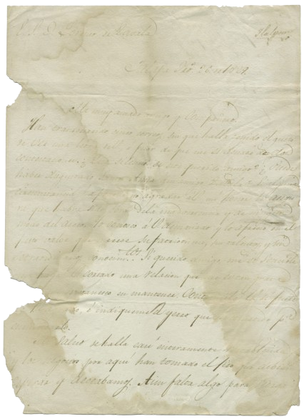
Lorenzo de Zavala
Lorenzo de Zavala
The Portal to Texas History
A letter from Santa Anna to Zavala when the 2 men were still friends in 1829. The Portal to Texas History
Notes:
Santa Anna, Antonio Lopez de. Antonio Lopez de Santa Anna to Lorenzo de Zavala, February 26, 1829, letter, February 26, 1829; (https://texashistory.unt.edu/ark:/67531/metapth6024/: accessed March 7, 2025), University of North Texas Libraries, The Portal to Texas History, https://texashistory.unt.edu; crediting The Dolph Briscoe Center for American History.
Wheeler, Larry. Portrait of Lorenzo de Zavala, artwork, 1980; (https://texashistory.unt.edu/ark:/67531/metapth3002/: accessed March 7, 2025), University of North Texas Libraries, The Portal to Texas History, https://texashistory.unt.edu; crediting San Jacinto Museum of History.

Slide 16
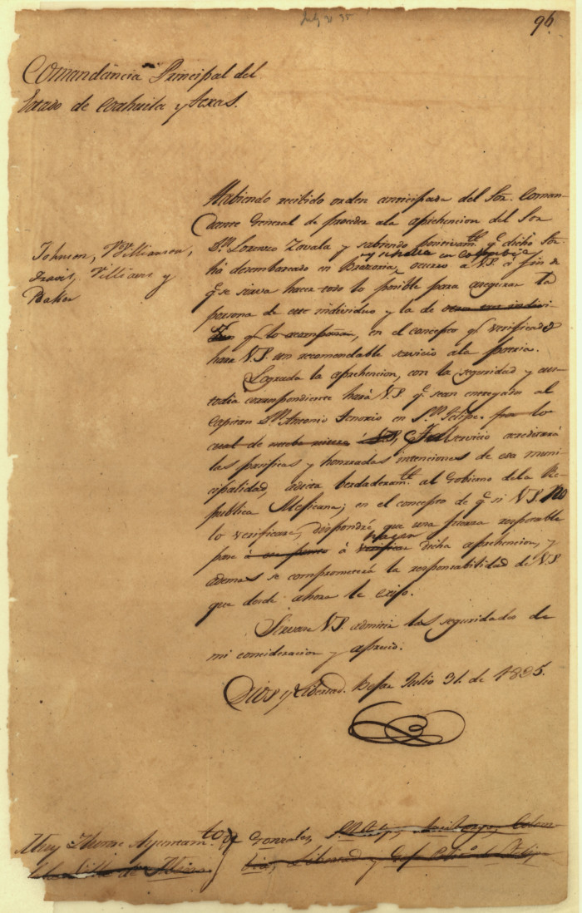
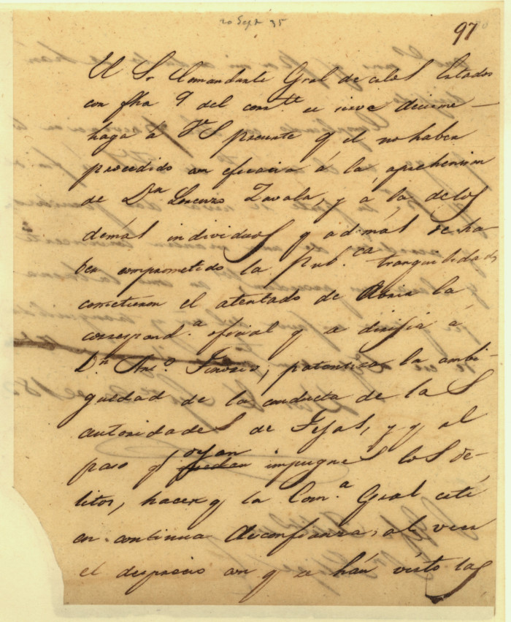
José Domingo de Ugartechea
Ugartechea’s angry letter to the officials in San Felipe de Austin who refused to arrest Zavala.
The Portal to Texas History
Ugartechea’s arrest order for Lorenzo de Zavala
The Portal to Texas History
Notes:
Ugartechea, José Domingo. José Domingo Ugartechea, Principal Commandant of Texas to Ayuntamiento of Gonzales], letter, July 31, 1835; (https://texashistory.unt.edu/ark:/67531/metapth5852/: accessed March 7, 2025), University of North Texas Libraries, The Portal to Texas History, https://texashistory.unt.edu; crediting Texas General Land Office.
Ugartechea, José Domingo. José Domingo Ugartechea, Principal Commandant of Texas to Political Chief at San Felipe de Austin], letter, September 20, 1835; (https://texashistory.unt.edu/ark:/67531/metapth5851/: accessed March 7, 2025), University of North Texas Libraries, The Portal to Texas History, https://texashistory.unt.edu; crediting Texas General Land Office.

Slide 17
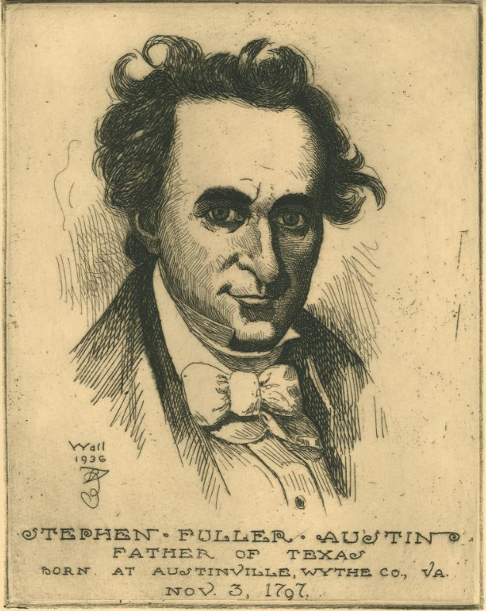
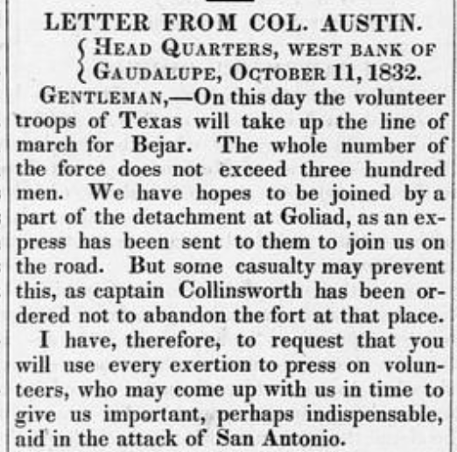
Stephen F. Austin
A letter from Austin published in the Telegraph and Texas Register.
The Portal to Texas History
Stephen F. Austin
The Portal to Texas History
Notes:
[Following Stephen F. Austin, Father of Texas], artwork, 1936; (https://texashistory.unt.edu/ark:/67531/metapth31619/: accessed March 10, 2025), University of North Texas Libraries, The Portal to Texas History, https://texashistory.unt.edu; crediting Star of the Republic Museum.
Baker & Bordens. Telegraph and Texas Register (San Felipe de Austin [i.e. San Felipe], Tex.), Vol. 1, No. 2, Ed. 1, Saturday, October 17, 1835, newspaper, October 17, 1835; San Felipe de Austin, Texas. (https://texashistory.unt.edu/ark:/67531/metapth47875/: accessed March 10, 2025), University of North Texas Libraries, The Portal to Texas History, https://texashistory.unt.edu; crediting The Dolph Briscoe Center for American History.

Slide 18
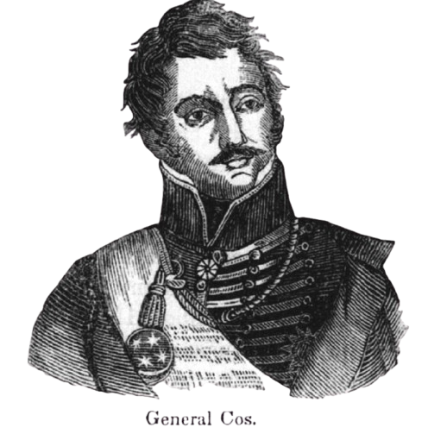
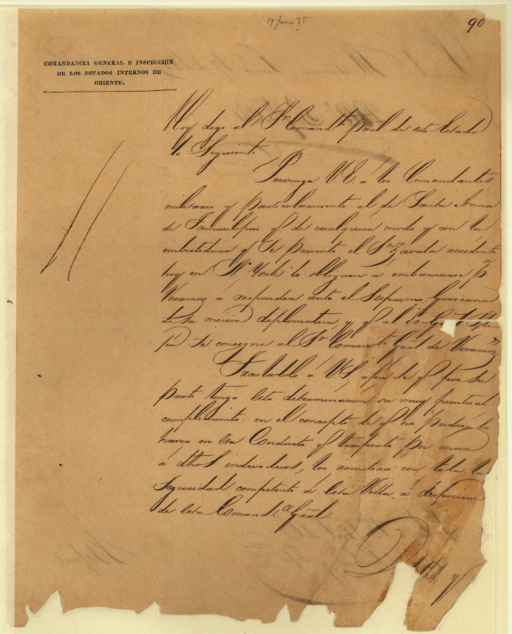
Martín Perfecto de Cos
A letter from Cos to Ugartechea regarding the arrest orders of Lorenzo de Zavala
The Portal to Texas History
Notes:
de Cos, Martin Perfecto. Letter from Martín Perfecto de Cos to Commandant General June 17th 1835, letter, June 17, 1835; (https://texashistory.unt.edu/ark:/67531/metapth5844/: accessed March 10, 2025), University of North Texas Libraries, The Portal to Texas History, https://texashistory.unt.edu; crediting Texas General Land Office.
Mexican General Martín Perfecto de Cos. Pioneer Heroes and Daring Deeds, published by Scammell and Company in 1882; reprinted in Frank Thompson's 2002 book The Alamo, published by the University of North Texas Press. This media file is in the public domain in the United States. This applies to U.S. works where the copyright has expired, often because its first publication occurred prior to January 1, 1930, and if not then due to lack of notice or renewal. See this page for further explanation. https://commons.wikimedia.org/wiki/File:Martin_perfecto_de_cos.jpg

Slide 19
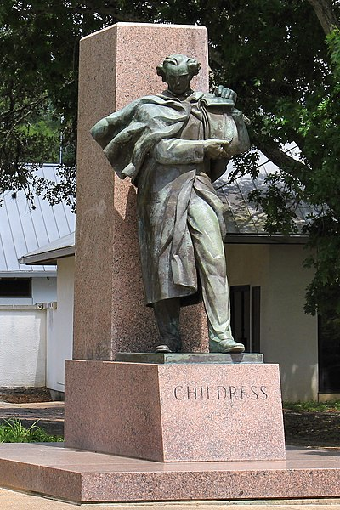
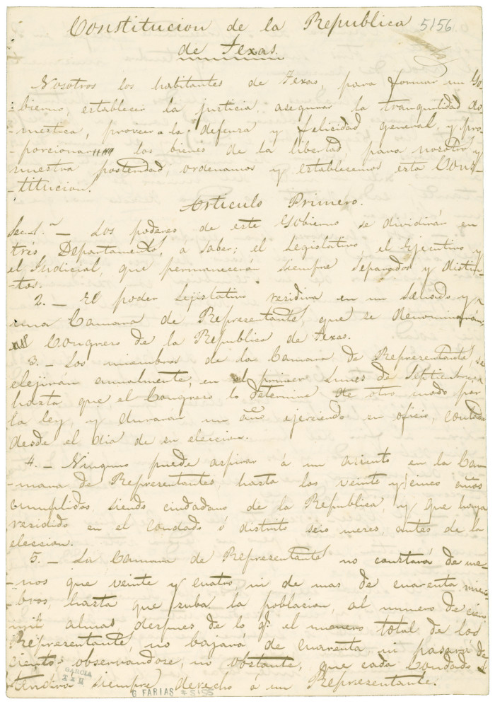
George Childress
The George C. Childress Centennial Statue at Washington-on-the-Brazos State Historic Site.
A copy of the constitution of Texas
The Portal to Texas History
Notes:
The George C. Childress Centennial Statue at Washington-on-the-Brazos State Historic Site. Raoul Josset sculpted the statue for the 1936 Texas Centennial. The statue was dedicated on March 2, 1939. Larry D. Moore © 2016 Larry D. Moore. Licensed under CC BY 4.0. Attribution Specification: Reuse without attribution is a violation of the license. The photographer's name and the link to the license are required. A link back to this source is requested. Example: Larry D. Moore, CC BY 4.0, Wikimedia Commons. https://commons.wikimedia.org/wiki/File:George_Childress_Centennial_Statue.jpg
Kimble, H. S. [Copy of the Constitution of the Republic of Texas, March 17, 1836], text, March 17, 1836; (https://texashistory.unt.edu/ark:/67531/metapth6708/: accessed March 10, 2025), University of North Texas Libraries, The Portal to Texas History, https://texashistory.unt.edu; crediting The Dolph Briscoe Center for American History.

Slide 20
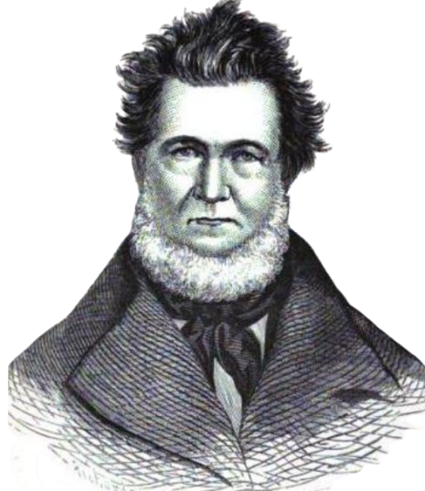
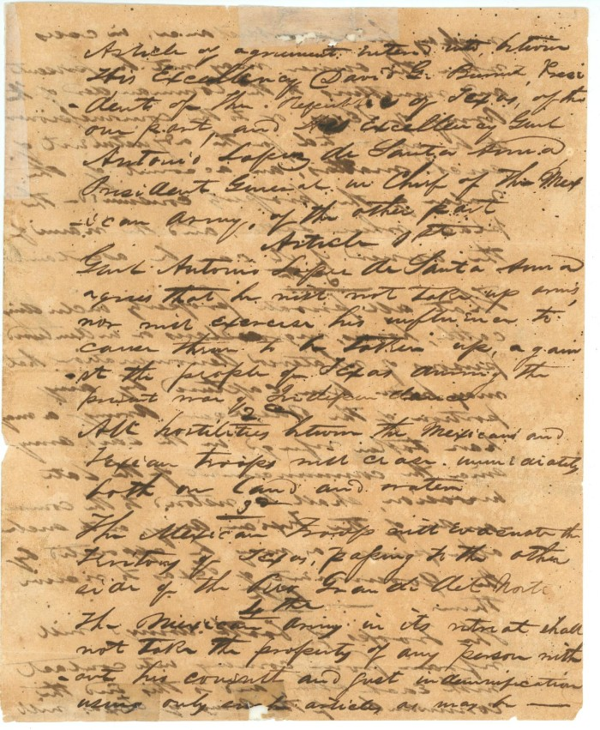
David. G. Burnet
A Portrait of David G. Burnet
The Portal to Texas History
The Treaty of Velasco
The Portal to Texas History
Notes:
Treaty of Velasco, text, 1836; (https://texashistory.unt.edu/ark:/67531/metapth31159/: accessed March 10, 2025), University of North Texas Libraries, The Portal to Texas History, https://texashistory.unt.edu; crediting Star of the Republic Museum.
Baker, D. W. C. (De Witt Clinton), 1832-1881. A Texas Scrap-Book: Made Up of the History, Biography, and Miscellany of Texas and Its People, book, 1875; New York. (https://texashistory.unt.edu/ark:/67531/metapth39132/: accessed March 10, 2025), University of North Texas Libraries, The Portal to Texas History, https://texashistory.unt.edu; crediting Austin History Center, Austin Public Library.

Slide 21
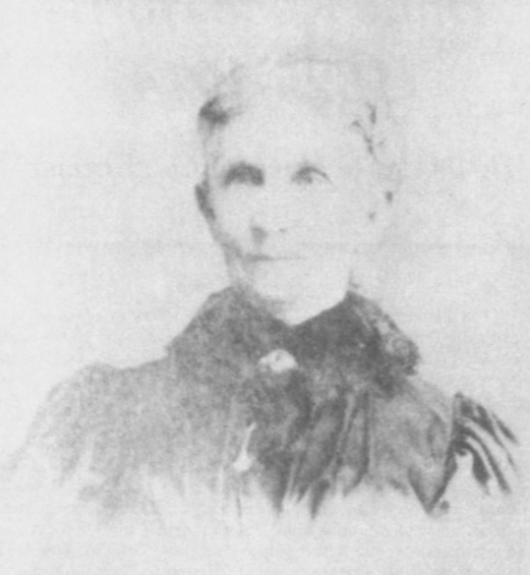
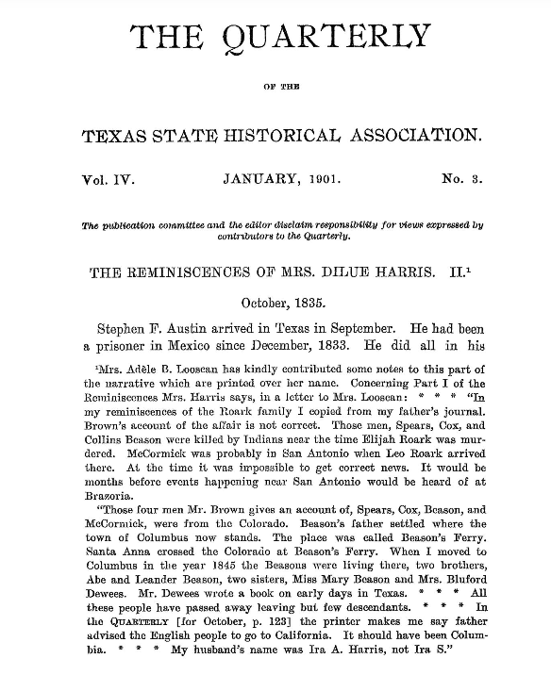
Dilue Rose Harris
Dilue Rose Harris years after the war
The Portal to Texas History
“The Reminiscences of Mrs. Dilue Harris”
The Portal to Texas History
Notes:
Texas State Historical Association. The Quarterly of the Texas State Historical Association, Volume 4, July 1900 - April, 1901, periodical, 1901; Austin, Texas. (https://texashistory.unt.edu/ark:/67531/metapth101018/: accessed March 10, 2025), University of North Texas Libraries, The Portal to Texas History, https://texashistory.unt.edu; crediting Texas State Historical Association.
Carrington, Evelyn M. Women in Early Texas, book, 1993; Austin, Texas. (https://texashistory.unt.edu/ark:/67531/metapth296851/: accessed February 19, 2025), University of North Texas Libraries, The Portal to Texas History, https://texashistory.unt.edu; crediting Texas State Historical Association.

Slide 22
José Antonio Navarro
A photograph of Navarro’s house
Laredo Street, San Antonio, Texas
The Portal to Texas History
Navarro in the late 1800s.
The Portal to Texas History
Notes:
Raba, Ernst Wilhelm, 1874-1951. [Jose Antonio Navarro Portrait], photograph, Date Unknown; (https://texashistory.unt.edu/ark:/67531/metapth460098/: accessed March 10, 2025), University of North Texas Libraries, The Portal to Texas History, https://texashistory.unt.edu; crediting San Antonio Conservation Society.
Texas Historical Commission. [Jose Antonio Navarro House], photograph, Date Unknown; (https://texashistory.unt.edu/ark:/67531/metapth674635/: accessed March 10, 2025), University of North Texas Libraries, The Portal to Texas History, https://texashistory.unt.edu; crediting Texas Historical Commission.

Slide 23
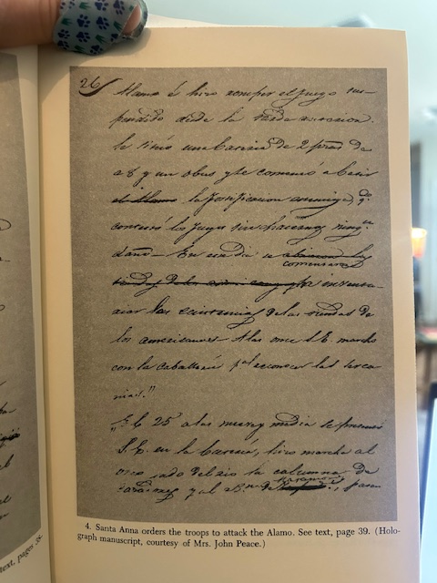
José Enrique de la Peña
Peña’s signature
Peña writing about Santa Anna’s orders to attack the Alamo.
Notes:
With Santa Anna in Texas : a personal narrative of the revolution A personal Narrative of the Revolution by Jose Enrique de la Pena. Translated and edited by Carmen Perry. Texas A & M University Press, College Station, [1975]

Slide 24
Exit Ticket Follow the directions below to complete your exit ticket
Choose 2 people we learned about in today’s lesson.
Complete the graphic organizer showing something you think these 2 people would have agreed on.
Share with a partner.

Slide 25
Share with the class: 2
The two people I chose are _______ and ______
I think these 2 people probably shared similar points of view about __________ because they probably both thought __________

