Slide 1
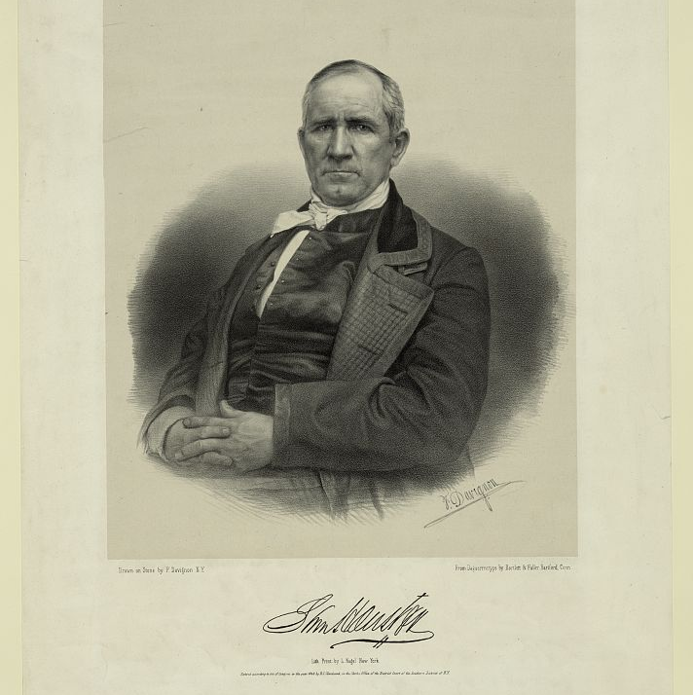
Unidad 5: La Revolución de Texas
Lección 5:
Quién es quién de la Revolución de Texas
Notes:
Sam Houston. , ca. 1848. Apr. 27. Photograph. https://www.loc.gov/item/2003656937/.

Slide 2
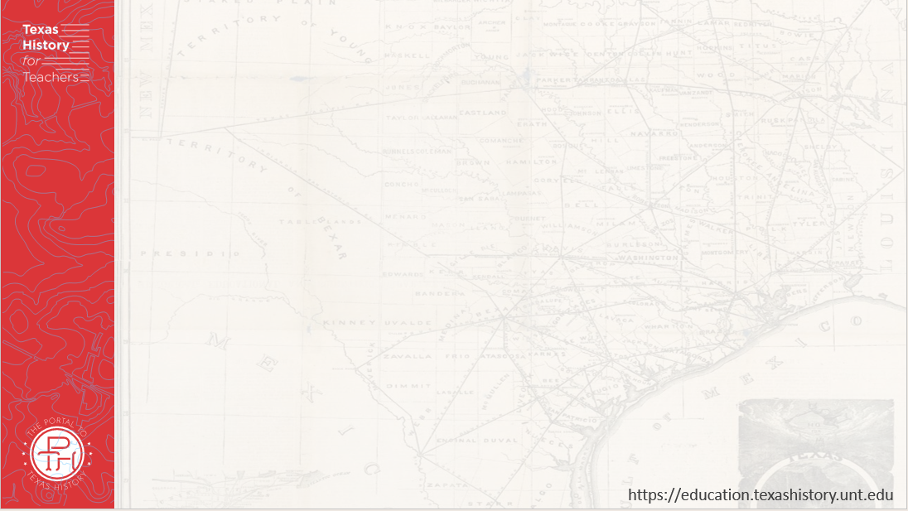




Calentamiento Sigue las instrucciones de abajo para completar tu calentamiento
Piensa en todos los diferentes grupos de personas que vivieron la Revolución de Texas.
Elige un punto de vista y completa el organizador gráfico proporcionado.
Comparte con una pareja.

Slide 3
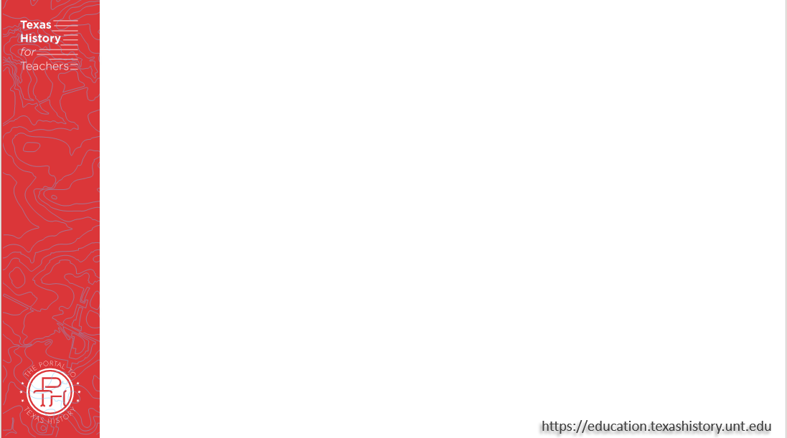
Comparte con la clase:
La persona que imaginaba se llamaba _________. Una información sobre él o ella es ____

Slide 4

Essential Question
Quiénes fueron algunas de las personas clave de la Revolución de Texas y por qué fueron importantes?

Slide 5

En la lección de hoy
Estudiaremos a las personas clave que participaron en la Revolución de Texas, identificando información importante sobre sus vidas y su importancia para la Revolución de Texas.
Utilizaré lecturas de pasajes sobre cada persona para completar un gráfico que resume y parafrasea información significativa sobre cada persona.

Slide 6
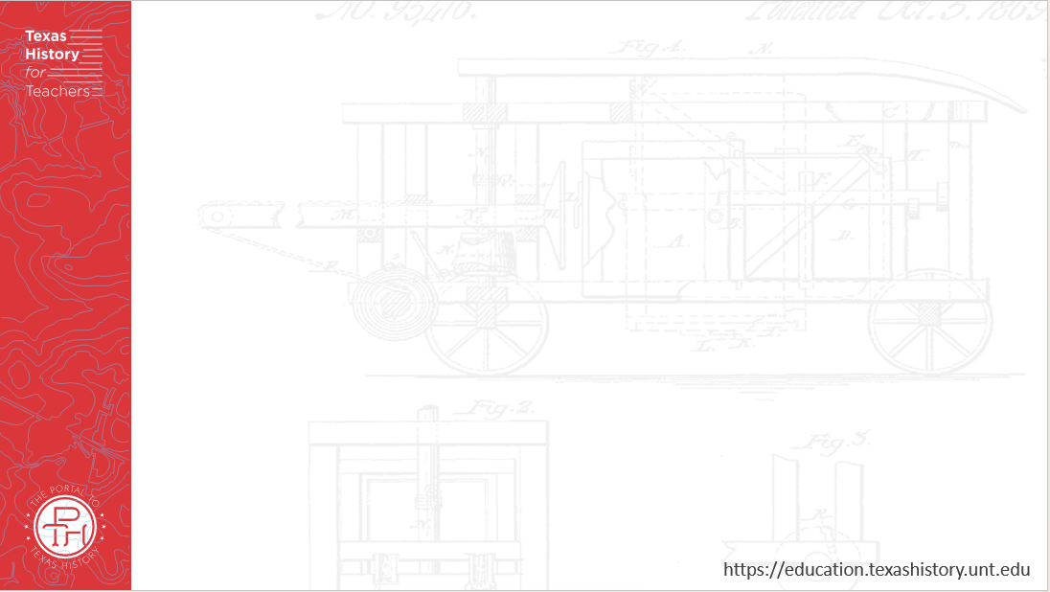
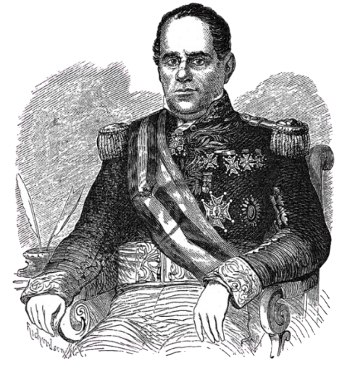
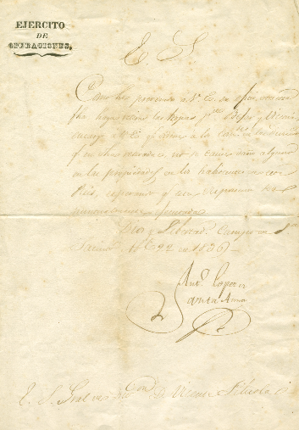
Antonio López de Santa Anna
Carta de Santa Anna ordenando la retirada de su ejército el 22 de abril de 1836. El portal a la historia de Texas
Santa Anna El portal a la historia de Texas
Notes:
Santa Anna, Antonio Lopez de. [Letter from Santa Anna Ordering Retreat of the Mexican Army, April 22, 1836]. Humanities Texas Grant. University of North Texas Libraries, The Portal to Texas History, https://texashistory.unt.edu; crediting The Dolph Briscoe Center for American History. https://texashistory.unt.edu/ark:/67531/metapth5928/m1/1. April 22, 1836.
Santa Anna. 1879. A Pictorial History of Texas, From the Earliest Visits of European Adventurers, to A.D. 1879. by Homer S. Thrall, 147. St. Louis, MO: N. D. Thomspon & Co., 1879. University of North Texas Libraries, The Portal to Texas History, https://texashistory.unt.edu/ark:/67531/metapth5828/.

Slide 7
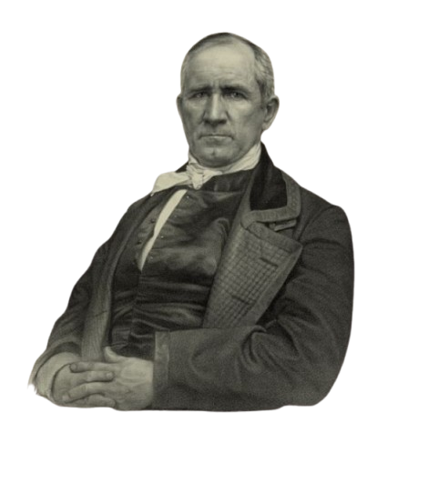
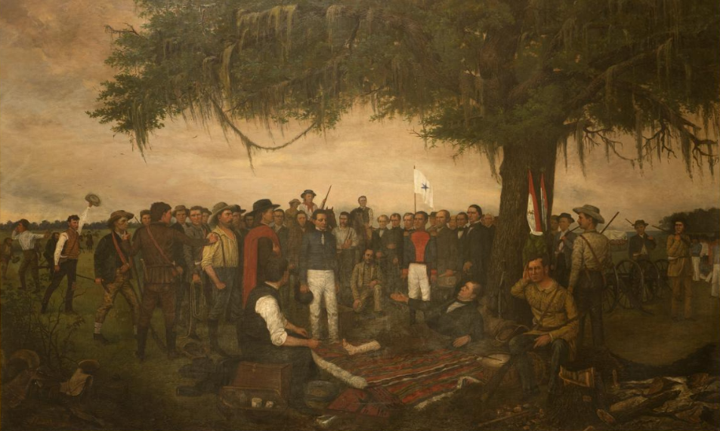
Sam Houston
Una pintura que representa la rendición de Santa Anna a Sam Houston, quien fue pintado tumbado bajo el árbol debido a su lesión en la pierna. Biblioteca del Congreso
Sam Houston Biblioteca del Congreso
Notes:
Highsmith, Carol M, photographer. Painting, "Surrender of Santa Anna," by William Henry Huddle, in the South Foyer of the Texas Capitol, Austin, Texas. April 17, 2014. Photograph. Library of Congress Prints and Photographs Division. https://www.loc.gov/item/2014632129/
Sam Houston. April 27, 1848. Photograph. Library of Congress Prints and Photographs Division. https://www.loc.gov/item/2003656937/

Slide 8
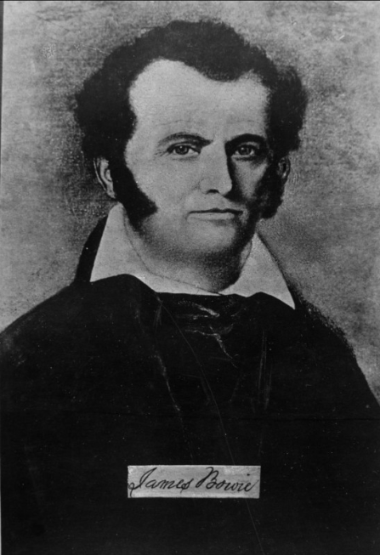
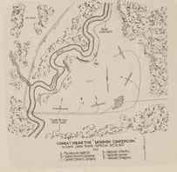
James “Jim” Bowie
Mapa de la Batalla de Concepción bajo el batallón del coronel Bowie. El portal a la historia de Texas
James Bowie El portal a la historia de Texas
Notes:
Combat near the "Mission Concepcion," by Colonel James Bowie's Battalion, October 28, 1835., map, 1938?; (https://texashistory.unt.edu/ark:/67531/metapth492941/: accessed March 7, 2025), University of North Texas Libraries, The Portal to Texas History, https://texashistory.unt.edu; crediting Hardin-Simmons University Library.
Portrait of a Man, photograph, Date Unknown; (https://texashistory.unt.edu/ark:/67531/metapth55639/: accessed March 7, 2025), University of North Texas Libraries, The Portal to Texas History, https://texashistory.unt.edu; crediting Hardin-Simmons University Library.

Slide 9
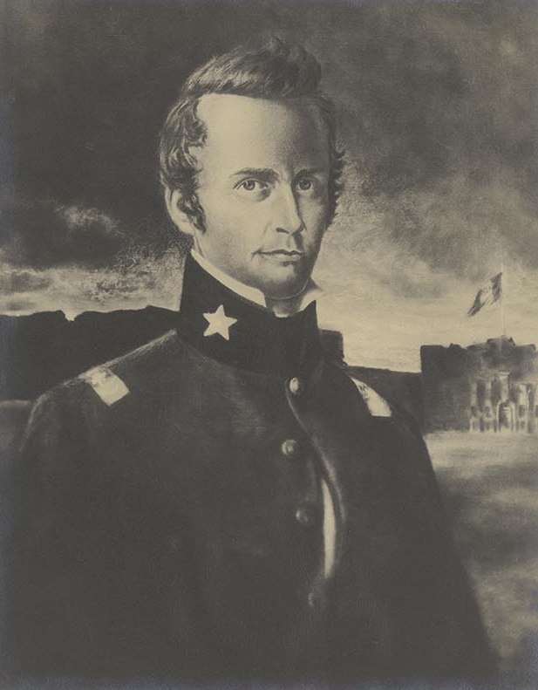
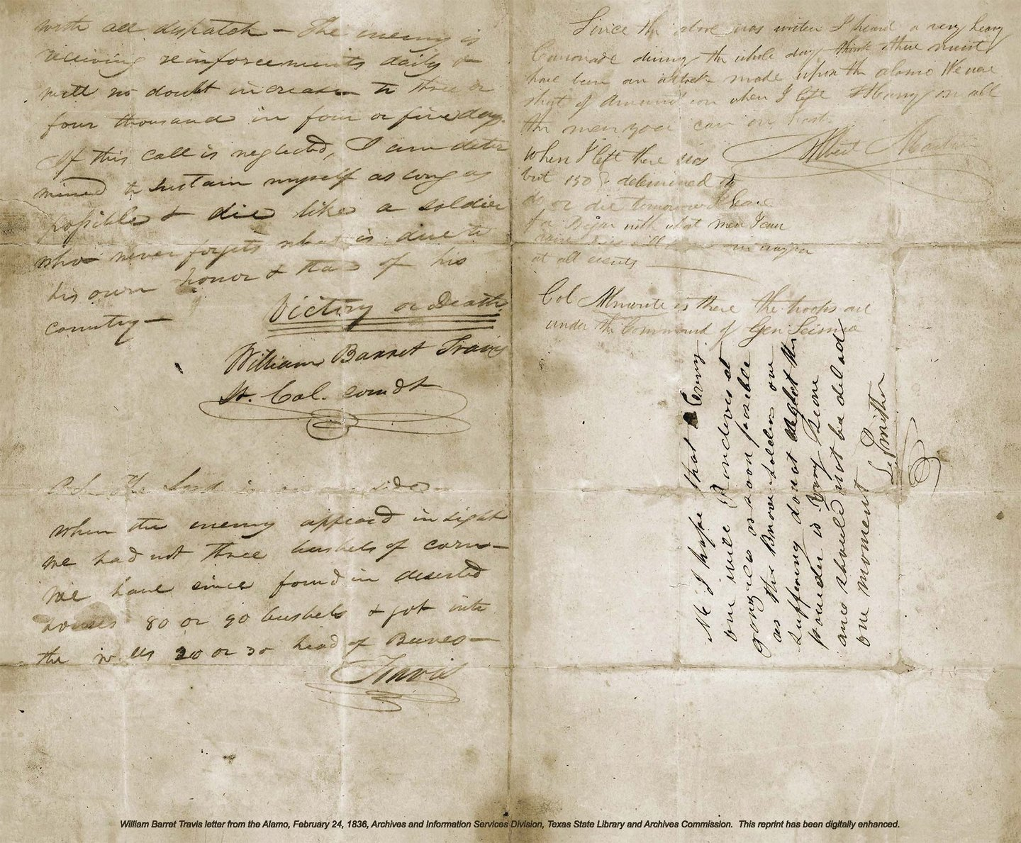
William Barret Travis
La famosa carta de Travis "Victoria o Muerte" Biblioteca y Archivos Estatales de Texas
William B. Travis Biblioteca y Archivos Estatales de Texas
Notes:
William B. Travis’ “Victory or Death” letter. Texas State Library and Archives. The Travis Letter | The Alamo
Portrait of William B. Travis by McArdle. The McArdle Scrapbooks Dawn at the Alamo. Texas State Library and Archives. Portrait of William B. Travis by McArdle | Texas State Library

Slide 10
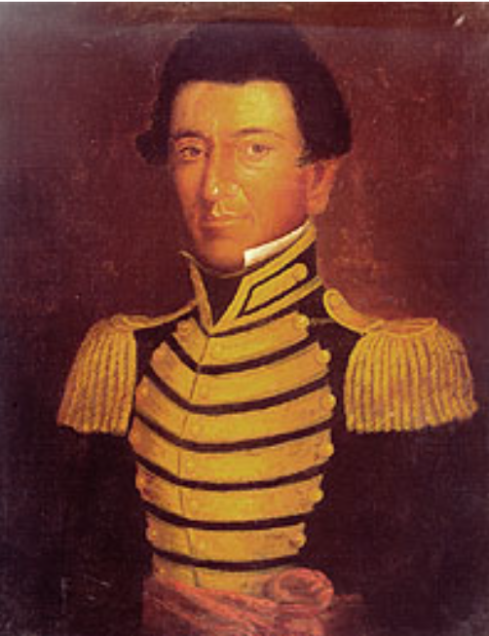
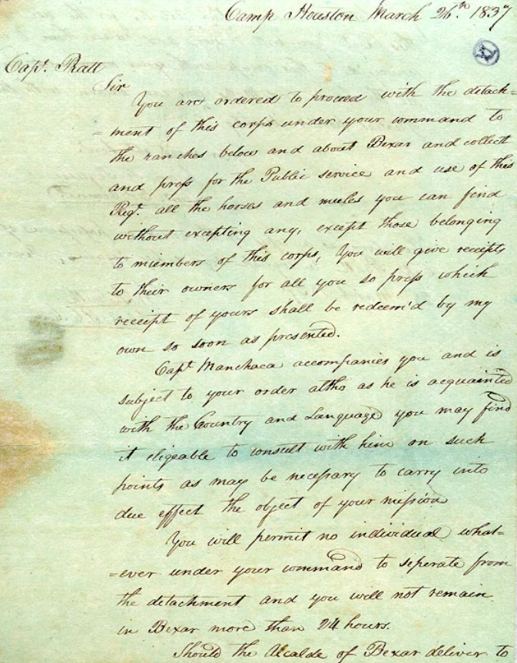
Juan Seguín
Una carta escrita por Seguín tras la guerra Biblioteca y Archivos Estatales de Texas
Juan Seguín Biblioteca y Archivos Estatales de Texas
Notes:
Juan Seguin. Giants of Texas History. Texas State Library and Archives. Juan Seguin | Texas State Library
Juan Seguín to Captain Pratt, March 26, 1837. Giants of Texas History. Juan Seguin. Juan Seguín to Captain Pratt, March 26, 1837 | Texas State Library

Slide 11
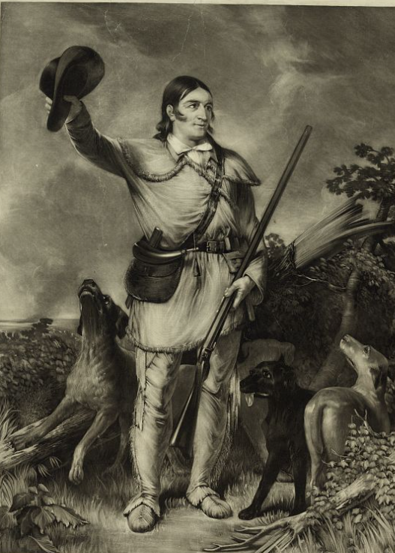
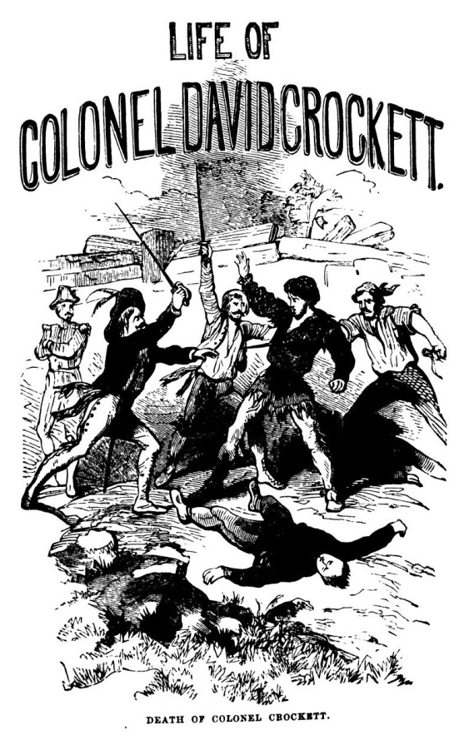
David “Davy” Crockett
Coronel Crockett La Biblioteca del Congreso
Autobiografía de Crockett El portal a la historia de Texas
Notes:
Stuart, C., Artist. Colonel Crockett / engraved by C. Stuart from the original portrait by J.G. Chapman. , ca. 1839. Photograph. https://www.loc.gov/item/93511184/.
Crockett, Davy. Life of Col. David Crockett, book, 1860; Philadelphia, Pennsylvania. (https://texashistory.unt.edu/ark:/67531/metapth29780/: accessed March 7, 2025), University of North Texas Libraries, The Portal to Texas History, https://texashistory.unt.edu; crediting Star of the Republic Museum.

Slide 12
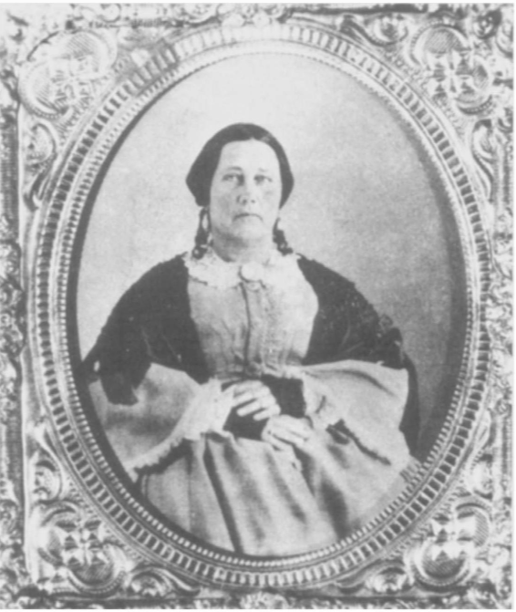
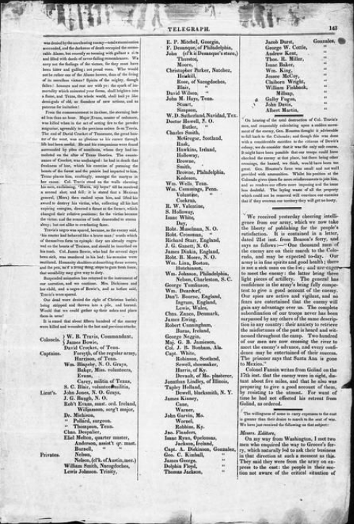
Susanna Dickinson
Un artículo de periódico sobre El Álamo, incluyendo supervivientes como Susanna. 24 de marzo de 1836. El portal a la historia de Texas
Susanna, años después de la guerra. El portal a la historia de Texas
Notes:
Baker & Bordens. Telegraph and Texas Register (San Felipe de Austin [i.e. San Felipe], Tex.), Vol. 1, No. 21, Ed. 1, Thursday, March 24, 1836, newspaper, March 24, 1836; San Felipe de Austin, Texas. (https://texashistory.unt.edu/ark:/67531/metapth47891/: accessed March 7, 2025), University of North Texas Libraries, The Portal to Texas History, https://texashistory.unt.edu; crediting The Dolph Briscoe Center for American History.
Carrington, Evelyn M. Women in Early Texas, book, 1993; Austin, Texas. (https://texashistory.unt.edu/ark:/67531/metapth296851/: accessed February 19, 2025), University of North Texas Libraries, The Portal to Texas History, https://texashistory.unt.edu; crediting Texas State Historical Association.

Slide 13
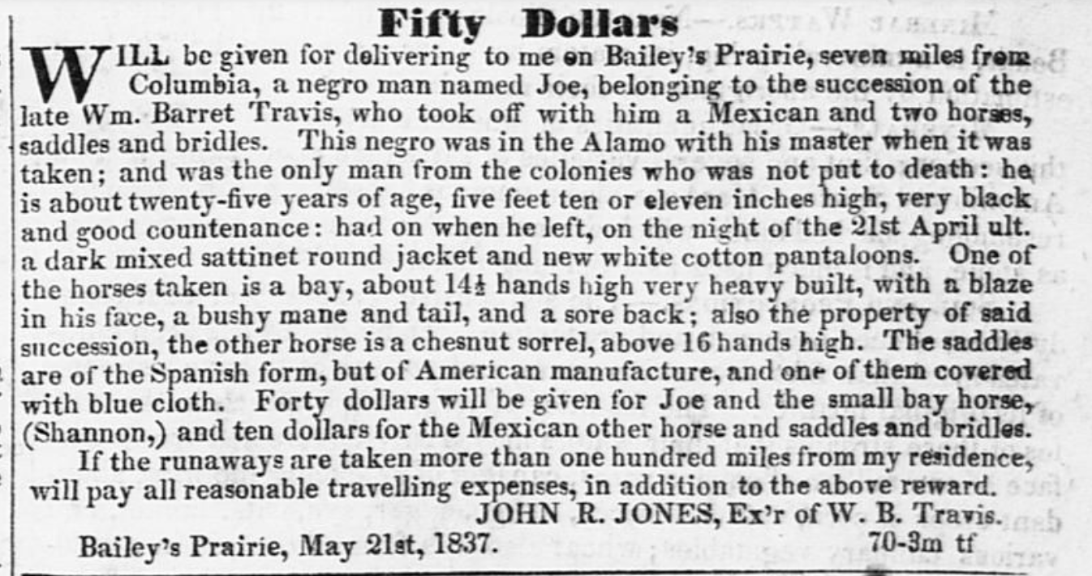
Joe
Un anuncio que se colocó después de que Joe escapara de la esclavitud en Texas ofreciendo una recompensa por su regreso. El portal a la historia de Texas
Notes:
Cruger & Moore. Telegraph and Texas Register (Houston, Tex.), Vol. 2, No. 28, Ed. 1, Saturday, July 29, 1837, newspaper, July 29, 1837; Houston, Texas. (https://texashistory.unt.edu/ark:/67531/metapth47941/: accessed March 7, 2025), University of North Texas Libraries, The Portal to Texas History, https://texashistory.unt.edu; crediting The Dolph Briscoe Center for American History.

Slide 14
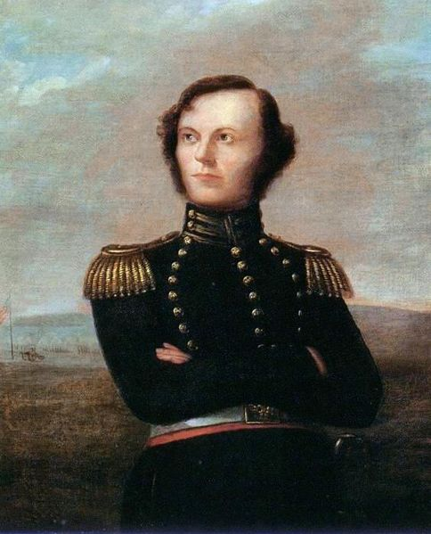
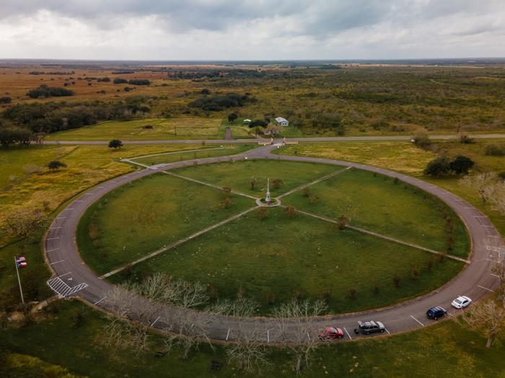
James Fannin
James W. Fannin Sociedad Histórica de Dallas
El Sitio Histórico Estatal del Campo de Batalla Fannin Marcando el lugar de la Batalla de Coleto Creek El portal a la historia de Texas
Notes:
Portrait of James W. Fannin. Exploring the Alamo Legends by Wallace O. Chariton (Republic of Texas Press, 1990), Dallas Historical Society. This work is in the public domain in its country of origin and other countries and areas where the copyright term is the author's life plus 70 years or fewer. https://commons.wikimedia.org/wiki/File:JamesWFannin.jpg
Hicks, William. [Fannin Battleground State Historic Site: Aerial View], photograph, December 15, 2021; (https://texashistory.unt.edu/ark:/67531/metapth1490445/: accessed March 7, 2025), University of North Texas Libraries, The Portal to Texas History, https://texashistory.unt.edu; .

Slide 15
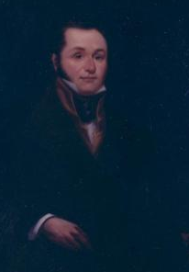
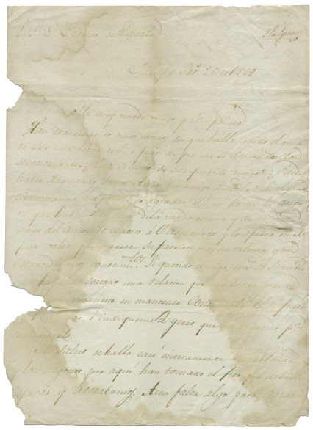
Lorenzo de Zavala
Lorenzo de Zavala
El portal a la historia de Texas
Una carta de Santa Anna a Zavala cuando los dos hombres aún eran amigos en 1829. El portal a la historia de Texas
Notes:
Santa Anna, Antonio Lopez de. Antonio Lopez de Santa Anna to Lorenzo de Zavala, February 26, 1829, letter, February 26, 1829; (https://texashistory.unt.edu/ark:/67531/metapth6024/: accessed March 7, 2025), University of North Texas Libraries, The Portal to Texas History, https://texashistory.unt.edu; crediting The Dolph Briscoe Center for American History.
Wheeler, Larry. Portrait of Lorenzo de Zavala, artwork, 1980; (https://texashistory.unt.edu/ark:/67531/metapth3002/: accessed March 7, 2025), University of North Texas Libraries, The Portal to Texas History, https://texashistory.unt.edu; crediting San Jacinto Museum of History.

Slide 16
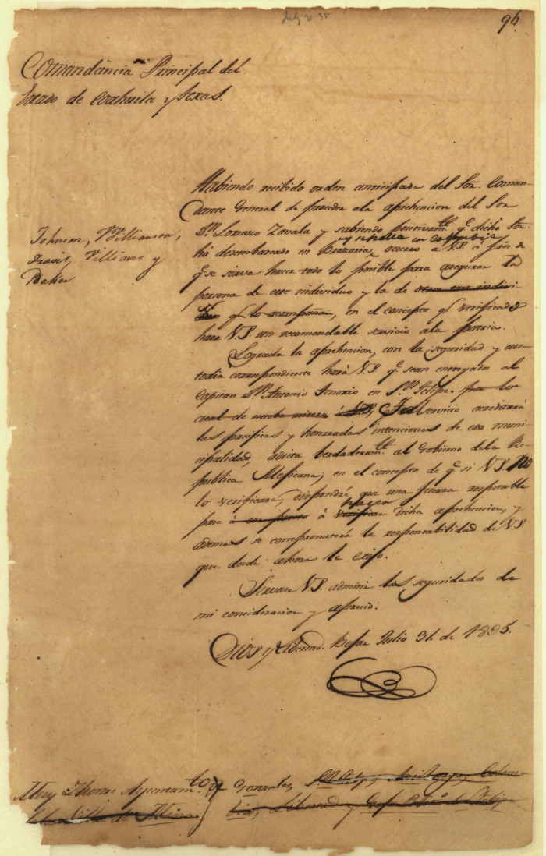
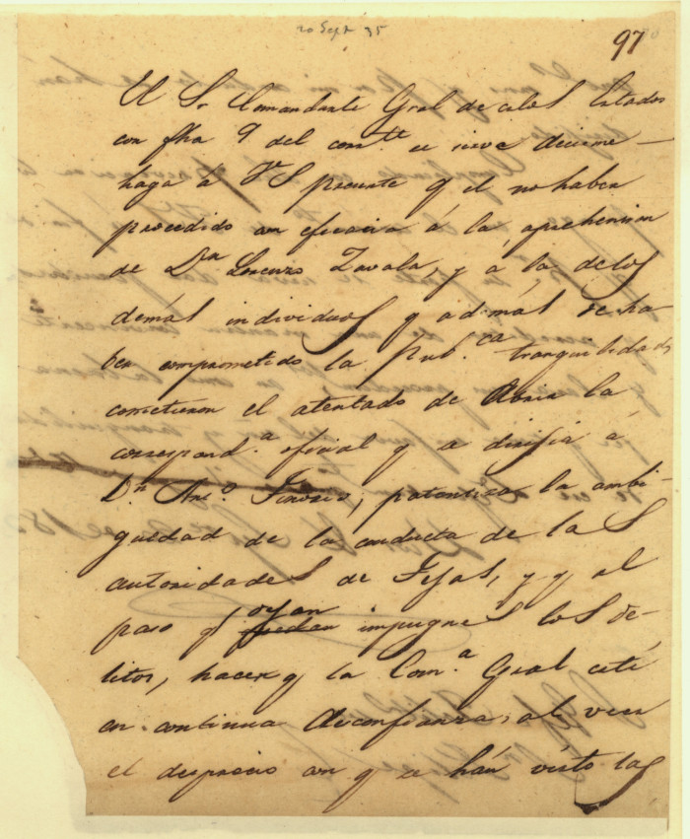
José Domingo de Ugartechea
La airada carta de Ugartechea a las autoridades de San Felipe de Austán, quienes se negaron a arrestar a Zavala. El portal a la historia de Texas
Orden de arresto de Ugartechea contra Lorenzo de Zavala El portal a la historia de Texas
Notes:
Ugartechea, José Domingo. José Domingo Ugartechea, Principal Commandant of Texas to Ayuntamiento of Gonzales], letter, July 31, 1835; (https://texashistory.unt.edu/ark:/67531/metapth5852/: accessed March 7, 2025), University of North Texas Libraries, The Portal to Texas History, https://texashistory.unt.edu; crediting Texas General Land Office.
Ugartechea, José Domingo. José Domingo Ugartechea, Principal Commandant of Texas to Political Chief at San Felipe de Austin], letter, September 20, 1835; (https://texashistory.unt.edu/ark:/67531/metapth5851/: accessed March 7, 2025), University of North Texas Libraries, The Portal to Texas History, https://texashistory.unt.edu; crediting Texas General Land Office.

Slide 17
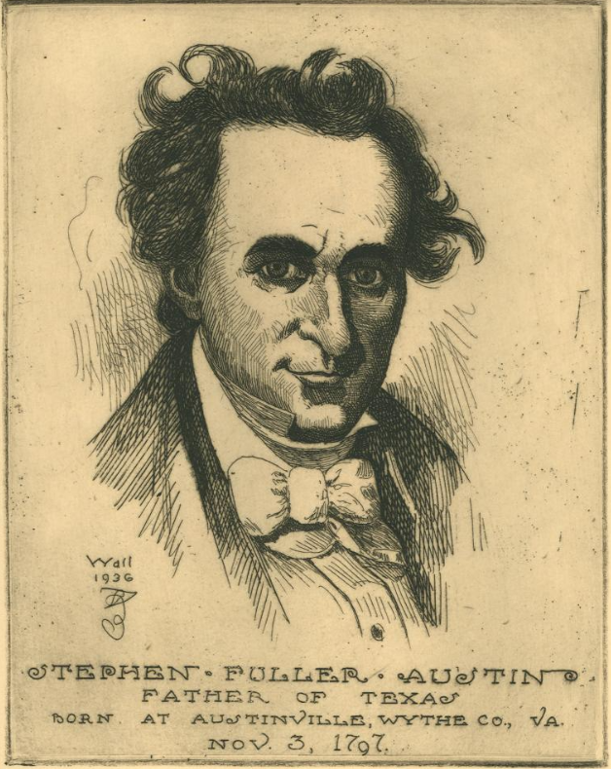
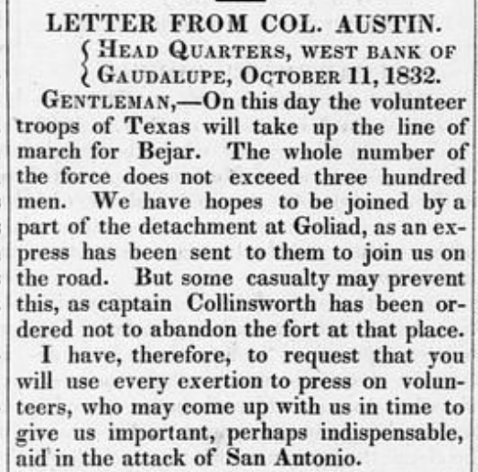
Stephen F. Austin
Una carta de Austin publicada en el Telegraph and Texas Register. El portal a la historia de Texas
Stephen F. Austin El portal a la historia de Texas
Notes:
[Following Stephen F. Austin, Father of Texas], artwork, 1936; (https://texashistory.unt.edu/ark:/67531/metapth31619/: accessed March 10, 2025), University of North Texas Libraries, The Portal to Texas History, https://texashistory.unt.edu; crediting Star of the Republic Museum.
Baker & Bordens. Telegraph and Texas Register (San Felipe de Austin [i.e. San Felipe], Tex.), Vol. 1, No. 2, Ed. 1, Saturday, October 17, 1835, newspaper, October 17, 1835; San Felipe de Austin, Texas. (https://texashistory.unt.edu/ark:/67531/metapth47875/: accessed March 10, 2025), University of North Texas Libraries, The Portal to Texas History, https://texashistory.unt.edu; crediting The Dolph Briscoe Center for American History.

Slide 18
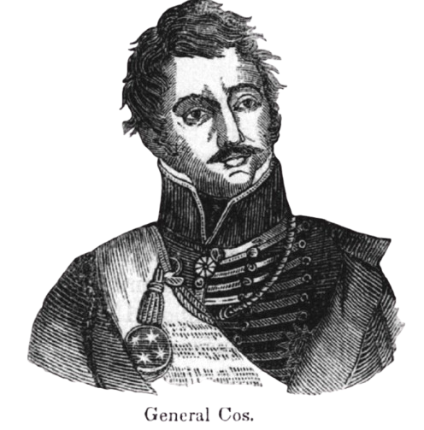
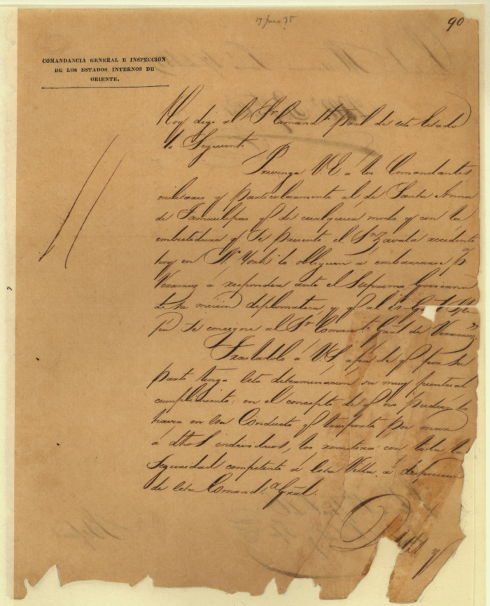
Martín Perfecto de Cos
Una carta de Cos a Ugartechea respecto a las órdenes de arresto de Lorenzo de Zavala El portal a la historia de Texas
Notes:
de Cos, Martin Perfecto. Letter from Martín Perfecto de Cos to Commandant General June 17th 1835, letter, June 17, 1835; (https://texashistory.unt.edu/ark:/67531/metapth5844/: accessed March 10, 2025), University of North Texas Libraries, The Portal to Texas History, https://texashistory.unt.edu; crediting Texas General Land Office.
Mexican General Martín Perfecto de Cos. Pioneer Heroes and Daring Deeds, published by Scammell and Company in 1882; reprinted in Frank Thompson's 2002 book The Alamo, published by the University of North Texas Press. This media file is in the public domain in the United States. This applies to U.S. works where the copyright has expired, often because its first publication occurred prior to January 1, 1930, and if not then due to lack of notice or renewal. See this page for further explanation. https://commons.wikimedia.org/wiki/File:Martin_perfecto_de_cos.jpg

Slide 19
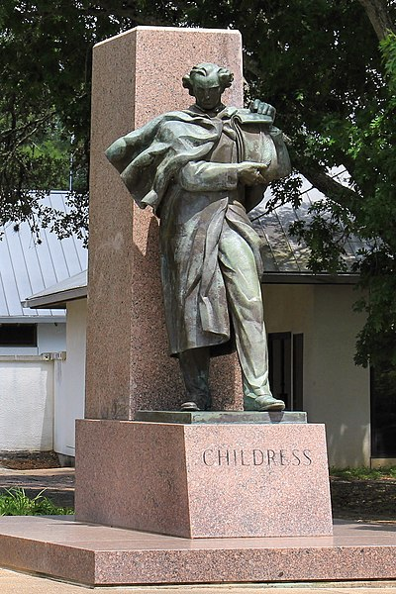
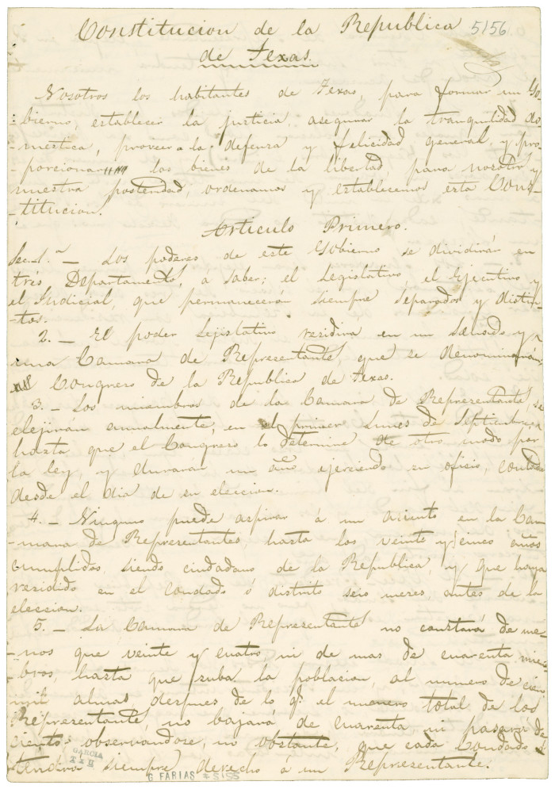
George Childress
La estatua del centenario de George C. Childress en el Sitio Histórico Estatal Washington-on-the-Brazos.
Una copia de la constitución de Texas El portal a la historia de Texas
Notes:
The George C. Childress Centennial Statue at Washington-on-the-Brazos State Historic Site. Raoul Josset sculpted the statue for the 1936 Texas Centennial. The statue was dedicated on March 2, 1939. Larry D. Moore © 2016 Larry D. Moore. Licensed under CC BY 4.0. Attribution Specification: Reuse without attribution is a violation of the license. The photographer's name and the link to the license are required. A link back to this source is requested. Example: Larry D. Moore, CC BY 4.0, Wikimedia Commons. https://commons.wikimedia.org/wiki/File:George_Childress_Centennial_Statue.jpg
Kimble, H. S. [Copy of the Constitution of the Republic of Texas, March 17, 1836], text, March 17, 1836; (https://texashistory.unt.edu/ark:/67531/metapth6708/: accessed March 10, 2025), University of North Texas Libraries, The Portal to Texas History, https://texashistory.unt.edu; crediting The Dolph Briscoe Center for American History.

Slide 20
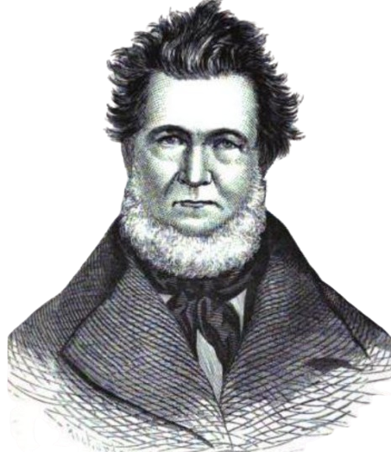
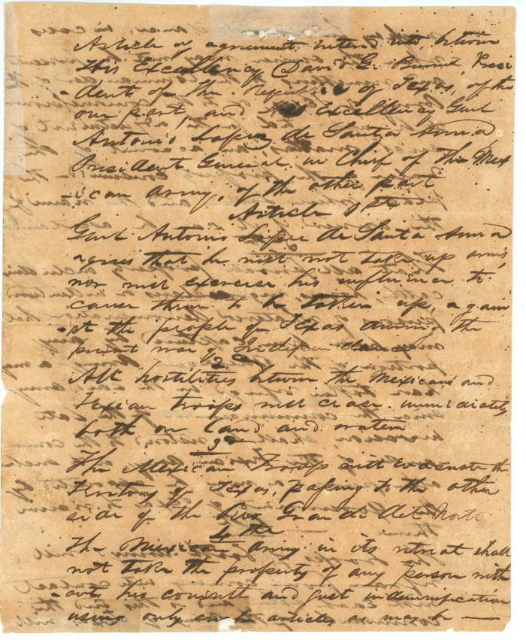
David. G. Burnet
Un retrato de David G. Burnet El portal a la historia de Texas
El Tratado de Velasco El portal a la historia de Texas
Notes:
Treaty of Velasco, text, 1836; (https://texashistory.unt.edu/ark:/67531/metapth31159/: accessed March 10, 2025), University of North Texas Libraries, The Portal to Texas History, https://texashistory.unt.edu; crediting Star of the Republic Museum.
Baker, D. W. C. (De Witt Clinton), 1832-1881. A Texas Scrap-Book: Made Up of the History, Biography, and Miscellany of Texas and Its People, book, 1875; New York. (https://texashistory.unt.edu/ark:/67531/metapth39132/: accessed March 10, 2025), University of North Texas Libraries, The Portal to Texas History, https://texashistory.unt.edu; crediting Austin History Center, Austin Public Library.

Slide 21
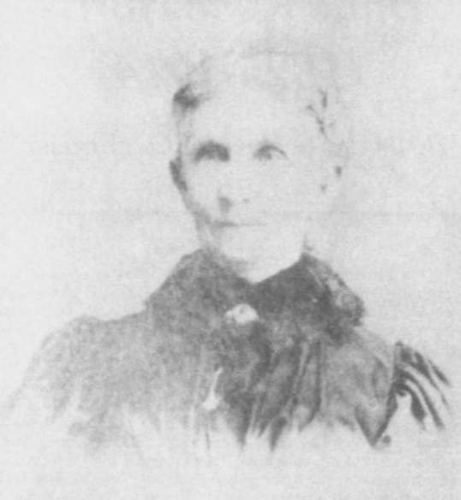
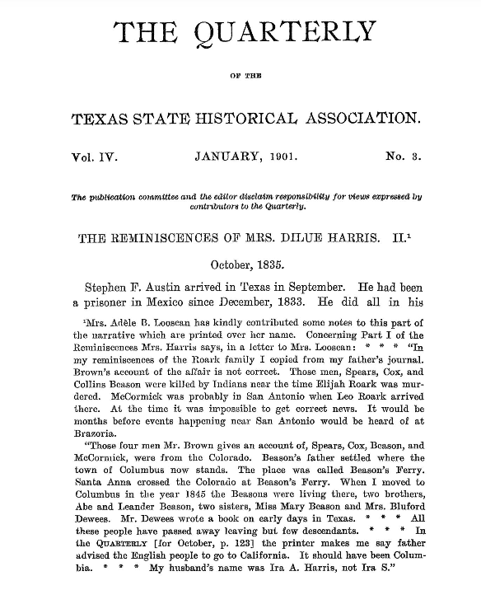
Dilue Rose Harris
Dilue Rose Harris años después de la guerra El portal a la historia de Texas
"Los recuerdos de la señora Dilue Harris" El portal a la historia de Texas
Notes:
Texas State Historical Association. The Quarterly of the Texas State Historical Association, Volume 4, July 1900 - April, 1901, periodical, 1901; Austin, Texas. (https://texashistory.unt.edu/ark:/67531/metapth101018/: accessed March 10, 2025), University of North Texas Libraries, The Portal to Texas History, https://texashistory.unt.edu; crediting Texas State Historical Association.
Carrington, Evelyn M. Women in Early Texas, book, 1993; Austin, Texas. (https://texashistory.unt.edu/ark:/67531/metapth296851/: accessed February 19, 2025), University of North Texas Libraries, The Portal to Texas History, https://texashistory.unt.edu; crediting Texas State Historical Association.

Slide 22
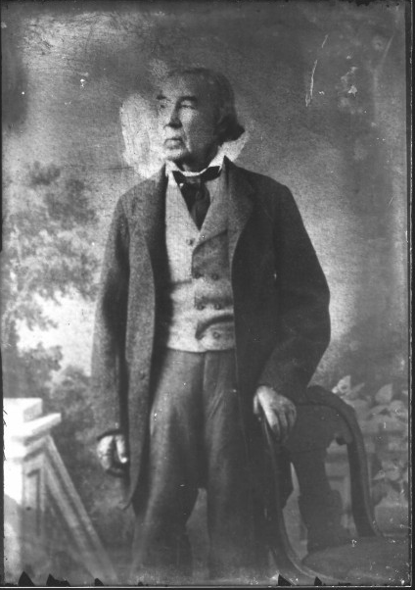
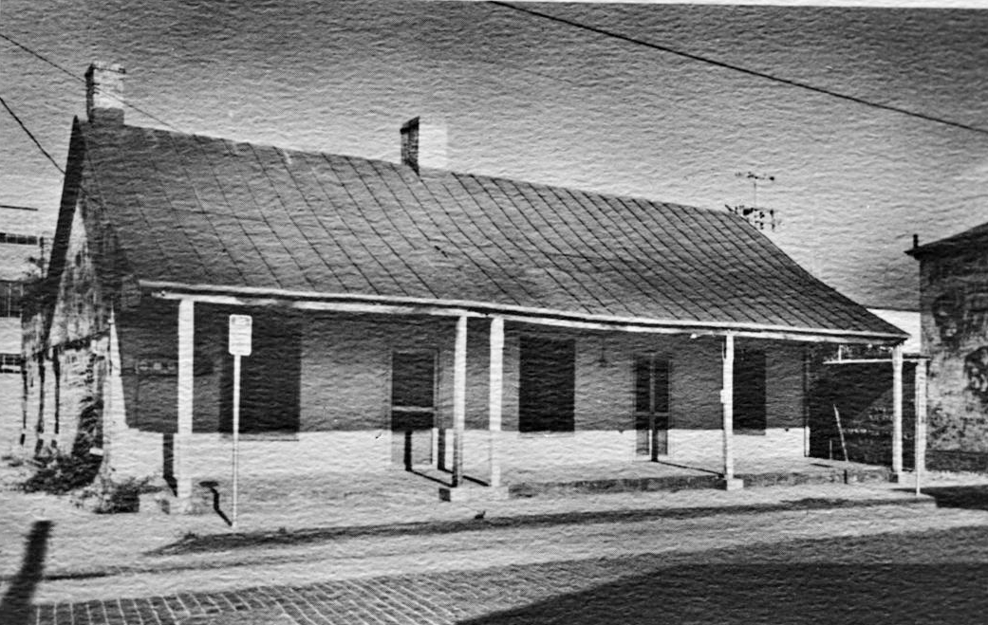
José Antonio Navarro
Una fotografía de la casa de Navarro Calle Laredo, San Antonio, Texas El portal a la historia de Texas
Navarro a finales del siglo XIX. El portal a la historia de Texas
Notes:
Raba, Ernst Wilhelm, 1874-1951. [Jose Antonio Navarro Portrait], photograph, Date Unknown; (https://texashistory.unt.edu/ark:/67531/metapth460098/: accessed March 10, 2025), University of North Texas Libraries, The Portal to Texas History, https://texashistory.unt.edu; crediting San Antonio Conservation Society.
Texas Historical Commission. [Jose Antonio Navarro House], photograph, Date Unknown; (https://texashistory.unt.edu/ark:/67531/metapth674635/: accessed March 10, 2025), University of North Texas Libraries, The Portal to Texas History, https://texashistory.unt.edu; crediting Texas Historical Commission.

Slide 23
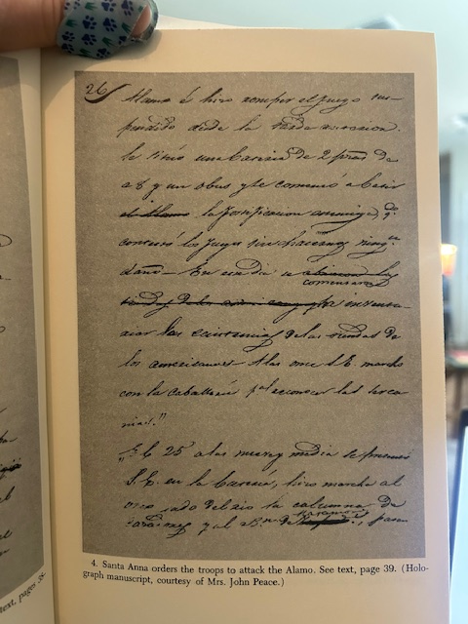
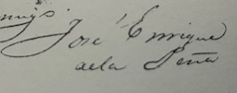
José Enrique de la Peña
La firma de Peña
Peña escribiendo sobre las órdenes de Santa Anna de atacar el Álamo.
Notes:
With Santa Anna in Texas : a personal narrative of the revolution A personal Narrative of the Revolution by Jose Enrique de la Pena. Translated and edited by Carmen Perry. Texas A & M University Press, College Station, [1975]

Slide 24
Billete de salida Sigue las instrucciones a continuación para completar tu ticket de salida
Elige a 2 personas de las que aprendimos en la lección de hoy.
Completa el organizador gráfico mostrando algo en lo que creas que estas dos personas habrían estado de acuerdo.
Comparte con una pareja.

Slide 25
Comparte con la clase: 2
Las dos personas que elegí son _______ y ______
Creo que estas dos personas probablemente compartían puntos de vista similares sobre __________ porque probablemente ambos pensaban __________

